Slide 1
Update of Neoadjuvant Therapies for Resectable Lung Cancer
Jessica S. Donington, MD, MSCR
Professor of Surgery
Chief, Section of Thoracic Surgery
The University of Chicago Medicine
Chicago, IL

Slide 2



Resource Information
About This Resource
These slides are one component of a continuing education program available online at MedEd On The Go titled Earlier Use of ICIs in NSCLC: Integrating the Latest Evidence Into Clinical Practice
Program Learning Objectives:
Apply the latest evidence to optimize the use of neoadjuvant immunotherapy treatment options to improve outcomes of patients with resectable NSCLC
Apply the latest evidence to optimize the use of adjuvant immunotherapy treatment options to improve outcomes of post-resection NSCLC patients
Evaluate current and emerging evidence to inform patient selection and treatment strategies with perioperative immunotherapy in early-stage NSCLC
MedEd On The Go®
www.mededonthego.com
This content or portions thereof may not be published, posted online or used in presentations without permission.
This content can be saved for personal use (non-commercial use only) with credit given to the resource authors.
To contact us regarding inaccuracies, omissions or permissions please email us at support@MedEdOTG.com

Slide 3
Disclaimer
The views and opinions expressed in this educational activity are those of the faculty and do not necessarily represent the views of Total CME, LLC, the CME providers, or the companies providing educational grants. This presentation is not intended to define an exclusive course of patient management; the participant should use their clinical judgment, knowledge, experience, and diagnostic skills in applying or adopting for professional use any of the information provided herein. Any procedures, medications, or other courses of diagnosis or treatment discussed or suggested in this activity should not be used by clinicians without evaluation of their patient's conditions and possible contraindications or dangers in use, review of any applicable manufacturer’s product information, and comparison with recommendations of other authorities. Links to other sites may be provided as additional sources of information.

Slide 4
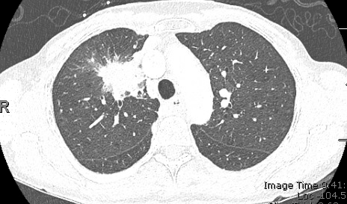
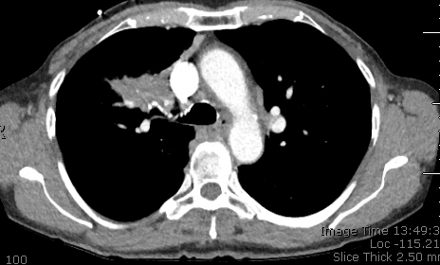
Case Presentation
79 y/o F distant smoker presented for 2nd opinion
Went to ED with self-limited chest pain and work up revealed RUL mass
Very active, exercises daily
Remote history of early breast cancer on tamoxifen
She was scheduled to start chemo/XRT

Slide 5
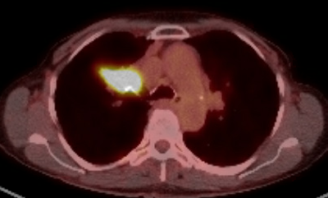
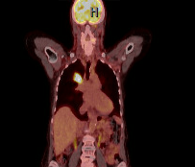
Case Presentation
CT with 4.5 cm suprahilar mass
PET with SUV 15.6, no uptake out of mass
Brain MRI was without metastasis
She had undergone EBUS and navigational bronchoscopy
Mass NSCLC unspecified (no molecular testing)
LNs 4R, 7, 11R negative for malignancy

Slide 6
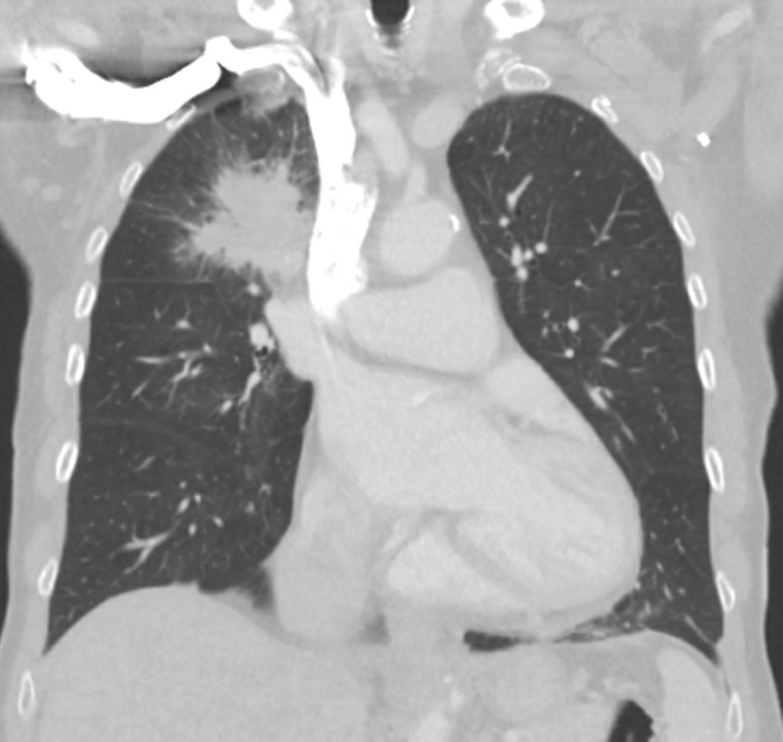
Case Presentation
Molecular analysis
  No targetable mutations
  PD-L1 90%
PFTs
  FEV1: 1.88L, 71% predicted
  DLCO: 13.54, 73% predicted
cIIB, T2bN0M0
MDT discussion

Slide 7
Treatment for “Early-Stage” NSCLC
Local Therapy
For local-regional control
Systemic therapy
To reduce risk of
distant relapse
Chemotherapy
Targeted therapy
Cancer immunotherapy

Slide 8
Basic NSCLC Treatment Strategies
IA
Resection alone
Consider Sublobar Resection
Resectable IB, II and IIIA
Surgery ±
peri-adjuvant cancer immunotherapy or targeted therapy
± chemotherapy ± RT
Unresectable IIIB/C
Chemotherapy/RT ± cancer immunotherapy or targeted therapy
T and N | N0 |  | N1 | N2 | N3
T1 | IA |  | IIA | IIIA | IIIB
T2a/b | IB | IIA | IIA/IIB | IIIA | IIIB
T3 | IIB |  | IIIA | IIIA | IIIC
T4 | IIIA |  | IIIA | IIIB | IIIC
M1a/b/c | IVA/B/C |  | IVA/B/C | IVA/B/C | IVA/B/C
IVA/B/C
Systemic therapy: cancer immunotherapy; targeted therapy; chemotherapy

Slide 9

Neoadjuvant
CheckMate-816
Peri-adjuvant
AEGEAN
NeoTorch
Keynote-0671
CheckMate-77T
Adjuvant
IMPower010
PEARLS/Keynote-091
IMpower030

Slide 10
Trial | CheckMate-816¹ | AEGEAN² | Neotorch³ | KEYNOTE-671⁴ | CheckMate 77T⁵ | IMpower030⁶ | IMpower010⁷ | KEYNOTE- 091⁸
Timing | Neoadjuvant | Peri-adjuvant | Peri-adjuvant | Peri-adjuvant | Peri-adjuvant | Peri-adjuvant | Adjuvant | Adjuvant
Size | 358 | 802 | 3500 | 786 | 452 | 453 | 1005 | 1177
Agent I/O | Nivolumab (PD-1) | Durvaulmab (PD-L1) | Torpalimab (PD-1) | Pembrolizumab (PD-1) | Nivolumab (PD-1) | Atezolizumab (PD-L1) | Atezolizumab (PD-L1) | Pembrolizumab (PD-1)
# cycles (neo/adj) | 3 | 4/12 | 3/14 | 4/13 | 4/12 | 4/16 | 16 | 18
Inclusion | Resectable IB-IIIA (7th) | Resectable II-IIIB (8th) by lobectomy | Resectable II-IIIB (8th) | Resectable II-IIIB (8th) | Resectable IIA-IIIB | Resectable II-IIIB (8th) | Completely resected IB (>4cm)-IIIA (7th) | Completely resected IB (>4cm)-IIIA (7th)
Stage II%/III% | 30/64 | 27/73 | 20/80 | 30/70 | 35/64 | TBD | 59/41 | 72/28
1⁰ endpoint | pCR, EFS | MPR, EFS | MPR, EFS | EFS, OS | EFS | EFS | DFS hierarchical | DFS, DFS>50% PD-L1
Key 2⁰ endpoints | MPR, OS, TDDM | MPR, DFS, OS | pCR, DFS, safety, OS | MPR, pCR, QoL | pCR, MPR, OS | pCR, MPR, DFS, OS, QoL | OS, DFS >50% PD-L1 | OS, DFS >1% PD-L1
Chemotx | Platinum doublet | Platinum-based | Platinum-based | Cisplatin doublet | Platinum doublet | Platinum-based | Cisplatin doublet | Platinum doublet encouraged
EGFR/ALK | No document mutation (WT-Asia) | No document mutation | WT | No document mutation (7%) | WT | WT | Included (15%) | Included (7.5%)

Slide 11
Neoadjuvant Immunotherapy
(CheckMate-816)

Slide 12
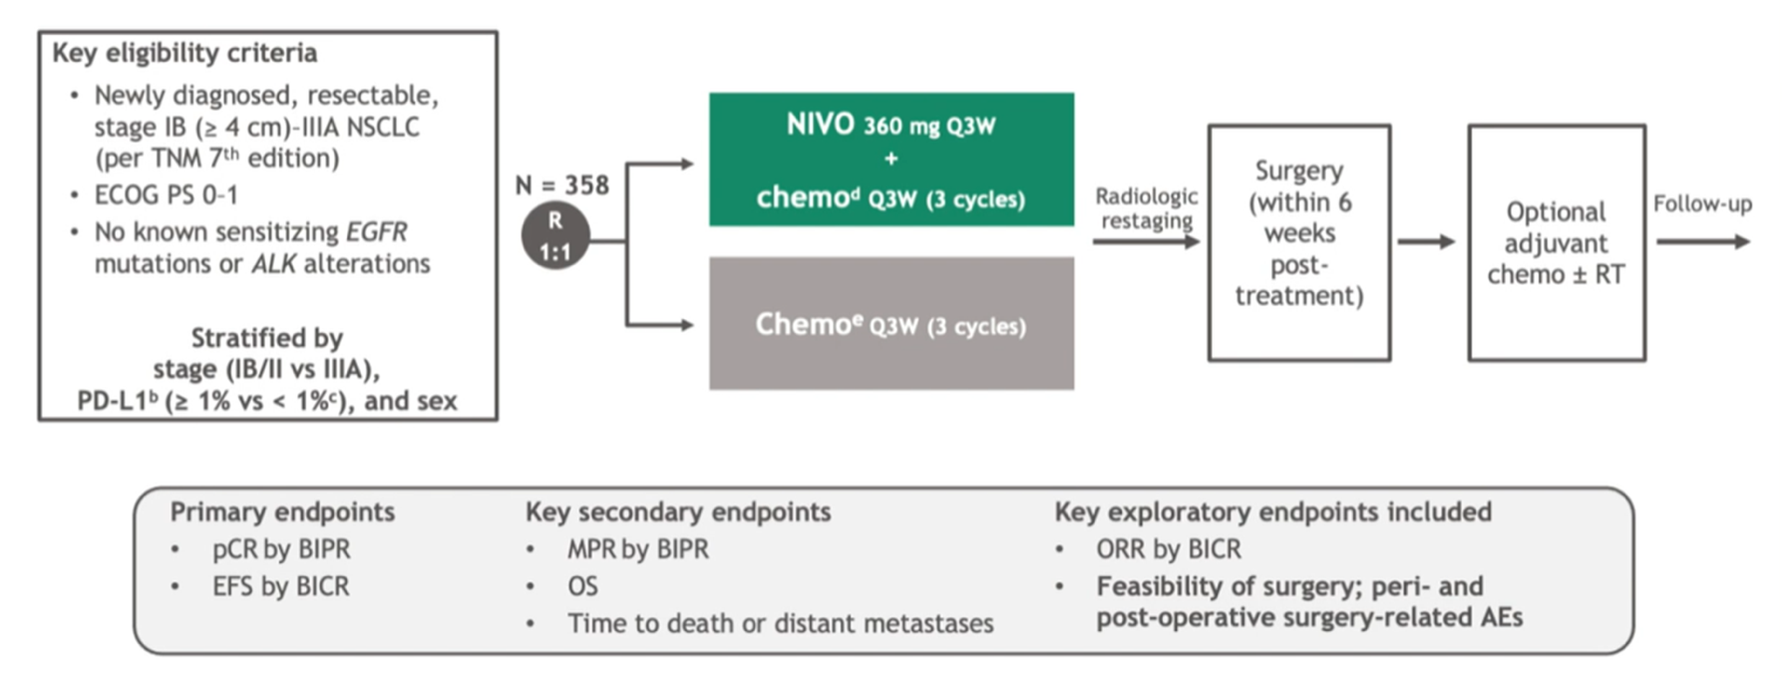
CheckMate-816: Study Schema

Slide 13
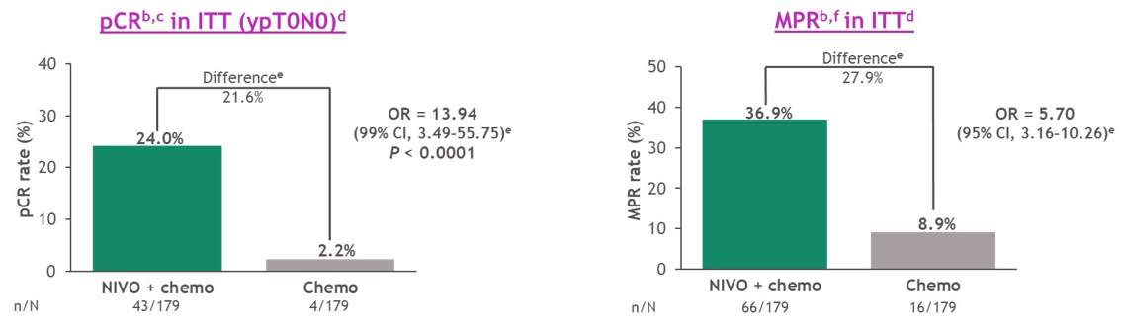
CheckMate-816ª: pCR and MPR

Slide 14
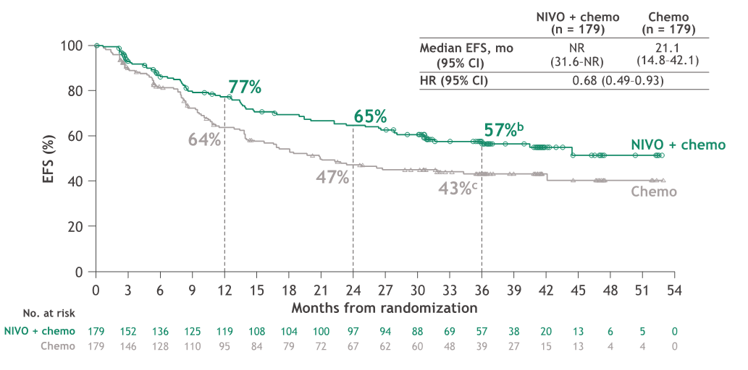
CheckMate-816: 3-Year EFS Updateª

Slide 15
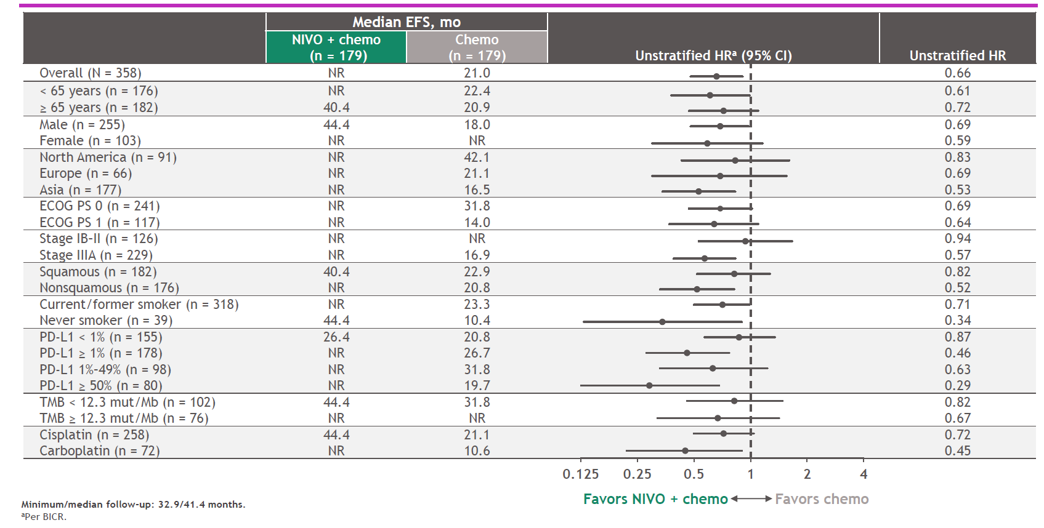
CheckMate-816: 3-Year EFSª Subgroup Analysis

Slide 16
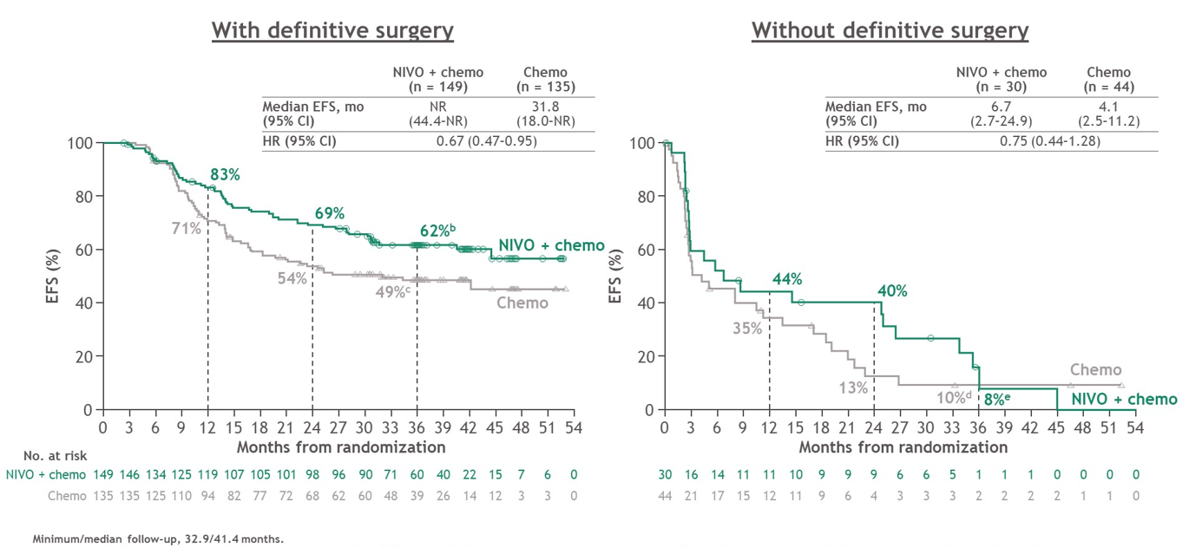
CheckMate-816: 3-Year EFSª by Definitive Surgery Status

Slide 17
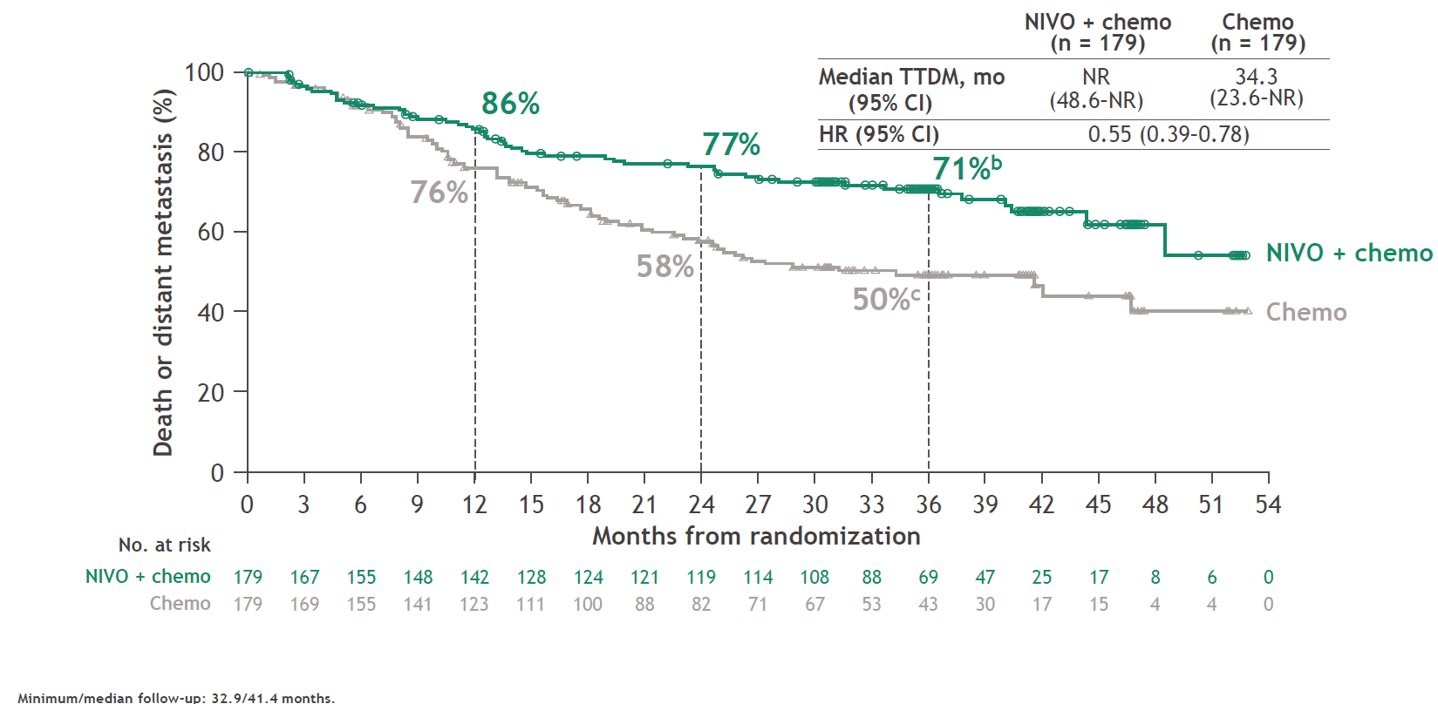
CheckMate-816: 3-Year Time To Distant Metastasis (TTDMª)

Slide 18
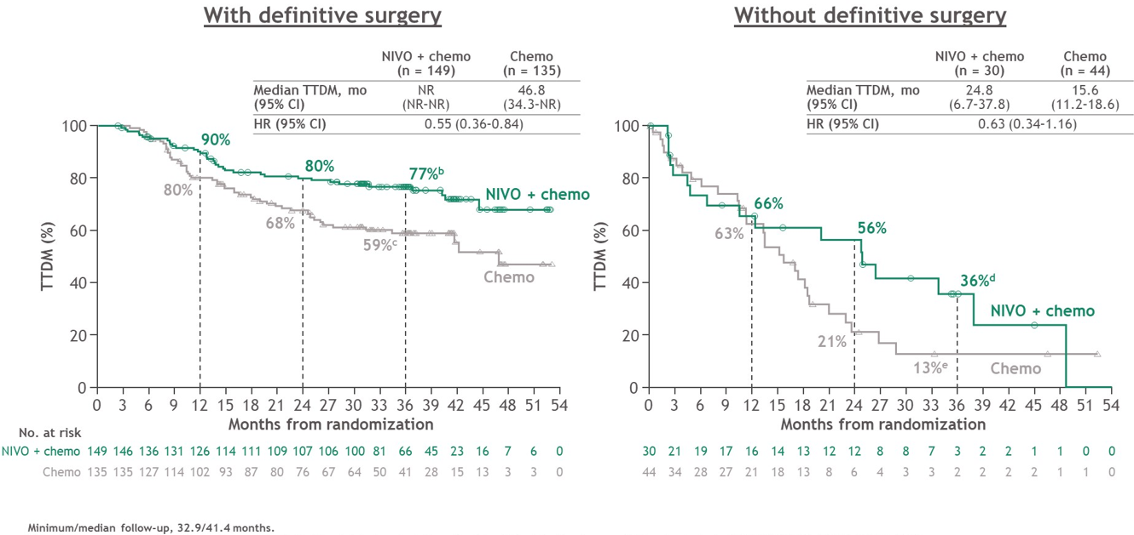
CheckMate-816: TTDMª by Definitive Surgery Status
3-Year

Slide 19
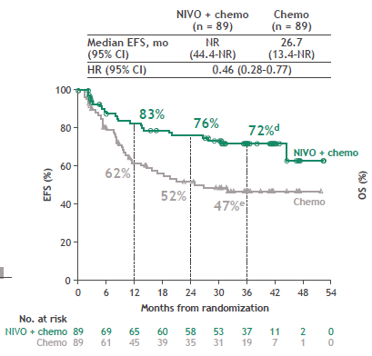
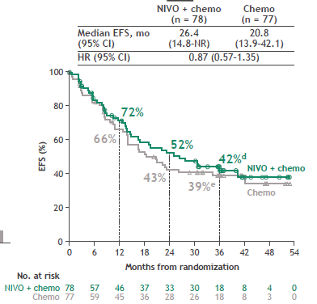
CheckMate-816: 3-Year EFS by PD-L1 status
PD-L1> 1%
PD-L1< 1%

Slide 20
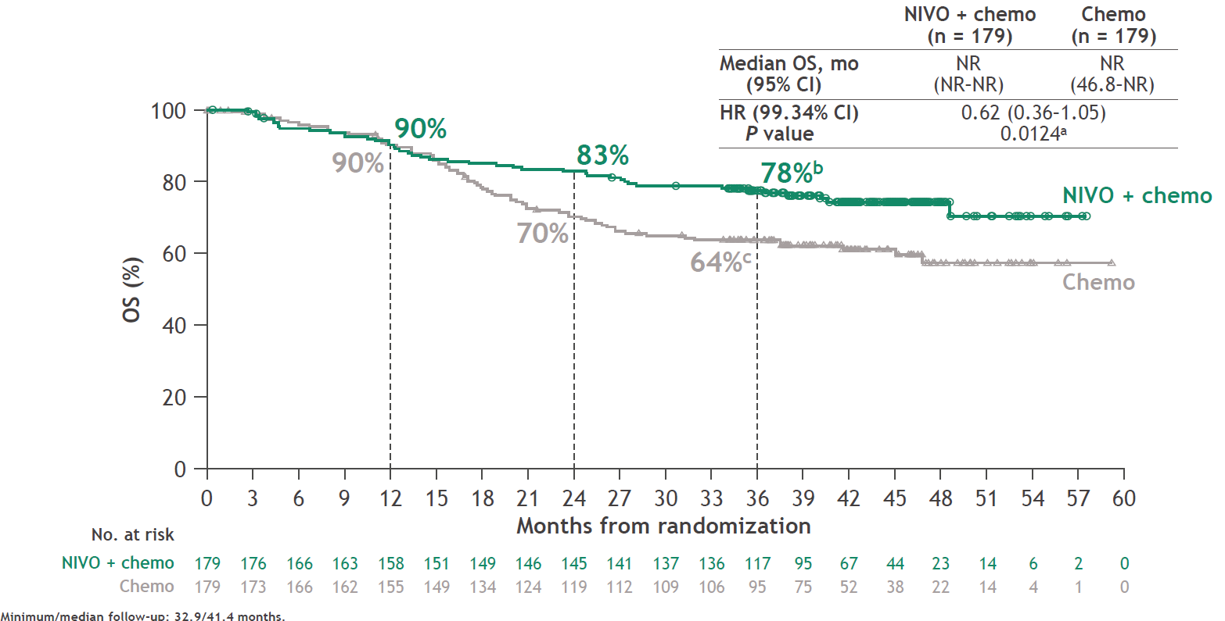
CheckMate-816: 3-Year OS Update

Slide 21
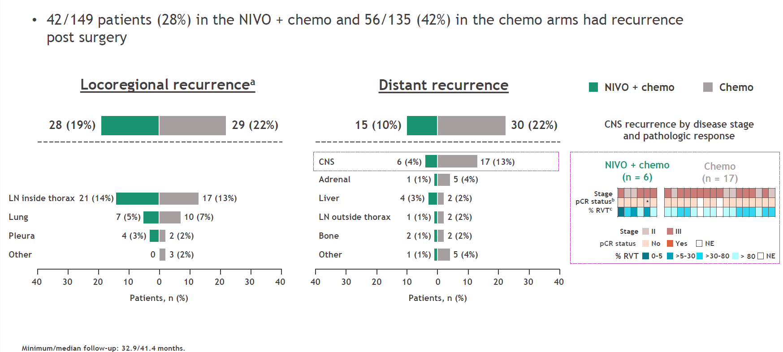
CheckMate-816: Recurrence Patterns

Slide 22
Peri-Adjuvant Immunotherapy
(AEGEAN, Neotorch, KEYNOTE-671, CheckMate 77T, IMpower030)

Slide 23
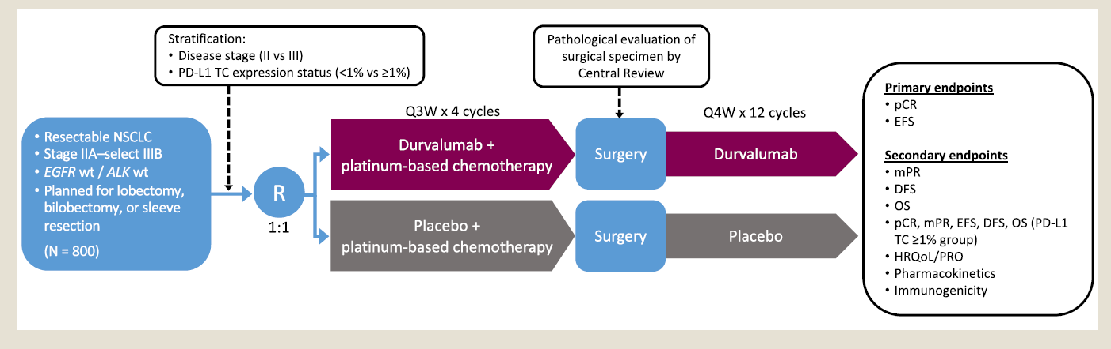
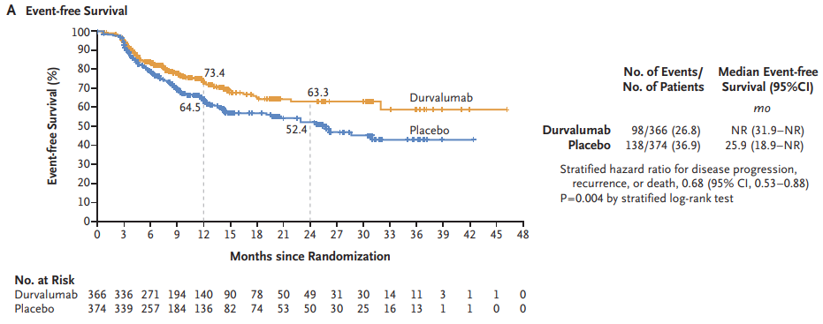
AEGEAN

Slide 24
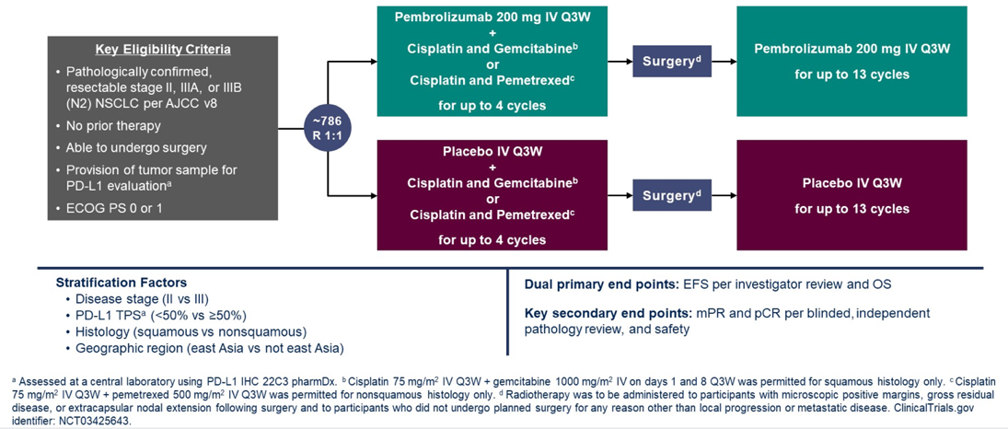
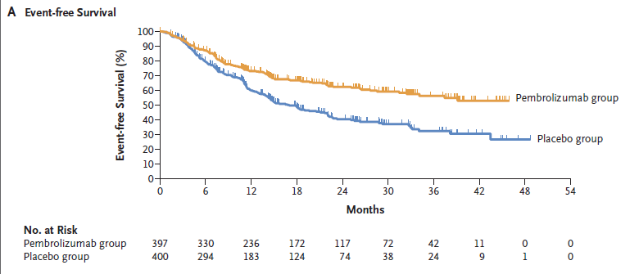
KEYNOTE-671
HR(95%CI)
0.58(0.46-0.72)

Slide 25
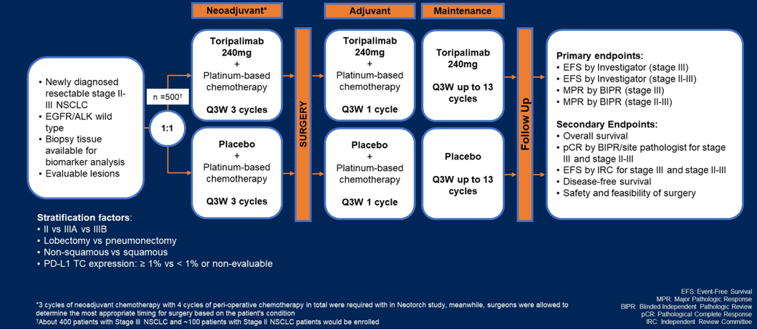
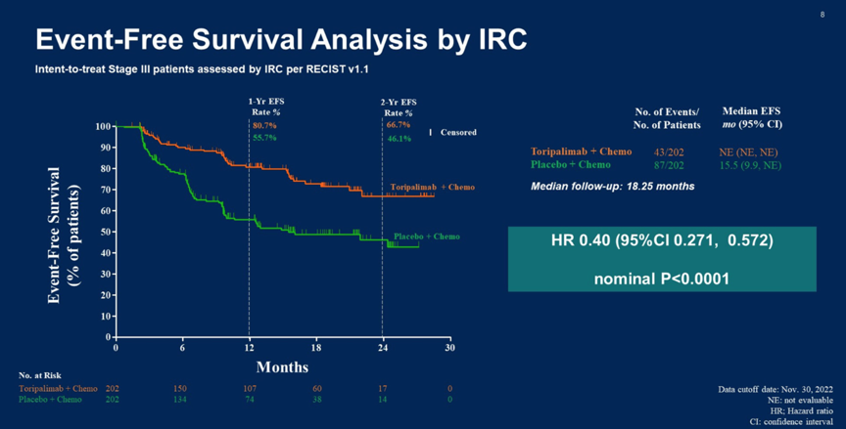
Neotorch

Slide 26
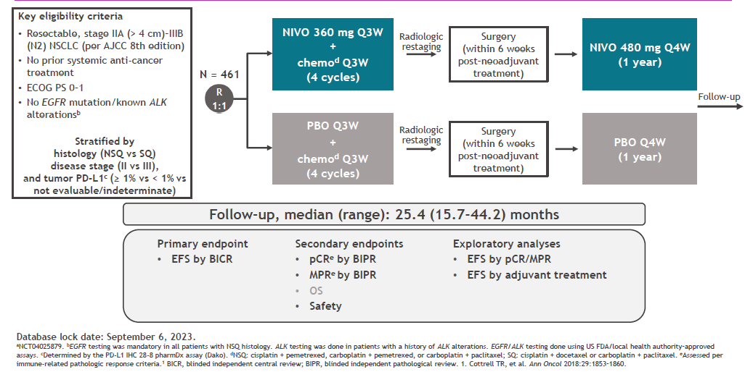
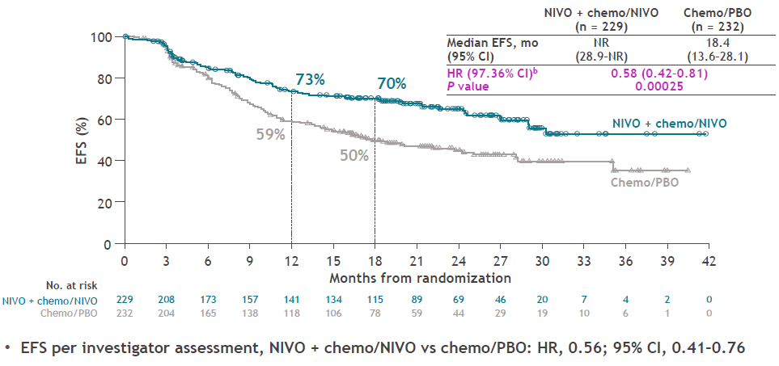
CheckMate 77T

Slide 27
Comparison of Pathologic Responses
pCR
Pathologic Complete Response
No viable tumor at resection
MPR
Major Pathologic Response
10% viable tumor at resection

Slide 28

NEOADJUVANT IMMUNOTHERAPY CONCLUSIONS
CheckMate-816 is only pure neoadjuvant trial
Growing evidence in peri-adjuvant space
Significant improvement in pathologic response and EFS
Promising early OS improvement
Appears safe and well tolerated, but attrition throughout each step
Too early to understand added benefit of peri-adjuvant
More work for providers
  Requires understanding agents and indication
  Biomarker testing is essential

Slide 29



Looking for more resources
on this topic?
CME/CE in minutes
Congress highlights
Late-breaking data
Quizzes
Webinars
In-person events
Slides & resources
www.MedEdOTG.com

