Slide 1
Case: Adjuvant Immunotherapy for Localized NSCLC
Joshua E. Reuss, MD
Thoracic Medical Oncologist
Assistant Professor of Medicine
Georgetown University School of Medicine
Washington, DC

Slide 2



Resource Information
About This Resource
These slides are one component of a continuing education program available online at MedEd On The Go titled Earlier Use of ICIs in NSCLC: Integrating the Latest Evidence Into Clinical Practice
Program Learning Objectives:
Apply the latest evidence to optimize the use of neoadjuvant immunotherapy treatment options to improve outcomes of patients with resectable NSCLC
Apply the latest evidence to optimize the use of adjuvant immunotherapy treatment options to improve outcomes of post-resection NSCLC patients
Evaluate current and emerging evidence to inform patient selection and treatment strategies with perioperative immunotherapy in early-stage NSCLC
MedEd On The Go®
www.mededonthego.com
This content or portions thereof may not be published, posted online or used in presentations without permission.
This content can be saved for personal use (non-commercial use only) with credit given to the resource authors.
To contact us regarding inaccuracies, omissions or permissions please email us at support@MedEdOTG.com

Slide 3
Disclaimer
The views and opinions expressed in this educational activity are those of the faculty and do not necessarily represent the views of Total CME, LLC, the CME providers, or the companies providing educational grants. This presentation is not intended to define an exclusive course of patient management; the participant should use their clinical judgment, knowledge, experience, and diagnostic skills in applying or adopting for professional use any of the information provided herein. Any procedures, medications, or other courses of diagnosis or treatment discussed or suggested in this activity should not be used by clinicians without evaluation of their patient's conditions and possible contraindications or dangers in use, review of any applicable manufacturer’s product information, and comparison with recommendations of other authorities. Links to other sites may be provided as additional sources of information.

Slide 4
Case Example
Mr. N is a 75yo male with history of prior tobacco use, chronic atrial fibrillation on apixaban and HTN who presents to you for a medical oncology consultation following resection of a localized NSCLC. He originally underwent a CT chest for intermittent chest tightness that revealed a 1.3 x 1.3cm left upper lobe (LUL) lung mass. PET/CT showed that this mass was hypermetabolic with SUV 4.4 but revealed no hypermetabolic lymphadenopathy or distant metastatic disease. Bronchoscopic biopsy of LUL lung mass was positive for TTF1+ adenocarcinoma. L hilar, subcarinal and R hilar lymph nodes were negative for malignancy. Mr. N subsequently underwent robotic LUL lobectomy with mediastinal lymph node dissection with pathology revealing a 1.4cm invasive mucin-producing adenocarcinoma. Margins were negative with no lymphovascular invasion but 2 of 12 lymph nodes were positive for malignancy (both peribronchial) with final disease stage pT1bN1Mx = stage IIB. NGS reveals KRAS G12C, PD-L1 60%.
What is your recommended systemic therapy approach for Mr. N?

Slide 5
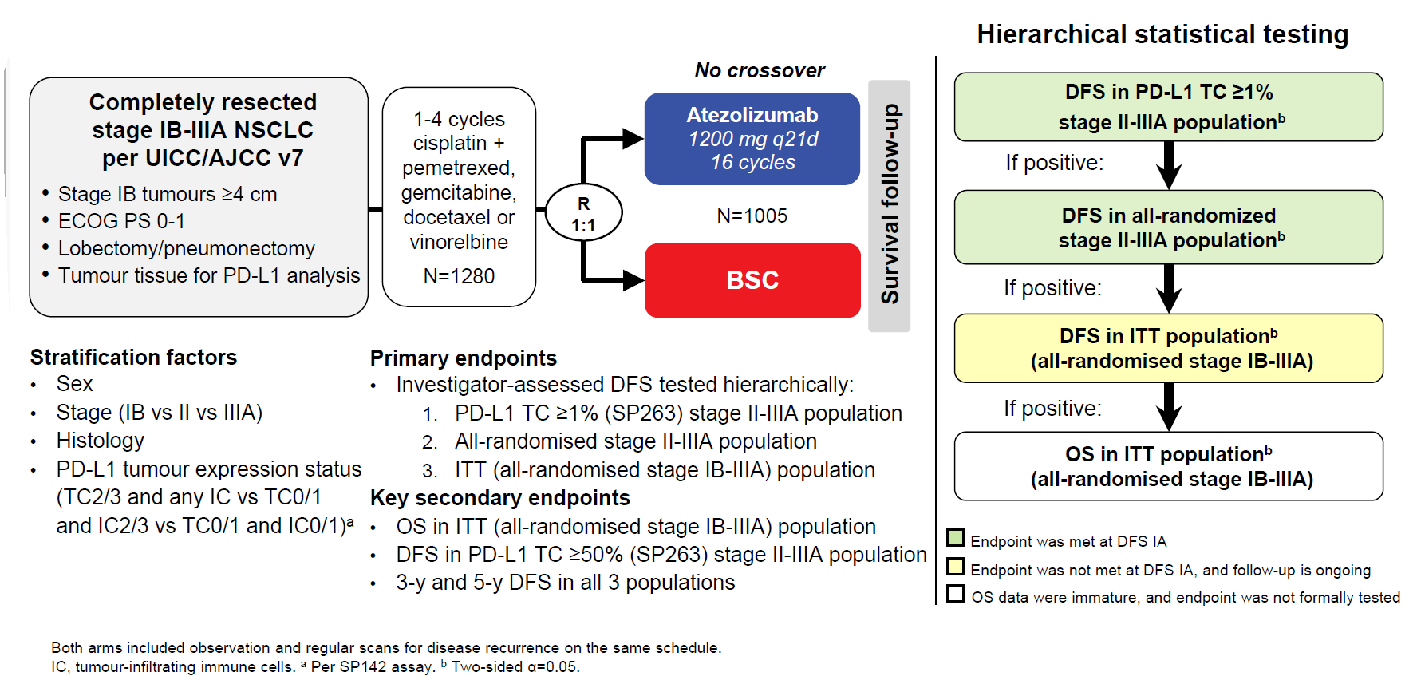
Phase III IMpower010

Slide 6
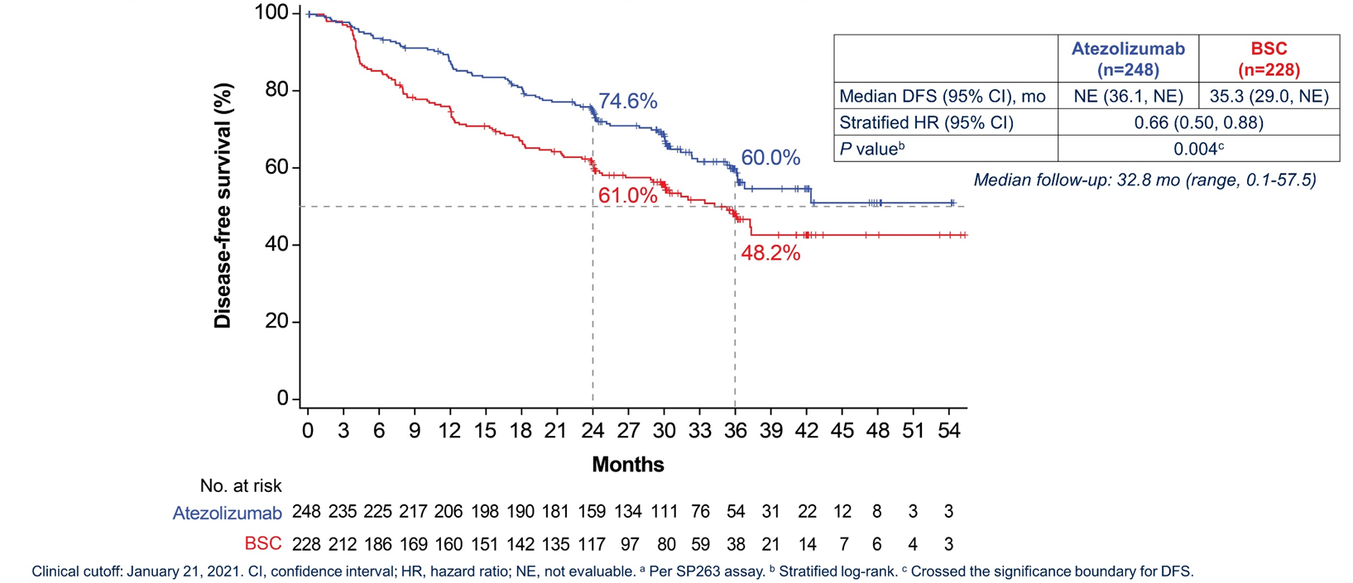
Atezolizumab Improves DFS in Patients With Resected PD-L1 Positive (TC≥1%ª) Stage II-IIIA NSCLC

Slide 7
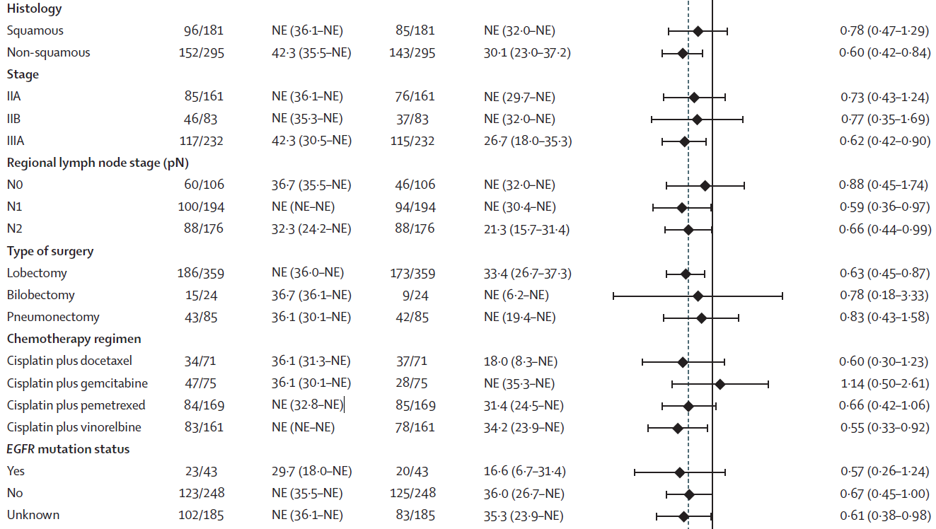
Atezolizumab Improves DFS in Patients With Resected PD-L1 Positive (TC≥1%ª) Stage II-IIIA NSCLC

Slide 8
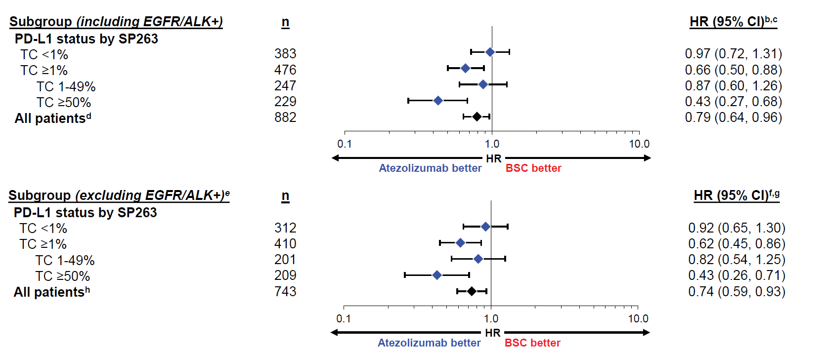
DFS Benefit Driven by PD-L1 High Subgroup?
DFS by PD-L1 statusª
All-randomized stage II-IIIA population (with and without known EGFR/ALK+ disease

Slide 9
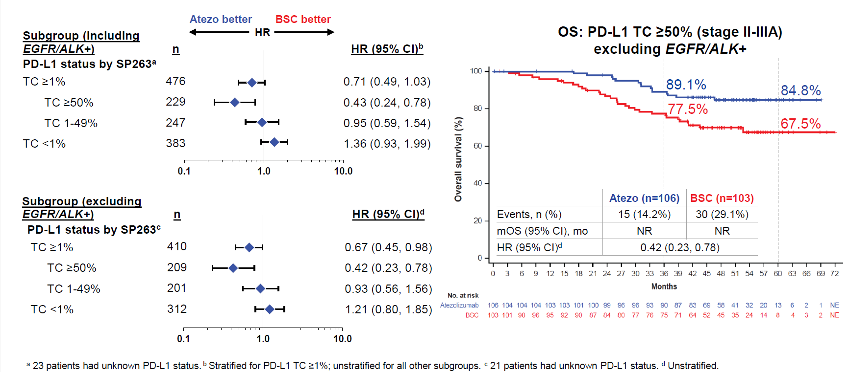
Early Signal of OS Benefit in PD-L1 High (TC≥50%) Subgroup

Slide 10
Phase III PEARLS/KEYNOTE-091 Trial
Randomized, Triple-Blind, Phase 3 Trial
Eligibility for Registration
Confirmed stage IB (T ≥4 cm), II, or IIIA NSCLC per AJCC v7
Complete surgical resection with negative margins (R0)
Provision of tumor tissue for
PD-L1 testing
Eligibility for Randomization
No evidence of disease
ECOG PS 0 or 1
Adjuvant chemotherapy
  Considered for stage IB
  (T ≥4 cm) disease
  Strongly recommended for stage II and IIIA disease
  Limited to ≤4 cycles
Pembrolizumab 200 mg Q3W
for ≤18 administrations (~1 yr)
PD-L1 testing
done centrally using
PD-L1 IHC
22C3 pharmDx
R
1:1
Placebo Q3W
for ≤18 administrations (~1 yr)
Stratification Factors
Disease stage (IB vs II vs IIIA)
PD-L1 TPS (<1% vs 1-49% vs ≥50%)
Receipt of adjuvant chemotherapy (yes vs no)
Geographic region (Asia vs Eastern Europe vs
Western Europe vs rest of world)
Dual Primary End Points
DFS in the overall population
DFS in the PD-L1 TPS ≥50%
population
Secondary End Points
DFS in the PD-L1 TPS ≥1% population
OS in the overall, PD-L1 TPS ≥50%, and
PD-L1 TPS ≥1% populations
Lung cancer-specific survival in the
overall population
Safety

Slide 11
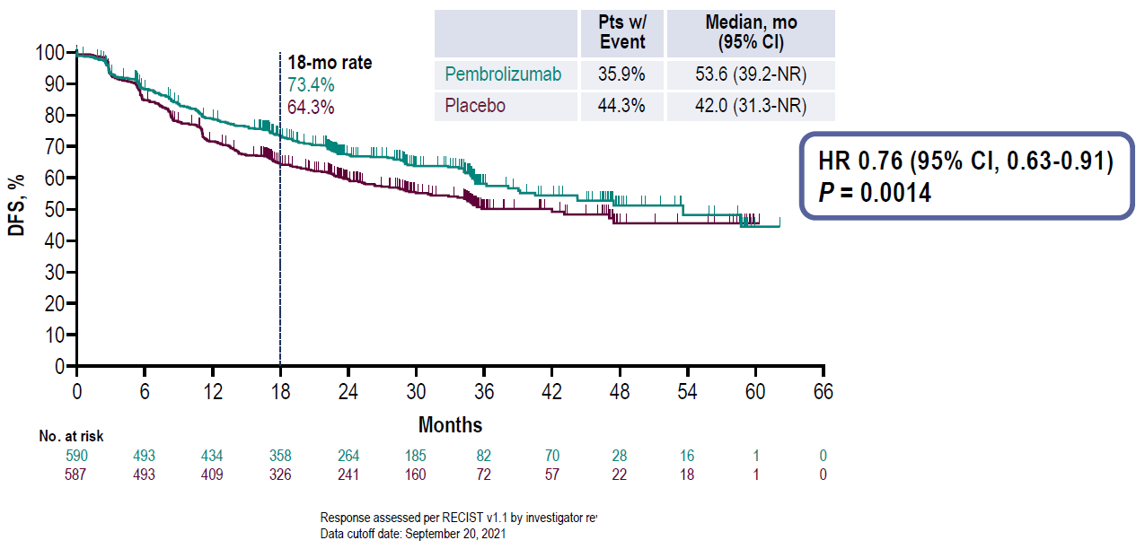
Adjuvant Pembrolizumab Improves DFS in
Overall Population
NR, not reportable; RECIST, response evaluation criteria in solid tumors.
Paz-Ares L, et al. ESMO 2022. Abstract VP3-2022.

Slide 12
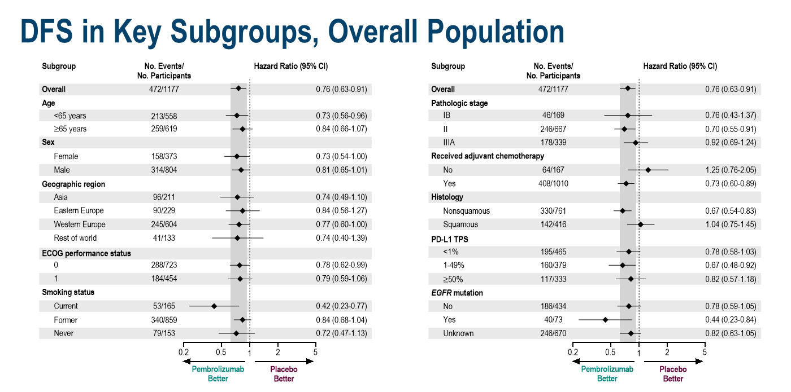
Adjuvant Pembrolizumab DFS Benefit Not Driven by PD-L1 Expression?

Slide 13
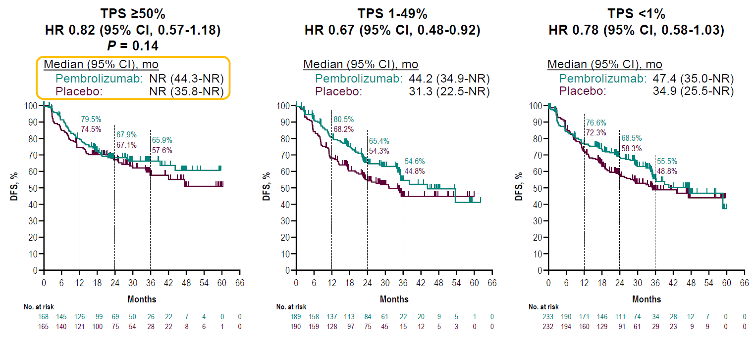

Did Chemotherapy Arm Over-Perform in the PD-L1 High Subgroup?
Paz-Ares et al. ESMO Plenary 2022
Data cutoff date: September 20, 2021
@Joshua_Reuss

Slide 14
Phase III Adjuvant Immunotherapy - Summary
 | IMpower010¹ | PEARLS²
Design Stage Chemotherapy? | Atezolizumab versus BSC IB-IIIA (AJCC 7th) Yes | Pembrolizumab versus Placebo IB-IIIA (AJCC 7th) Advised for II/IIIA
Primary Endpoint | Hierarchical DFS: PD-L1 TC ≥1% stage II/IIIA → all-randomized stage II/IIIA → ITT population | Split α allocation: DFS in overall population DFS in PD-L1 TS ≥50%
% Stage IIIA | 41.1% | 28.8%
DFS HR (95% CI) PD-L1* <1% PD-L1* ≥1% PD-L1* 1-49% PD-L1* ≥50% | 0.79 (0.64-0.96) - Stage II/IIIA 0.97 (0.72-1.31) 0.66 (0.49-0.87) 0.87 (0.60-1.26) 0.43 (0.27-0.68) | 0.76 (0.63-0.91) - Overall Pop 0.78 (0.58-1.03) N/A 0.67 (0.48-0.92) 0.82 (0.57-1.18)
% ≥G3 AEs (G5) | 23% (2%) | 34% (2%)
FDA approved | PD-L1+ (TC ≥1%) Stage II/IIIA | Stage IB-IIIA NSCLC (irrespective of PD-L1 status)
*IHC per SP263 in IMpower010 and 22C3 in PEARLS
AE: adverse event; BSC: best supportive care; DFS: disease free survival; G: grade; HR: hazard ratio
@Joshua_Reuss

Slide 15
For Whom Is the Adjuvant Approach Appropriate?
Post-surgical upstaging
Patient/provider preference
Concern for tolerability of neoadjuvant approach
Important Unanswered Questions:
What is the ideal duration of adjuvant therapy?
Who truly needs it and who may be cured with surgery alone?
What is the ideal way to monitor for treatment response?
If a patient experiences disease recurrence on adjuvant therapy, then what?

Slide 16
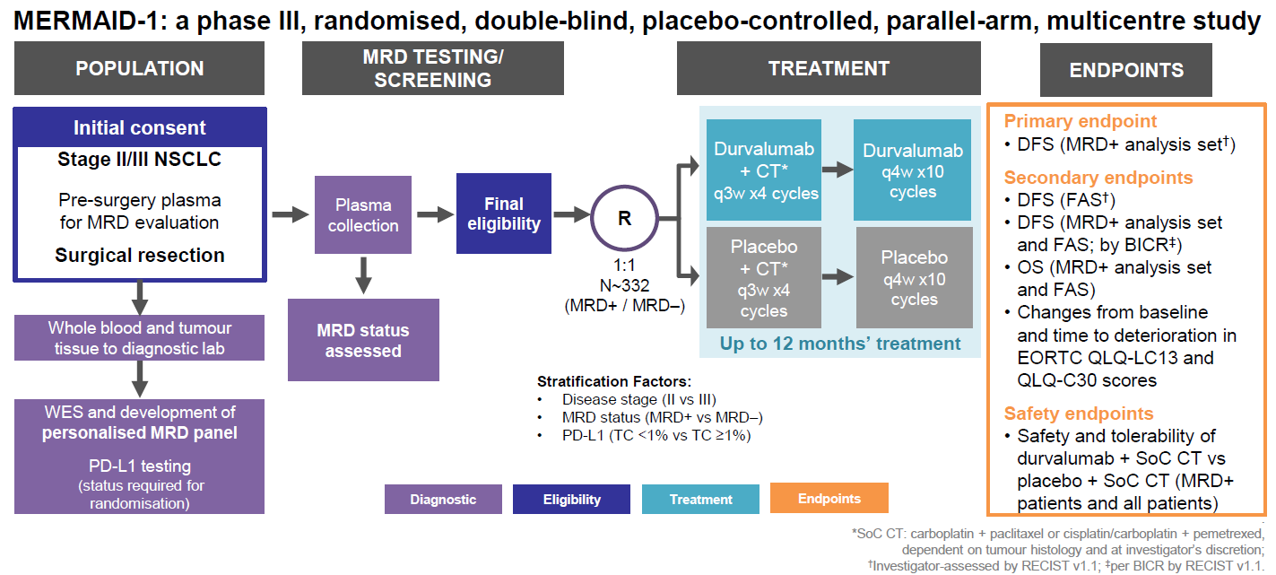
MERMAID-1 Trial
@Joshua_Reuss

Slide 17
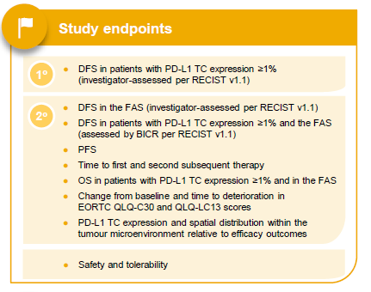
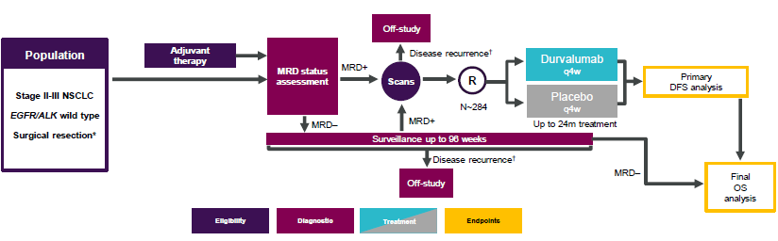
MERMAID-2 Trial
Phase 3, randomized, double-blind, placebo-controlled, parallel-arm, international, multicenter study

Slide 18
Case Example - Revisited
Mr. N is a 75yo male with history of prior tobacco use, chronic atrial fibrillation on apixaban and HTN who presents to you for a medical oncology consultation following resection of a localized NSCLC. He originally underwent a CT Chest for intermittent chest tightness that revealed a 1.3 x 1.3cm left upper lobe (LUL) lung mass. PET/CT showed that this mass was hypermetabolic with SUV 4.4 but revealed no hypermetabolic lymphadenopathy or distant metastatic disease. Bronchoscopic biopsy of LUL lung mass was positive for TTF1+ adenocarcinoma. L hilar, subcarinal and R hilar lymph nodes were negative for malignancy. Mr. N subsequently underwent robotic LUL lobectomy with mediastinal lymph node dissection with pathology revealing a 1.4cm invasive mucin-producing adenocarcinoma. Margins were negative with no lymphovascular invasion but 2 of 12 lymph nodes were positive for malignancy (both peribronchial) with final disease stage pT1bN1Mx = stage IIB. NGS reveals KRAS G12C, PD-L1 60%.
What is your recommended systemic therapy approach for Mr. N?
Received 4 cycles of adjuvant carboplatin/pemetrexed chemotherapy followed by 1 year of pembrolizumab immunotherapy. Course complicated by grade 1 pneumonitis necessitating brief cessation of immunotherapy but was able to resume. Remains recurrence-free at this time.

Slide 19



Looking for more resources
on this topic?
CME/CE in minutes
Congress highlights
Late-breaking data
Quizzes
Webinars
In-person events
Slides & resources
www.MedEdOTG.com

