Slide 1
Case: Peri-Operative Immunotherapy in Early-Stage NSCLC
Joshua E. Reuss, MD
Thoracic Medical Oncologist
Assistant Professor of Medicine
Georgetown University School of Medicine
Washington, D.C.

Slide 2
Resource Information
About This Resource
These slides are one component of a continuing education program available online at MedEd On The Go titled Earlier Use of ICIs in NSCLC: Integrating the Latest Evidence Into Clinical Practice
Program Learning Objectives:
Apply the latest evidence to optimize the use of neoadjuvant immunotherapy treatment options to improve outcomes of patients with resectable NSCLC
Apply the latest evidence to optimize the use of adjuvant immunotherapy treatment options to improve outcomes of post-resection NSCLC patients
Evaluate current and emerging evidence to inform patient selection and treatment strategies with perioperative immunotherapy in early-stage NSCLC
MedEd On The Go®
www.mededonthego.com
This content or portions thereof may not be published, posted online or used in presentations without permission.
This content can be saved for personal use (non-commercial use only) with credit given to the resource authors.
To contact us regarding inaccuracies, omissions or permissions please email us at support@MedEdOTG.com

Slide 3
Disclaimer
The views and opinions expressed in this educational activity are those of the faculty and do not necessarily represent the views of Total CME, LLC, the CME providers, or the companies providing educational grants. This presentation is not intended to define an exclusive course of patient management; the participant should use their clinical judgment, knowledge, experience, and diagnostic skills in applying or adopting for professional use any of the information provided herein. Any procedures, medications, or other courses of diagnosis or treatment discussed or suggested in this activity should not be used by clinicians without evaluation of their patient's conditions and possible contraindications or dangers in use, review of any applicable manufacturer’s product information, and comparison with recommendations of other authorities. Links to other sites may be provided as additional sources of information.

Slide 4
Case Example
Mr. W is a 77-year-old male with a history of COPD, type 2 diabetes, HTN and HLD who presents to you for a recommendation on management of locally advanced NSCLC. He had been following with pulmonology with yearly CT scans for a growing right upper lobe (RUL) lung nodule but was lost to follow-up during the COVID-19 pandemic and recently re-presented. Repeat CT imaging and PET/CT shows a 5.4 x 4.7cm FDG-avid RUL lung mass along with an enlarged right hilar and precarinal lymph node. Pathology from EBUS with bronchoscopic biopsy returns showing keratinizing squamous cell carcinoma of RUL lung mass, with right paratracheal and precarinal lymph nodes positive for NSCLC. A brain MRI is negative for intracranial metastases. The patient’s case is reviewed at multidisciplinary tumor board and is deemed as potentially resectable.
What is your recommended treatment approach for Mr. W?

Slide 5
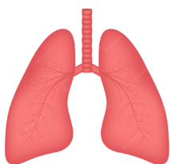
A Visual Glossary of Terms
Neoadjuvant = treatment before surgery
Adjuvant = treatment after surgery
Peri-operative = treatment before and after surgery
- alive, disease-free
1 year
- alive, cancer recurred
- dead
1-year disease-free survival (DFS) = 50%
1-year overall survival (OS) = 80%

Slide 6
KEYNOTE-671 Study Design Randomized, Double-Blind, Phase 3 Trial

Slide 7
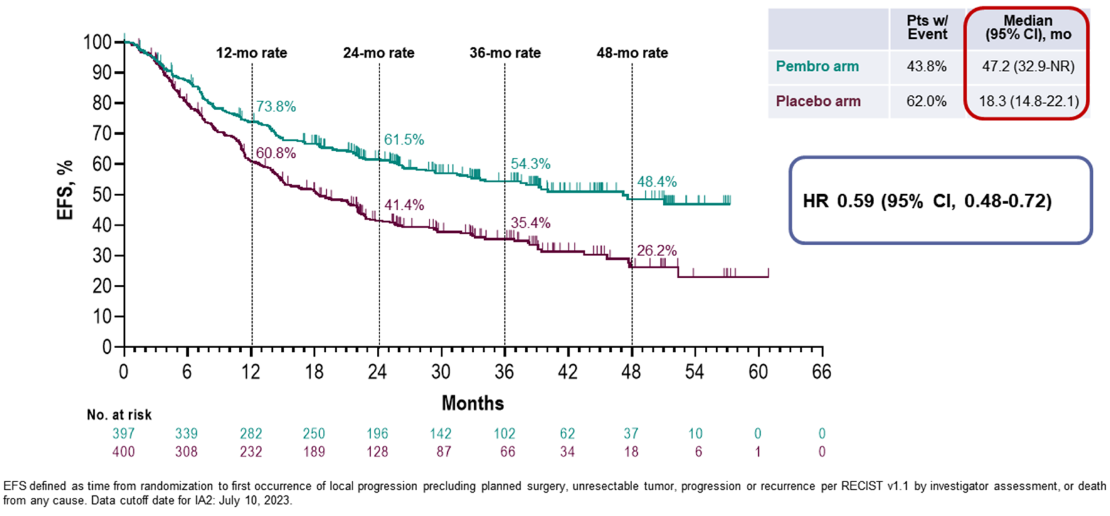
Pembrolizumab plus chemotherapy followed by surgery and adjuvant pembrolizumab improves event-free survival (EFS)
Median follow-up: 36.6 months (18.8-62.0)

Slide 8
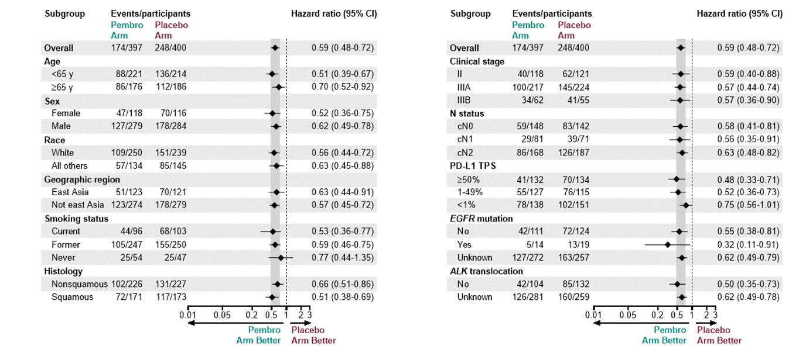
Pembrolizumab Plus Chemotherapy Followed by Surgery and Adjuvant Pembrolizumab Improves Event-Free Survival (EFS)

Slide 9
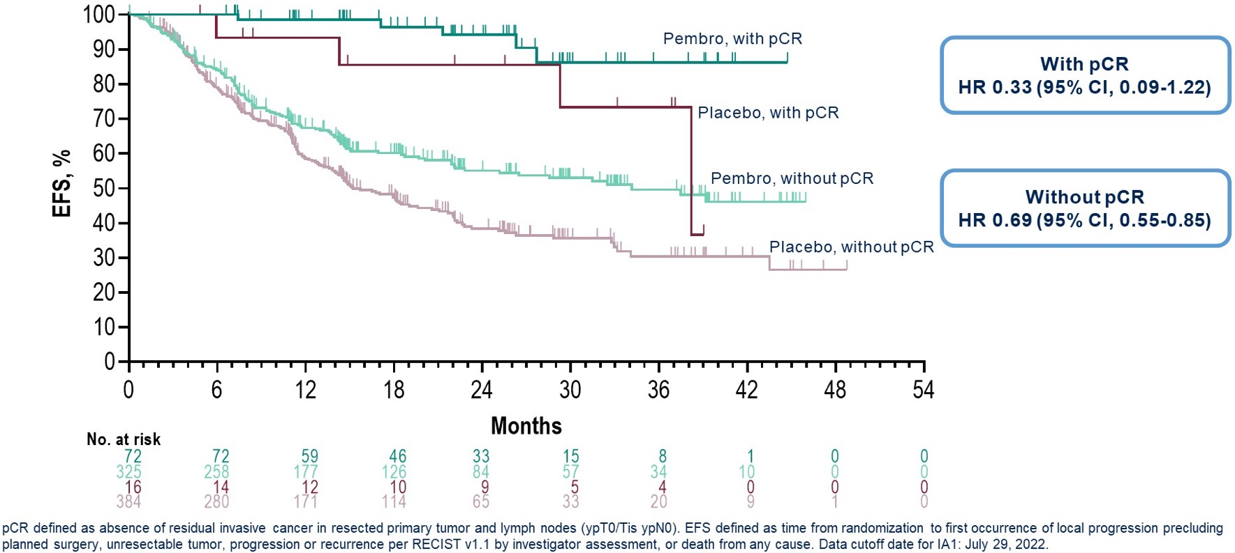
Clinical Benefit Apparent in Both Patients Who Do and Do Not Achieve a Pathologic Complete Response (pCR) to Therapy

Slide 10
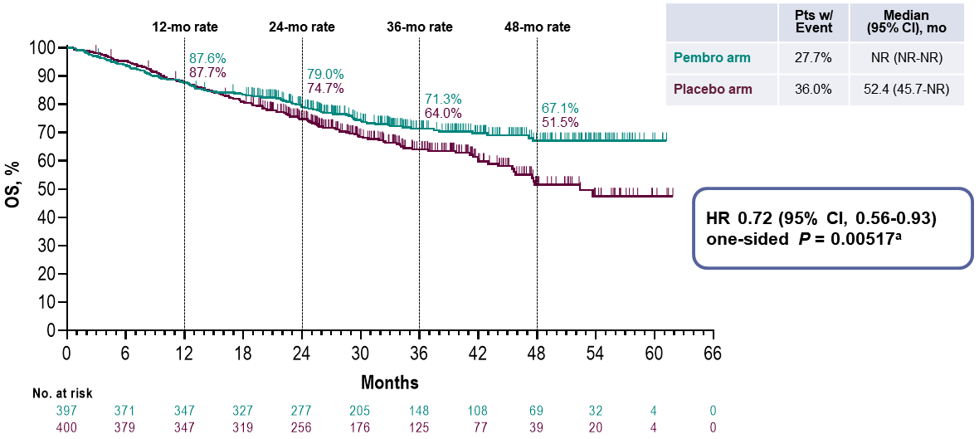
Pembrolizumab plus chemotherapy followed by surgery and adjuvant pembrolizumab improves overall survival
Median follow-up: 36.6 months (18.8-62.0)

Slide 11
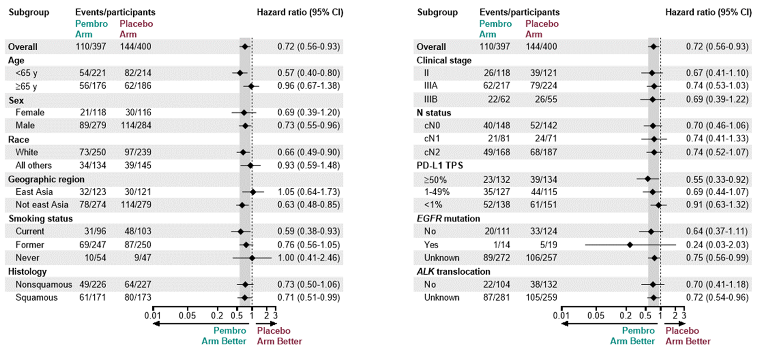
Pembrolizumab plus chemotherapy followed by surgery and adjuvant pembrolizumab improves overall survival

Slide 12
Phase III AEGEAN Trial

Slide 13
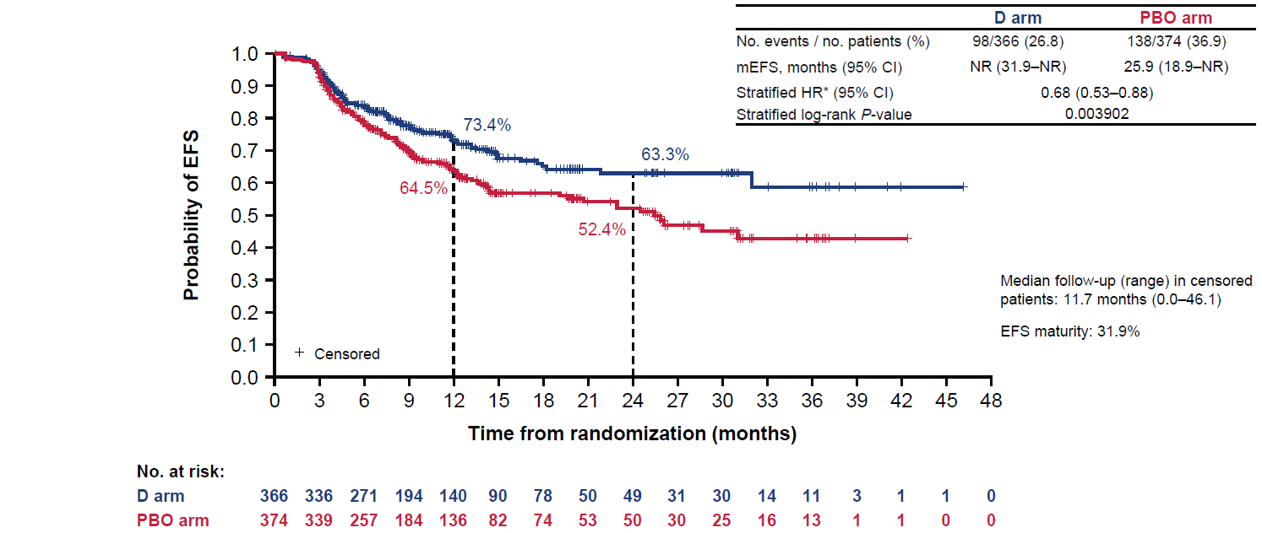
Durvalumab Plus Chemotherapy Followed by Surgery and Adjuvant Durvalumab Improves Event-Free Survival (EFS)

Slide 14
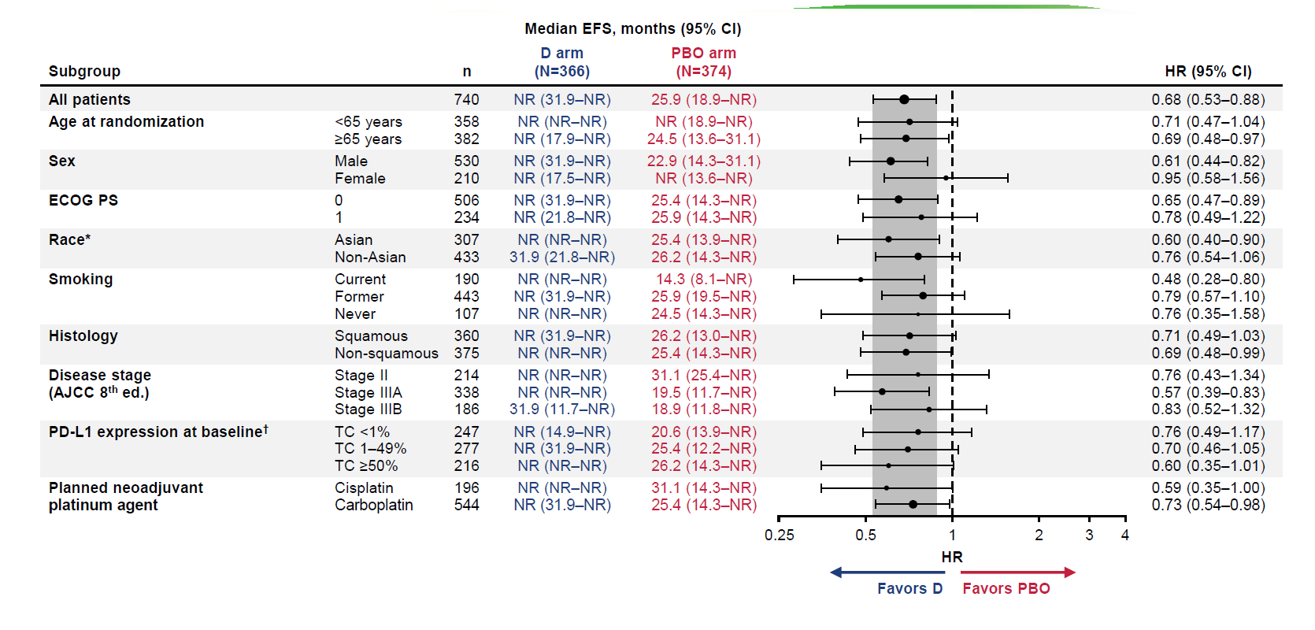
Durvalumab Plus Chemotherapy Followed by Surgery and Adjuvant Durvalumab Improves Event-Free Survival

Slide 15
Phase III Neotorch Trial: Neotorch Study Design

Slide 16
Toripalimab Plus Chemotherapy Followed by Surgery and Adjuvant Toripalimab Improves Event-Free Survival (EFS) in Stage III NSCLC

Slide 17
Toripalimab Plus Chemotherapy Followed by Surgery and Adjuvant Toripalimab Improves Event-Free Survival (EFS)

Slide 18
Phase III CheckMate 77Tª Trial

Slide 19
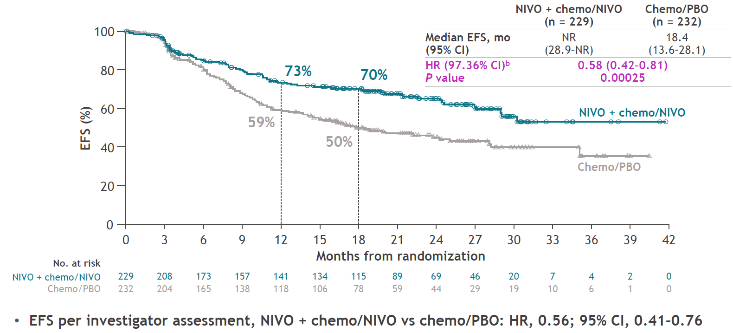
Nivolumab Plus Chemotherapy Followed by Surgery and Adjuvant Nivolumab Improves Event-Free Survival (EFS)ª

Slide 20
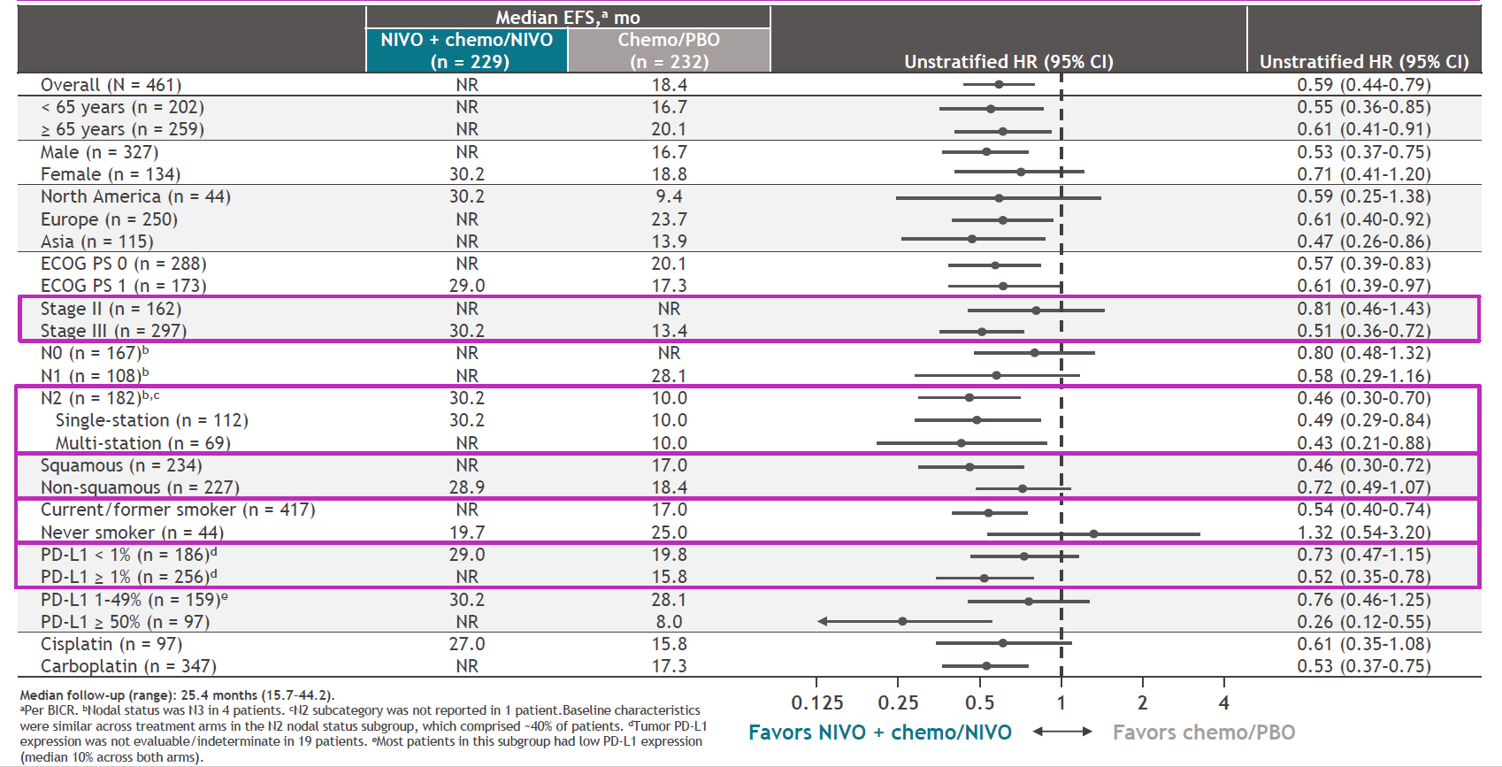
CheckMate 77T: EFS Analysis by Key Subgroups

Slide 21
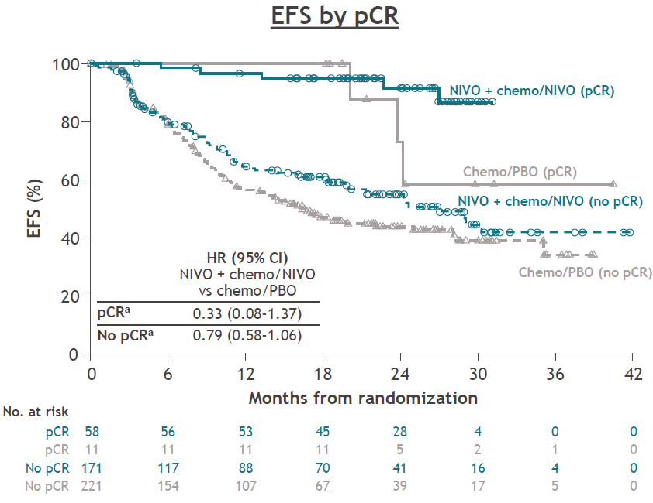
Clinical Benefit Apparent in Both Patients Who Do and Do Not Achieve a Pathologic Complete Response (pCR) to Therapy

Slide 22
Phase III Neoadjuvant/Perioperative Chemo-Immunotherapy Studies - Summary
 | CheckMate 816^{1,2} | KEYNOTE-671^{3,4,5} | AEGEAN^{6,7} | CheckMate 77T⁸ | Neotorch^{9,^}
Design Trial Size Stage Placebo? Adj IO? | Neoadj Nivo-chemo vs chemo - N = 358 IB-IIIA (AJCC 7th) No No | Peri-op Pembro-chemo vs placebo-chemo - N = 797 II-IIIB (AJCC 8th) Yes Yes | Peri-op Durva-chemo vs placebo-chemo - N = 740 II-IIIB (AJCC 8th) Yes Yes | Peri-op Nivo-chemo vs placebo-chemo N = 461 IIA-IIIB (AJCC 8th) Yes Yes | Peri-op Tori-chemo vs placebo-chemo N = 464 II-III (?) Yes Yes
% Stage III# IIIA IIIB | 64% 64% 0% | 70% 55% 15% | 71% 46% 25% | 64% N/A N/A | N/A (data available for stage III only)
pCR rate (95% CI) | 24% (18.0 - 31.0) | 18% (14.5 – 22.3) | 17% (13.5 – 21.5) | 25% (19.8-31.5) | 28% (22.1 – 35.0)
Median f/u | 41.4mo | 36.6mo | 11.7mo | 25.4 | 18.3mo
EFS HR (95% CI) - PD-L1* <1% - PD-L1* ≥1% - PD-L1* 1-49% - PD-L1* ≥50% | 0.68 (0.49-0.93) – ITT 0.87 (?) 0.46 (?) 0.63 (?) 0.29 (?) | 0.59 (0.48 – 0.72) – ITT 0.75 (0.56-1.01) 0.47 (0.36-0.63)% 0.52 (0.36-0.73) 0.48 (0.33-0.71) | 0.68 (0.53-0.88) – ITT 0.76 (0.49-1.17) Unknown 0.70 (0.46-1.05) 0.60 (0.35-1.01) | 0.58 (0.42-0.81) – ITT 0.73 (0.47-1.15) 0.52 (0.35-0.78) 0.76 (0.46-1.25) 0.26 (0.12-0.55) | 0.40 (0.27-0.57) 0.59 (0.33-1.03) 0.31 (0.20-0.48) Unknown Unknown
% ≥G3 AEs (G5) | 41% (0%) | 45% (1.0%) | 32% (1.8%) | 47% (1.0%) | 63% (3.0%)
FDA approved | Resectable NSCLC tumor ≥4cm or node positive | Resectable NSCLC tumor ≥4cm or node positive | TBA | TBA | N/A

Slide 23
How Do We Select Patients for a Neoadjuvant Approach Versus a Peri-Operative Approach?
Patient/disease specific factors
Disease histology (squamous vs adenocarcinoma)?
PD-L1 status?
Other molecular markers (KRAS, STK11, KEAP1, etc)?
Can we utilize a response-adaptive approach?
Pathologic response?
Minimal residual disease (MRD) assessment/monitoring?
What do we do for patients who experience recurrence on adjuvant therapy or experience no pathologic response to neoadjuvant therapy?
Add checkpoint (CTLA-4, TIGIT, etc.)?
Add antibody-drug conjugate?
Change chemotherapy backbone?
Utilize tumor to create patient-specific immune approach (vaccine, TIL, CAR-T)?

Slide 24
Can PD-L1 Inform Decision-Making?
EFS sub-groups by PD-L1 status
CheckMate 816¹
Unstratified HR (per BICR) (95% CI)
Unstratified HR
KEYNOTE-671^{2,3}
HR
HR (95% CI)
AEGEAN⁴
HR
HR (95% CI)
CheckMate 77T⁵
HR
Unstratified HR (per BICR) (95% CI)

Slide 25
Can Disease Histology Inform Decision-Making?
EFS sub-groups by histology
CheckMate 816¹
Unstratified HR (per BICR) (95% CI)
Unstratified HR
KEYNOTE-671^{2,3}
HR
HR (95% CI)
AEGEAN⁴
HR
HR (95% CI)
CheckMate 77T⁵
HR
Unstratified HR (per BICR) (95% CI)

Slide 26
Case Example - Revisited
Mr. W is a 77-year-old male with history of COPD, type 2 diabetes, HTN and HLD who presents to you for a recommendation on management of locally advanced NSCLC. He had been following with pulmonology with yearly CT scans for a growing right upper lobe (RUL) lung nodule but was lost to follow-up during the COVID-19 pandemic and recently re-presented. Repeat CT imaging and PET/CT shows a 5.4 x 4.7cm FDG-avid RUL lung mass along with an enlarged right hilar and precarinal lymph node. Pathology from EBUS with bronchoscopic biopsy returns showing keratinizing squamous cell carcinoma of RUL lung mass, with right paratracheal and precarinal lymph nodes positive for NSCLC. A brain MRI is negative for intracranial metastases. The patient’s case is reviewed at multidisciplinary tumor board and is deemed as potentially resectable.
What is your recommended treatment approach for Mr. W?
Received 3 cycles of neoadjuvant nivo/carboplatin/pac chemotherapy followed by surgical resection. Pathology at resection showed 10% residual viable tumor in resection bed, as well as residual tumor in station 4R, 7 and 10R lymph nodes. NGS testing reveals PD-L1 50%, TMB 9 mut/Mb; TP53, PTEN, SMAD4.
Would you recommend any additional treatment at this time?
Proceeded with adjuvant pembrolizumab, which he continues at this time with excellent tolerability and no evidence of disease recurrence.

Slide 27
Looking for more resources on this topic?
CME/CE in minutes
Congress highlights
Late-breaking data
Quizzes
Webinars
In-person events
Slides & resources
www.MedEdOTG.com

