Slide 1
How Do Brain Metastases Affect Your Choice of Systemic Treatment in a Patient with HR+/HER2-Low MBC?
Sarah Sammons, MD Associate Director, Metastatic Breast Cancer Dana Farber Cancer Institute Boston, MA
Notes:
Brief summary demonstrating T-Dxd efficacy in HER2+ aBC brain mets
What we are learning from the attached citations
Current ongoing studies evaluating T-Dxd in HER2-low aBC with brain mets

Slide 2
Resource Information
About This Resource
These slides are one component of a continuing education program available online at MedEd On The Go titled Expanding ADCs Across Metastatic Breast Cancer: Disrupting Dx & Tx Silos
Program Learning Objectives:
Correctly determine HER2 expression status in existing and newly diagnosed metastatic breast cancer patients
Develop evidence-based treatment strategies for patients with HR-positive/HER2-low MBC
Differentiate key components and advantages of ADCs in special populations of patients with metastatic breast cancer
Identify strategies for improving adherence through adverse effect management
MedEd On The Go®
www.mededonthego.com
This content or portions thereof may not be published, posted online or used in presentations without permission.
This content can be saved for personal use (non-commercial use only) with credit given to the resource authors.
To contact us regarding inaccuracies, omissions or permissions please email us at support@MedEdOTG.com

Slide 3
Disclaimer
The views and opinions expressed in this educational activity are those of the faculty and do not necessarily represent the views of Total CME, LLC, the CME providers, or the companies providing educational grants. This presentation is not intended to define an exclusive course of patient management; the participant should use their clinical judgment, knowledge, experience, and diagnostic skills in applying or adopting for professional use any of the information provided herein. Any procedures, medications, or other courses of diagnosis or treatment discussed or suggested in this activity should not be used by clinicians without evaluation of their patient's conditions and possible contraindications or dangers in use, review of any applicable manufacturer’s product information, and comparison with recommendations of other authorities. Links to other sites may be provided as additional sources of information.

Slide 4
Background
Trastuzumab deruxtecan (T-DXd) has changed the standard of care in patients with advanced HER2+ breast cancer
While chemotherapy has had limited activity in breast cancer brain metastases, antibody-drug conjugates (ADCs) are showing promising results in this critical unmet need
T-DXd has shown impressive activity in both stable and active/progressive brain metastases

Slide 5
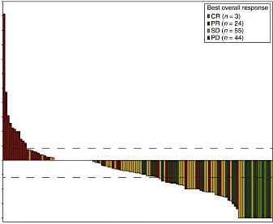
T-DM1 Showed Initial Activity of ADCs in HER2+ Brain Metastases
275
250
225
200
175
150
125
100
75
50
25
0
-25
-50
-75
-100
398/2003 enrolled patients with BM at baseline
In the 126 patients with measurable BM:
Best overall response (CNS and non-CNS) = 21.4%
Clinical benefit rate = 42.9%
Challenged historical thinking that large ADCs could not penetrate BBB
Best overall response
CR (n = 3)
PR (n = 24)
SD (n = 55)
PD (n = 44)
% change in sum of dimensions of target brain lesions
Patients (n = 125)

Slide 6
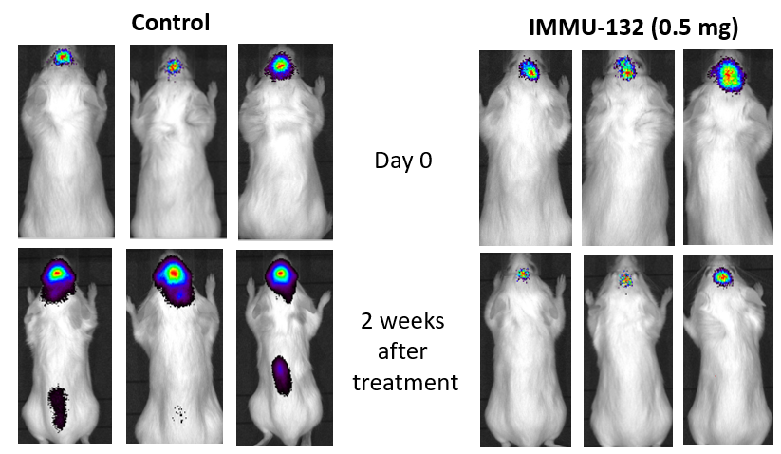
Sacituzumab Govitecan Showed Therapeutic Levels in Resected Brain Tumors in Small Study
 | CNS Tumor Mean Total SN-38 | CNS Tumor Mean Free [SN-38] | Fold change from IC-50
Breast cancer CNS metastases (N = 4) | 455nM (174-1160) | 73nM (15-198) | 150-fold
Glioblastoma multiforme (N = 6) | 270nM (93-687) | 46nM (20-90) | 40-fold
SN-38 levels in a preoperative window trial of Sacituzumab govitecan in patients with BCBM or GBM
Tumor response in MDA-MB-468 intracranial xenografts.

Slide 7
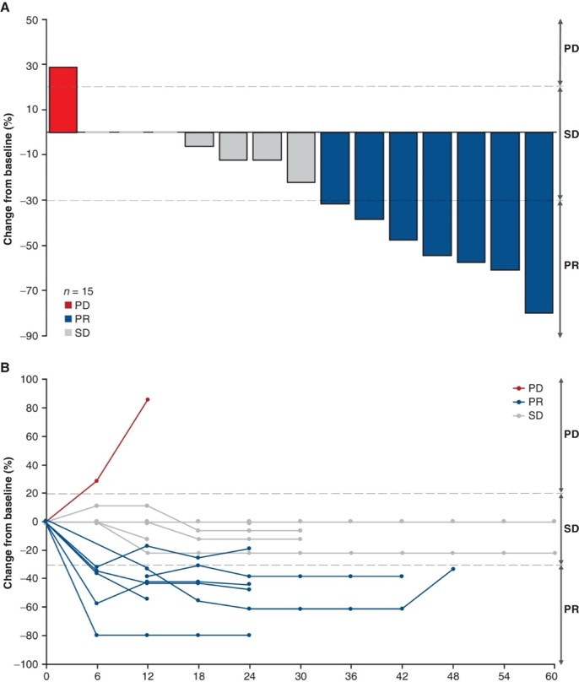
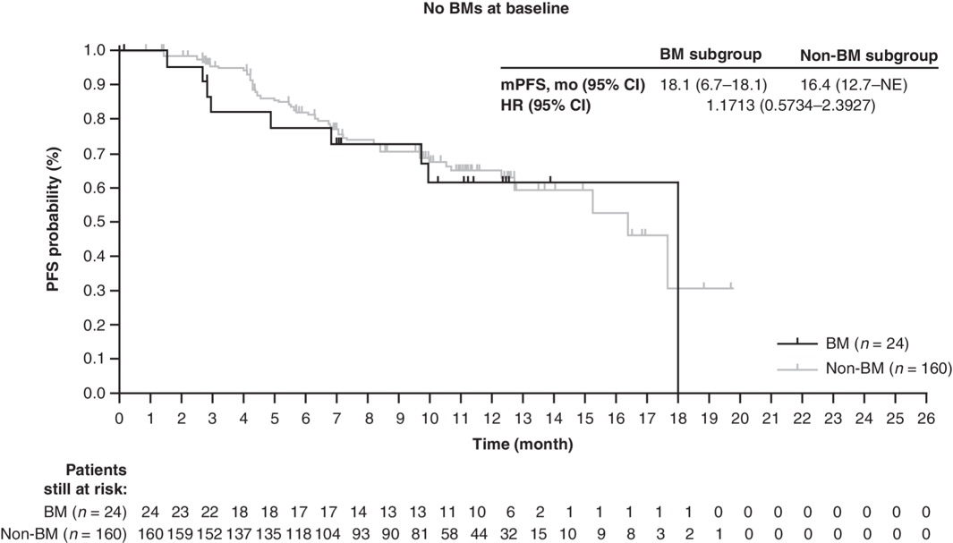
Trastuzumab Deruxtecan (T-DXd) Showed Impressive Disease Control in Patients with Stable HER2+ Brain Metastases
DESTINY BREAST 01- Subgroup Analysis of Stable Brain Metastases

Slide 8
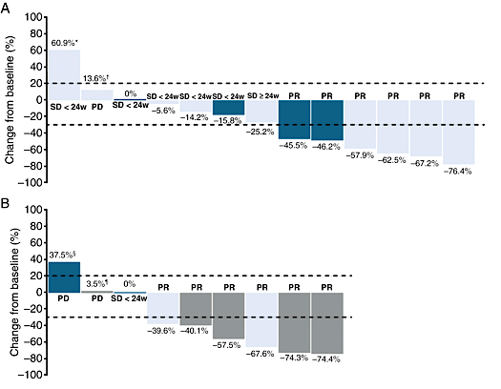
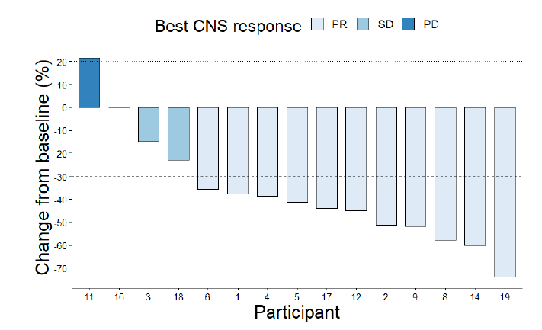
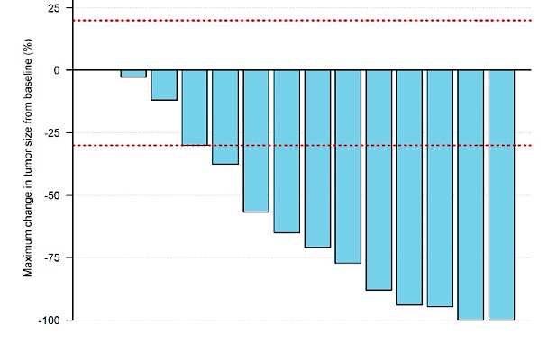
T-DXd has Recently Shown Striking Response in HER2+ Active Brain Metastases
Debbrah: T-DXd
Real-life Cohort with T-DXd
Tuxedo: T-DXd
CNS ORR 50% HER2+
CNS ORR 33%; HER2-Low (N=6)
CNS ORR 73%
CNS ORR 73%
Active= untreated or progressive despite radiation therapy

Slide 9
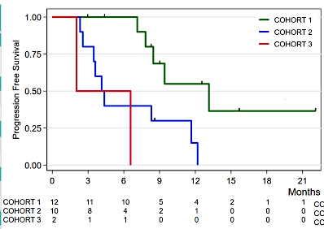
Small Subsets of Stable HER2-Low Brain Metastases Patients on T-DXd Have Been Reported
DAISY CLINICAL TRIAL, N= 177 analyzed, 24 with stable BMs
Table 1. Baseline characteristics of patients with BMs
 | Overall n=24 | Cohort 1 n=12 | Cohort 2 n=10 | Cohort 3 n=2
Confirmed BOR % (n) [95% Cl] | 62.5 (15/24) [40.6-81.2] | 91.7 (11/12) [61.5-99.8] | 30 (3/10) [6.7-65.2] | 50 (1/2) [1.3-98.7]
CBR % (n) [95% Cl] | 70.8 (17/24) [48.9-87.4] | 91.7 (11/12) [61.5-99.8] | 50 (5/10) [18.7-81.3] | 50 (1/2) [1.3-98.7]
mPFS (months) [95% Cl] | 8.5 [4.4-12.2] | 13 [7.1-NR] | 4.1 [2.3-11.7] | NA [2.0-NR]
Death, % (n) | 29.2 (7/24) | 25.0 (3/12) | 40 (4/10) | 0 (0/2)
N=10 patients in Cohort 2 had stable HER2-low brain metastases

Slide 10
Ongoing Research Studying ADCs in Patients with Brain Metastases
Antibody-Drug Conjugate | Mechanism of Action | NCT # (Phase)
Ladiratuzumab vedotin | Zinc transporter LIV-1-directed antibody with monomethyl auristatin E payload | 03310957 (II)
Patritumab deruxtecan | HER3-directed antibody with topoisomerase I inhibitor payload | 05620914 (I)
Sacituzumab govitecan | TROP2-directed antibody with topoisomerase inhibitor payload | 04647916 (II)
Trastuzumab deruxtecan | HER2-directed antibody with topoisomerase I inhibitor payload | 04538742 (I/II) 04752059 (II) 04420598 (II) 04739761 (III)
Trastuzumab duocarmazine | HER2-directed antibody with duocarmycin payload | 03262935 (III)

Slide 11
Looking for more resources on this topic?
CME/CE in minutes
Congress highlights
Late-breaking data
Quizzes
Webinars
In-person events
Slides & resources
www.MedEdOTG.com

