Slide 1
HER2 & PD-L1: Exploring Clinical Characteristics of G/GEJ Cancers in Relation to Biomarker Positivity
Yelena Y. Janjigian, MD
Chief
Gastrointestinal Oncology Service
Memorial Sloan Kettering Cancer Center
New York, NY

Slide 2
Resource Information
About This Resource
These slides are one component of a continuing education program available online at MedEd On The Go titled Navigating Challenges in Metastatic Gastric/GEJ Cancer Management: Advancements in Biomarker-Directed Therapies
Program Learning Objectives:
Describe relevant molecular biomarkers and how they relate to clinical characteristics of G/GEJ cancers
Discuss the impact molecular biomarkers have on treatment selection in metastatic G/GEJ cancers
Evaluate clinical data with current and investigational combination regimens for the first-line treatment of advanced G/GEJ cancers
Identify adverse effects associated with individual components of combination regimens and their prophylactic and management strategies in the setting of advanced or metastatic G/GEJ cancers
Implement strategies to provide holistic, multidisciplinary care for patients with advanced or metastatic G/GEJ cancers
Evaluate recent practice-changing data to inform treatment strategies for patients with G/GEJ cancers
MedEd On The Go®
www.mededonthego.com
This content or portions thereof may not be published, posted online or used in presentations without permission.
This content can be saved for personal use (non-commercial use only) with credit given to the resource authors.
To contact us regarding inaccuracies, omissions or permissions please email us at support@MedEdOTG.com

Slide 3
Disclaimer
The views and opinions expressed in this educational activity are those of the faculty and do not necessarily represent the views of Total CME, LLC, the CME providers, or the companies providing educational grants. This presentation is not intended to define an exclusive course of patient management; the participant should use their clinical judgment, knowledge, experience, and diagnostic skills in applying or adopting for professional use any of the information provided herein. Any procedures, medications, or other courses of diagnosis or treatment discussed or suggested in this activity should not be used by clinicians without evaluation of their patient's conditions and possible contraindications or dangers in use, review of any applicable manufacturer’s product information, and comparison with recommendations of other authorities. Links to other sites may be provided as additional sources of information.

Slide 4
Biomarker Positivity in Gastroesophageal Cancers
70%
Chromosomal Instability (CIN)
30% of CIN
ERBB2 amplified
20%
Genomic Stability (GS)
5%
Microsatellite Instable (MSI)
Epstein Bar Virus infection (EBV)
5%

Slide 5
Clinical Characteristics of HER2-Positive G/GEJ Cancers
Historically associated with poor survival outcomes¹
HER2 overexpression more common in2:
Esophagogastric junction tumors > stomach tumors
Intestinal subtypes > diffuse subtypes

Slide 6
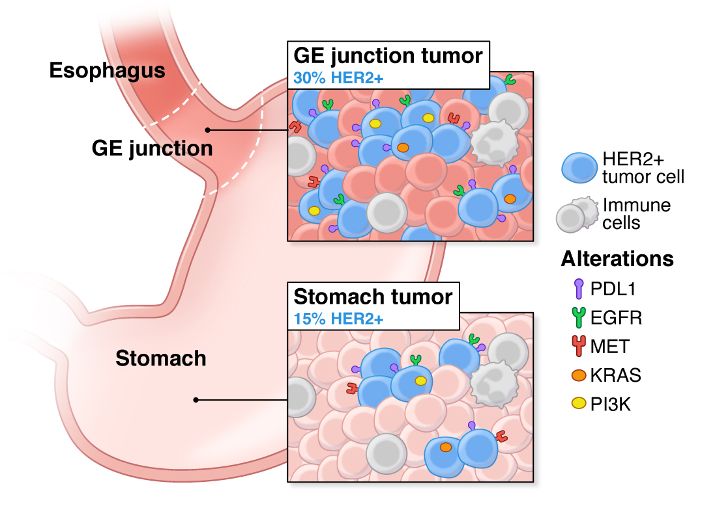
Co-expression and Heterogeneity is a Therapeutic Barrier in HER2+ Adenocarcinoma

Slide 7
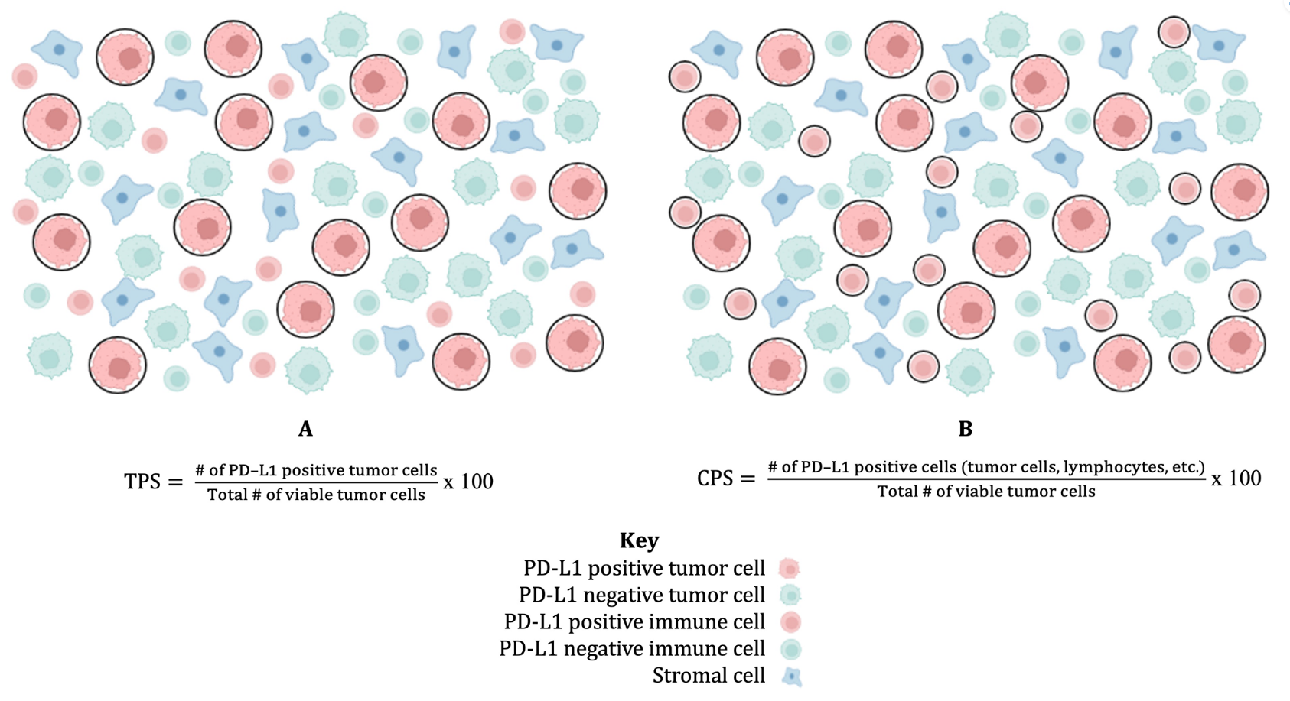
PD-L1 as a Biomarker in Gastric/GEJ Cancers
Approximately 60% of G/GEJ adenocarcinomas express PD-L1
PD-L1 expression on tumor cells is infrequent, with most of PD-L1 staining seen on immune cells within the stroma of the tumor
PD-L1 testing in upper gastrointestinal cancers is reported as CPS to include all the cell types that stain positively, in contrast to TPS
Despite the initial potential shown by CPS, there have been inconsistent responses to immunotherapy by PD-L1 expression level
Using CPS and TPS for Scoring PD-L1 Immunostaining

Slide 8
MMR/MSI as a Biomarker in Gastric/GEJ Cancers
MSI is a marker of dMMR
Esophageal adenocarcinoma
Up to 5% are MSI-H
Histologically distinct: have increased TILs and high-grade histology, such as medullary, mucinous or signet-ring cell subtype
Gastric adenocarcinoma
Approximately 6% are MSI-H
Observed in older females, tumors located in the antrum, intestinal subtype, early stage disease
Associated with a better prognosis

Slide 9
Summary
Biomarker driven therapy with anti-PD-1 and HER2-targeted agents improves survival & transforms patient lives
HER2 and PD-L1 will continue to impact long term outcomes
Greater magnitude of benefit in biomarker enriched populations
Critical to continue to test for HER2, MSI, PD-L1 and ctDNA

Slide 10
Looking for more resources on this topic?
CME/CE in minutes
Congress highlights
Late-breaking data
Quizzes
Webinars
In-person events
Slides & resources
www.MedEdOTG.com

