Slide 1
What Are the Data Supporting First Line C3 Inhibitor Treatment of PNH?
Carlos M. de Castro, MD
Professor of Medicine
Duke University School of Medicine, Division of Malignant Hematology and Cellular Therapy
Duke Cancer Institute,
Durham, NC

Slide 2



Resource Information
About This Resource
These slides are one component of a continuing education program available online at MedEd On The Go titled Reconsidering First Line PNH Treatment: Is There a Standard of Care?
Program Learning Objectives:
Explain the advantages and limitations of each FDA-approved complement inhibitor in the first-line treatment of PNH
Evaluate recent practice-changing data in first-line complement inhibitor treatment of PNH
Recognize and manage treatment-related adverse events associated with the use of complement inhibitors
MedEd On The Go®
www.mededonthego.com
This content or portions thereof may not be published, posted online or used in presentations without permission.
This content can be saved for personal use (non-commercial use only) with credit given to the resource authors.
To contact us regarding inaccuracies, omissions or permissions please email us at support@MedEdOTG.com

Slide 3
Disclaimer
The views and opinions expressed in this educational activity are those of the faculty and do not necessarily represent the views of Total CME, LLC, the CME providers, or the companies providing educational grants. This presentation is not intended to define an exclusive course of patient management; the participant should use their clinical judgment, knowledge, experience, and diagnostic skills in applying or adopting for professional use any of the information provided herein. Any procedures, medications, or other courses of diagnosis or treatment discussed or suggested in this activity should not be used by clinicians without evaluation of their patient's conditions and possible contraindications or dangers in use, review of any applicable manufacturer’s product information, and comparison with recommendations of other authorities. Links to other sites may be provided as additional sources of information.

Slide 4
Clinical Impact of Extravascular Hemolysis
Complement-mediated Intravascular Hemolysis
Consequences
Increased LDH
Anemia
Hemoglobinuria
Nitrous Oxide Squelching
Fatigue
PNH RBC
No Eculizumab Treatment
Eculizumab Treatment
Consequences
Increased LDH
Anemia
Fatigue
PNH RBC Survival
C3b Deposition, Possible Extravascular Hemolysis

Slide 5


Complement Activation: Current and Emerging Targets
Classical
Pathway
Lectin
Pathway
Danicopan
BCX9930
Alternative
Pathway
Iptacopan
Pegcetacoplan
C3
Activated MBL
CD55, CFH
C3_{H2O}
C3_{H20}
Tickover
C1qrs
CD55
B
D + B
D +
Proximal
Antibody
C4b2a
C3
C3bBb
C3b
C3_{H2O} Bb
C3
CFI/MCP
Ba
C3
Amplification
Weak Anaphylatoxin
Eculizumab Ravulizumab Crovalimab
C3b
C3bi
CR3
Microbial Opsonization
Immune Complex Clearance
C3a
CFI, CFH
C5-convertase
Membrane attack complex formation leads to:
Prothrombotic & proinflammatory environment
Cell lysis
Cell activation
C5
Prothrombotic
Potent anaphylatoxin
Chemotaxis
Cell activation
Proinflammatory
Terminal
C5a
C5b
C6
C7
C8
C9
Terminal Complement Complex
CD59
Clinical consequences of chronic hemolysis

Slide 7
Proximal Complement Inhibitors Pegcetacoplan
Pegcetacoplan is a pegylated pentadecapeptide that targets C3. Administered by SQ pump twice a week
PEGASUS is a phase 3, randomized, multicenter trial comparing pegcetacoplan to eculizumab in PNH patients on eculizumab with an Hgb <10.5
Primary endpoint was the change in Hgb at week 16
Pegcetacoplan was superior to eculizumab in improving Hgb levels and other clinical outcomes
Adverse events include injection site reactions, diarrhea (mild), and breakthrough hemolysis.
FDA approved May 2021

Slide 9
PEGASUS: Secondary Endpoints

Slide 10
PEGASUS:
Safety Outcomes
Breakthrough hemolysis reported in 13 patients
  9 eculizumab
  4 pegcetacoplan
3 patients in pegcetacoplan group discontinued due to TEAE of hemolysis
  Included 1 SAE
Injection site reactions: mostly mild
  None led to change in dose or study discontinuation
Diarrhea mostly mild (1 moderate)
  No dose changes due to diarrhea

Slide 11
PEGASUS Trial Conclusions
In patients with persistent anemia despite eculizumab therapy, pegcetacoplan was superior to eculizumab with respect to:
  Change from baseline to week 16 Hgb level
  Provided improvements in key hematologic and clinical variables, such as freedom from transfusion
Adverse effects included injection-site irritation and mild diarrhea
In this population, treating intravascular hemolysis as well as preventing extravascular hemolysis by proximal complement inhibition with pegcetacoplan may result in better control of disease than treatment with eculizumab

Slide 12
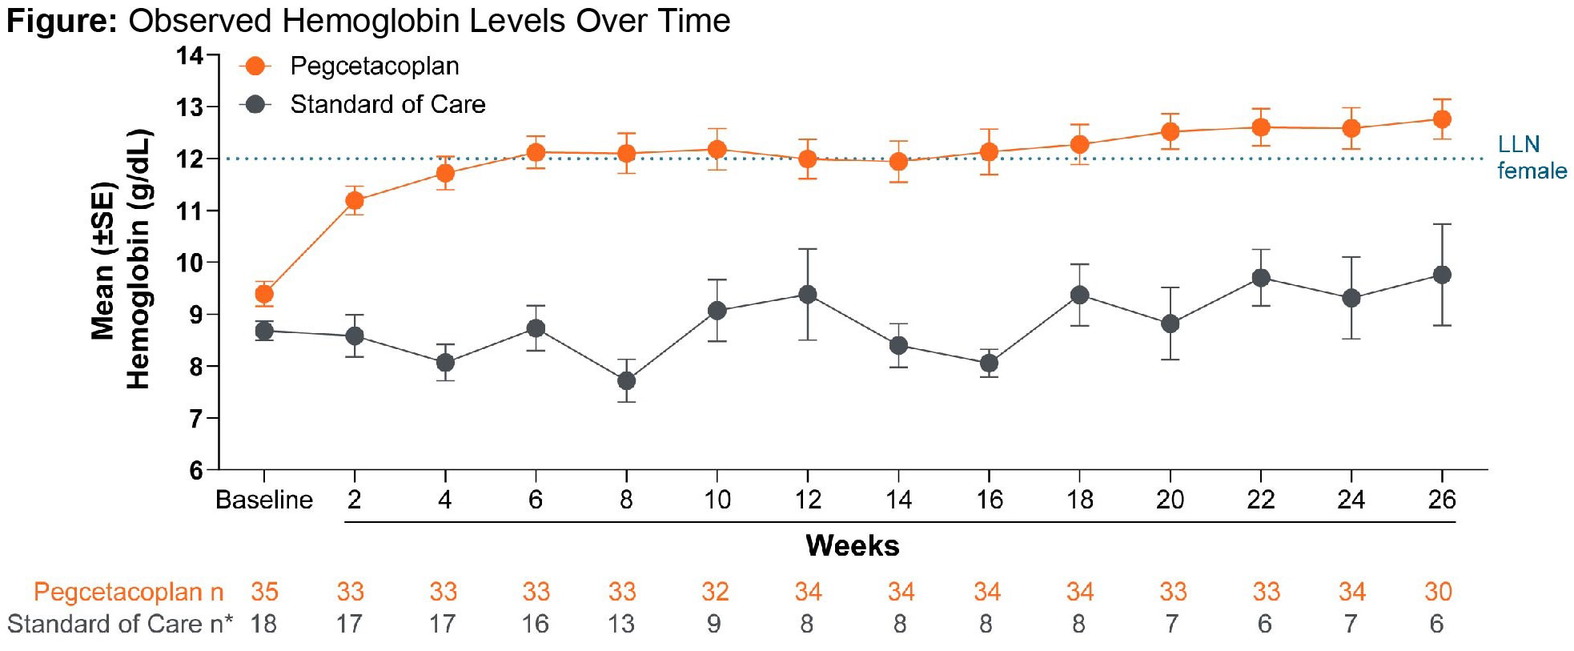
PRINCE
The PRINCE study is investigating pegcatcoplan in complement inhibitor naïve patients.

Slide 13



Looking for more resources
on this topic?
CME/CE in minutes
Congress highlights
Late-breaking data
Quizzes
Webinars
In-person events
Slides & resources
www.MedEdOTG.com

