Slide 1
What Are the Data Supporting First Line C5 Inhibitor Treatment of PNH?
Catherine Broome, MD
Associat Professor
Medicine MedStar Georgetown University Lombardi Cancer Center
Washington, DC

Slide 2



Resource Information
About This Resource
These slides are one component of a continuing education program available online at MedEd On The Go titled Reconsidering First Line PNH Treatment: Is There a Standard of Care?
Program Learning Objectives:
Explain the advantages and limitations of each FDA-approved complement inhibitor in the first-line treatment of PNH
Evaluate recent practice-changing data in first-line complement inhibitor treatment of PNH
Recognize and manage treatment-related adverse events associated with the use of complement inhibitors
MedEd On The Go®
www.mededonthego.com
This content or portions thereof may not be published, posted online or used in presentations without permission.
This content can be saved for personal use (non-commercial use only) with credit given to the resource authors.
To contact us regarding inaccuracies, omissions or permissions please email us at support@MedEdOTG.com

Slide 3
Disclaimer
The views and opinions expressed in this educational activity are those of the faculty and do not necessarily represent the views of Total CME, LLC, the CME providers, or the companies providing educational grants. This presentation is not intended to define an exclusive course of patient management; the participant should use their clinical judgment, knowledge, experience, and diagnostic skills in applying or adopting for professional use any of the information provided herein. Any procedures, medications, or other courses of diagnosis or treatment discussed or suggested in this activity should not be used by clinicians without evaluation of their patient's conditions and possible contraindications or dangers in use, review of any applicable manufacturer’s product information, and comparison with recommendations of other authorities. Links to other sites may be provided as additional sources of information.

Slide 4
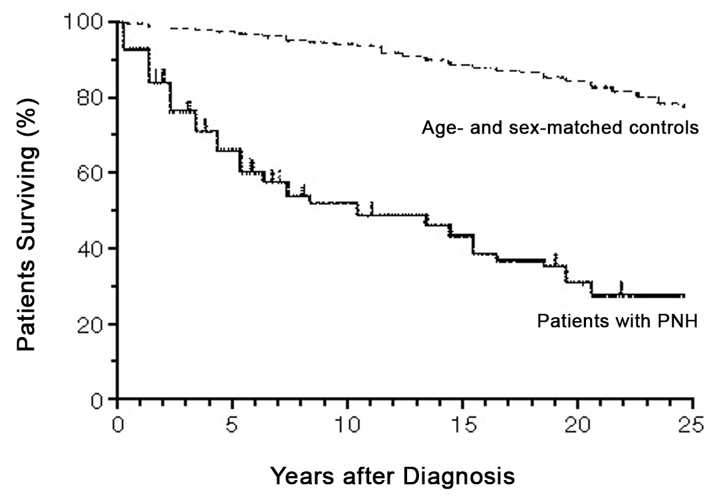
Natural History of PNH

Slide 5
TRIUMPH and SHEPHARD TRIALS for PNH
Patient with PNH
Evidence of Hemolysis
Transfusions
TRIUMPH
SHEPHARD
Patients N=87
Randomized, Multicenter, Double-Blind, Placebo-Controlled
Primary Endpoints
Stabilization of hemoglobin levels
Number of units of packed red cells transfused
Other Endpoints
Fatigue and QoL
Transfusion avoidance
Hgb levels
Hemolysis
Thromboembolic events
PNH RBCs
Patients N=97
Open-Label,
Minimal Transfusions
Lower platelet cut off
Primary Endpoints
Hemolysis as assessed by LDH area under the curve (AUC)
Safety
Other Endpoints
Hgb levels
Transfusions
Thromboembolic events
Fatigue and QoL
PNH RBCs

Slide 6
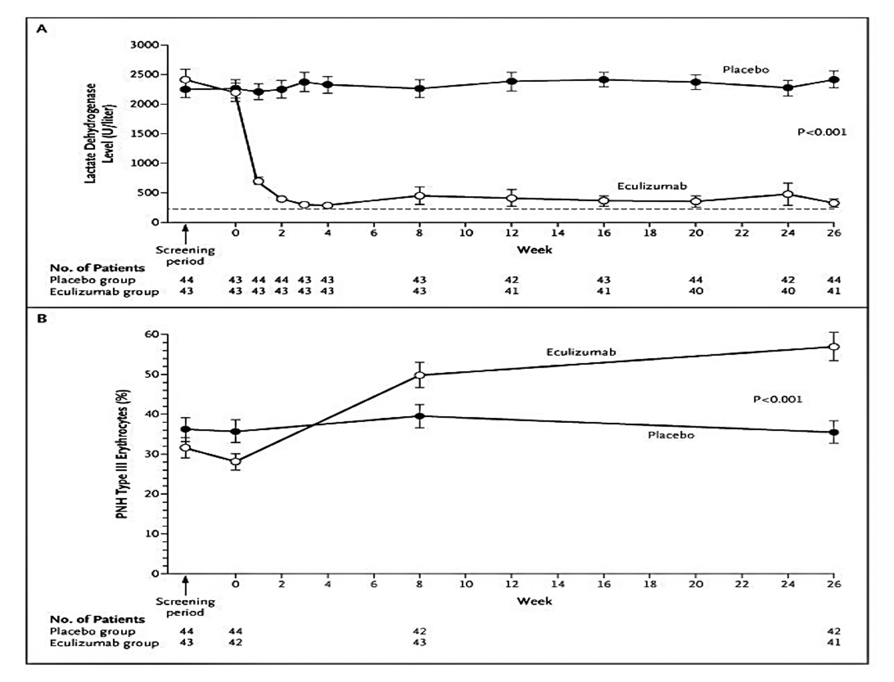
TRIUMPH
The effect of eculizumab on chronic intravascular hemolysis was demonstrated by an immediate (1 week) and sustained decrease in lactate dehydrogenase levels
The median value of the areas under the curve for lactate dehydrogenase plotted against time (in days) was 85.8% lower in the eculizumab group than in the placebo group (58,587 vs. 411,822 U/liter; P<0.001)

Slide 7
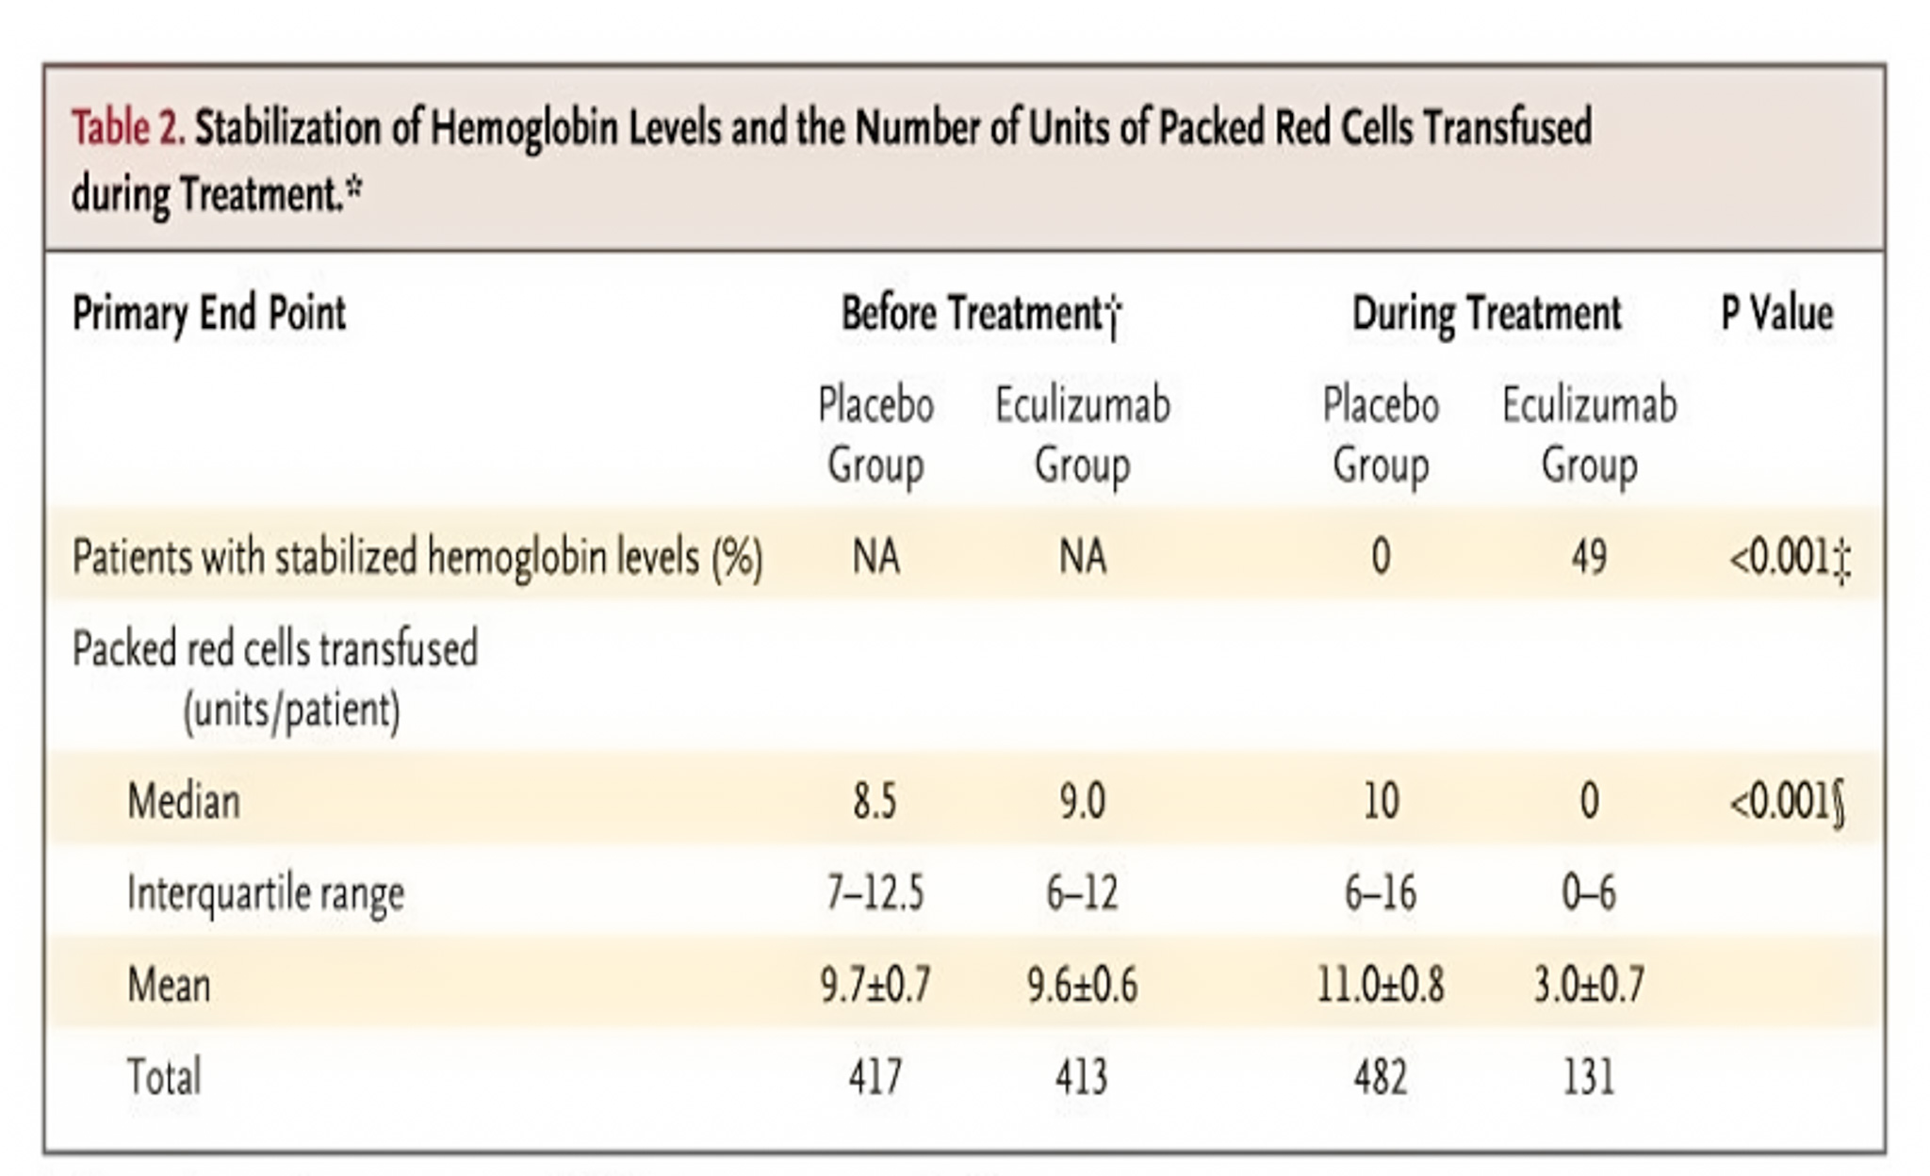
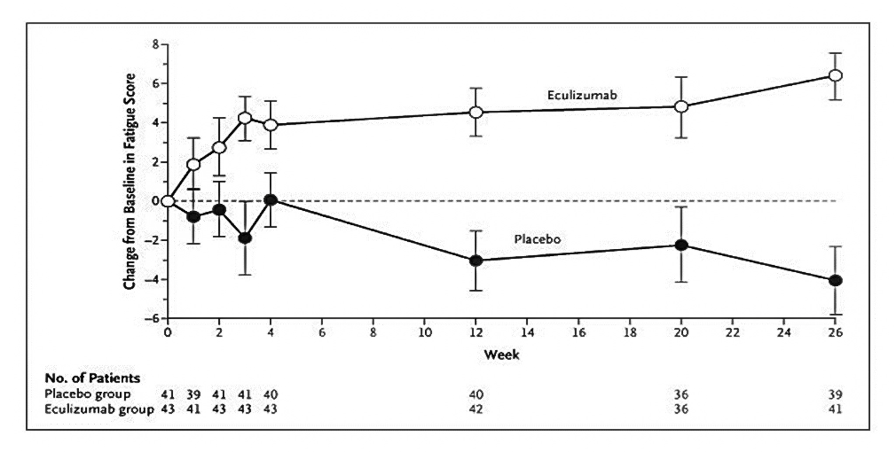
TRIUMPH
At the end of the treatment period, 49% of patients in the eculizumab group (21 of 43) had levels of hemoglobin that remained above the prespecified set point (median, 7.7 g per deciliter for both groups) in the absence of transfusions, whereas stabilization of hemoglobin levels did not occur in any patient in the placebo group (P<0.001)
By week 26, the median number of units of packed red cells transfused per patient was 0 in the eculizumab group and 10 in the placebo group (P<0.001)
Patients in the eculizumab group had a mean increase (improvement) in scores on the FACIT-Fatigue instrument of 6.4±1.2 points from baseline to week 26, whereas in the placebo group the mean score decreased by 4.0±1.7 points during this period, for a total difference between the two groups
of 10.4 point

Slide 8
SHEPARD
89 of 97 patients maintained complete inhibition of serum hemolytic activity with every 14-day dosing throughout the duration of the treatment period
Every patient treated with eculizumab had a substantial reduction in hemolysis as measured by levels of LDH. The primary efficacy end point of LDH AUC was significantly reduced compared with baseline with a median change of − 632 264 U/L × day (P < .001). Lactate dehydrogenase was reduced from a mean of 2201 ± 105 U/L at baseline to 297 ± 21 U/L at 52 weeks (P < .001, mixed model analysis)

Slide 9
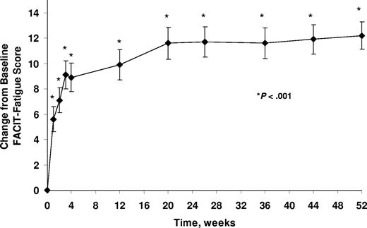
SHEPARD
Change from baseline in FACIT-Fatigue scores (mean ± SE)
during eculizumab treatment

Slide 10
The 301 Study
This phase 3, open-label study assessed the noninferiority of ravulizumab to eculizumab in complement inhibitor-naive adults with PNH Patients with LDH ≥1.5 times the upper limit of normal and at least 1 PNH symptom were randomized 1:1 to receive ravulizumab or eculizumab for 183 days
Coprimary efficacy end points were proportion of patients remaining transfusion-free and LDH normalization. Secondary end points were percent change from baseline in LDH, change from baseline in FACIT-Fatigue score, proportion of patients with breakthrough hemolysis, stabilized hemoglobin, and change in serum free C5
Ravulizumab was noninferior to eculizumab for both coprimary and all key secondary end points (P_{inf} < .0001)

Slide 11
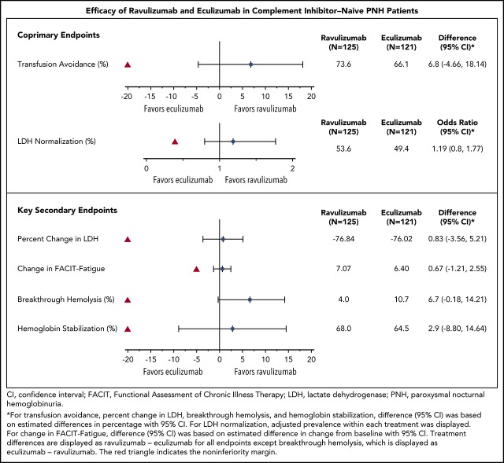
301 Study Results

Slide 12

Eculizumab Has a Major Impact on Survival in PNH
Survival is comparable to age- and gender-matched control population out to 8 years
100
80
n = 79
Age- and sex-matched normal population
60
Eculizumab treated
40
Cumulative surviving (%)
20
0
0
1
2
3
4
5
6
7
8
9
Time (years)
96% (76/79) patient survival
There was no difference in mortality between patients on eculizumab and the normal population (P=0.46)

Slide 13



Looking for more resources
on this topic?
CME/CE in minutes
Congress highlights
Late-breaking data
Quizzes
Webinars
In-person events
Slides & resources
www.MedEdOTG.com

