Slide 1
What Is the Impact of First Line PNH Treatment Choice on Risk of Thrombosis?
Carlos M. de Castro, MD
Professor of Medicine
Duke University School of Medicine, Division of Malignant Hematology and Cellular Therapy
Duke Cancer Institute
Durham, NC

Slide 2



Resource Information
About This Resource
These slides are one component of a continuing education program available online at MedEd On The Go titled Reconsidering First Line PNH Treatment: Is There a Standard of Care?
Program Learning Objectives:
Explain the advantages and limitations of each FDA-approved complement inhibitor in the first-line treatment of PNH
Evaluate recent practice-changing data in first-line complement inhibitor treatment of PNH
Recognize and manage treatment-related adverse events associated with the use of complement inhibitors
MedEd On The Go®
www.mededonthego.com
This content or portions thereof may not be published, posted online or used in presentations without permission.
This content can be saved for personal use (non-commercial use only) with credit given to the resource authors.
To contact us regarding inaccuracies, omissions or permissions please email us at support@MedEdOTG.com

Slide 3
Disclaimer
The views and opinions expressed in this educational activity are those of the faculty and do not necessarily represent the views of Total CME, LLC, the CME providers, or the companies providing educational grants. This presentation is not intended to define an exclusive course of patient management; the participant should use their clinical judgment, knowledge, experience, and diagnostic skills in applying or adopting for professional use any of the information provided herein. Any procedures, medications, or other courses of diagnosis or treatment discussed or suggested in this activity should not be used by clinicians without evaluation of their patient's conditions and possible contraindications or dangers in use, review of any applicable manufacturer’s product information, and comparison with recommendations of other authorities. Links to other sites may be provided as additional sources of information.

Slide 4
Thrombosis (Blood clots) in PNH
Thrombosis is the most feared complication of PNH
Occurs in 40% of patients
Contributes to end organ damage- lungs, liver, kidney
Leading cause of death
  Accounts for 40–67% of deaths
  First TE increases risk for death 5- to 10-fold
Thrombosis can be the presenting symptom
First thrombotic event can be fatal
May be correlated with the size of the WBC clone
May occur in unusual locations

Slide 5
Thrombosis in PNH
Arterial / MI
Arterial / CVA
2%
DVT: leg
14%
18%
Superficial
4%
Cerebral
6%
DVT: other
PE
15%
7%
Hepatic / portal
Mesenteric / splenic
16%
18%

Slide 6
Thrombotic Events
45
39
40
35
30
25
Thrombotic Events (#)
20
15
10
P = 0.0001
5
3
0
Pre-Eculizumab Treatment
Eculizumab Treatment
92% Fewer thrombotic events with eculizumab treatment
Majority of patients (63%) received concomitant anticoagulants
The effect of anticoagulant withdrawal was not studied
There were fewer thrombotic events with eculizumab treatment than during the same period of time prior to treatment.

Slide 7


Complement Activation: Current and Emerging Targets
Classical
Pathway
Lectin
Pathway
Danicopan
BCX9930
Alternative
Pathway
Iptacopan
Pegcetacoplan
C3
Activated MBL
CD55, CFH
C3_{H2O}
C3_{H20}
Tickover
C1qrs
CD55
B
D + B
D +
Proximal
Antibody
C4b2a
C3
C3bBb
C3b
C3_{H2O} Bb
C3
CFI/MCP
Ba
C3
Amplification
Weak Anaphylatoxin
Eculizumab Ravulizumab Crovalimab
C3b
C3bi
CR3
Microbial Opsonization
Immune Complex Clearance
C3a
CFI, CFH
C5-convertase
Membrane attack complex formation leads to:
Prothrombotic & proinflammatory environment
Cell lysis
Cell activation
C5
Prothrombotic
Potent anaphylatoxin
Chemotaxis
Cell activation
Proinflammatory
Terminal
C5a
C5b
C6
C7
C8
C9
Terminal Complement Complex
CD59
Clinical consequences of chronic hemolysis

Slide 8
Rates of Thrombosis During C5 Inhibitor Therapy
Eculizumab clinical trial thrombotic event rate 1.07 to 2.14 events / 100 patient years
  2.14 events / 100 patient years in 467.1 patient years1
  1.07 events / 100 patient years2
  UK Leeds rate of 0.8 events / 100 patient years3
Ravulizumab thrombosis rate 1.38 events / 100 patient years4

Slide 9
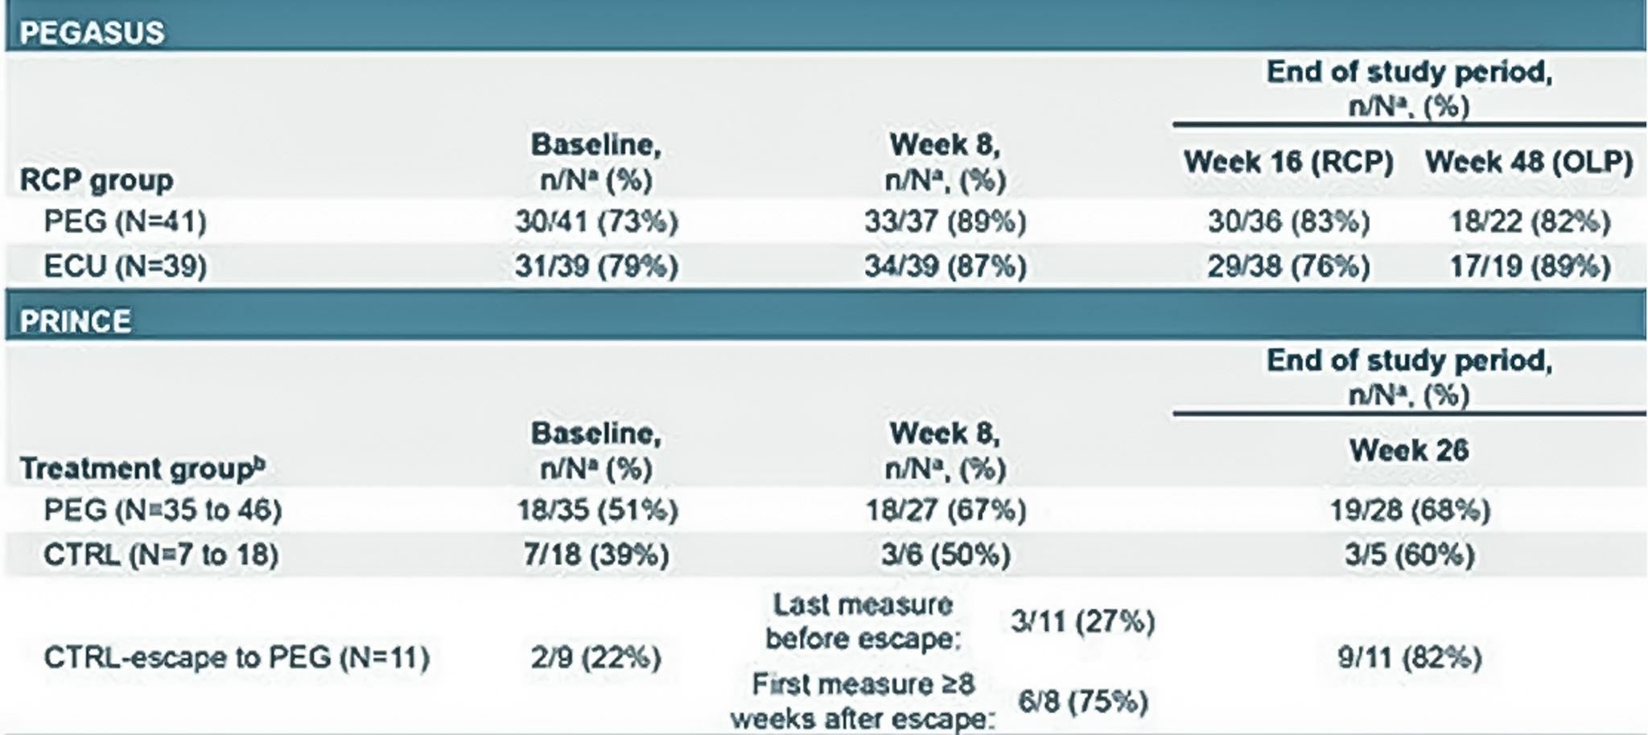
Rates of Thrombosis During C3 Inhibitor Therapy
307 Study
  Long-term pegcetacoplan extension for PNH patients on clinical trials
  Thrombotic events
    5 events during clinical trials, 1.22 events/100 patient years in 409.4 years
    2 events US post-marketing, 1.17 events/100 patients in 170.8 years
PEGASUS and PRINCE
  Post hoc analysis examined incidence of thrombosis, anti-thrombotic therapy, and D-dimer normalization in PNH patients treated with pegcetacoplan
  Pegcetacoplan: 1.54 events/100 patient years in 130 patient-years
  Eculizumab: 1.77 events/100 patient years for patients on ECU treatment before entry into PEGASUS

Slide 10
PEGCETACOPLAN – Real World Data
Since FDA approval in May 2021, pegcetacoplan appears to be effective and safe in treating patients with PNH
No increase in episodes of thrombosis compared to historical rates with C5 inhibition
No increase in meningococcal infections compared to historical rates with C5 inhibition
No increase in other infection rates
High compliance rates
Improvements in Hgb levels, transfusion requirements, and symptoms, and quality of life measures
High patient satisfaction levels
Presentation at the International PNH Interest Group Symposium, Harrogate, England, 2023

Slide 11



Looking for more resources
on this topic?
CME/CE in minutes
Congress highlights
Late-breaking data
Quizzes
Webinars
In-person events
Slides & resources
www.MedEdOTG.com

