Slide 1
Is Long-Term Complement Inhibition Safe and Effective in PNH?
Catherine Broome, MD
Associate Professor
Medicine MedStar Georgetown University Lombardi Cancer Center
Washington, DC

Slide 2



Resource Information
About This Resource
These slides are one component of a continuing education program available online at MedEd On The Go titled Reconsidering First Line PNH Treatment: Is There a Standard of Care?
Program Learning Objectives:
Explain the advantages and limitations of each FDA-approved complement inhibitor in the first-line treatment of PNH
Evaluate recent practice-changing data in first-line complement inhibitor treatment of PNH
Recognize and manage treatment-related adverse events associated with the use of complement inhibitors
MedEd On The Go®
www.mededonthego.com
This content or portions thereof may not be published, posted online or used in presentations without permission.
This content can be saved for personal use (non-commercial use only) with credit given to the resource authors.
To contact us regarding inaccuracies, omissions or permissions please email us at support@MedEdOTG.com

Slide 3
Disclaimer
The views and opinions expressed in this educational activity are those of the faculty and do not necessarily represent the views of Total CME, LLC, the CME providers, or the companies providing educational grants. This presentation is not intended to define an exclusive course of patient management; the participant should use their clinical judgment, knowledge, experience, and diagnostic skills in applying or adopting for professional use any of the information provided herein. Any procedures, medications, or other courses of diagnosis or treatment discussed or suggested in this activity should not be used by clinicians without evaluation of their patient's conditions and possible contraindications or dangers in use, review of any applicable manufacturer’s product information, and comparison with recommendations of other authorities. Links to other sites may be provided as additional sources of information.

Slide 4
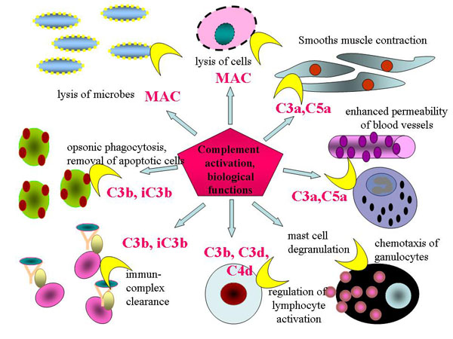
Complement Functions

Slide 5
C5 Inhibition for PNH Long-Term Safety
Adverse event | Patients, no. (%)
 | SHEPHERD |  |  | TRIUMPH |  | Long-term extension
 | Eculizumab |  |  | Eculizumab | Placebo | Eculizumab*
 | 52 wk, n = 97 | 1st 26 wk, n = 97 | 2nd 26 wk, n = 96 | 26 wk, n = 43 | 26 wk, n = 44 | N = 195
Headache | 51 (52.6) | 47 (48.5) | 14 (14.6) | 19(44.2) | 12(27.3) | 107 (54.9)
Nasopharyngitis | 31 (32.0) | 22 (22.7) | 15 (15.6) | 10(23.3) | 8(18.2) | 97 (49.7)
Upper respiratory tract infection | 29 (29.9) | 14 (14.4) | 18 (18.8) | 6(14.0) | 10(22.7) | 80 (41.0)
Nausea | 20 (20.6) | 16 (16.5) | 7 (7.3) | 7(16.3) | 5(11.4) | 63 (2.3)
Pyrexia | 19 (19.6) | 11 (11.3) | 10 (10.4) | - | - | 40 (20.5)
Back pain | 15 (15.5) | 7 (7.2) | 9 (9.4) | 8(18.6) | - | 48 (24.6)
Dizziness | 14 (14.4) | 10 (10.3) | 6 (6.3) | - | 5(11.4) | 39 (20.0)
Urinary tract infection | 13 (13.4) | 7 (7.2) | 7 (7.3) | - | - | 33 (16.9)
Arthralgia | 12 (12.4) | 10 (10.3) | 2 (2.1) | - | 5(11.4) | 43 (22.1)
Diarrhea | 12 (12.4) | 8 (8.2) | 6 (6.3) | - | 5(11.4) | 68 (34.9)
Abdominal pain | 11 (11.3) | 9 (9.3) | 2 (2.1) | - | 5(11.4) | 43 (22.1)
Myalgia | 10 (10.3) | 9 (9.3) | 3 (3.1) | - | - | 29 (14.9)
Vomiting | 10 (10.3) | 8 (8.2) | 4 (4.2) | - | 5(11.4) | 50 (25.6)
Cough | - | - | - | 5(11.6) | - | 39 (20.0)
Fatigue | - | - | - | 5(11.6) | - | 25 (12.8)
Oropharyngeal pain | - | - | - | - | - | 42 (21.5)
Pain in extremity | - | - | - | - | - | 39 (20.0)
Influenza-like illness | - | - | - | - | - | 34 (17.4)
Viral infection | - | - | - | - | - | 30 (15.4)
Constipation | - | - | - | - | - | 29 (14.9)
Contusion | - | - | - | - | - | 29 (14.9)
Abdominal pain upper | - | - | - | - | - | 24 (12.3)
Insomnia | - | - | - | - | - | 23 (11.8)
Sinusitis | - | - | - | - | - | 23 (11.8)
Epistaxis | - | - | - | - | - | 21 (10.8)
Edema peripheral | - | - | - | - | - | 20 (10.3)
Pruritus | - | - | - | - | - | 20 (10.3)
Rash | - | - | - | - | - | 20 (10.3)
The probability of a patient experiencing one or more AEs was significantly lower in the last 6 months of eculizumab treatment than in the first 6 months, suggesting that no cumulative toxicity is associated with long-term administration of eculizumab
However, although serious infection-related AEs were not fatal, patients under eculizumab treatment should be closely monitored throughout treatment

Slide 6
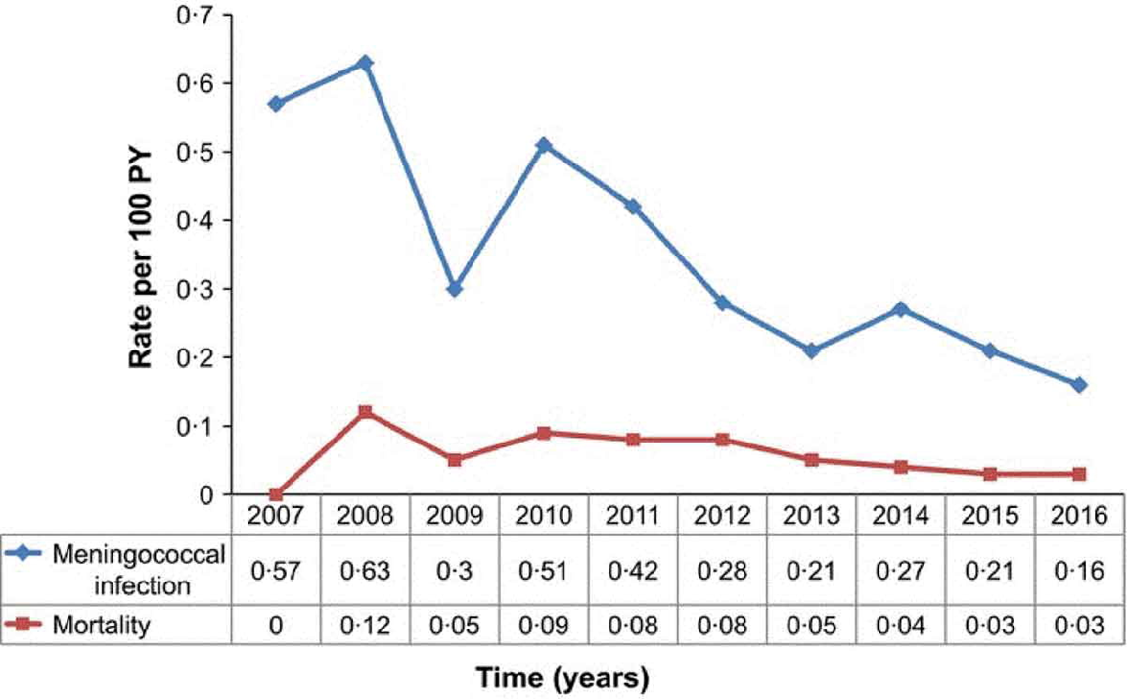
C5 Inhibition for PNH Long-Term Safety
Seventy‐six cases of meningococcal infection were reported, representing an overall rate of 0.25 reports per 100 PY (0.24 per 100 PY for PNH and 0.29 per 100 PY for aHUS). There were eight fatal cases of meningococcal infection (by serotype B in two, X, C, and Y in one each, unknown in three) (0.03 per 100 PY), all of which occurred in patients with PNH. All eight patients had received a meningococcal vaccination, although not against
all serotypes

Slide 7
C5 Inhibition for PNH Long-Term Safety
Serious non-meningococcal infection rate per 100 PY | 5.8
Causal organism NOS, (%) of total infections | 62.8
Bacterial infection (%) | 22.8
Viral infection (%) | 11.2
Fungal infection (%) | 2.4
Sepsis among infections (%) | 11.7
Solid tumor and hematological malignancy rate per 100 PY | 2.6
Hematological tumors, (%) of total malignancies | 53*
Leukemia, (%) of hematological tumors | 90
Lymphomas (%) | 6.2
Other NOS (%) | 3.8
Solid tumors, (%) of total malignancies | 47
Gastrointestinal, (%) of solid tumors | 17
Skin (%) | 15.2†
Reproductive (%) | 12.2
Breast (%) | 9.2
Other (%) | 46.4

Slide 8
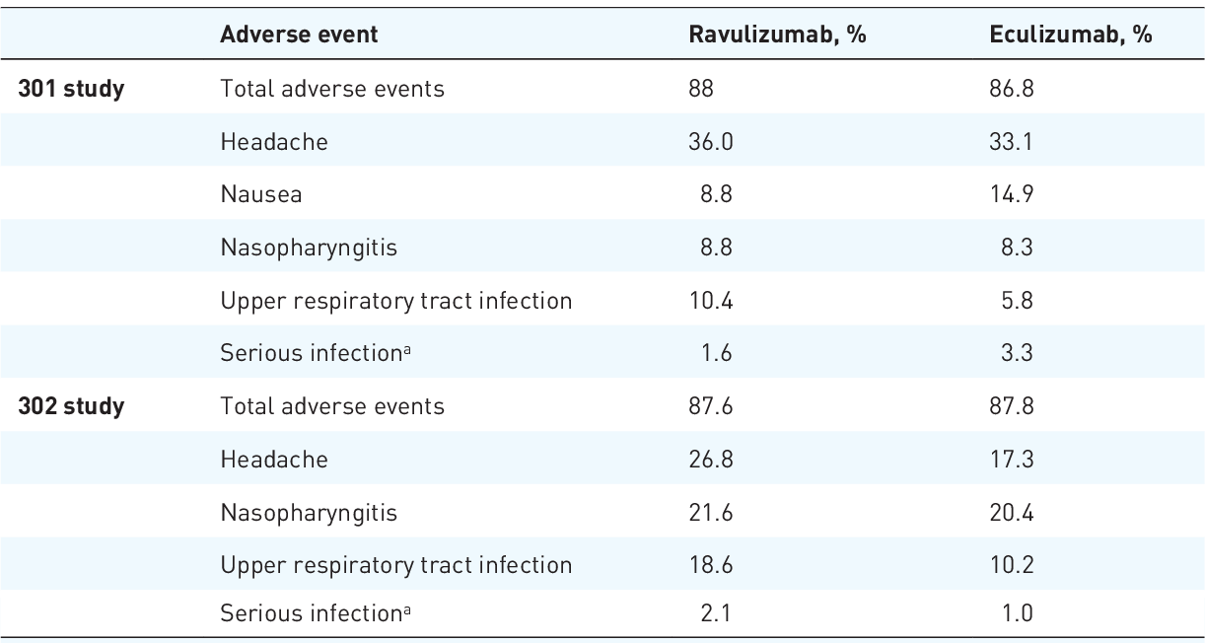
Reported Adverse Events From the Ravulizumab Phase III Clinical Trials

Slide 9
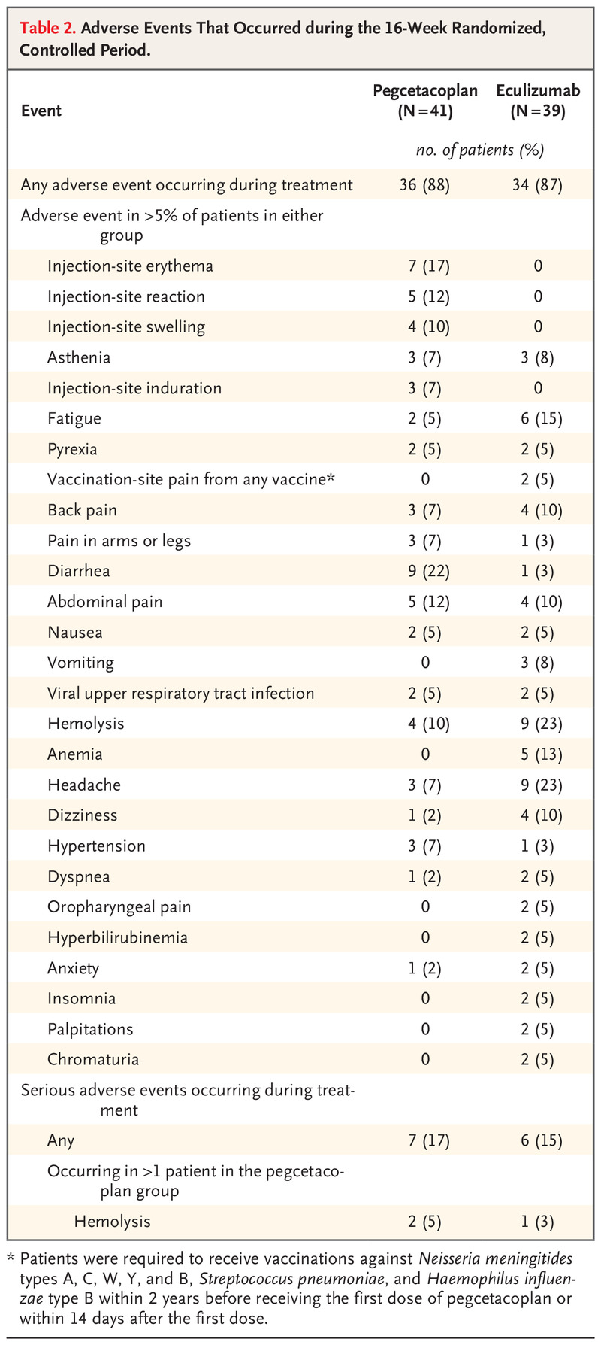
Long-Term Safety C3 Inhibition for PNH

Slide 10
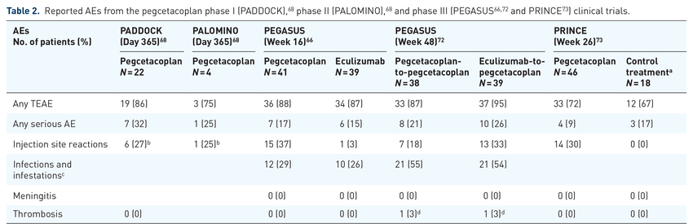
Long-Term Safety C3 Inhibition for PNH

Slide 11



Looking for more resources
on this topic?
CME/CE in minutes
Congress highlights
Late-breaking data
Quizzes
Webinars
In-person events
Slides & resources
www.MedEdOTG.com

