Slide 1
Patient Case: How Would You Treat a Newly Diagnosed PNH Patient With Near Normal Hgb?
Catherine Broome, MD
Associate Professor
Medicine MedStar Georgetown University Lombardi Cancer Center
Washington DC

Slide 2
Resource Information
About This Resource
These slides are one component of a continuing education program available online at MedEd On The Go titled Reconsidering First Line PNH Treatment: Is There a Standard of Care?
Program Learning Objectives:
Explain the advantages and limitations of each FDA-approved complement inhibitor in the first-line treatment of PNH
Evaluate recent practice-changing data in first-line complement inhibitor treatment of PNH
Recognize and manage treatment-related adverse events associated with the use of complement inhibitors
MedEd On The Go®
www.mededonthego.com
This content or portions thereof may not be published, posted online or used in presentations without permission.
This content can be saved for personal use (non-commercial use only) with credit given to the resource authors.
To contact us regarding inaccuracies, omissions or permissions please email us at support@MedEdOTG.com

Slide 3
Disclaimer
The views and opinions expressed in this educational activity are those of the faculty and do not necessarily represent the views of Total CME, LLC, the CME providers, or the companies providing educational grants. This presentation is not intended to define an exclusive course of patient management; the participant should use their clinical judgment, knowledge, experience, and diagnostic skills in applying or adopting for professional use any of the information provided herein. Any procedures, medications, or other courses of diagnosis or treatment discussed or suggested in this activity should not be used by clinicians without evaluation of their patient's conditions and possible contraindications or dangers in use, review of any applicable manufacturer’s product information, and comparison with recommendations of other authorities. Links to other sites may be provided as additional sources of information.

Slide 4
Patient Case
34-year-old female presents with several months of fatigue, mild DOE and superficial thrombophlebitis in lower extremities bilaterally
Lab reveals: Hgb 10.4 g/dL, normal WBC count and platelets, LDH 550 units/L, retic count 5.7%, DAT negative. Total bili 3.4 mg/dL
Peripheral smear –unremarkable
Flow cytometry WBC PNH clone 10.2% RBC clone 5.3%

Slide 5
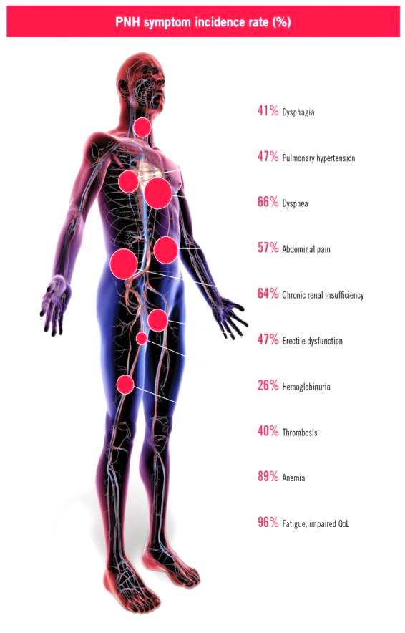
Common Symptoms in Patients with PNH
PNH Symptom Incidence Rate (%)
41% Dysphagia
47% Pulmonary Hypertension
66% Dyspnea
57% Abdominal Pain
64% Chronic Renal Insufficiency
47% Erectile dysfunction
26% Hemoglobinuria
39% Thrombosis
88% Anemia
96% Fatigue, Impaired QoL

Slide 6
Conceptual Model of PNH
Fatigue
Abdominal pain
Headaches
Shortness of breath
Difficulty swallowing
Erectile dysfunction
Hemoglobinuria
Cardiovascular symptoms (e.g., chest pain, irregular heartbeat)
Cognitive symptoms (e.g., confusion, poor concentration, dizziness)
Bruising/bleeding
Back pain
Leg pain
Impacts of PNH:
Preoccupation with disease
E.g., thoughts center around disease, disease center of life
Emotional impacts
E.g., fear, loss of lightheartedness, stress, helplessness
Physical impacts
E.g., trouble walking, jogging, standing
Impacts on ADLs
E.g., problems getting household work done
Impacts on relationship
E.g., support from family/friends
PNH Symptoms:
Impacts on illness perceptions
E.g., losing control of own body, visible symptoms remind me I'm sick
Impact on work/school life
E.g., problems with work, no flexibility in planning studies
Overall quality of life
E.g., normal rhythm of life affected, missing something in life, future prospects limited

Slide 7
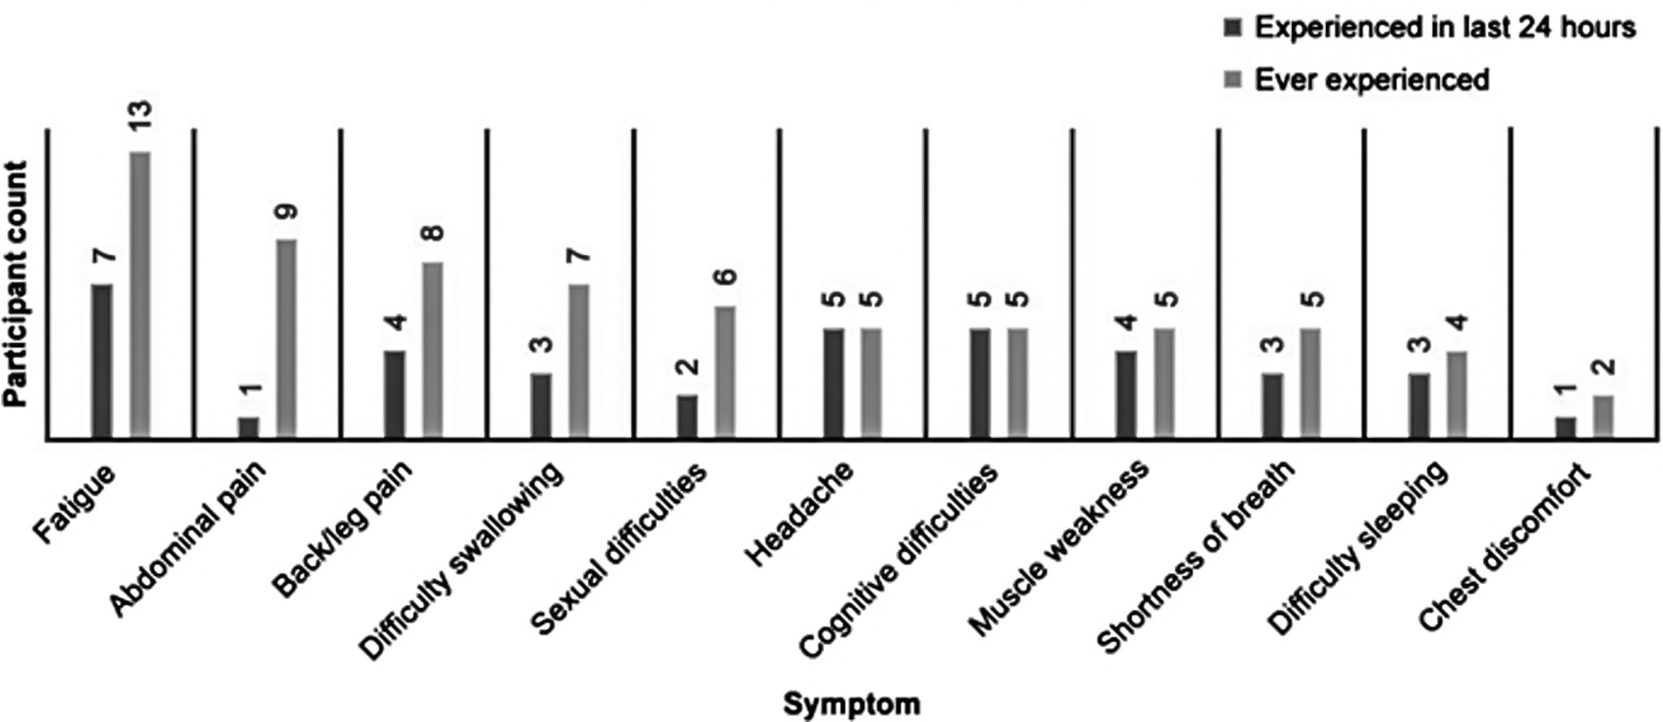
Comparison of Symptoms Ever Experienced Vs. Experienced in the Last 24 Hours

Slide 8
Laboratory Features of PNH
Hypocellular, normocellular or hypercellular bone marrow often with erythroid hyperplasia
May see erythroid dysplasia
Iron deficiency
Low serum iron, low ferritin, increased transferrin, absent bone marrow iron
Creatinine and blood urea nitrogen (BUN) may be increased from acute and/or chronic renal damage
Liver function tests may be abnormal due to hepatic or portal vein thrombosis
Mild reduction in blood counts may occur due to splenomegaly caused by portal vein thrombosis or splenic vein thrombosis

Slide 9
Effects of Uncontrolled or Excessive Complement Activation
Lysis of red blood cells-HEMOLYSIS¹
Activation of platelets^{2,3}
Endothelial activation, especially in the kidneys⁴
Cytokine activation^{1,5}
Result: hemolysis, venous thrombosis, microvascular thromboses, and potential renal effects^{1,2,4-6}

Slide 10
Thrombosis in PNH
Thrombosis in PNH leads to severe morbidity and is the most common cause of mortality
Venous thrombosis is more common than arterial thrombosis
Thrombosis may occur in any PNH patient, but those with a large percentage of PNH cells (>50% WBC) have the greatest risk
The 10-year risk of thrombosis for those with >50% clone is 44%, whereas it is only 5.8% in patients with <50% clone

Slide 11
Mechanisms for Thrombosis in PNH
Multifactorial pathogenesis of thrombosis in PNH:
Hemolysis
Reduced Nitric Oxide¹
Platelet hyperreactivity
Hypercoagulability
Prothrombotic membranes²
Excessive platelet activation from CD59 deficiency¹
Impaired fibrinolysis receptor for urokinase-type plasminogen activator (u-PAR) is deficient on PNH leukocytes
Platelet consumption may result from microthrombi^{2,3}
Endothelial cell perturbation
Tissue factor initiated coagulation independent of hemolysis^{2,3}
C5a
Elevated inflammatory/coagulation markers including D-dimer

Slide 12
Common Symptoms of PNH: Conclusions
Common symptoms in PNH associated with TE should be considered as part of a comprehensive clinical assessment
Abdominal pain, chest pain, dyspnea, hemoglobinura
Abdominal pain and dyspnea are linked by underlying hemolysis and the treat of thrombosis²
66% of patients report shortness of breath³
59% of patients report abdominal pain⁴
97% of patients report fatigue¹
Fatigue and severe dyspnea are prominent clinical features that can be associated with pulmonary hypertension and cardiac dysfunction
76% of patients with PNH have disruptions in daily activities¹
Clone size does not correlate to symptom severity⁵

Slide 13
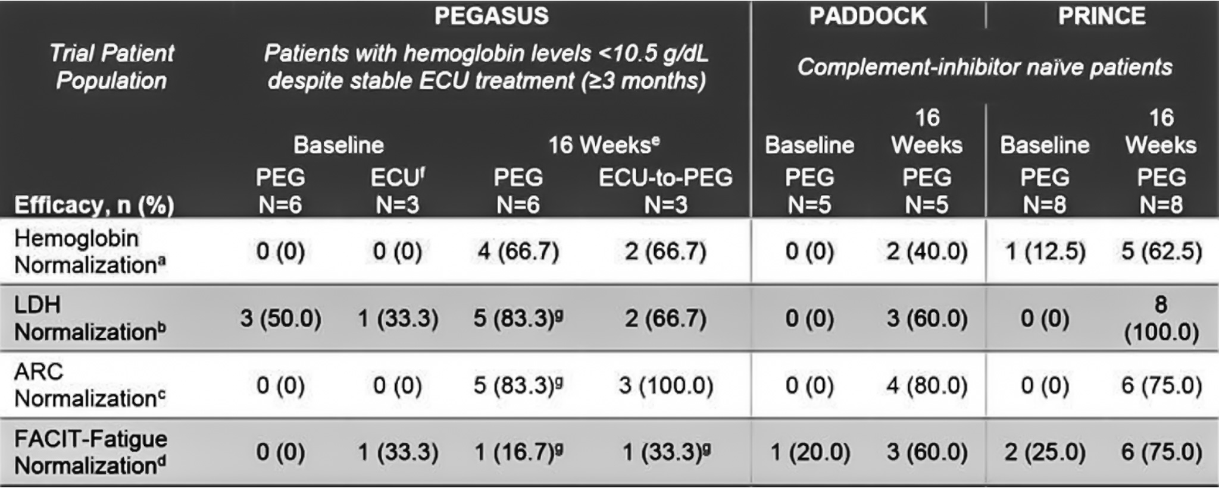
Pegcetacoplan Treatment in PNH Patients with Baseline Hgb at or Above 10 gm/dL
Post hoc analysis of PADDOCK and PRINCE studies
Evaluated hemoglobin, LDH, absolute reticulocyte count, and FACIT-Fatigue normalization rates after pegcetacoplan treatment
Subgroup of 22 patients with PNH and baseline hemoglobin >10.0 gm/dL

Slide 14
Patient Case
Reasons to consider treatment in the 34-year-old with small clone size but evidence of hemolysis and thrombosis
FATIGUE- mediated in part by complement activity
THROMBOSIS- mediated by complement activity
HEMOLYSIS- mediated by complement activity

Slide 15
Looking for more resources on this topic?
CME/CE in minutes
Congress highlights
Late-breaking data
Quizzes
Webinars
In-person events
Slides & resources
www.MedEdOTG.com

