Slide 1
Anticoagulation Management of AF: What Has Changed?
Sean Pokorney, MD
Assistant Professor of Medicine
Duke University
Duke Clinical Research Institute
Durham, NC

Slide 2
Resource Information
About This Resource
These slides are one component of a continuing education program available online at MedEd On The Go titled ACC/AHA/ACCP/HRS Guideline Updates in the Management of Atrial Fibrillation
Program Learning Objectives:
Recognize the current and emerging evidence-based guidance on the identification of and management of care for patients with AF
MedEd On The Go®
www.mededonthego.com
This content or portions thereof may not be published, posted online or used in presentations without permission.
This content can be saved for personal use (non-commercial use only) with credit given to the resource authors.
To contact us regarding inaccuracies, omissions or permissions please email us at support@MedEdOTG.com

Slide 3
Disclaimer
The views and opinions expressed in this educational activity are those of the faculty and do not necessarily represent the views of Total CME, LLC, the CME providers, or the companies providing educational grants. This presentation is not intended to define an exclusive course of patient management; the participant should use their clinical judgment, knowledge, experience, and diagnostic skills in applying or adopting for professional use any of the information provided herein. Any procedures, medications, or other courses of diagnosis or treatment discussed or suggested in this activity should not be used by clinicians without evaluation of their patient's conditions and possible contraindications or dangers in use, review of any applicable manufacturer’s product information, and comparison with recommendations of other authorities. Links to other sites may be provided as additional sources of information.

Slide 4
Antithrombotic Therapy
Recommendations for Antithrombotic Therapy Referenced studies that support the recommendations are summarized in the Online Data Supplement.
COR | LOE | Recommendations
1 | A | For patients with AF and an estimated annual thromboembolic risk of ≥ 2% per year (e.g., CHA₂DS₂-VASc score of ≥ 2 in men and ≥ 3 in women), anticoagulation is recommended to prevent stroke and systemic thromboembolism.^{1–7}
1 | A | In patients with AF who do not have a history of moderate to severe rheumatic mitral stenosis or a mechanical heart valve, and who are candidates for anticoagulation, DOACs are recommended over warfarin to reduce the risk of mortality, stroke, systemic embolism, and ICH.^{1–7}
2a | A | For patients with AF and an estimated annual thromboembolic risk of ≥ 1% but < 2% per year (equivalent to CHA₂DS₂-VASc score of 1 in men and 2 in women), anticoagulation is reasonable to prevent stroke and systemic thromboembolism.^{1,3}
3: Harm | B-R | In patients with AF who are candidates for anticoagulation and without an indication for antiplatelet therapy, aspirin either alone or in combination with clopidogrel as an alternative to anticoagulation is not recommended to reduce stroke risk.^{8,9}
3: No Benefit | B-NR | In patients with AF without risk factors for stroke, aspirin monotherapy for prevention of thromboembolic events is of no benefit.^{10,11}
AF, atrial fibrillation; COR, class of recommendation; DOAC, direct oral anticoagulant; ICH, intracranial hemorrhage; LOE, level of evidence;
Joglar JA, et al. Circulation.2024;149(1):e1-e156.
© 2023 by the American College of Cardiology Foundation and the American Heart Association, Inc.

Slide 5
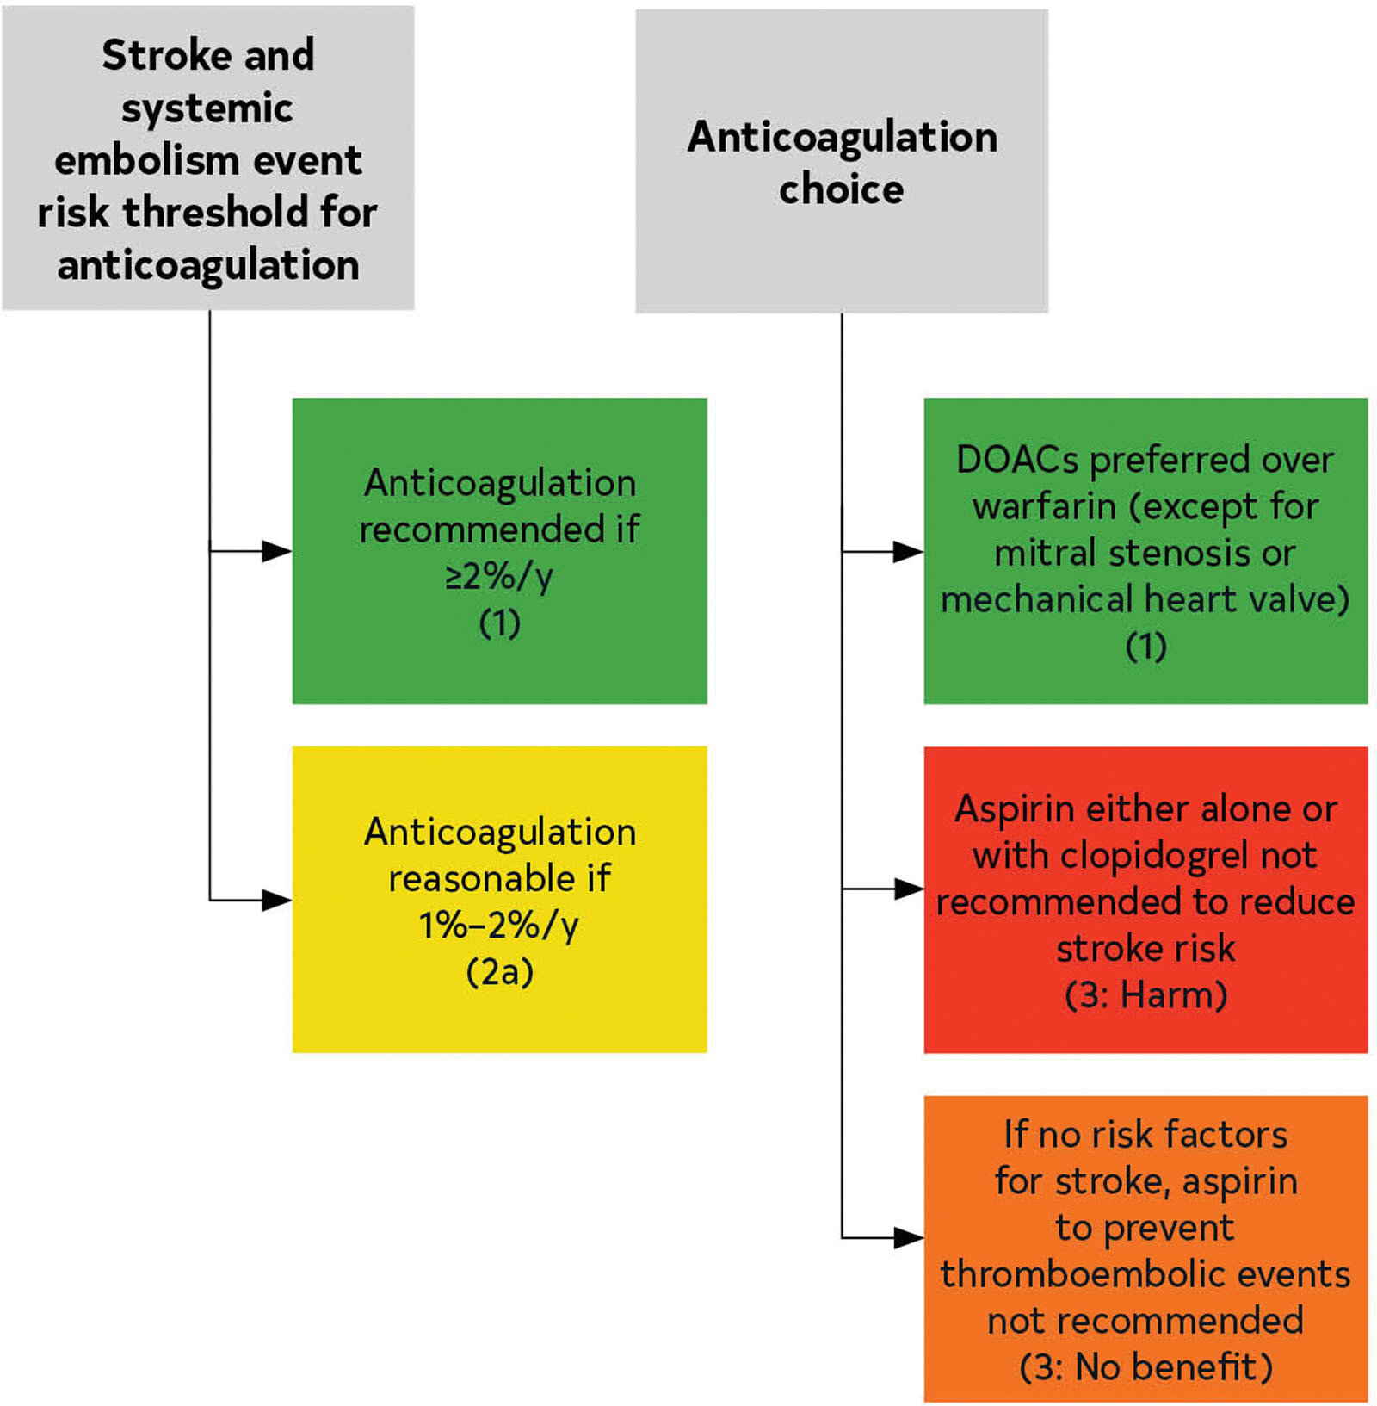
Antithrombotic Options in Patients with AF

Slide 6
Looking for more resources on this topic?
CME/CE in minutes
Congress highlights
Late-breaking data
Quizzes
Webinars
In-person events
Slides & resources
www.MedEdOTG.com

