Slide 1
Selecting Anticoagulants for Acute VTE
Geoffrey Barnes, MD, MSc
Associate Professor of Internal Medicine
Vascular and Cardiovascular Medicine
Frankel Cardiovascular Center
University of Michigan
Ann Arbor, MI

Slide 2
Resource Information
About This Resource
These slides are one component of a continuing education program available online at MedEd On The Go titled Treating and Preventing Clots: Anticoagulation in Atrial Fibrillation and Venous Thromboembolism
Program Learning Objectives:
Discuss appropriate diagnostic criteria and challenges faced in screening patients who may be at risk for blood clots due to either AF or VTE
Identify appropriate candidates for oral anticoagulation when AF or VTE is detected
Develop evidence-based, individualized treatment plans for patients with an indication for oral anticoagulation
MedEd On The Go®
www.mededonthego.com
This content or portions thereof may not be published, posted online or used in presentations without permission.
This content can be saved for personal use (non-commercial use only) with credit given to the resource authors.
To contact us regarding inaccuracies, omissions or permissions please email us at support@MedEdOTG.com

Slide 3
Disclaimer
The views and opinions expressed in this educational activity are those of the faculty and do not necessarily represent the views of Total CME, LLC, the CME providers, or the companies providing educational grants. This presentation is not intended to define an exclusive course of patient management; the participant should use their clinical judgment, knowledge, experience, and diagnostic skills in applying or adopting for professional use any of the information provided herein. Any procedures, medications, or other courses of diagnosis or treatment discussed or suggested in this activity should not be used by clinicians without evaluation of their patient's conditions and possible contraindications or dangers in use, review of any applicable manufacturer’s product information, and comparison with recommendations of other authorities. Links to other sites may be provided as additional sources of information.

Slide 4
Clinical Case
74-year-old man with a history of HTN presents to the ED with acute onset dyspnea, mild chest pain; tore his Achilles tendon 3 weeks prior
HR 82, RR 22, BP 132/86, SpO2 96% ra
Troponin “normal”
PECT: Right lower lobe segmental PE, no RV strain

Slide 5
Clinical Case
Key question:
What anticoagulant is best for this patient?

Slide 6
Anticoagulation is Key for All VTE
Purpose of anticoagulation: prevent VTE extension/new clot
Needs to be initiated ASAP
Goal: Rapid onset

Slide 7
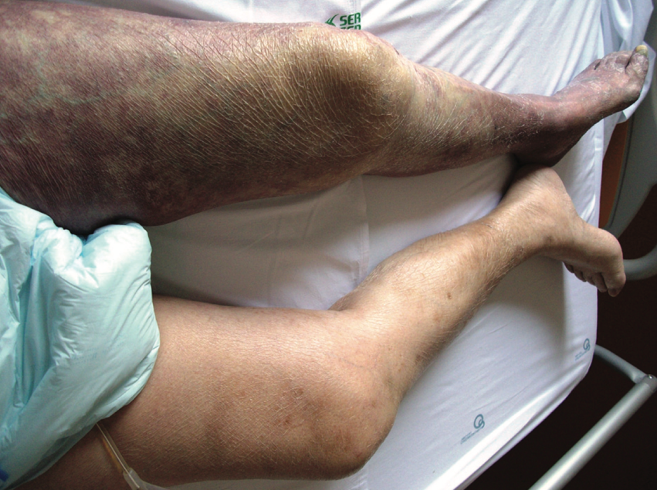
When to Use Heparin: DVT
Phlegmasia cerula dolens
Venous occlusion → increased limb pressure → arterial ischemia
Requires rapid thrombectomy/thrombolysis
Unfractionated heparin preferred anticoagulant

Slide 8
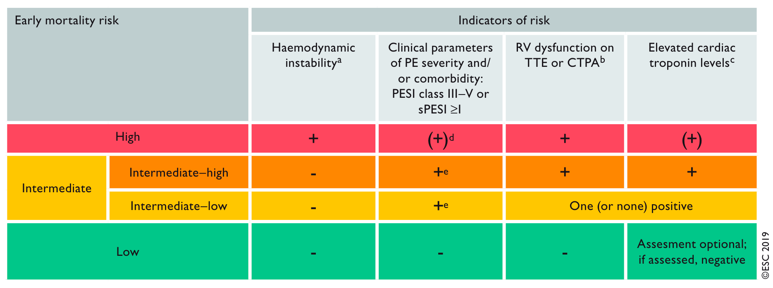
Anticoagulation in PE: Importance of Risk Stratification
“Advanced therapy” recommended
Hospitalization recommended
Consider Home Discharge

Slide 9
Selecting Patients for Home PE Treatment
HESTIA Criteria
Hemodynamic instability?
Thrombolysis/thrombectomy needed?
Active bleeding/high risk of bleeding?
O2 requirement?
PE diagnosed on anticoagulation?
Pain requiring IV medications?
Medical or social need for hospitalization?
CrCl < 30 ml/min
Severe liver impairment?
Pregnant?
History of heparin-inducted thrombocytopenia?
1+ Yes
Admit
“Low Risk” by ESC Criteria
No to all
Home Discharge

Slide 10
Selecting Anticoagulants
Rivaroxaban 15 mg BID x21 days
Apixaban 10 mg BID x7 days
Rivaroxaban 20 mg daily
Apixaban 5 mg BID
Rivaroxaban 10 or 20 mg daily
Apixaban 2,5 or 5 mg BID
Oral only
Initial Management (5-21 days)
Primary Treatment
(3-6 month)
Secondary Prevention
(beyond 3-6 month)
Enoxaparin 1 mg/kg BID
OR
Unfractioned heparin
Apixaban 5 mg BID
Dabigatran 150 mg BID
Edoxaban 60 mg daily
Warfarin (INR goal 2.0-3.0)
Apixaban 2,5 or 5 mg BID
Dabigatran 150 mg BID
Warfarin (INR goal 2.0-3.0)
Parenteral Lead in

Slide 11
Return to Case
74-year-old man with acute PE
What anticoagulant is best?
Low risk PE, no HESTIA criteria → home discharge is advised
Prefer oral anticoagulation
Apixaban 10 mg BID x7d, then 5mg BID
Rivaroxaban 15 mg BID x21d, then 20mg daily

Slide 12
Looking for more resources on this topic?
CME/CE in minutes
Congress highlights
Late-breaking data
Quizzes
Webinars
In-person events
Slides & resources
www.MedEdOTG.com

