Slide 1
Ongoing Oral Anticoagulation Management
Geoffrey Barnes, MD, MSc
Associate Professor of Internal Medicine
Vascular and Cardiovascular Medicine
Frankel Cardiovascular Center
University of Michigan
Ann Arbor, MI

Slide 2
Resource Information
About This Resource
These slides are one component of a continuing education program available online at MedEd On The Go titled Treating and Preventing Clots: Anticoagulation in Atrial Fibrillation and Venous Thromboembolism
Program Learning Objectives:
Discuss appropriate diagnostic criteria and challenges faced in screening patients who may be at risk for blood clots due to either AF or VTE
Identify appropriate candidates for oral anticoagulation when AF or VTE is detected
Develop evidence-based, individualized treatment plans for patients with an indication for oral anticoagulation
MedEd On The Go®
www.mededonthego.com
This content or portions thereof may not be published, posted online or used in presentations without permission.
This content can be saved for personal use (non-commercial use only) with credit given to the resource authors.
To contact us regarding inaccuracies, omissions or permissions please email us at support@MedEdOTG.com

Slide 3
Disclaimer
The views and opinions expressed in this educational activity are those of the faculty and do not necessarily represent the views of Total CME, LLC, the CME providers, or the companies providing educational grants. This presentation is not intended to define an exclusive course of patient management; the participant should use their clinical judgment, knowledge, experience, and diagnostic skills in applying or adopting for professional use any of the information provided herein. Any procedures, medications, or other courses of diagnosis or treatment discussed or suggested in this activity should not be used by clinicians without evaluation of their patient's conditions and possible contraindications or dangers in use, review of any applicable manufacturer’s product information, and comparison with recommendations of other authorities. Links to other sites may be provided as additional sources of information.

Slide 4
Clinical Case
64-year-old woman is diagnosed with low-risk acute pulmonary embolism
Started on apixaban 10 mg BID in the ED
Referral to your clinic for follow up

Slide 5
Clinical Case
Key Question?
What follow up for her anticoagulation is appropriate?

Slide 6
Considerations in the First Month
Did they get the medication as prescribed?
Cost
Access
Are they taking the medication as prescribed?
Dosing
Frequency
Are there other factors that contribute to bleeding risk?
Drug-drug interactions
Other anti-thrombotic medications

Slide 7
Preparing for Dosing Transitions
Rivaroxaban 15 mg BID x21 days
Apixaban 10 mg BID x7 days
Rivaroxaban 20 mg daily
Apixaban 5 mg BID
Rivaroxaban 10 or 20 mg daily
Apixaban 2,5 or 5 mg BID
Oral only
Initial Management (5-21 days)
Primary Treatment
(3-6 month)
Secondary Prevention
(beyond 3-6 month)
Enoxaparin 1 mg/kg BID
OR
Unfractioned heparin
Apixaban 5 mg BID
Dabigatran 150 mg BID
Edoxaban 60 mg daily
Warfarin (INR goal 2.0-3.0)
Apixaban 2,5 or 5 mg BID
Dabigatran 150 mg BID
Warfarin (INR goal 2.0-3.0)
Parenteral Lead in

Slide 8
Experiencing Drug-Related Complications
How to prevent complications
Avoid nose bleeds → saline spray, Vaseline
PPI if multiple anti-thrombotic medications
How to treat complications
Proper nosebleed management
Do NOT stop meds without contacting doctor

Slide 9
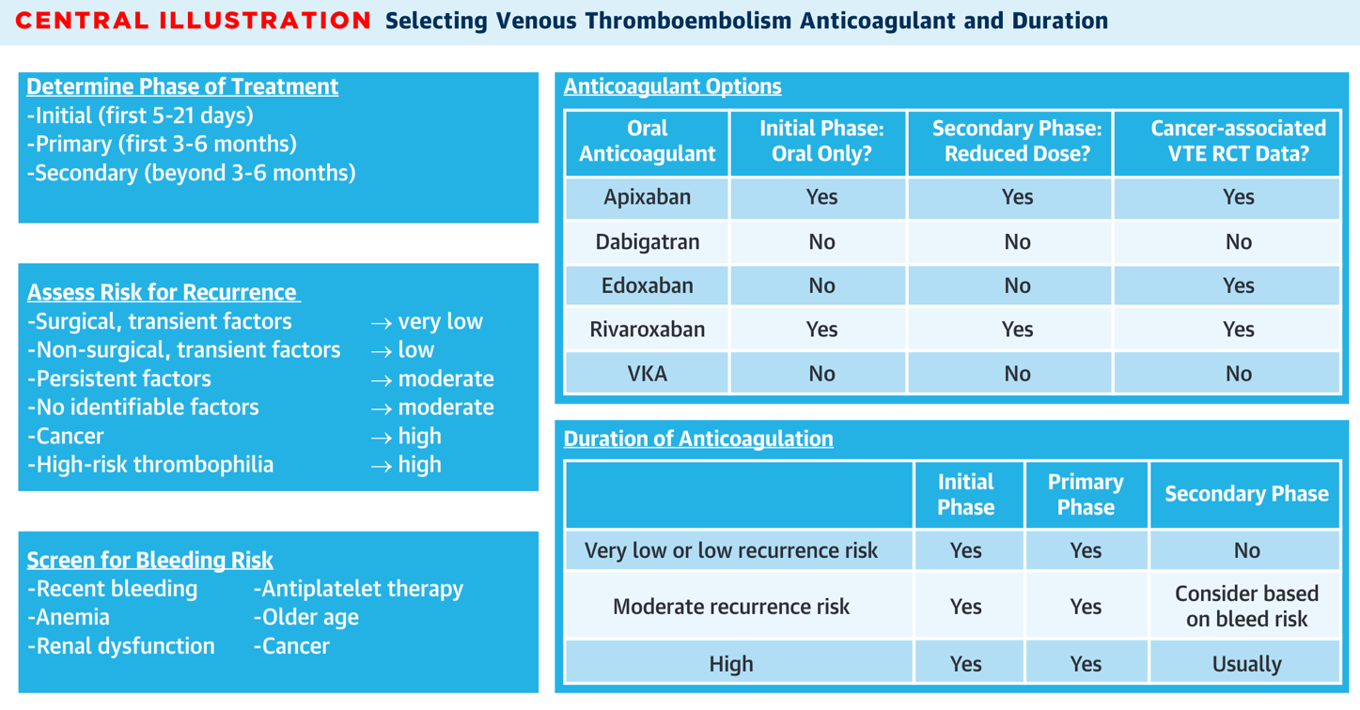
Short Versus Long-Term Anticoagulation

Slide 10
Return to the Case
64-year-old woman with acute PE
What follow up is appropriate?
Ensure access to medication, dose change at 21 days (apixaban 5 mg BID)
Discuss prevention/treatment of anticoagulation-related complications
Discuss short- versus long-term treatment plan

Slide 11
Looking for more resources on this topic?
CME/CE in minutes
Congress highlights
Late-breaking data
Quizzes
Webinars
In-person events
Slides & resources
www.MedEdOTG.com

