Slide 1
Case: Recognizing the Signs & Symptoms of VTE
Dennis I. Narcisse, MD, MS
Fellow in Cardiovascular Disease
Division of Cardiology
Duke University Medical Center
Duke Clinical Research Institute
Durham, NC

Slide 2
Resource Information
About This Resource
These slides are one component of a continuing education program available online at MedEd On The Go titled Treating and Preventing Clots: Anticoagulation in Atrial Fibrillation and Venous Thromboembolism
Program Learning Objectives:
Discuss appropriate diagnostic criteria and challenges faced in screening patients who may be at risk for blood clots due to either AF or VTE
Identify appropriate candidates for oral anticoagulation when AF or VTE is detected
Develop evidence-based, individualized treatment plans for patients with an indication for oral anticoagulation
MedEd On The Go®
www.mededonthego.com
This content or portions thereof may not be published, posted online or used in presentations without permission.
This content can be saved for personal use (non-commercial use only) with credit given to the resource authors.
To contact us regarding inaccuracies, omissions or permissions please email us at support@MedEdOTG.com

Slide 3
Disclaimer
The views and opinions expressed in this educational activity are those of the faculty and do not necessarily represent the views of Total CME, LLC, the CME providers, or the companies providing educational grants. This presentation is not intended to define an exclusive course of patient management; the participant should use their clinical judgment, knowledge, experience, and diagnostic skills in applying or adopting for professional use any of the information provided herein. Any procedures, medications, or other courses of diagnosis or treatment discussed or suggested in this activity should not be used by clinicians without evaluation of their patient's conditions and possible contraindications or dangers in use, review of any applicable manufacturer’s product information, and comparison with recommendations of other authorities. Links to other sites may be provided as additional sources of information.

Slide 4
Case Presentation:
What is the likelihood this case is VTE?
72 y.o. female
Past Medical History: COPD, Type 2 Diabetes, HTN, Obesity (BMI 38)
Medications: Tiotropium, albuterol, metformin, lisinopril
Presenting symptoms: chest pain and dyspnea progressive over 12 hours
Pertinent ROS
No prior CAD or symptoms
Exam
Heart rate 120s sinus tachycardia, Oxygen 93% on room air, no leg edema or swelling
Imaging
CXR: hyperinflation but clear lung fields
No DVT symptoms, recent surgery, or active cancer
Recent viral upper respiratory infection requiring 3 day hospitalization but resolved 2 weeks ago
ECG: normal sinus rhythm, tachycardia, no acute changes

Slide 5
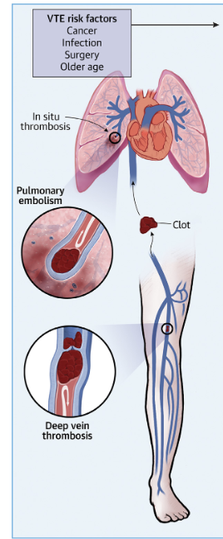
Venous Thromboembolism (VTE)
VTE is a single disease entity with 2 clinical presentations: deep vein thrombosis (DVT) and pulmonary embolism (PE)
Affects approximately 10 million people every year worldwide
Remains the first cause of preventable hospital death and associated with short- and long-term morbidity, disability, and health care costs
Important to diagnose accurately to reduce unnecessary exposure to anticoagulation

Slide 6
Deep Vein Thrombosis
Impacts > 2 million US individuals per year
Features are nonspecific and many patients are asymptomatic
Wells Score for Leg DVT
Component | Points
Active cancer Localized tenderness Entire leg swollen Calf swelling > 3 cm Pitting edema Collateral superficial veins Previous DVT Bedridden/surgery Paralysis Alternate diagnosis | 1 1 1 1 1 1 1 1 1 -2
Common risk factors include:​
Immobilization​​
Recent surgery​​
Obesity​​
Malignancy​​
Oral contraceptives​​
Pregnancy​​
Age > 65
A score of two or higher indicates that the probability of DVT is likely; a score of less than two indicates that the probability of DVT is unlikely. In patients with symptoms in both legs, the more symptomatic leg is used.

Slide 7
You will know it when you see it?
Signs and Symptoms | Source
 | O’Donell et al,³ Grade A, % |  | Hager,⁴ Grade B, % |  | Molloy et al,¹² Grade A, %
 | DVT+ | DVT- | DVT+ | DVT- | DVT+ | DVT-
Pain | 78 | 75 | 90 | 97 | 48 | 23
Tenderness | 76 | 89 | 84 | 74 | 43 | 35
Edema | 78 | 67 | 82 | 32 | 43 | 26
 | 56 | 61 | 33 | 21 | 11 | 11
Swelling^{b} | 85 | 56 | …^{c} | … | 41 | 39
Erythema^{b} | 24 | 38 | … | … | … | …

Slide 8
You will know it when you see it?
Signs and Symptoms | Source
 | O’Donell et al,³ Grade A, % |  | Hager,⁴ Grade B, % |  | Molloy et al,¹² Grade A, %
 | DVT+ | DVT- | DVT+ | DVT- | DVT+ | DVT-
Pain | 78 | 75 | 90 | 97 | 48 | 23
Tenderness | 76 | 89 | 84 | 74 | 43 | 35
Edema | 78 | 67 | 82 | 32 | 43 | 26
 | 56 | 61 | 33 | 21 | 11 | 11
Swelling^{b} | 85 | 56 | …^{c} | … | 41 | 39
Erythema^{b} | 24 | 38 | … | … | … | …
Things aren't always what they appear/seem to be…
Clinical features are not highly specific; however, the absence of symptoms does decrease the likelihood of DVT drastically (LR 0.4)

Slide 9
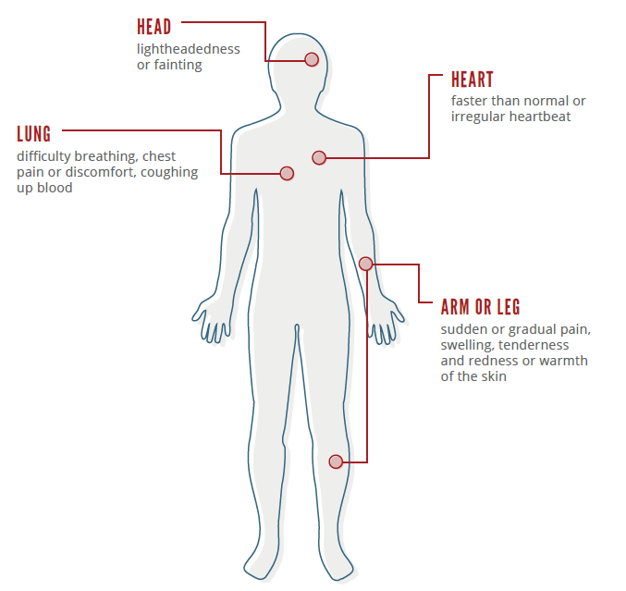
Acute PE
Wide variety of presenting features, from asymptomatic to shock or sudden death
Critical to have high level of suspicion
Most common symptoms:
Dyspnea at rest or with exertion (73%)
Pleuritic pain (67%)
Cough (37%)
Orthopnea (28%)
Calf or thigh pain and/or swelling (44%)
Wheezing (21%)
Hemoptysis (12%)

Slide 10
Back to the case:
Wells’ Criteria for PE can objectify risk of PE based on signs and symptoms. This case is a score of 6, which is moderate or “PE Likely” (16-28%)
72 year old female
Past Medical History: COPD, Type 2 Diabetes, HTN, Obesity (BMI 38)
Medications: Tiotropium, albuterol, metformin, lisinopril
Presenting symptoms: chest pain and dyspnea progressive over 12 hours
Pertinent ROS
No prior CAD or symptoms
Exam
Heart rate 120s sinus tachycardia, Oxygen 93% on room air, no leg edema or swelling
Imaging
CXR: hyperinflation but clear lung fields
No DVT symptoms, recent surgery, or active cancer
Recent viral upper respiratory infection requiring 3 day hospitalization but resolved 2 weeks ago
ECG: normal sinus rhythm, tachycardia, no acute changes

Slide 11
Conclusion
VTE is composed of DVT and PE and are often challenging to recognize clinically due to varying degree of symptoms
Clinical signs and symptoms of VTE lack specificity individually, but the absence of symptoms drastically reduces the likelihood
Scoring systems are useful to help determine pretest probabilities of DVT and PE (such as Wells Scoring system)

Slide 12
Looking for more resources on this topic?
CME/CE in minutes
Congress highlights
Late-breaking data
Quizzes
Webinars
In-person events
Slides & resources
www.MedEdOTG.com

