Slide 1
Case: Evaluation and
Diagnosis of VTE
Dennis I. Narcisse, MD, MS
Fellow in Cardiovascular Disease
Division of Cardiology
Duke University Medical Center
Duke Clinical Research Institute
Durham, NC
Notes:
Case—Diagnosing Patients with VTE (Discuss initial steps to evaluate and diagnose a patient with a suspected DVT.)

Slide 2



Resource Information
About This Resource
These slides are one component of a continuing education program available online at MedEd On The Go titled Treating and Preventing Clots: Anticoagulation in Atrial Fibrillation and Venous Thromboembolism
Program Learning Objectives:
Discuss appropriate diagnostic criteria and challenges faced in screening patients who may be at risk for blood clots due to either AF or VTE
Identify appropriate candidates for oral anticoagulation when AF or VTE is detected
Develop evidence-based, individualized treatment plans for patients with an indication for oral anticoagulation
MedEd On The Go®
www.mededonthego.com
This content or portions thereof may not be published, posted online or used in presentations without permission.
This content can be saved for personal use (non-commercial use only) with credit given to the resource authors.
To contact us regarding inaccuracies, omissions or permissions please email us at support@MedEdOTG.com

Slide 3
Disclaimer
The views and opinions expressed in this educational activity are those of the faculty and do not necessarily represent the views of Total CME, LLC, the CME providers, or the companies providing educational grants. This presentation is not intended to define an exclusive course of patient management; the participant should use their clinical judgment, knowledge, experience, and diagnostic skills in applying or adopting for professional use any of the information provided herein. Any procedures, medications, or other courses of diagnosis or treatment discussed or suggested in this activity should not be used by clinicians without evaluation of their patient's conditions and possible contraindications or dangers in use, review of any applicable manufacturer’s product information, and comparison with recommendations of other authorities. Links to other sites may be provided as additional sources of information.

Slide 4
Case 1:
64-year-old man referred to emergency department for suspected DVT
Past medical history: HTN, type 2 diabetes, prostate cancer (active treatment started 6 months ago) with pelvic lymph node involvement
Presenting symptoms: progressive pain, swelling, warmth, and redness of his
right calf for 48 hours
Pertinent ROS
No history of DVT/PE, not on blood thinners
Exam
Heart rate 80, oxygen saturation 97% on room air
Imaging
Bilateral ultrasound with compression does not demonstrate evidence of DVT
Receiving chemotherapy
No recent surgery or immobilization
No chest pain or dyspnea
Right calf circumference 5 cm greater than left calf
Localized tenderness along venous system
Pitting edema in right leg

Slide 5
Case 1:
You determine his clinical pretest probability to be high (by Wells score=5)
64-year-old man referred to emergency department for suspected DVT
Past medical history: HTN, type 2 diabetes, prostate cancer (active treatment started 6 months ago) with pelvic lymph node involvement
Presenting symptoms: progressive pain, swelling, warmth, and redness of his
right calf for 48 hours
Pertinent ROS
No history of DVT/PE, not on blood thinners
Exam
Heart rate 80, oxygen saturation 97% on room air
Imaging
Bilateral ultrasound with compression does not demonstrate evidence of DVT
Receiving chemotherapy
No recent surgery or immobilization
No chest pain or dyspnea
Right calf circumference 5 cm greater than left calf
Localized tenderness along venous system
Pitting edema in right leg

Slide 6
Case 1:
You determine his clinical pretest probability to be high (by Wells score=5)
64-year-old man referred to emergency department for suspected DVT
Past medical history: HTN, type 2 diabetes, prostate cancer (active treatment started 6 months ago) with pelvic lymph node involvement
Presenting symptoms: progressive pain, swelling, warmth, and redness of his
right calf for 48 hours
What next?
Pertinent ROS
No history of DVT/PE, not on blood thinners
Exam
Heart rate 80, oxygen saturation 97% on room air
Imaging
Bilateral ultrasound with compression does not demonstrate evidence of DVT
Receiving chemotherapy
No recent surgery or immobilization
No chest pain or dyspnea
Right calf circumference 5 cm greater than left calf
Localized tenderness along venous system
Pitting edema in right leg

Slide 7
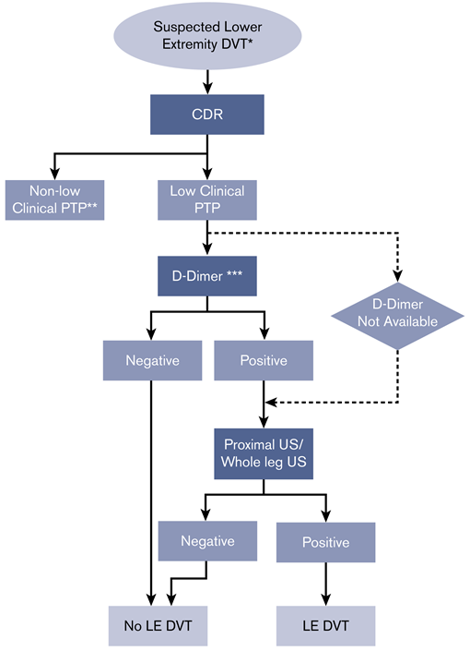
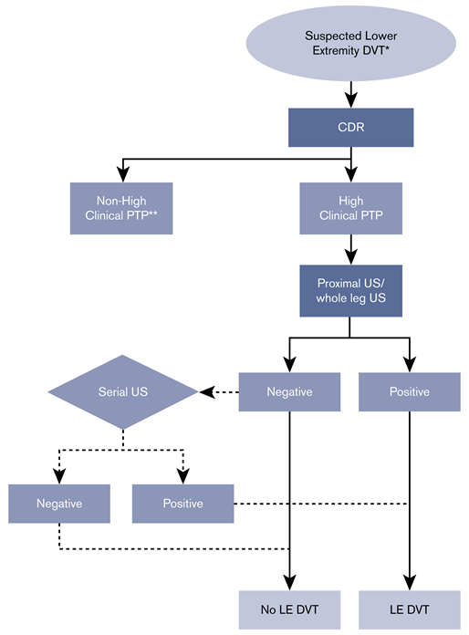
Low Pretest Probability
High Pretest Probability

Slide 8
Low Pretest Probability
High Pretest Probability

Slide 9
Low Pretest Probability
High Pretest Probability

Slide 10
Low Pretest Probability
High Pretest Probability
Serial US if initial is negative in high pretest population

Slide 11
Low Pretest Probability
High Pretest Probability
Serial US if initial is negative in high pretest population

Slide 12
Case 1 Summary:
Utilizing pretest probability scoring is crucial in these patients for appropriate guidance in management
In patients with high pretest probability and negative initial lower extremity ultrasound, serial imaging is indicated to fully exclude DVT
In patients with low pretest probability, D-dimer is the first recommended diagnostic test to exclude DVT

Slide 13
Case Presentation 2:
72-year-old woman
Past medical history: COPD, type 2 diabetes, HTN, obesity (BMI 38)
Medications: tiotropium, albuterol, metformin, lisinopril
Presenting symptoms: chest pain and dyspnea progressive over 12 hours
Pertinent ROS
No prior CAD or symptoms
Exam
Heart rate 120s sinus tachycardia, oxygen 93% on room air, no leg edema or swelling
Imaging
CXR: hyperinflation but clear lung fields
No DVT symptoms, recent surgery, or active cancer
Recent viral upper respiratory infection requiring 3-day hospitalization but resolved 2 weeks ago
ECG: normal sinus rhythm, tachycardia, no acute changes

Slide 14
Case Presentation 2:
Important considerations prior to evaluation are that this patient’s pretest probability is moderate/intermediate by Wells score AND they have history of lung disease
72-year-old woman
Past medical history: COPD, type 2 diabetes, HTN, obesity (BMI 38)
Medications: tiotropium, albuterol, metformin, lisinopril
Presenting symptoms: chest pain and dyspnea progressive over 12 hours
Pertinent ROS
No prior CAD or symptoms
Exam
Heart rate 120s sinus tachycardia, oxygen 93% on room air, no leg edema or swelling
Imaging
CXR: hyperinflation but clear lung fields
No DVT symptoms, recent surgery, or active cancer
Recent viral upper respiratory infection requiring 3-day hospitalization but resolved 2 weeks ago
ECG: normal sinus rhythm, tachycardia, no acute changes

Slide 15
Determine preset probability
(Well’s score or Geneva score)
Low or
indeterminate
High
Wells Score for PE
Component | Points
DVT signs / symptoms No alternate diagnosis Tachycardia Immobilization/surgery Previous DVT or PE Hemoptysis Active cancer | 3 3 1.5 1.5 1.5 1 1
D-dimer
testing
CT angiography
pulmonary
arteries (CTPA)
If negative,
PE ruled out
If positive,
treat for PE
Score >6: high PTP
Score ≥2 and ≤6: intermediate PTP
Score <2: low PTP
If negative + high PTP, alternative imaging recommended (lower ext
US and V/Q scan) + dimer
If positive,
subsequesnt imaging
Required (V/Q or CTPA)

Slide 16
D-dimer has low utility in hospitalized, postsurgical or pregnant patients
Determine preset probability
(Well’s score or Geneva score)
Low or
indeterminate
High
Wells Score for PE
Component | Points
DVT signs / symptoms No alternate diagnosis Tachycardia Immobilization/surgery Previous DVT or PE Hemoptysis Active cancer | 3 3 1.5 1.5 1.5 1 1
D-dimer
testing
CT angiography
pulmonary
arteries (CTPA)
If negative,
PE ruled out
If positive,
treat for PE
Score >6: high PTP
Score ≥2 and ≤6: intermediate PTP
Score <2: low PTP
If negative + high PTP, alternative imaging recommended (lower ext
US and V/Q scan) + dimer
If positive,
subsequesnt imaging
Required (V/Q or CTPA)

Slide 17
D-dimer has low utility in hospitalized, postsurgical or pregnant patients
Determine preset probability
(Well’s score or Geneva score)
Low or
indeterminate
High
Wells Score for PE
Component | Points
DVT signs / symptoms No alternate diagnosis Tachycardia Immobilization/surgery Previous DVT or PE Hemoptysis Active cancer | 3 3 1.5 1.5 1.5 1 1
D-dimer
testing
CT angiography
pulmonary
arteries (CTPA)
If negative,
PE ruled out
If positive,
treat for PE
Score >6: high PTP
Score ≥2 and ≤6: intermediate PTP
Score <2: low PTP
If negative + high PTP, alternative imaging recommended (lower ext
US and V/Q scan) + dimer
If positive,
subsequesnt imaging
Required (V/Q or CTPA)

Slide 18
Imaging Considerations for PE
V/Q Scan
Requires normal chest x-ray and no history of lung disease for highest accuracy
Best for young patients, pregnant patients, and those who cannot have contrast
CTPA
Preferred in high pretest probability
Can visualize other lung pathology, RV dysfunction, and proximal leg veins
90% sensitivity, 95% specificity
Timely result and more assessible
Requires contrast and has relatively higher radiation exposure
Indeterminate or nondiagnostic scans will still require CTPA
Much more sensitive than CTPA in diagnosing chronic PEs
Limited institutional access or expertise in nuclear medicine

Slide 19
Case 2 Summary:
Scoring system to calculate pretest probability should be utilized in conjunction with clinical gestalt
In patients with low or intermediate pretest probability, a high sensitivity D-dimer can safely exclude PE without additional testing
CTPA is preferred imaging modality over V/Q scan in patients with high pretest probability or in individuals who are likely to have a nondiagnostic V/Q result (pre-existing lung disease)

Slide 20



Looking for more resources
on this topic?
CME/CE in minutes
Congress highlights
Late-breaking data
Quizzes
Webinars
In-person events
Slides & resources
www.MedEdOTG.com

