Slide 1
Implementing VTE Learnings into Clinical Practice
Elaine M. Hylek, MD, MPH
Professor of Medicine
Boston University School of Medicine
Boston, MA

Slide 2



Resource Information
About This Resource
These slides are one component of a continuing education program available online at MedEd On The Go titled Treating and Preventing Clots: Anticoagulation in Atrial Fibrillation and Venous Thromboembolism
Program Learning Objectives:
Discuss appropriate diagnostic criteria and challenges faced in screening patients who may be at risk for blood clots due to either AF or VTE
Identify appropriate candidates for oral anticoagulation when AF or VTE is detected
Develop evidence-based, individualized treatment plans for patients with an indication for oral anticoagulation
MedEd On The Go®
www.mededonthego.com
This content or portions thereof may not be published, posted online or used in presentations without permission.
This content can be saved for personal use (non-commercial use only) with credit given to the resource authors.
To contact us regarding inaccuracies, omissions or permissions please email us at support@MedEdOTG.com

Slide 3
Disclaimer
The views and opinions expressed in this educational activity are those of the faculty and do not necessarily represent the views of Total CME, LLC, the CME providers, or the companies providing educational grants. This presentation is not intended to define an exclusive course of patient management; the participant should use their clinical judgment, knowledge, experience, and diagnostic skills in applying or adopting for professional use any of the information provided herein. Any procedures, medications, or other courses of diagnosis or treatment discussed or suggested in this activity should not be used by clinicians without evaluation of their patient's conditions and possible contraindications or dangers in use, review of any applicable manufacturer’s product information, and comparison with recommendations of other authorities. Links to other sites may be provided as additional sources of information.

Slide 4
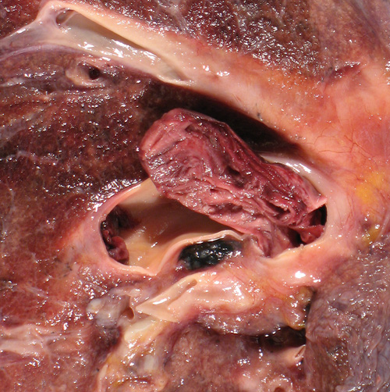
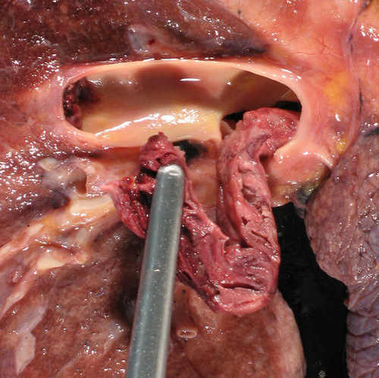
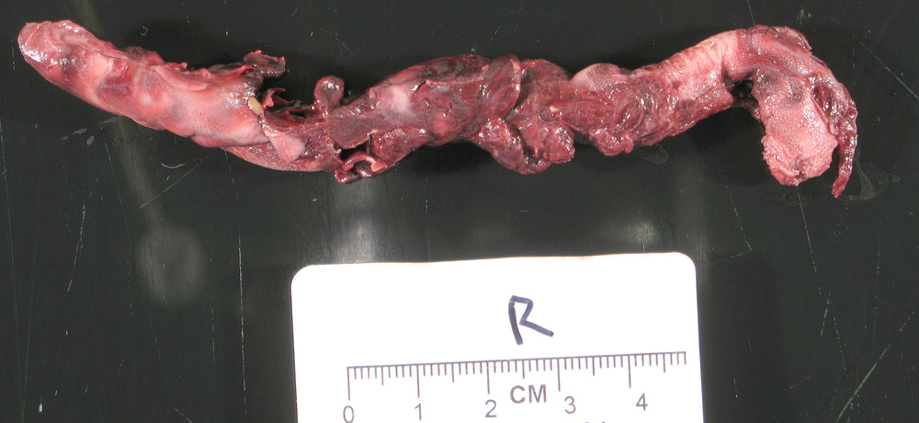

Slide 5

Patient Case
58-year-old healthy man
Works from home with recent long hours on computer
Notes flu-like illness with myalgias, low-grade fever
Perseveres and goes on planned family vacation to Europe
Notes sore calf 3 days into trip that he attributes to sightseeing and walking for hours. Takes a pain reliever
Seeks urgent care visit when he returns to the U.S. 7 days later
Ultrasound confirms DVT. On further questioning, he notes that his brother had a pulmonary embolus in the past and his mother had a DVT

Slide 6
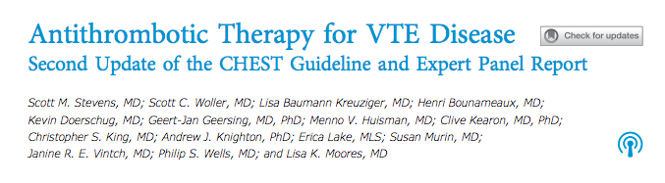
Acute VTE Rx: CHEST Guideline Update 2021

Slide 7
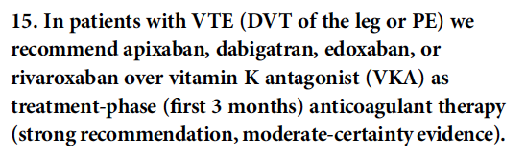
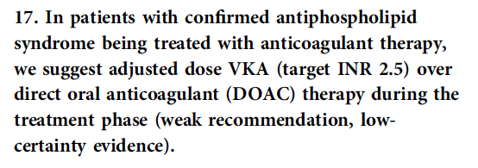

Slide 8
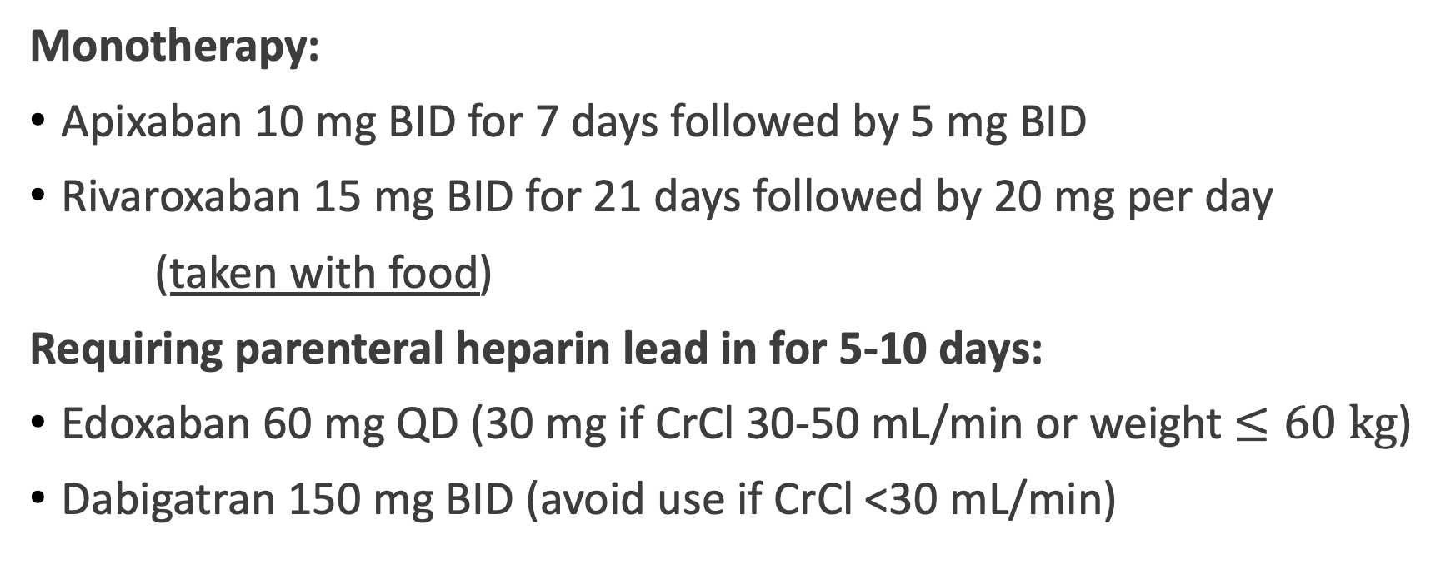
Treatment Options
Monotherapy:
Apixaban 10 mg BID for 7 days followed by 5 mg BID
Rivaroxaban 15 mg BID for 21 days followed by 20 mg per day
(taken with food)
Requiring parenteral heparin lead in for 5-10 days:
Edoxaban 60 mg QD (30 mg if CrCl 30-50 mL/min or weight $≤60 kg$)
Dabigatran 150 mg BID (avoid use if CrCl <30 mL/min)
Acute Rx for 3 months

Slide 9
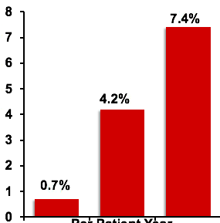
Duration of Rx: Three Months Versus Indefinite
Systematic review of prospective cohort studies and RCTs
15 studies
5159 subjects
Follow up 3-96 months
Conclusion: setting of thrombosis strongly influences recurrence rate
Recurrence rate
at 24 months
Per patient year
Nonsurgical
Surgical trigger
Idiopathic
Non-surgical trigger

Slide 10
Duration of Anticoagulation Rx
Provoked
Transient risk factor(s)
Unprovoked (idiopathic)
Nontransient risk factor(s)
Low risk of recurrence
High risk of recurrence
Consider discontinuing after
3 months
Consider continuing therapy
Consider continuing therapy
Transient/reversible risk factors²
Surgery, trauma, immobilization, lengthy travel, estrogen therapy, pregnancy
Nontransient risk factors²
Cancer, antiphospholipid syndrome, inflammatory bowel disease, thrombophilia

Slide 11
Duration of Anticoagulation Rx
Extended long-term prophylaxis dosing:
Apixaban 2.5 mg BID
Rivaroxaban 10 mg QD
Provoked
Transient risk factor(s)
Unprovoked (idiopathic)
Nontransient risk factor(s)
Low risk of recurrence
High risk of recurrence
Consider discontinuing after
3 months
Consider continuing therapy
Consider continuing therapy
Transient/reversible risk factors²
Surgery, trauma, immobilization, lengthy travel, estrogen therapy, pregnancy
Nontransient risk factors²
Cancer, antiphospholipid syndrome, inflammatory bowel disease, thrombophilia

Slide 12



Looking for more resources
on this topic?
CME/CE in minutes
Congress highlights
Late-breaking data
Quizzes
Webinars
In-person events
Slides & resources
www.MedEdOTG.com

