Slide 1
Oral Anticoagulation Management in Patients with Atrial Fibrillation
John H. Alexander, MD, MHS
Professor of Medicine/Cardiology
Duke Clinical Research Institute
Duke Health
Durham, NC

Slide 2


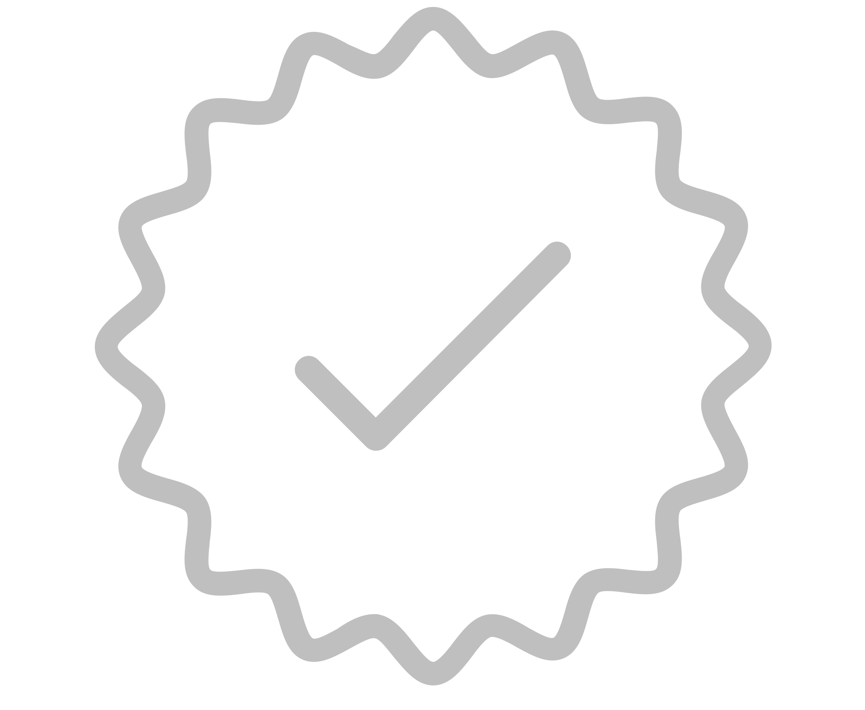
Resource Information
About This Resource
These slides are one component of a continuing education program available online at MedEd On The Go titled Treating and Preventing Clots: Anticoagulation in Atrial Fibrillation and Venous Thromboembolism
Program Learning Objectives:
Discuss appropriate diagnostic criteria and challenges faced in screening patients who may be at risk for blood clots due to either AF or VTE
Identify appropriate candidates for oral anticoagulation when AF or VTE is detected
Develop evidence-based, individualized treatment plans for patients with an indication for oral anticoagulation
MedEd On The Go®
www.mededonthego.com
This content or portions thereof may not be published, posted online or used in presentations without permission.
This content can be saved for personal use (non-commercial use only) with credit given to the resource authors.
To contact us regarding inaccuracies, omissions or permissions please email us at support@MedEdOTG.com

Slide 3
Disclaimer
The views and opinions expressed in this educational activity are those of the faculty and do not necessarily represent the views of Total CME, LLC, the CME providers, or the companies providing educational grants. This presentation is not intended to define an exclusive course of patient management; the participant should use their clinical judgment, knowledge, experience, and diagnostic skills in applying or adopting for professional use any of the information provided herein. Any procedures, medications, or other courses of diagnosis or treatment discussed or suggested in this activity should not be used by clinicians without evaluation of their patient's conditions and possible contraindications or dangers in use, review of any applicable manufacturer’s product information, and comparison with recommendations of other authorities. Links to other sites may be provided as additional sources of information.

Slide 4
Disclosures
This program is supported by Pfizer
I have research grants from: Artivion/CryoLife, Bayer, Bristol-Myers Squibb, CSL Behring, Ferring, U.S. FDA, Humacyte, U.S. NIH
I receive advisory board/consulting payments from: AbbVie, Akros, Artivion/CryoLife, AtriCure, Bayer, Bristol-Myers Squibb, Ferring, GlaxoSmithKline, Janssen, Novostia, Pfizer, Portola, Theravance, Veralox

Slide 5
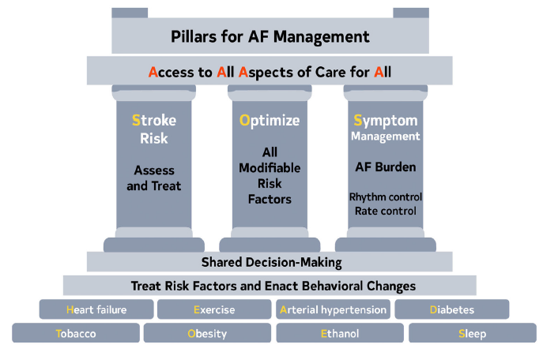
Atrial Fibrillation
Clinical AF vs. subclinical AF
First detected AF
Paroxysmal AF
Persistent AF (>7 days)
Long-standing persistent AF (>12 months)
Permanent AF
Obsolete Terms
Chronic AF
Valvular and nonvalvular AF
Lone AF

Slide 6
Thromboembolic Risk
CHA₂DS₂-VASc
CHF/ LV dysfunction 1
Hypertension 1
Age 75 or older 2
Diabetes mellitus 1
Stroke/TIA/TE 2
Vascular disease 1
Age 65 to 74 1
Female sex 1
Score | Annual stroke rate, %
n | 1084 | 73,538
0 | 0 | 0.78
1 | 1.3 | 2.01
2 | 2.2 | 3.71
3 | 3.2 | 5.92
4 | 4.0 | 9.27
5 | 6.7 | 15.26
6 | 9.8 | 19.78
7 | 9.6 | 21.50
8 | 6.7 | 22.38
9 | 15.2 | 23.64
Score 0 – 9
Validated in 1084 NVAF patients not on OAC with known TE status at 1 year in Euro Heart Survey
Notes:
6

Slide 7
Thromboembolism Prophylaxis
Aspirin
Warfarin (INR 2-3)
DOACs | T_{1/2} | Renal | Dosing
Apixaban | 10-12 hrs | 25% | 5 BID, 2.5 BID*
Dabigatran | 12-17 hrs | 80% | 150 BID, 110 BID, 75 BID*
Edoxaban | 9-11 hrs | 35% | 60 QD, 30 QD*, 15 QD
Rivaroxaban | 6-9 hrs | 35% | 20 QD, 15 QD*, 10 QD
*Dose reduction for select population

Slide 8
Thromboembolism Prophylaxis
Aspirin
Warfarin (INR 2-3)
DOACs | Stroke | Bleeding | ICH
Apixaban | Less | Less | Less
Dabigatran | Less | Same | Less
Edoxaban | Same | Less | Less
Rivaroxaban | Same | Same | Less

Slide 9
DOAC Dose Reduction
DOACs | Criteria | Dose Change
Apixaban | 2/3 older than 80 yr, Wt. less than 60 kg, Cr greater than 1.5 mg/dl | 5.0 → 2.5 mg BID
Dabigatran | ESRD | 150 → 75 BID
Edoxaban | CrCl 30 to 50 ml/min Strong PGP inhibitor Wt. less than 60 kg | 60 → 30 mg QD
Rivaroxaban | CrCl 30 to 50 ml/min | 20 → 15 mg QD

Slide 10
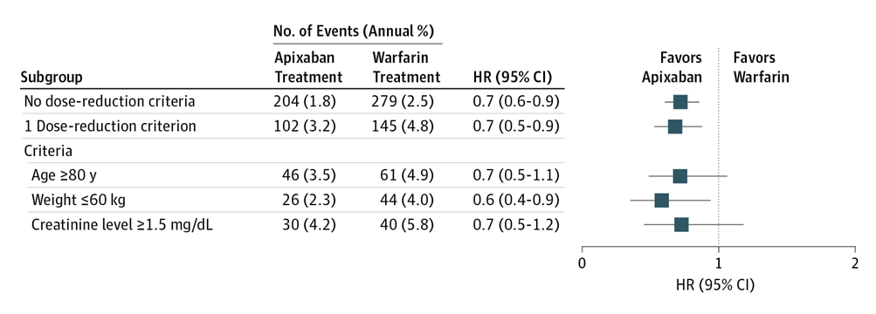
DOAC Under-Dosing
Low dose NOACs are less effective at preventing stroke: 41% increased risk of ischemic stroke with low dose edoxaban vs. warfarin in ENGAGE
Apixaban 5 mg BID vs. warfarin in pts with one dose reduction criteria
Major Bleeding

Slide 11
The Real Opportunity = Rx More Patients
Preventable Strokes from AF
3 to 4 million people in the US have AF
Fewer than half (2 million) are anticoagulated
Of these, 5% stroke per year (100,000)
Of these, 70% are preventable
Greater than 70,000 preventable strokes per year in the US
World-wide at least 10 million people with AF, more than half not treated, and over 200,000 preventable strokes per year

Slide 12



Looking for more resources
on this topic?
CME/CE in minutes
Congress highlights
Late-breaking data
Quizzes
Webinars
In-person events
Slides & resources
www.MedEdOTG.com

