Slide 1
Case: Approaches to Anticoagulation for AF
Christopher B. Granger, MD,
Donald F. Fortin, M.D. Distinguished Professor of Medicine, Professor of Nursing
Duke University Medical Center
Durham, NC

Slide 2


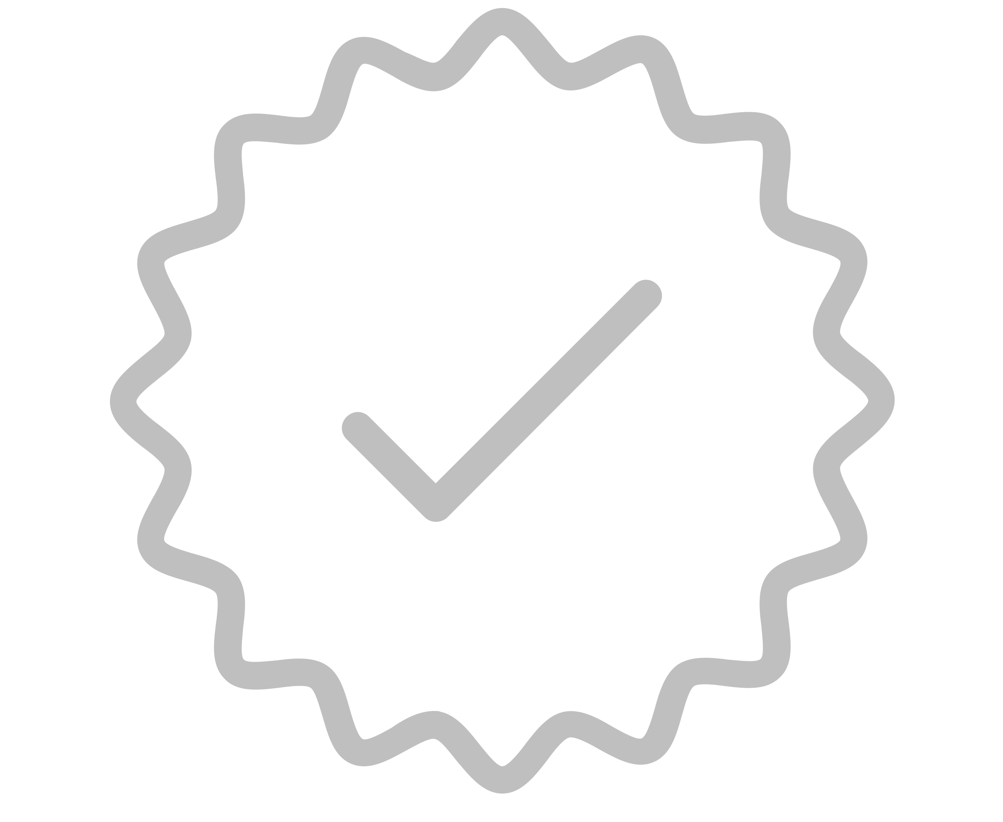
Resource Information
About This Resource
These slides are one component of a continuing education program available online at MedEd On The Go titled Treating and Preventing Clots: Anticoagulation in Atrial Fibrillation and Venous Thromboembolism
Program Learning Objectives:
Discuss appropriate diagnostic criteria and challenges faced in screening patients who may be at risk for blood clots due to either AF or VTE
Identify appropriate candidates for oral anticoagulation when AF or VTE is detected
Develop evidence-based, individualized treatment plans for patients with an indication for oral anticoagulation
MedEd On The Go®
www.mededonthego.com
This content or portions thereof may not be published, posted online or used in presentations without permission.
This content can be saved for personal use (non-commercial use only) with credit given to the resource authors.
To contact us regarding inaccuracies, omissions or permissions please email us at support@MedEdOTG.com

Slide 3
Disclaimer
The views and opinions expressed in this educational activity are those of the faculty and do not necessarily represent the views of Total CME, LLC, the CME providers, or the companies providing educational grants. This presentation is not intended to define an exclusive course of patient management; the participant should use their clinical judgment, knowledge, experience, and diagnostic skills in applying or adopting for professional use any of the information provided herein. Any procedures, medications, or other courses of diagnosis or treatment discussed or suggested in this activity should not be used by clinicians without evaluation of their patient's conditions and possible contraindications or dangers in use, review of any applicable manufacturer’s product information, and comparison with recommendations of other authorities. Links to other sites may be provided as additional sources of information.

Slide 4
89 year old woman, paroxysmal AF, 48 kg, bioprosthetic aortic valve, creatinine 1.0 (creatinine clearance 30), falls once every two months, and broke her hip while on apixaban. What should be done after her fractures?
Too high risk, stop anticoagulation
Switch to aspirin 81 mg a day
Warfarin with low INR target
Continue apixaban 2.5 mg bid
Place LAA occluder device

Slide 5
Estimated 71% RRR in Stroke, NOAC vs Control
Warfarin compared
to control or placebo
Relative Risk Reduction
(95% CI)
NOAC compared
to warfarin
Relative Risk Reduction
(95% CI)
Trial
Trial
AFASAK I (1990)
SPAF I (1991)
BAATAF (1990)
CAFA (1991)
SPINAF (1992)
EAFT (1993)
Combined
RE-LY (2009)
ROCKET AF (2011)
ARISTOTLE (2011)
ENGAGE AF-TIMI 48
(2013)
Combined
100%
50%
0
−50%
−100%
50%
0
−50%
Favors warfarin
Favors placebo
or control
Favors NOAC
Favors warfarin
RRR 64%
RRR 20%
Warfarin vs. Placebo or Control
(6 trials, total n=2,900)
NOAC vs. Warfarin
(4 trials, total n=71,683)
Hart RG, et al. Ann Intern Med. 2007;146(12):857-67
Ruff C, et al. Lancet. 2014;383(9921):955-62.
Carnicelli AP, et al. Circulation. 2022;145(4):242-255.

Slide 6
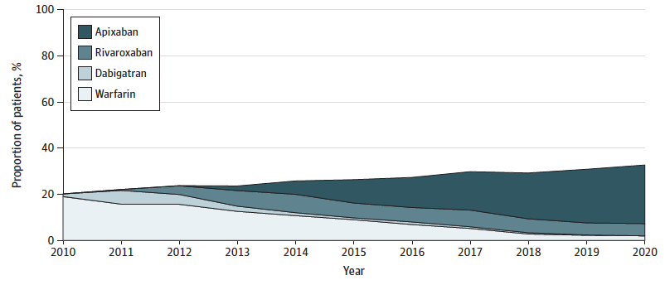
Oral Anticoagulant Initiation and Direct OAC Uptake in 2010-2020
381,000 Optum Medicare Advantage patients with AF and stroke risk factors
OAC initiation within 12 months after new AF diagnosis increased from 20 to 33%
Less treatment with dementia, frailty, anemia

Slide 7
AVERROES: Efficacy and Safety
0.05
0.04
0.03
0.02
0.01
0.00
0.020
0.015
0.010
0.005
0.000
Aspirin
Apixaban
P<0.001
Aspirin
Apixaban
0 3 6 9 12 18
0 3 6 9 12 18
Stroke/SE: HR 0.45 (0.32-0.62)
Major bleeding: HR 1.13 (0.74-1.75)
1.18 (0.92 – 1.51)
ICH: 11 apixaban, 13 aspirin
Notes:
7

Slide 8
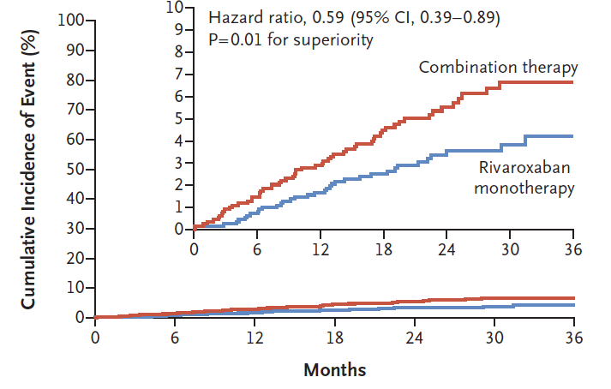
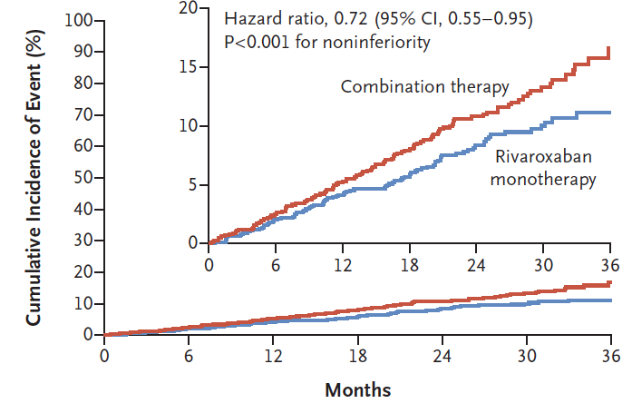
ISTH Major Bleeding:
70% increased with aspirin
Primary: Stroke, SE, MI, USA/revasc, death:
39% increased with aspirin
Death 73 v 41, HR 1.82, p<0.001

Slide 9
Apixaban vs. warfarin in patients
≥ 80 (n=2,436) vs. < 80 years
 | Event Rate (%/year) |  |  |  | Interaction P-value
 | Apixaban | Warfarin |  | HR (95% CI)
Stroke/Systemic Embolism |  |  |  |  | 0.91
Age < 80 | 1.23 | 1.55 |  | 0.79 (0.65, 0.96)
Age ≥ 80 | 1.53 | 1.90 |  | 0.81 (0.51, 1.29)
Major Bleeding |  |  |  |  | 0.74
Age < 80 | 1.93 | 2.78 |  | 0.70 (0.60, 0.82)
Age ≥ 80 | 3.55 | 5.41 |  | 0.66 (0.48, 0.90)
All Bleeding |  |  |  |  | 0.83
Age < 80 | 17.0 | 24.4 |  | 0.71 (0.67, 0.76)
Age ≥ 80 | 26.4 | 37.4 |  | 0.73 (0.64, 0.83)
Intracranial Bleeding |  |  |  |  | 0.67
Age < 80 | 0.32 | 0.73 |  | 0.43 (0.30, 0.62)
Age ≥ 80 | 0.47 | 1.32 |  | 0.36 (0.17, 0.77)
All-cause Mortality |  |  |  |  | 0.73
Age < 80 | 3.03 | 3.42 |  | 0.88 (0.78, 1.00)
Age ≥ 80 | 6.86 | 7.44 |  | 0.93 (0.74, 1.16)
Age < 80
Age ≥ 80
0.25
0.5
1
2
Apixaban better
Warfarin better

Slide 10
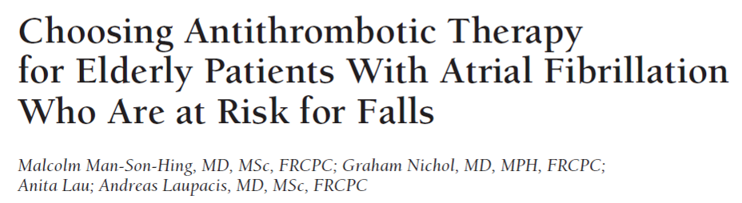
Among older patients, falling is common (about 30% fall at least once a year), and subdural hematomas are uncommon
“… persons taking warfarin must fall about 295 times in 1 year for warfarin to not be the optimal therapy.”
In ARISTOTLE, among patients with history of falls, there was an 80% lower rate of ICH with apixaban vs warfarin
  Of 375 patients with falling on apixaban, 0 had subdural hematoma

Slide 11
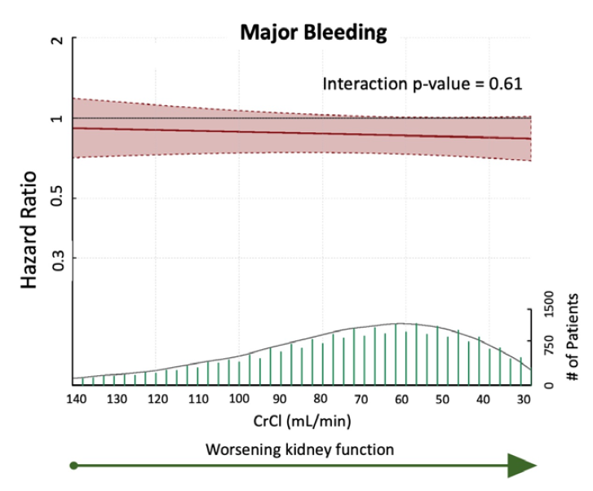
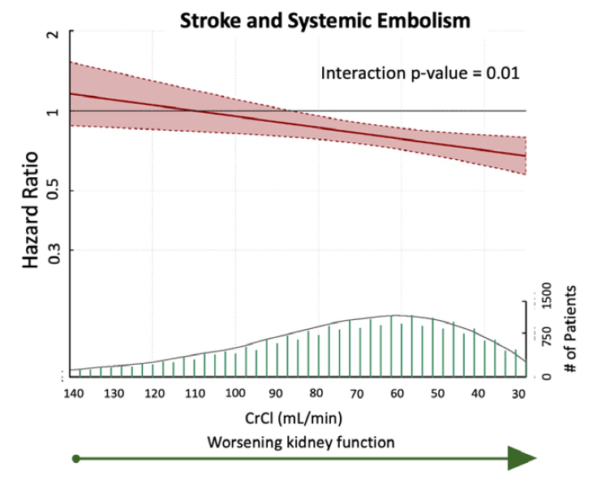
Direct Oral Anticoagulants Versus Warfarin Across the Sprectrum of Kidney Function: Patient-Level Network Meta-Analyses From COMBINE AF

Slide 12
89 year old woman, paroxysmal AF, 48 kg, bioprosthetic aortic valve, creatinine 1.0 (creatinine clearance 30), falls once every two months, and broke her hip while on apixaban. What should be done after her fractures?
Too high risk, stop anticoagulation
Switch to aspirin 81 mg a day
Warfarin with low INR target
Continue apixaban 2.5 mg bid
Place LAA occluder device

Slide 13



Looking for more resources
on this topic?
CME/CE in minutes
Congress highlights
Late-breaking data
Quizzes
Webinars
In-person events
Slides & resources
www.MedEdOTG.com

