Slide 1
Preventing Ischemic Stroke in Today’s World
Mike Sharma, MD, MSc, FRCPC
Michael G. Degroote Chair in Stroke Prevention
Director, Regional Stroke Program
Professor of Medicine
McMaster University
Population Health Research Institute

Slide 2
Resource Information
About This Resource
These slides are one component of a continuing education program available online at MedEd On The Go titled Stroke Management of the Future? The Potential Role of Factor XI/XIa Inhibitors in Secondary Stroke Prevention
Program Learning Objectives:
Review the currently available therapeutics and how they affect multiple pathways involved in the coagulation cascade, thereby increasing the potential for serious bleeds
Discuss factor XI and factor XIa inhibition and review new and emerging anticoagulation pharmacotherapy for secondary stroke prevention
MedEd On The Go®
www.mededonthego.com
This content or portions thereof may not be published, posted online or used in presentations without permission.
This content can be saved for personal use (non-commercial use only) with credit given to the resource authors.
To contact us regarding inaccuracies, omissions or permissions please email us at support@MedEdOTG.com

Slide 3
Disclaimer
The views and opinions expressed in this educational activity are those of the faculty and do not necessarily represent the views of Total CME, LLC, the CME providers, or the companies providing educational grants. This presentation is not intended to define an exclusive course of patient management; the participant should use their clinical judgment, knowledge, experience, and diagnostic skills in applying or adopting for professional use any of the information provided herein. Any procedures, medications, or other courses of diagnosis or treatment discussed or suggested in this activity should not be used by clinicians without evaluation of their patient's conditions and possible contraindications or dangers in use, review of any applicable manufacturer’s product information, and comparison with recommendations of other authorities. Links to other sites may be provided as additional sources of information.

Slide 4
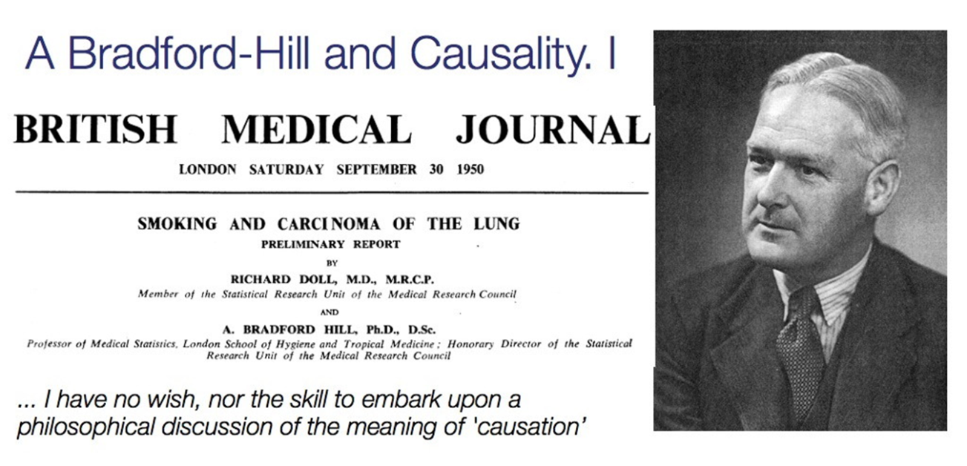
Perspective
Health statistics represent people with the tears wiped off
A Bradford Hill (1897-1991)

Slide 5
The Global Burden of Stroke
Ischemic stroke has a high incidence globally
2019:
Second leading cause of death and reduction in DALYs
Each year in the US, 795,000 people experience stroke²
12.2 million incident strokes worldwide¹
101
million
people living with stroke
23%
of those are
recurrent strokes
On average, every
40 seconds someone in the US has a stroke

Slide 6
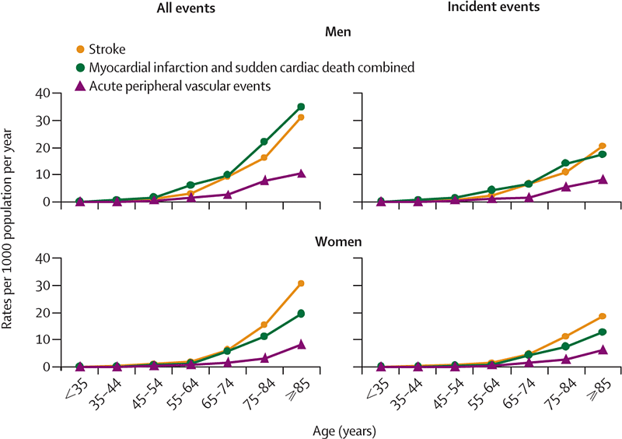
Stroke Incidence Is Age-Dependent

Slide 7
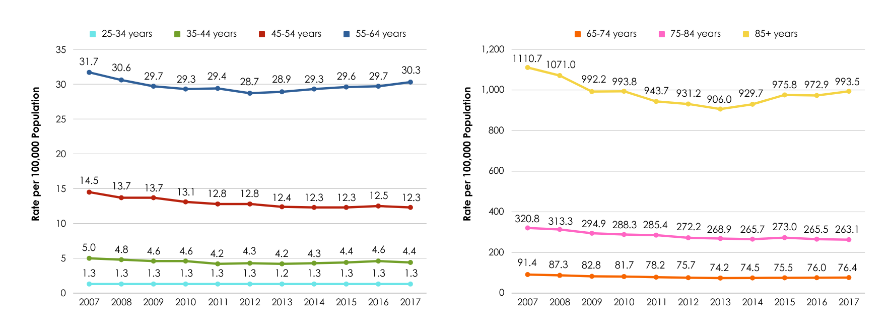
Stroke Mortality Is Age Dependent*

Slide 8
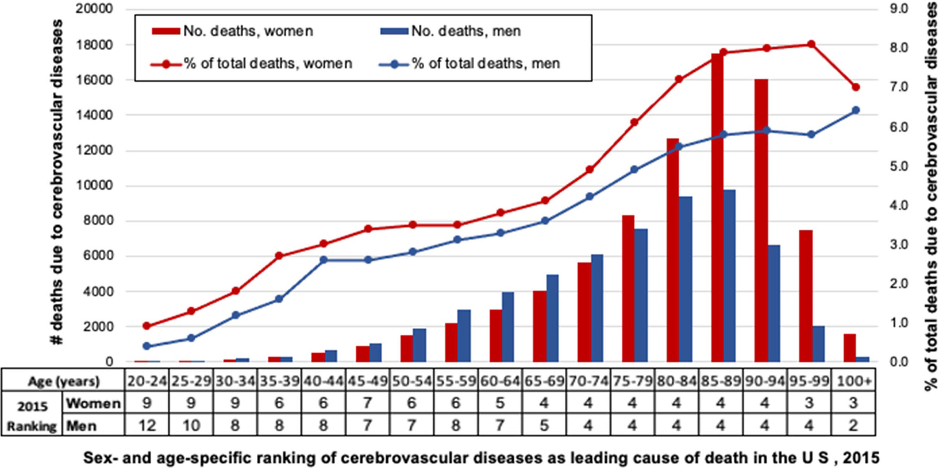
Prevalence of Stroke Deaths Related To Gender

Slide 9
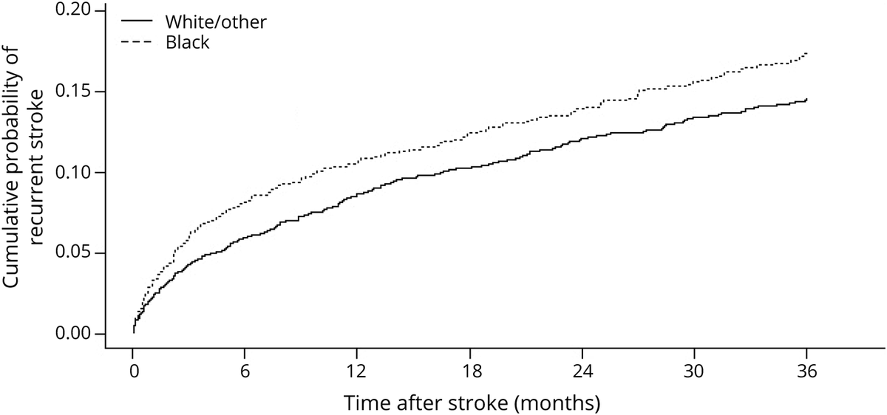
Recurrence Risk Is Affected by Race

Slide 10
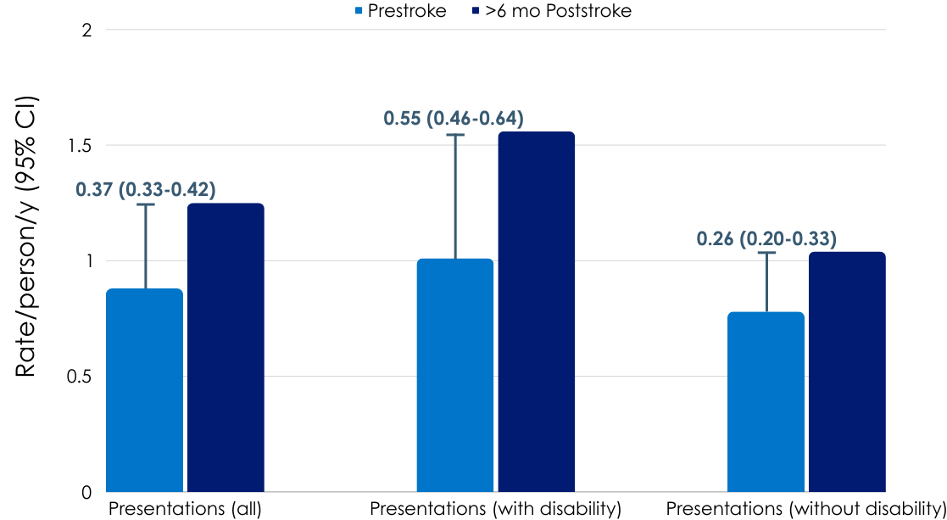
Hospital Visits Increase Long-Term After Stroke
0.55
0.37
0.26

Slide 11
Stroke Is a Costly Disease
Direct and indirect
cost of stroke was
$45.5
billion
from 2014-2015
Direct medical
cost of stroke was
~$28.0 billion
Direct medical
cost of stroke projected to be
~$94.3
billion
in 2035

Slide 12
Cost of Stroke Hospitalization and the First Year
First Stroke (mean - mean + 2 SD) :
Recurrent Stroke (mean - mean + 2 SD) :
In 2010
$40,670 - $203,806
In 2024*
$56,938 - $285,328
In 2010
$51,760 - $357,208
In 2024*
$72,464 - $500,091

Slide 13
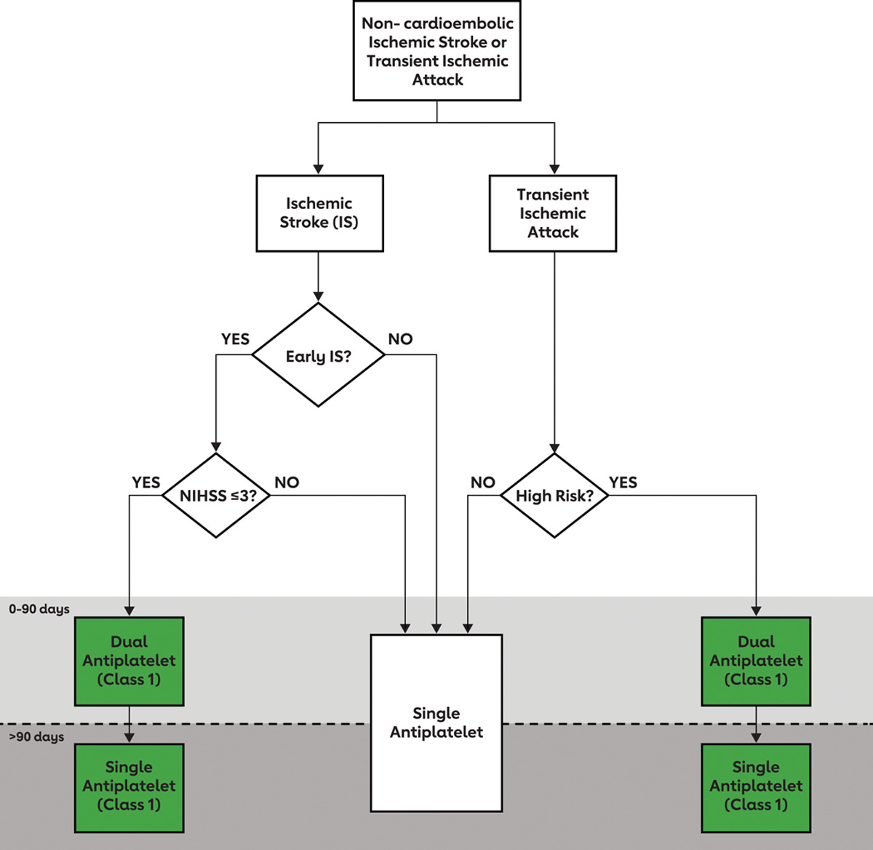
Guidelines for Antiplatelet Therapy Early After Minor Non-Cardioembolic IS or High-Risk TIA

Slide 14
Guidelines for Long-Term Secondary Prevention
Prior IS or TIA
CAD/PAD
No
Yes
Long-term SAPT
Antiplatelet therapy combined
with low-dose rivaroxaban
can be considered

Slide 15
Dual Pathway Inhibition Benefits Those With Previous Stroke: Data From COMPASS Trial
Patients with prior stroke (N=1032 in the 3 study arms)
Compared with ASA alone, rivaroxaban + ASA
↓ Ischemic Stroke: 3.4% versus 1.1% [HR 0.42 (95%CI 0.19-0.92)]
↓ Annualized rate of composite (CV death, stroke or MI): 6.6% versus 3.7%
↑ Annualized rate of major bleeding: 0.5% versus 1.9%
Not initiated early after stroke

Slide 16
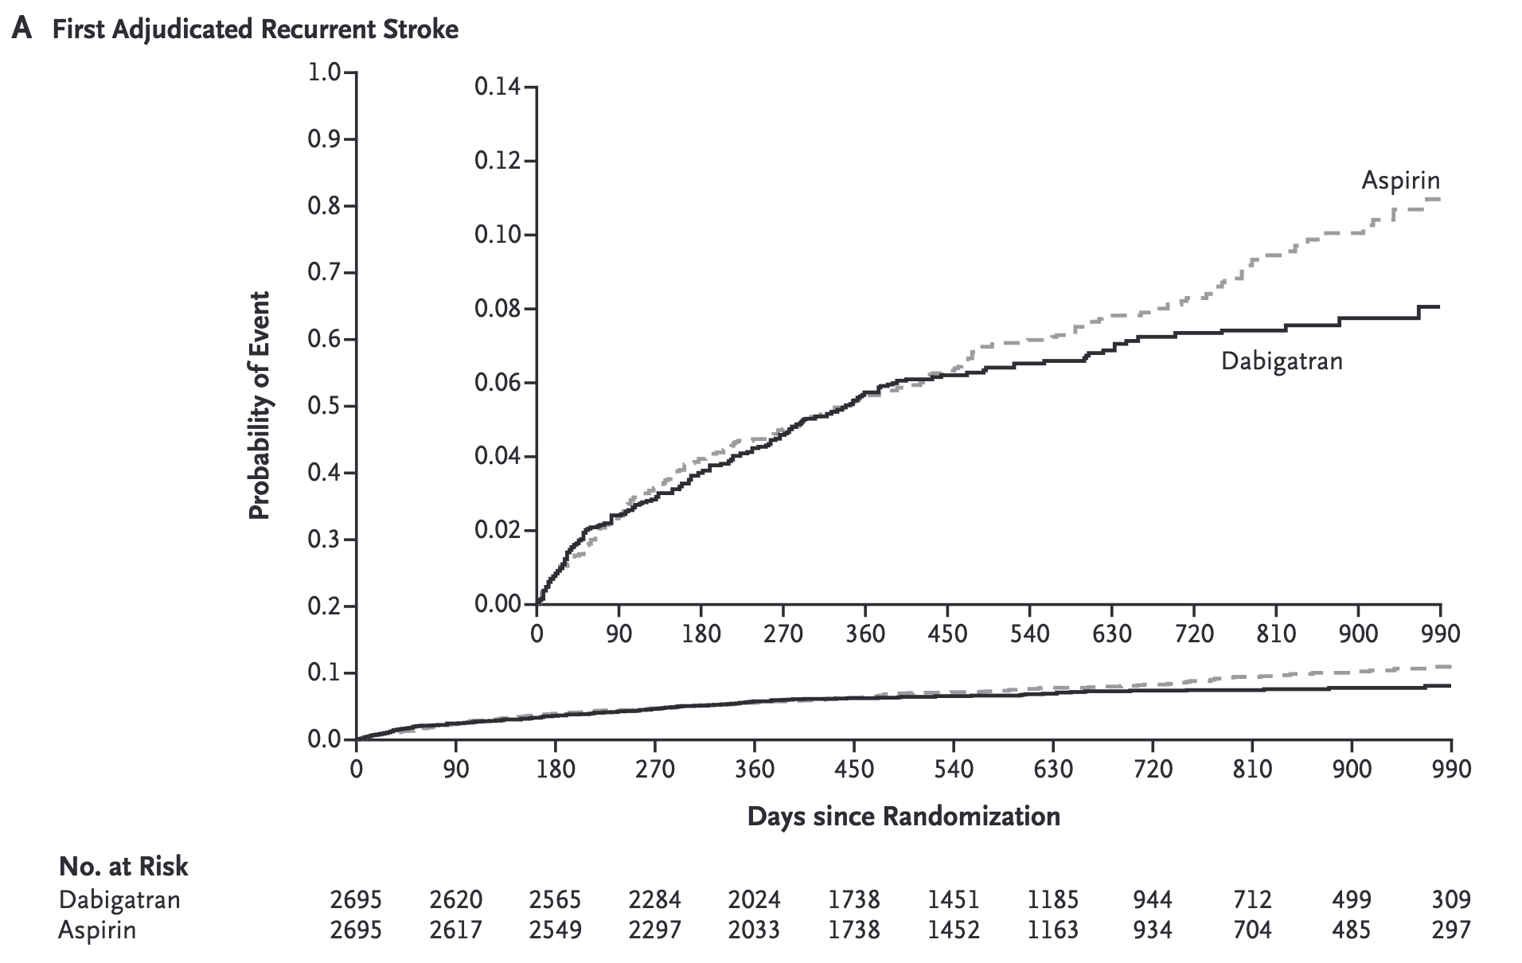
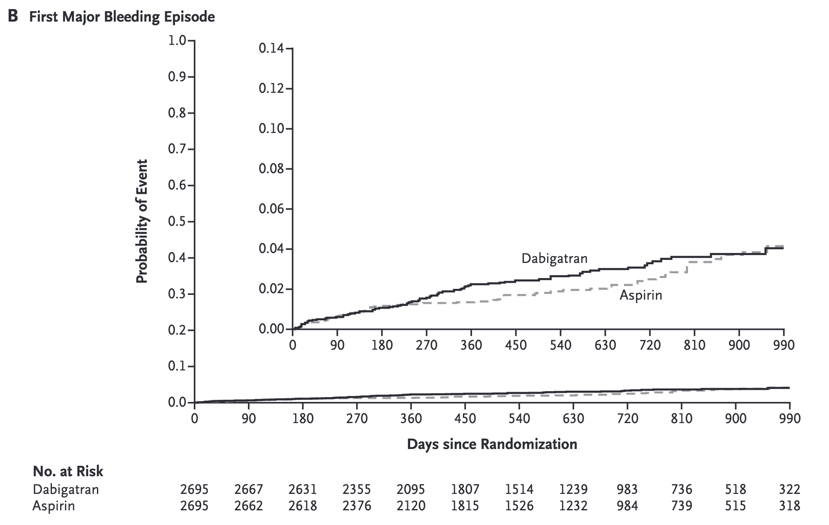
DOACs in ESUS Population
NAVIGATE ESUS
RE-SPECT ESUS
DOAC, direct oral anticoagulants; ESUS, embolic stroke of undetermined source.
Hart RG, et al. N Engl J Med. 2018;378:2191-201;Diener H-C, et al. N Engl J Med. 2019;380:1906-17.

Slide 17
Residual Risk of Recurrent Stroke Continues To Be High in Contemporary Studies
Ischemic stroke at 90 days
%
Wang Y, et al. Circulation. 2015;132:40–6; Johnston SC, et al. N Engl J Med. 2018;379(3):215-25; Johnston SC, et al. N Engl J Med. 2016;375:35-43; Wang Y, et al. N Engl J Med. 2013;369(1):11-9; Johnston SC, et al. N Engl J Med. 2020;383:207-17.

Slide 18
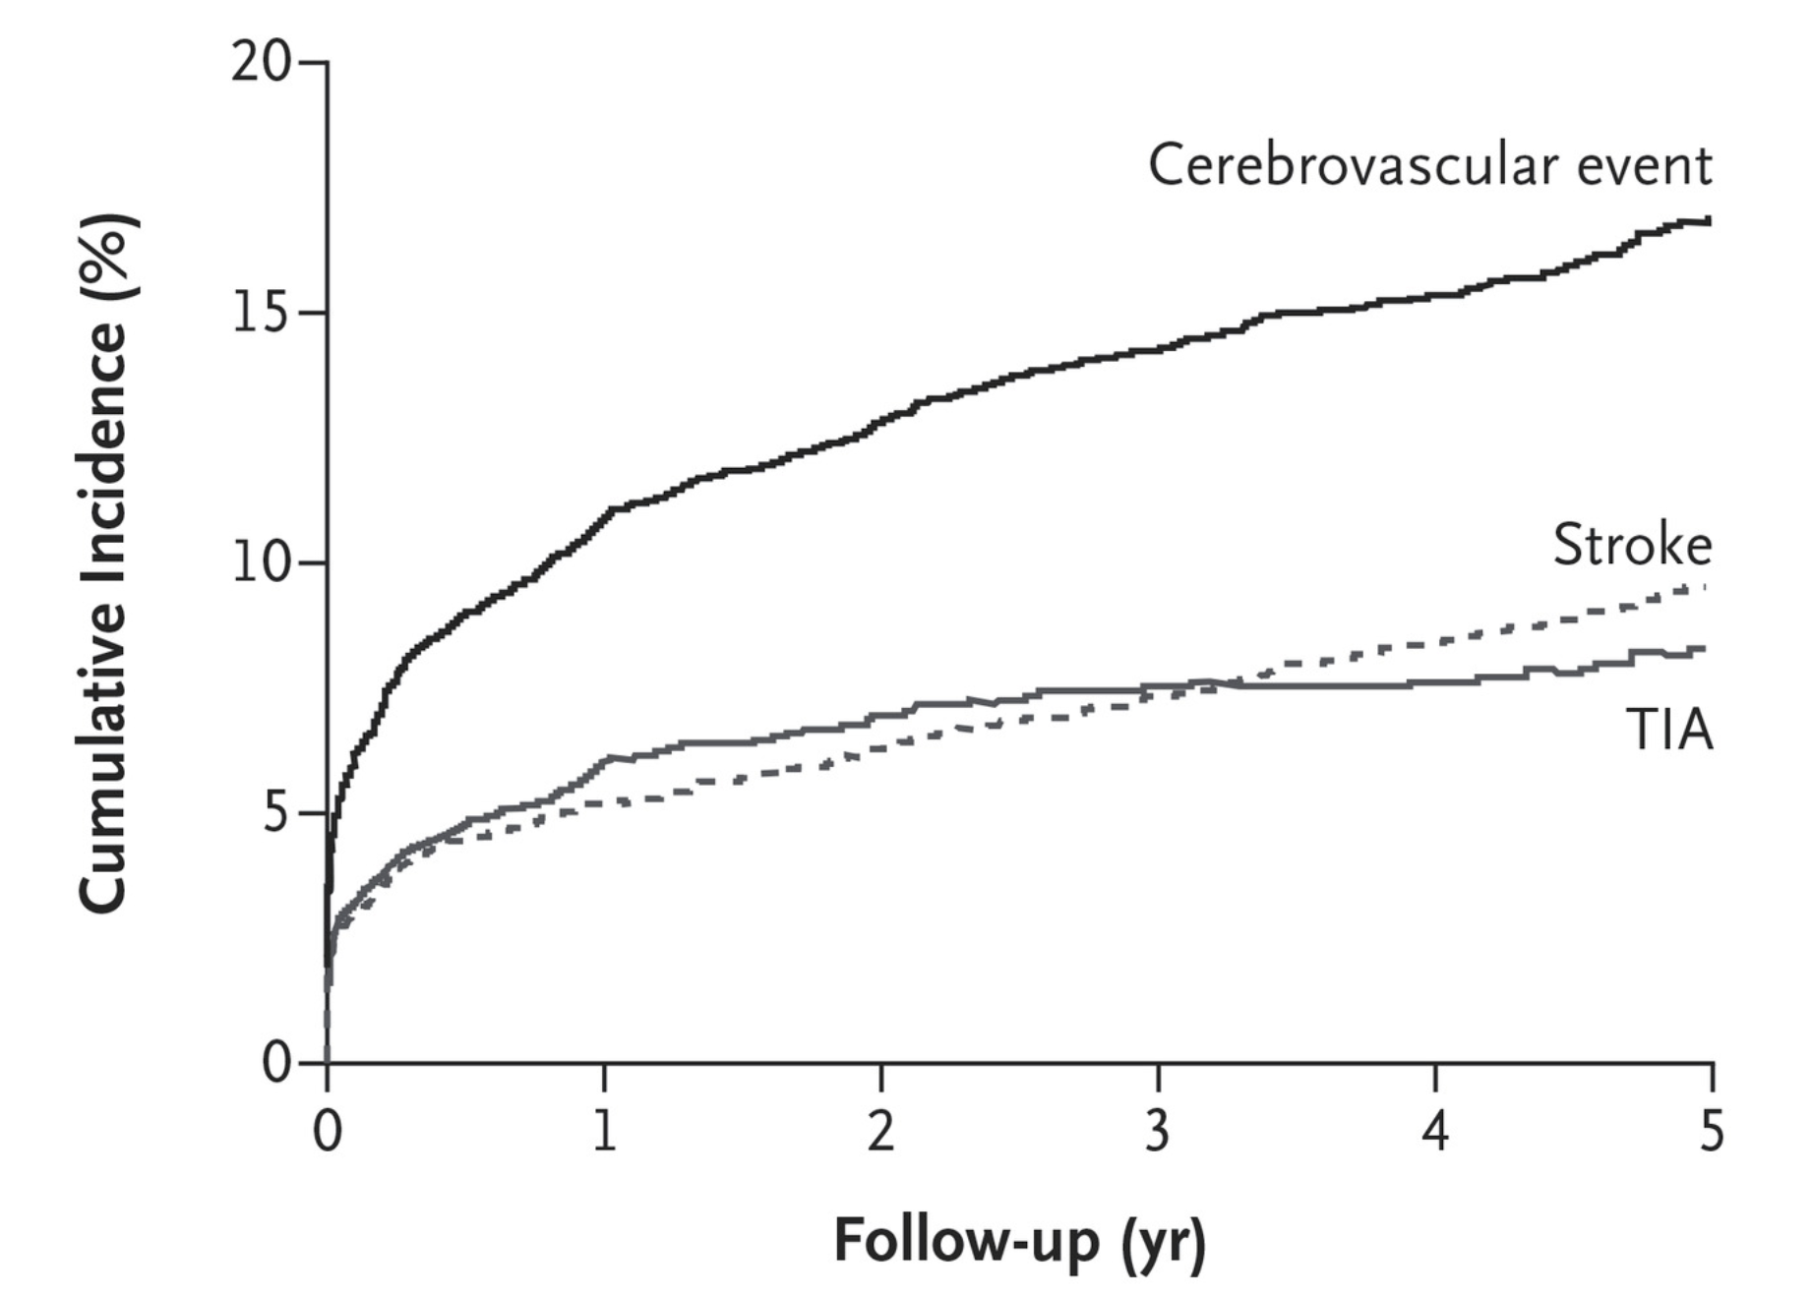
Long-Term Residual Risk Is High
TIAregistry.org project
Cumulative incidence of any
cerebrovascular event, any stroke, and TIA
At 5 years
ASA 70%
Other antiplatelet 36.5%
Dual antiplatelet 6.6%
Anticoagulant 17%
ASA, acetylsalicylic acid.
Amarenco P, et al. N Engl J Med. 2018;378:2182-90.

Slide 19
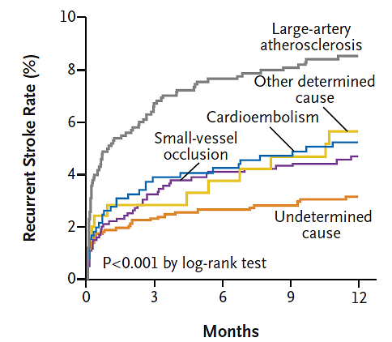
Stroke Recurrent Varies by Subtype
Different stroke etiologies or mechanisms might lead to different risk of stroke recurrence

Slide 20
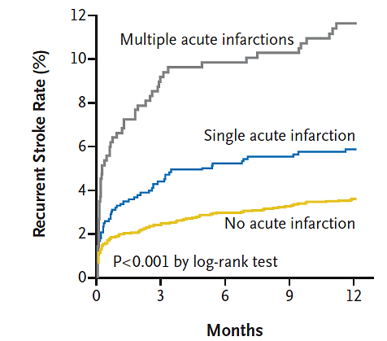
Stroke Recurrence Varies by Infarction Pattern
TIA registry project showed that patients with multiple acute infarctions had a higher risk of stroke recurrence than those with a single acute infarction versus no acute infarction

Slide 21
Unmet Need
COMPASS showed reduction in stroke and MACE but increased bleeding risk
Current Need
Recurrent Events
DOACs/ Increased Risk of Bleeding
Despite current antithrombotic treatment in non-cardioembolic stroke, there is a high risk of recurrent strokes
There is a need for a secondary prevention strategy to prevent recurrent strokes not associated with an increased risk of bleeding
MACE, major adverse cardiovascular event.
Wang Y, et al. Circulation. 2015;132:40–6; Johnston SC, et al. N Engl J Med. 2018;379(3):215-25; Johnston SC, et al. N Engl J Med. 2016;375:35-43; Johnston SC, et al. N Engl J Med. 2020;383:207-17; Sharma M, et al. Circulation. 2019;139:1134–45.

Slide 22
Looking for more resources on this topic?
CME/CE in minutes
Congress highlights
Late-breaking data
Quizzes
Webinars
In-person events
Slides & resources
www.MedEdOTG.com

