Slide 1
The Path Forward – What’s on the Horizon? Factor XI
Manesh R. Patel MD
Chief, Division of Cardiology
Director Duke Heart Center
Duke University

Slide 2
Resource Information
About This Resource
These slides are one component of a continuing education program available online at MedEd On The Go titled Stroke Management of the Future? The Potential Role of Factor XI/XIa Inhibitors in Secondary Stroke Prevention
Program Learning Objectives:
Review the currently available therapeutics and how they affect multiple pathways involved in the coagulation cascade, thereby increasing the potential for serious bleeds
Discuss factor XI and factor XIa inhibition and review new and emerging anticoagulation pharmacotherapy for secondary stroke prevention
MedEd On The Go®
www.mededonthego.com
This content or portions thereof may not be published, posted online or used in presentations without permission.
This content can be saved for personal use (non-commercial use only) with credit given to the resource authors.
To contact us regarding inaccuracies, omissions or permissions please email us at support@MedEdOTG.com

Slide 3
Disclaimer
The views and opinions expressed in this educational activity are those of the faculty and do not necessarily represent the views of Total CME, LLC, the CME providers, or the companies providing educational grants. This presentation is not intended to define an exclusive course of patient management; the participant should use their clinical judgment, knowledge, experience, and diagnostic skills in applying or adopting for professional use any of the information provided herein. Any procedures, medications, or other courses of diagnosis or treatment discussed or suggested in this activity should not be used by clinicians without evaluation of their patient's conditions and possible contraindications or dangers in use, review of any applicable manufacturer’s product information, and comparison with recommendations of other authorities. Links to other sites may be provided as additional sources of information.

Slide 4
Learning Objectives
Understand the mechanism of factor XI inhibitors
Understand the existing clinical data around factor XI therapy
Understand the factor XI therapy and its promise for the future

Slide 5
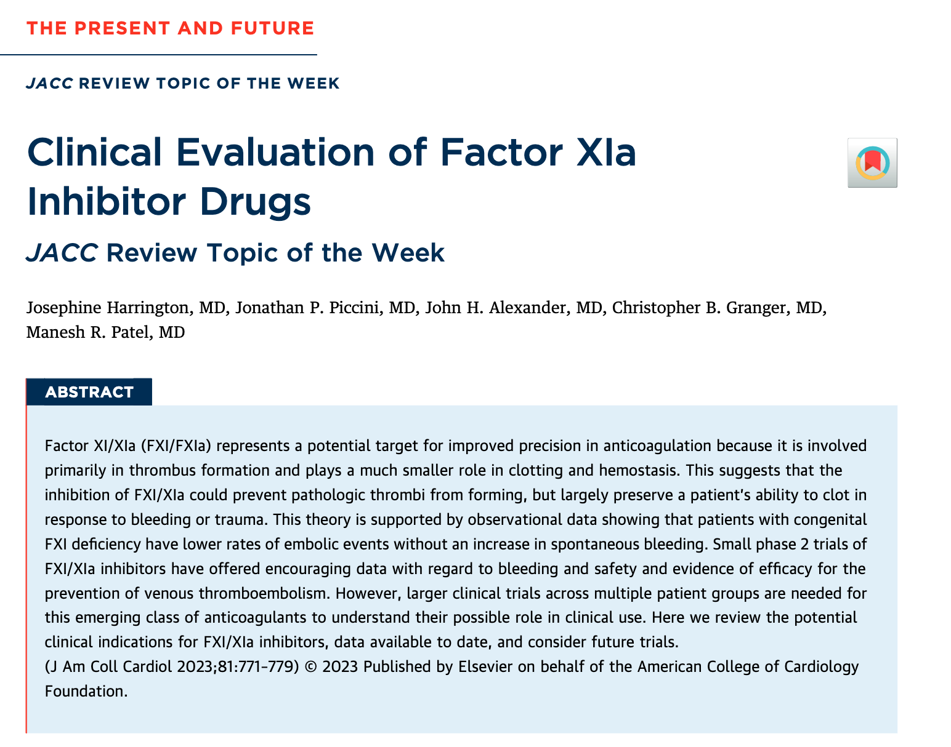
Good Reference for Review of Topic

Slide 6
The Promise of Factor XIa Inhibition

Slide 7
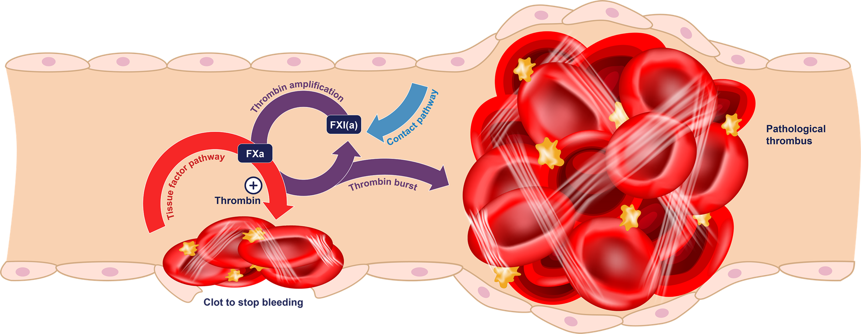
Normal Physiology: Without an Anticoagulant
BUT a pathological thrombus could also be created
When no anticoagulant is used, a clot is formed to stop the bleeding

Slide 8
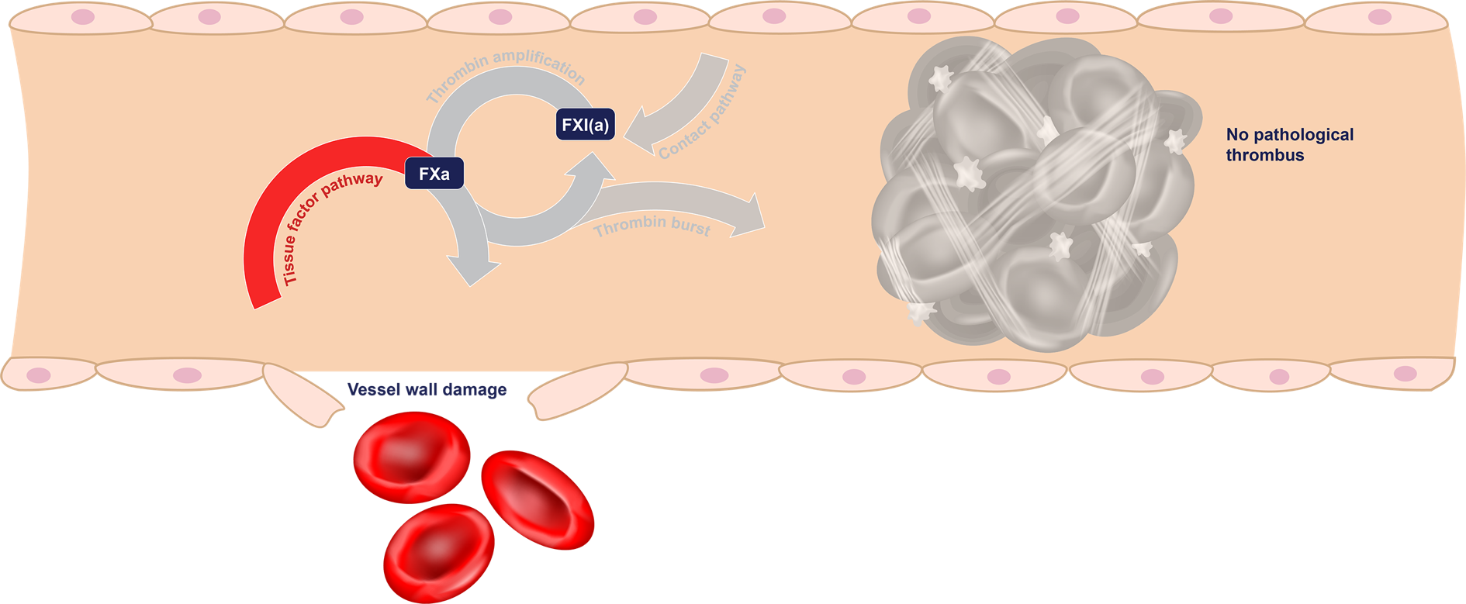
With a DOAC (e.g., Apixaban or Rivaroxaban)
DOAC
When a DOAC is used, FXa is inhibited, which prevents pathological thrombi
BUT it can also prevent the beneficial blood clots that stop bleeding in damaged vessels

Slide 9
With a Factor XI Inhibitor (Hypothesis: Uncoupling Hemostasis From Thrombosis)
Factor XI inhibitor
When a factor XI inhibitor is used, thrombin amplification is inhibited, which prevents pathological thrombi
AND the tissue factor pathway still produces thrombin, which allows beneficial blood clots to form

Slide 10
The Preclinical and Observational Data Supporting Factor XI as a Target for Therapy

Slide 11
Current Evidence Supporting FXI(a) Inhibition as a Target
CONDITION
OBSERVATION
FXI-knockout mice¹
Homozygous FXI-knockout mice are protected from thrombosis
At the same time, they do not show a bleeding phenotype differing from wild-type mice
In vivo animal models²
Reducing/inhibiting FXI showed strong antithrombotic effects in vivo
No increase in bleeding time even at very high doses or on top of dual antiplatelet therapy
Inherited FXI deficiency³
Individuals with FXI deficiency are reported to have a reduced incidence of VTE and stroke
Hemorrhage occasionally reported after trauma or surgery (dental extractions, tonsillectomies, surgery in the urinary and genital tracts, and nasal surgery)
FXI clinical experience
Antisense technology of IONIS⁴: Phase 2 study in TKA: Improved VTE risk reduction together with numerically less bleeding vs enoxaparin (of note, surgery was performed at suppressed FXI levels)
Anti-FXI-AB (MAA868⁵ and xisomab); Anti-FXIa-AB (osocimab²): Published data from Phase 1 studies confirmed good safety and tolerability even when high levels of FXI or FXIa inhibition were maintained for more than 1 month. TKA study for osocimab completed confirming FXIa-inhibition being efficacious and well tolerated. Oral selective FXIa inhibitor (milvexian): Phase 2 work showing FXIa inhibition efficacious in prevention of VTE and associated with low risk of bleeding.⁶

Slide 12
Genetic Predisposition to Low FXI Levels Is Associated With Reduced Risk of Ischemic Stroke and VTE
Thrombotic events (MI, ischemic stroke, and VTE)
Stroke subtypes
0.83
1.0
0.52
p<0.001
0.47
p<0.001
0.16
p<0.001
0.1
Error bars represent 95% confidence intervals. Odds ratios presented are for a 30% mean increase in aPTT (equivalent to pharmacological FXI lowering). Data are from 371,695 participants in the UK Biobank and two large genome-wide association studies. FXI, factor XI; MI, myocardial infarction Georgi B, et al. Stroke. 2019;50(11):3004-3012.

Slide 13
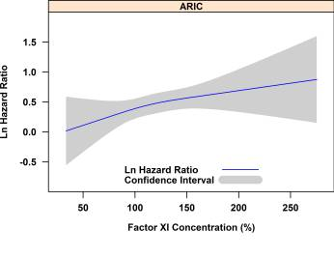
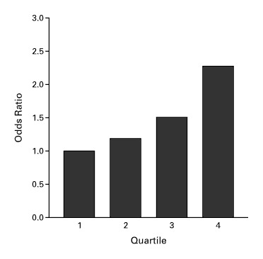
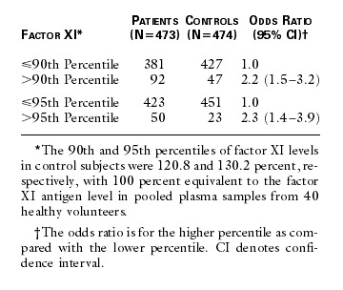
FXI Level Inversely Related to Risk of Thrombosis
Logarithm Hazard Ratio of Venous Thromboembolism in Relation to Factor XI Concentration, ARIC and CHS¹
Odds Ration for Thrombosis According to FXI Level²
Risk of Thrombosis According to Factor XI Level²
Subjects with highest plasma FXI levels had a x2 risk of VTE compared to those with lower levels

Slide 14
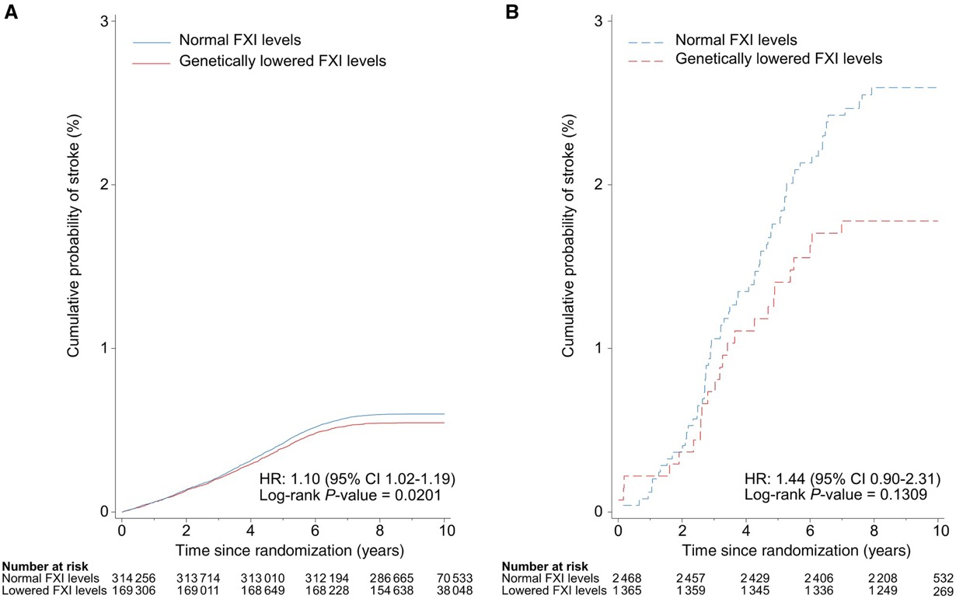
Probability of Ischemic Stroke in Individuals With Normal and Genetically Lowered Levels of FXI Activity
Participants without AF
Participants with AF

Slide 15
Clinical Data With FXI Therapies

Slide 16
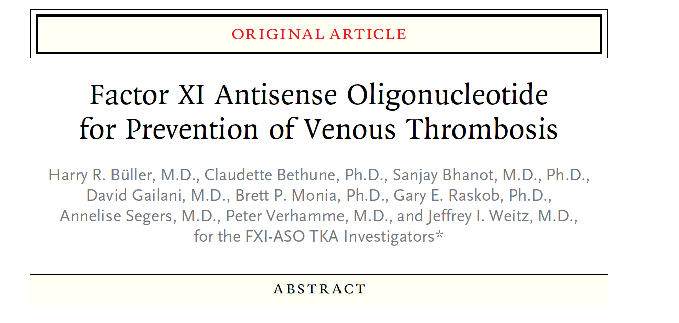
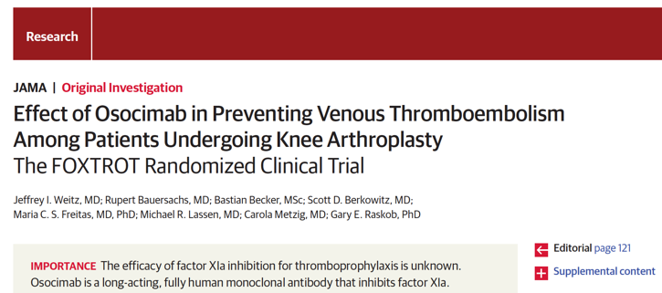
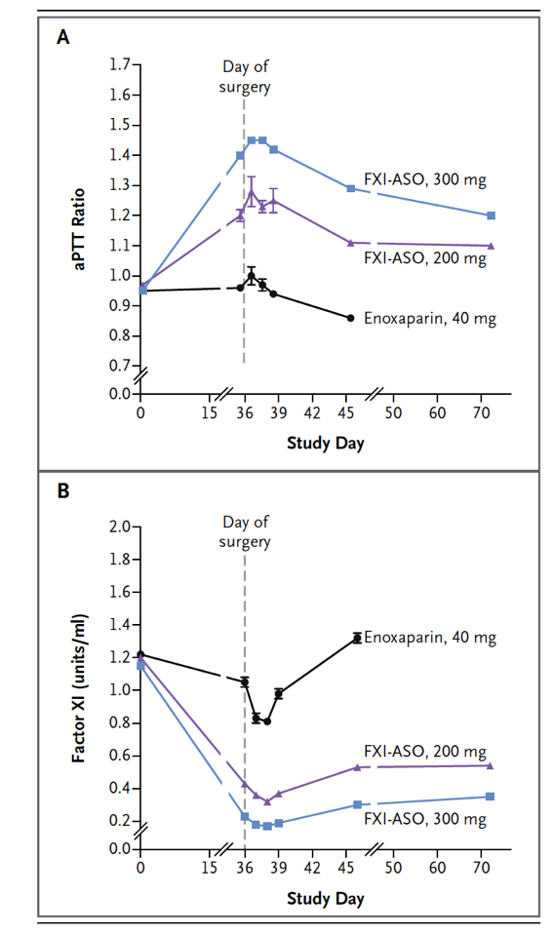
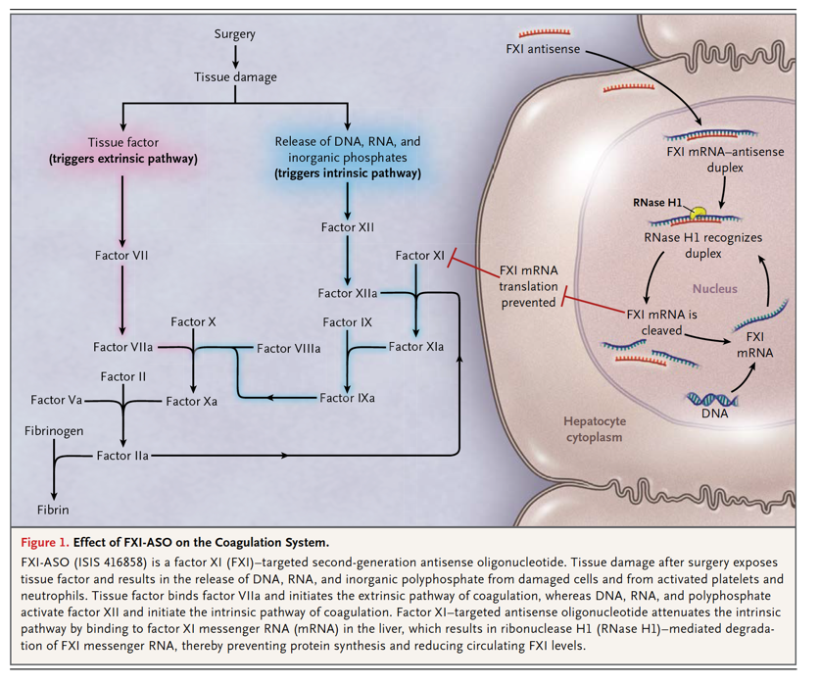

Slide 17
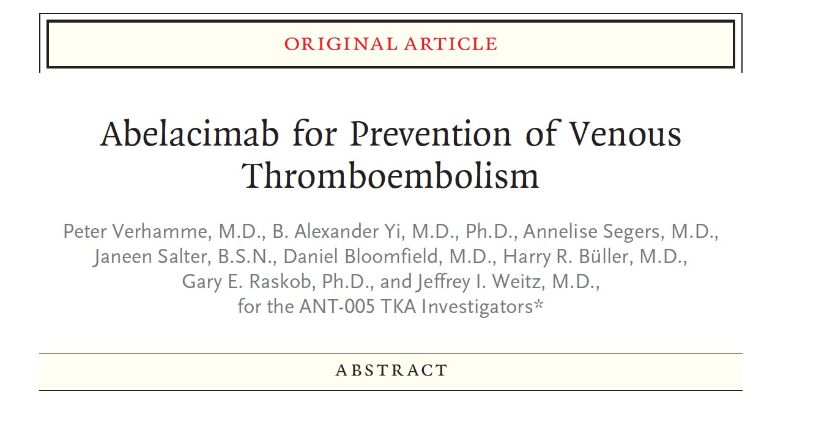
ANT-005 TKA Investigated the Use of Abelacimab Versus Enoxaparin in Patients Undergoing Elective Unilateral TKA
Abelacimab
Abelacimab

Slide 18
ANT-005 TKA Investigated the Use of Abelacimab Versus Enoxaparin in Patients Undergoing Elective Unilateral TKA
Abelacimab
Abelacimab

Slide 19
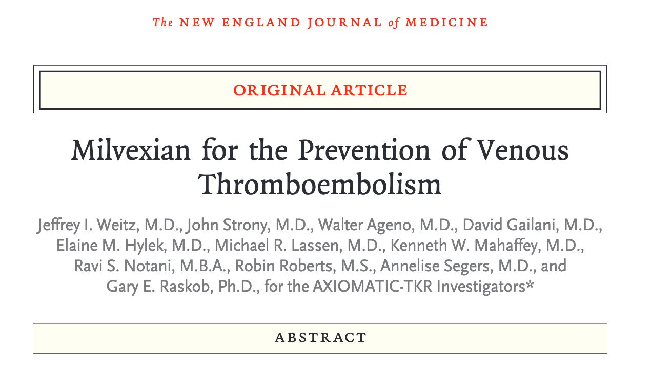
AXIOMATIC-TKR Investigated the Use of Milvexian Versus Enoxaparin in Patients Undergoing Elective Unilateral TKA
Milvexian twice daily
Milvexian once daily
Milvexian twice daily
Milvexian once daily

Slide 20
AXIOMATIC-TKR Investigated the Use of Milvexian Versus Enoxaparin in Patients Undergoing Elective Unilateral TKA
Milvexian twice daily
Milvexian once daily
Milvexian twice daily
Milvexian once daily

Slide 21
Prospective, randomized, double-blind, active-comparator, phase 2 study
Primary safety endpoint: bleeding (ISTH major and non-major clinically relevant bleeding)
Quantification of factor XI inhibition
Exploratory efficacy endpoint: stroke, systemic embolism, CV death, MI
Asundexian 50 mg n = 250
2 weeks post-study drug observation period
Patients with atrial fibrillation
Asundexian 20 mg n = 250
R
Apixaban n = 250
Day 1
Randomization
W12
EOT
EOS
Primary Objective: To evaluate that the oral FXIa inhibitor asundexian when compared to apixaban leads to a lower incidence of bleeding in participants with AF

Slide 22
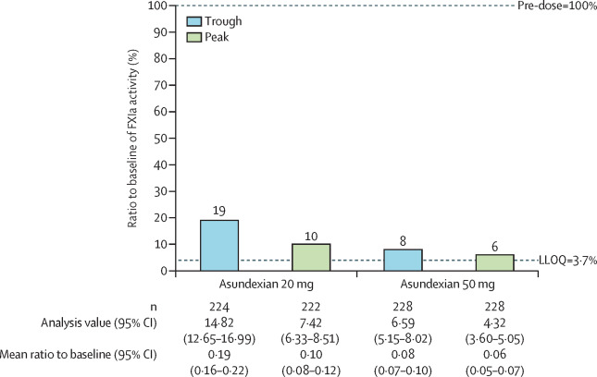
FXIa Activity - Inhibition Data
Vertical bars indicate the percent reduction in FXIa activity when compared with baseline. FXIa=activated coagulation factor XI.
LLOQ=lower level of quantification.

Slide 23
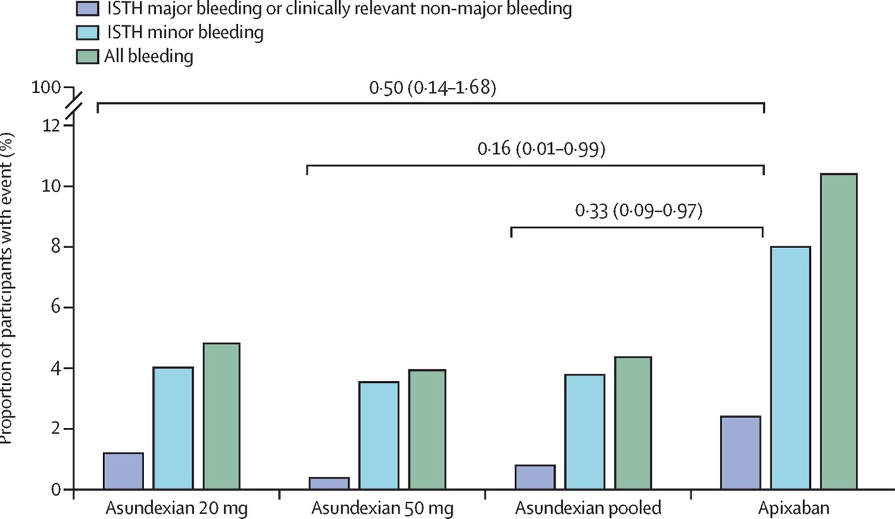
Primary Safety Outcome (ISTH Bleeding Classification)
On-treatment analysis, % of patients
No ISTH major bleeding in any treatment arm
Less bleeding in the 2 asundexian arms reported, when compared to apixaban for different severities of bleeding
Consistent also for BARC and TIMI bleeding definitions

Slide 24
Exploratory Efficacy Analysis
 | Asundexian 20 mg N = 251 IR (90% CI) | Asundexian 50 mg N = 254 IR (90% CI) | Apixaban N = 250 IR (90% CI) | Total N = 755 IR (90% CI)
CV death, MI, ischemic stroke, or systemic embolism | 2 (0.80 %) | 4 (1.57 %) | 3 (1.20 %) | 9 (1.19 %)
CV death | 1 (0.40 %) | 3 (1.18 %) | 3 (1.20 %) | 7 (0.93 %)
MI | 0 | 1 (0.39 %) | 0 | 1 (0.13 %)
Ischemic stroke | 2 (0.80 %) | 1 (0.39 %) | 0 | 3 (0.40 %)
Systemic embolism | 0 | 0 | 0 | 0
All-cause mortality (ITT) | 2 (0.80 %) | 4 (1.57 %) | 4 (1.60 %) | 10 (1.32 %)
As expected, only single efficacy endpoints were reported in the study.
→ No conclusion on efficacy can be drawn

Slide 25
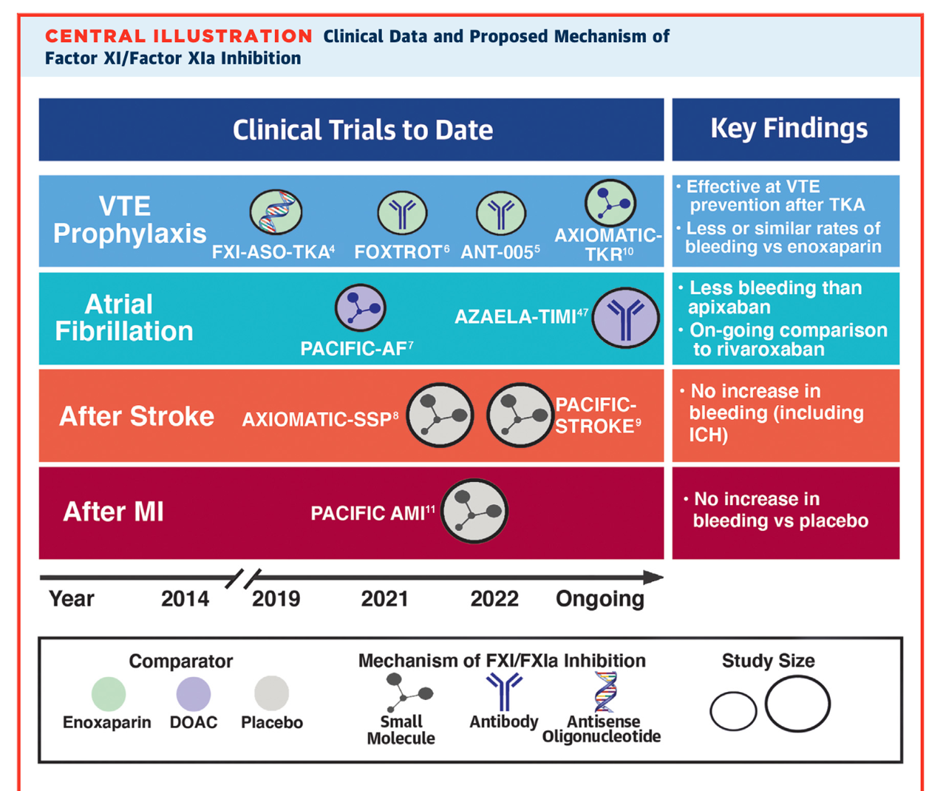
Phase 2 data have shown
Less bleeding than both enoxaparin and apixaban (PACIFIC AF)
No increase in bleeding in secondary stroke with signals toward less thrombosis
No increase in bleeding in AMI – efficacy signals limited

Slide 26
Phase 3 Studies

Slide 27
Phase 3 Studies

Slide 28
Factor XI Emerging Data
ASO, mAB, and small molecules being tested against FXI
Multiple programs ongoing, phase 3 asundexian OCEANIC AF stopped by DSMB for inferior efficacy – we can discuss how this does not relate to secondary stroke
Keys will be maximizing the compounds strengths to the patients, comparators, and use in clinical practice
Understanding patient preferences and net benefits will lead to improved next decade of anti-thrombotic therapy:
Aim to enroll more people (including those at high risk for bleeding, many of whom are not currently receiving therapy)
Capture broad endpoints (thrombotic, bleeding, and other) and patients’ perspectives and preferences

Slide 29
Looking for more resources on this topic?
CME/CE in minutes
Congress highlights
Late-breaking data
Quizzes
Webinars
In-person events
Slides & resources
www.MedEdOTG.com

