Slide 1
Emerging Data in the Management of Acute Ischemic Stroke/TIA
Ashkan Shoamanesh, MD, FRCPC
Associate Professor of Medicine (Neurology)
Marta and Owen Boris Chair in Stroke Research and Care
Director, Hemorrhagic Stroke Research Program and Scientist
McMaster University / Population Health Research Institute
Hamilton, Ontario, Canada

Slide 2



Resource Information
About This Resource
These slides are one component of a continuing education program available online at MedEd On The Go titled Stroke Management of the Future? The Potential Role of Factor XI/XIa Inhibitors in Secondary Stroke Prevention
Program Learning Objectives:
Review the currently available therapeutics and how they affect multiple pathways involved in the coagulation cascade, thereby increasing the potential for serious bleeds
Discuss factor XI and factor XIa inhibition and review new and emerging anticoagulation pharmacotherapy for secondary stroke prevention
MedEd On The Go®
www.mededonthego.com
This content or portions thereof may not be published, posted online or used in presentations without permission.
This content can be saved for personal use (non-commercial use only) with credit given to the resource authors.
To contact us regarding inaccuracies, omissions or permissions please email us at support@MedEdOTG.com

Slide 3
Disclaimer
The views and opinions expressed in this educational activity are those of the faculty and do not necessarily represent the views of Total CME, LLC, the CME providers, or the companies providing educational grants. This presentation is not intended to define an exclusive course of patient management; the participant should use their clinical judgment, knowledge, experience, and diagnostic skills in applying or adopting for professional use any of the information provided herein. Any procedures, medications, or other courses of diagnosis or treatment discussed or suggested in this activity should not be used by clinicians without evaluation of their patient's conditions and possible contraindications or dangers in use, review of any applicable manufacturer’s product information, and comparison with recommendations of other authorities. Links to other sites may be provided as additional sources of information.

Slide 4




Overview of Clinical Trials Investigating FXI Inhibition
The products shown are currently investigational and are not licensed for use in any country
KEY
Results presented
Results not presented
AF
Prior stroke
ESKD on hemodialysis
ACS/AMI
TKA
Cancer
COMPARATOR
PACIFIC-AF^{1,2}
OCEANIC-AF⁴
LIBREXIA-AF⁵
LILAC-TIMI⁶
Placebo
AZALEA-TIMI 71³
LMWH
PACIFIC-STROKE^{7,8}
OCEANIC-STROKE¹⁰
LIBREXIA-STROKE¹¹
DOAC
AXIOMATIC-SSP⁹
No comparator
TECHNOLOGY
ASO
ISIS-FXI_{Rx}^{12,13}
Xisomab 3G3^{14,15}
CONVERT*^{,16}
RE-THINc ESRD¹⁷
Antibody
Condition
Small molecule
PACIFIC-AMI^{18,19}
LIBREXIA-ACS²⁰
NUMBER OF PATIENTS
100–999
≥1000
<100
AXIOMATIC-TKR^{27,28}
FXI-ASO TKA^{21,22}
FOXTROT^{23,24}
ANT-005^{25,26}
ASTER^{#,29}
MAGNOLIA^{‡,30}
Xisomab 3G3^{§,31}
2014
2015
2016
2019
2020
2021
2022
Ongoing
Completion date

Slide 5
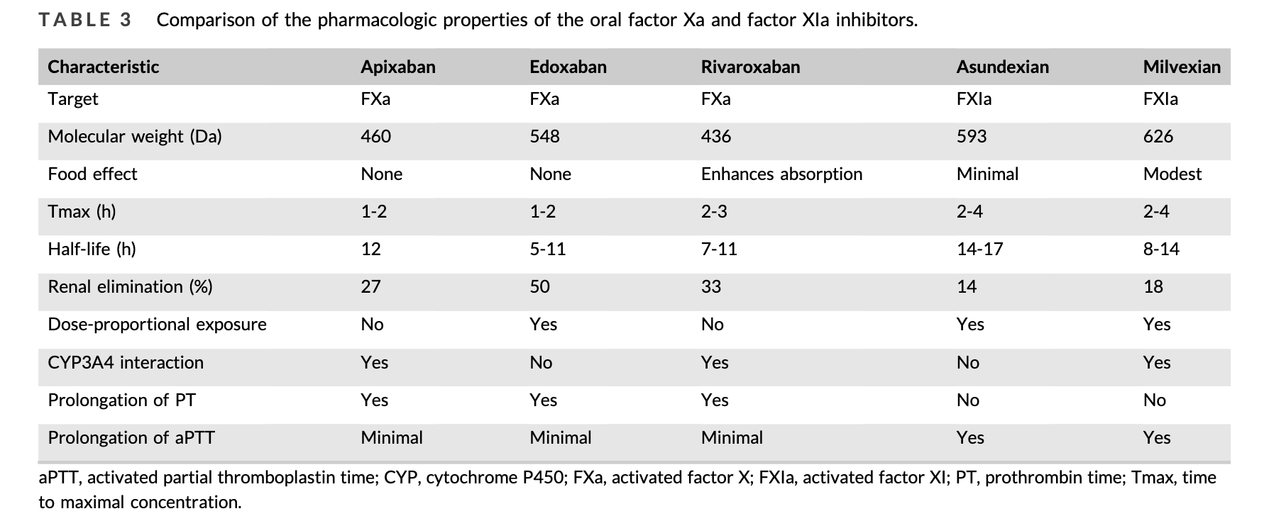
Comparison of Factor Xa and Factor XIa Inhibitors – Small Molecules

Slide 6



The PACIFIC Program
Concerted evaluation across Phase II programs with over 4,000 patients
Atrial fibrillation
20 mg asundexian
50 mg asundexian
Apixaban
Acute myocardial infarction
10 mg asundexian
20 mg asundexian
50 mg asundexian
Placebo
+ DAPT
Non-cardioembolic ischemic stroke
10 mg asundexian
20 mg asundexian
50 mg asundexian
Placebo
+ SAPT or DAPT
755 patients
Results presented at ACC 2022 and published in Lancet 2022¹
1,601 patients
Results presented at ESC 2022 and published in Circulation 2022²
1,808 patients
Results presented at ESC 2022 and published in Lancet 2022³

Slide 7
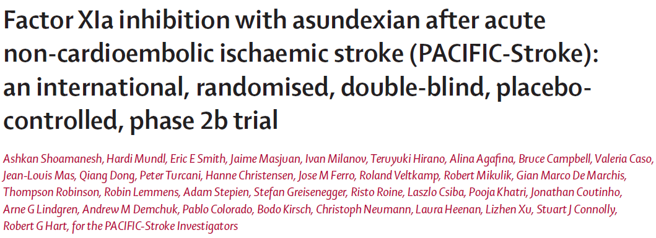

Slide 8
Non-Cardioembolic Ischemic Stroke
Ischemic stroke
Cardioembolic
27%
Other
2%
Cryptogenic
35%
Small vessel disease
23%
Large artery atherosclerosis
13%
Non-cardioembolic: ~75% of all ischemic stroke¹
Substantial recurrence rate (>6%/yr) despite current guideline recommended treatment²⁻⁵

Slide 9
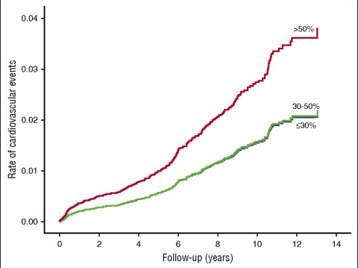




Human Genetic Data and Clinical Data Support the Testing of Asundexian, an FXIa Inhibitor, for Secondary Stroke Prevention
Significant reduced risk for CV events and ischemic stroke in FXI-deficient individuals
Significant reduced risk for ischemic stroke in patients with CAD and PAD treated with dual pathway inhibition (rivaroxaban and Aspirin)
HR for CV events
0.57 (95% CI 0.35-0.93) for ≤30% FXI activity
0.52 (95% CI 0.31-0.87) - for 30-50% FXI activity
Odds ratio for ischemic stroke 0.47 (95% CI 0.36-0.61)
Preis M, et al. (Blood. 2017;129(9):1210-121)
Sharma M, Circulation. 2019;139(9):1134-1145.

Slide 10
PACIFIC-Stroke: Schema
Prospective, randomized, double-blind, placebo-controlled, phase II, dose-ranging study
Asundexian 50 mg QD n = 447
Patients with
non-cardioembolic ischemic stroke ≤48 hrs from symptom onset
2 weeks
post-study drug
observation period
Asundexian 20 mg QD n = 450
R
Asundexian 10 mg QD n = 455
Placebo QD n = 456
Background APT
Day 1
Randomization
MRI prior to or up to 72 hours post randomization
6-12 Months
EOT
MRI
EOS
Enrollment: 1,808 patients between June 15, 2020, and July 22, 2021, at 196 sites in 23 countries

Slide 11
Primary Efficacy Outcome
Ischemic Stroke or Covert Infarcts at 6 Months
No observed dose-response (Emax2 model t statistic: -0.68, p=0.80)

Slide 12
Secondary Efficacy Outcome
Incident Covert Brain Infarct(s) on MRI at 6 Months (75% of Events; 69% Small Subcortical Infarcts)
Outcome | Asundexian, 10 mg (N=455) | Asundexian, 10 mg vs. placebo | Asundexian, 20 mg (N=450) | Asundexian, 20 mg vs. placebo | Asundexian, 50 mg (N=447) | Asundexian. 50 mg vs. placebo | Placebo (N=456)
 | No. of patients (%) | CIR (90% CI) | No. of patients (%) | CIR (90% CI) | No. of patients (%) | CIR (90% CI) | No. of patients (%)
Incident covert brain infarct(s) on MRI | 63 (13.8%) | 0.99 (0.75 - 1.30) | 74 (16.4%) | 1.17 (0.90 - 1.51) | 74 (16.6%) | 1.17 (0.91 - 1.52) | 64 (14.0%)
No effect on covert brain infarct

Slide 13

Secondary Efficacy Outcome
Total Follow-Up (Median 10.6 Months)
Outcome | Asundexian, 10 (N=455) | Asundexian, 10 vs. placebo | Asundexian, 20 (N=450) | Asundexian, 20 vs. placebo | Asundexian, 50 (N=447) | Asundexian, 50 vs. placebo | Placebo (N=456)
 | No. of patients (%) | HR (90% CI) | No. of patients (%) | HR (90% CI) | No. of patients (%) | HR (90% CI) | No. of patients (%)
Ischemic stroke | 26 (5.7%) | 0.93 (0.59-1.45) | 26 (5.8%) | 0.94 (0.60-1.47) | 22 (4.9%) | 0.80 (0.50-1.27) | 28 (6.1%)
Positive trend shown for reduction in ischemic stroke with asundexian 50 mg

Slide 14

Secondary Exploratory Outcomes: TIA
Total Follow-Up (Median 10.6 Months)
Outcome | Asundexian, 10 (N=455) | Asundexian, 10 vs. placebo | Asundexian, 20 (N=450) | Asundexian, 20 vs. placebo | Asundexian, 50 (N=447) | Asundexian, 50 vs. placebo | Placebo (N=456)
 | No. of patients (%) | HR (90% CI) | No. of patients (%) | HR (90% CI) | No. of patients (%) | HR (90% CI) | No. of patients (%)
TIA | 10 (2.2%) | 0.91 (0.44-1.87) | 2 (0.4%) | 0.18 (0.05-0.64) | 2 (0.4%) | 0.18 (0.05-0.65) | 11 (2.4%)

Slide 15
Post-Hoc Exploratory Outcome: Recurrent Ischemic Stroke or TIA Total Follow-Up (Median 10.6 Months)
HR 0.92, 90% CI 0.63 – 1.35
HR 0.74, 90% CI 0.49 – 1.12
HR 0.64, 90% CI 0.41 – 0.98
Dose dependent reduction of composite of ischemic stroke or TIA with asundexian

Slide 16
Outcome: Recurrent Stroke and TIA
Exploratory Post-Hoc Subgroup Analysis
A. Patients with large artery stroke (TOAST, N=320)
B. Patients with any extra-/intracranial atherosclerosis (vascular imaging, N= 791)
HR 0.56, 90% CI 0.26 – 1.19
HR 0.39, 90% CI 0.18 – 0.85
Patients with atherosclerosis had fewer recurrent strokes and TIA with asundexian 50

Slide 17
Bleeding Outcomes (n=1786; on-treatment)
A. Major or Clinically-Relevant Non-Major Bleeding (ISTH)¹
B. All Bleeding
HR 1.57, 90% CI 0.91 – 2.71
C. Hemorrhagic Transformation in Patients With Baseline MRI After Randomization
 | Asundexian 10 (N=277) | Asundexian 20 (N=265) | Asundexian, 50 (N=277) | Placebo (N=296)
HI1 and 2 | 29.6% | 29.4% | 30.3% | 32.8%
PH1 and 2 | 1.1% | 0.4% | 0% | 1.4%
No significant increase in bleeding and hemorrhagic transformation of index stroke

Slide 18
Efficacy and Safety of the FXIa Inhibitor Milvexian for Secondary Stroke Prevention: Final Results of the AXIOMATIC-SSP Dose-Finding Randomized Trial

Slide 19
AXIOMATIC-SSP
Study Design
Placebo
200 mg milvexian BID‡
Key inclusion criteria
Non-lacunar stroke
Visible atherosclerosis
NIHSS score ≤7
ABCD² score ≥6
≤48 hours after symptom onset
1st dose of study drug
100 mg milvexian BID
50 mg milvexian BID
25 mg milvexian BID
25 mg milvexian QD
Maximum of 6h between MRI and 1st dose of study drug
Patients with acute stroke or transient ischemic attack
Randomization (48h)*,†
All participants on 75 mg clopidogrel + 100 mg aspirin
Day
21
All participants on 100 mg aspirin
Day
90
Study MRI
(preferred)
OR
Study MRI within 72h
Study MRI

Slide 20
Symptomatic Ischemic Stroke*
38/691
15/328
12/318
13/328
11/310
27/351
Milvexian
RR (95% CI) vs. Placebo | 0.83 (0.46, 1.49) | 0.69 (0.36, 1.30) | 0.72 (0.39, 1.33) | 0.65 (0.33, 1.25) | 1.40 (0.87, 2.25)
No hemorrhagic strokes occurred

Slide 21
BARC Type 3 and 5 Bleeding*
 | Placebo (n = 682) | Milvexian | Milvexian
 |  | QD Regimen | BID Regimen
 |  | 25 mg (n = 325) | 25 mg (n = 313) | 50 mg (n = 325) | 100 mg (n = 306) | 200 mg (n = 344)
Composite event rate, n (%) [95% CI] | 4 (0.6) [0.2, 1.5] | 2 (0.6) [0.1, 2.2] | 2 (0.6) [0.1, 2.3] | 5 (1.5) [0.5, 3.6] | 5 (1.6) [0.5, 3.8] | 5 (1.5) [0.5, 3.4]
Components, n (%) BARC Type 3 BARC Type 5 | 4 (0.6) 0 | 2 (0.6) 0 | 2 (0.6) 0 | 5 (1.5) 0 | 5 (1.6) 0 | 5 (1.5) 0
Risk difference vs. placebo (95% CI) | – | 0.03 (–1.03, 1.72) | 0.05 (–1.02, 1.81) | 0.95 (–0.35, 3.06) | 1.05 (–0.30, 3.27) | 0.87 (–0.41, 2.86)
Relative risk vs. placebo (95% CI) | – | 1.05 (0.14, 5.89) | 1.09 (0.15, 6.11) | 2.62 (0.64, 11.75) | 2.79 (0.68, 12.47) | 2.48 (0.60, 11.09)

Slide 22
Atherosclerosis Hypothesis
A priori hypothesis based on COMPASS trial results
Consistency of effect in patients with LAA and any degree of atherosclerosis on vascular imaging
Robust effect size on TIA
Lack of effect on covert brain infarction (70% SSS)
Consistency between observations from PACIFIC-Stroke and AXIOMATIC-SSP

Slide 23
Pooled Treatment Effect on Outcome of Ischemic Stroke in Patients With Atherosclerotic Disease
 | Experimental |  | Control |  |  | Odds Ratio
Study or Subgroup | Events | Total | Events | Total | Weight | M-H, Random, 95% CI
AXIOMATIC-SSP | 12 | 287 | 38 | 625 | 69.4% | 0.67 [0.35, 1.31]
PACIFIC-Stroke | 6 | 195 | 12 | 198 | 30.6% | 0.49 [0.18, 1.34]
Total (95% CI) |  | 482 |  | 823 | 100.0% | 0.61 [0.35. 1.06]
Total Events | 18 |  | 50
Heterogeneity: Tau² = 0.00; ChP = 0.26, df - 1 (P = 0.61); F - OX
Test for overall efect. 7 = 1.74 (P = 0.08)
Odds Ratio
M-H, Random, 95%Cl
0.01
0. 1
1
10
100
Favours [experimental]
Favours [control]

Slide 24
Phase III OCEANIC-STROKE Study Design^{1,2}
Multicenter, international, randomized, placebo-controlled, double-blind, parallel-group, event-driven, Phase III study of the oral FXIa inhibitor asundexian for the prevention of ischemic stroke (active, recruiting)*
Patients with acute
non-cardioembolic ischemic stroke or high-risk TIA
Asundexian OD
plus antiplatelet therapy
R
Placebo OD
plus antiplatelet therapy
N≈9300
≤31 MONTHS
Primary efficacy outcome: Time to first occurrence of ischemic stroke
Primary safety outcome: Time to first occurrence of ISTH major bleeding

Slide 25
Phase III LIBREXIA-STROKE Study Design^{1,2}
Randomized, double-blind, parallel-group, placebo-controlled Phase III study of the oral FXIa inhibitor milvexian for stroke prevention (active, recruiting)*
Patients with acute ischemic stroke or
high-risk TIA
Milvexian BID
plus antiplatelet therapy
R
Placebo BID
plus antiplatelet therapy
N≈15,000
≤41 MONTHS
Primary outcome: Time to first occurrence of ischemic stroke
Notes:
LIBREXIASTROKE clinicaltrials.gov
Pg 1A, 1B, 2A-C, 3A, 3B
DC NOT OK - study is not yet recruiting
The rest are DC OK
UPDATED
LIBREXIA STROKE Press Release
Pg 1A
DC OK but add annotations from LIBREXIASTROKE clinicaltrials.gov o fully support
Pg 2B, 2C, 3A
ADDED

Slide 26
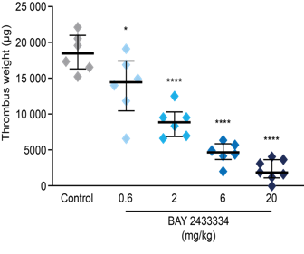
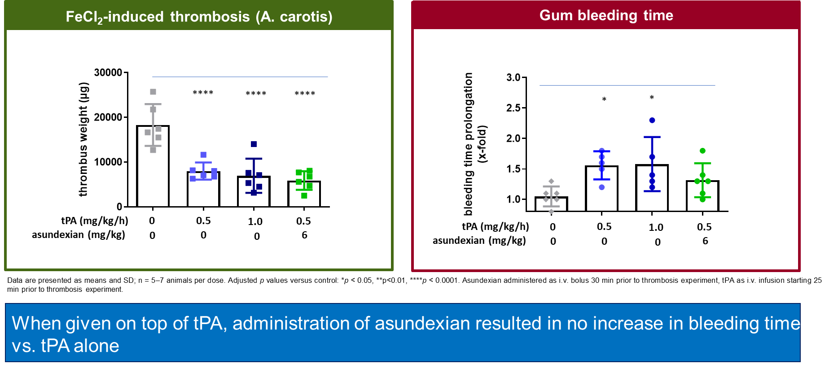
Impact of the Combination of Asundexian and tPA on Bleeding Times and Thrombosis in Rabbit Models

Slide 27
Conclusions
FXI/FXIa as a target for stroke prevention is supported by robust preclinical and clinical data
The phase 2b stroke prevention trials were largely consistent in their findings and suggest a reduction in ischemic stroke recurrence, particularly in patients enriched with atherosclerotic disease
If these results are confirmed in ongoing phase III trials, FXIa inhibition will establish a new paradigm that will enable us to reduce ischemic stroke without compromising safety in select patients with non-cardioembolic ischemic stroke

Slide 28
Questions/Contact
Email: ashkan.shoamanesh@phri.ca
Twitter/X: @Ash_Shoamanesh

Slide 29



Looking for more resources
on this topic?
CME/CE in minutes
Congress highlights
Late-breaking data
Quizzes
Webinars
In-person events
Slides & resources
www.MedEdOTG.com

