Slide 1
Who Needs Reversal or Repletion for UGI and LGI Bleeding: Case Presentation
Presenter:
Vinay Sehgal, MBChB, MRCP, PhD Consultant Gastroenterologist and Interventional Endoscopist University College London Hospital London, UK
Expert Emergency Medicine Panel:
Richard Body, MBChB, PhD University of Manchester Manchester, United Kingdom
Martin Möckel, MD, PhD Charité - Universitätsmedizin Hospital Berlin, Germany
Susann Järhult, MD Uppsala University Hospital Uppsala, Sweden
Moderator:
W. Brian Gibler, MD, FACEP, FACC, FAHA President, EMCREG-International University of Cincinnati College of Medicine Cincinnati, Ohio USA

Slide 2
Resource Information
About This Resource
These slides are one component of a continuing education program available online at MedEd On The Go titled Meet the Experts: Managing Life-Threatening Bleeding in Anticoagulated Patients in the Emergency Department
Program Learning Objectives:
Demonstrate the ability to delineate reversal from repletion for life-threatening bleeding in the anticoagulated patient
Demonstrate the ability to distinguish treatment implications for intracerebral, cerebellar, subdural, and subarachnoid hemorrhage in the anticoagulated patient
Distinguish between gastrointestinal bleeding in the anticoagulated patient, which requires observation in the ICU, versus life-threatening bleeding, which requires specific reversal therapy
Review specific reversal and repletion management by the emergency physician for anticoagulated patients with trivial to major trauma
MedEd On The Go®
www.mededonthego.com
This content or portions thereof may not be published, posted online or used in presentations without permission.
This content can be saved for personal use (non-commercial use only) with credit given to the resource authors.
To contact us regarding inaccuracies, omissions or permissions please email us at support@MedEdOTG.com

Slide 3
Disclaimer
The views and opinions expressed in this educational activity are those of the faculty and do not necessarily represent the views of Total CME, LLC, the CME providers, or the companies providing educational grants. This presentation is not intended to define an exclusive course of patient management; the participant should use their clinical judgment, knowledge, experience, and diagnostic skills in applying or adopting for professional use any of the information provided herein. Any procedures, medications, or other courses of diagnosis or treatment discussed or suggested in this activity should not be used by clinicians without evaluation of their patient's conditions and possible contraindications or dangers in use, review of any applicable manufacturer’s product information, and comparison with recommendations of other authorities. Links to other sites may be provided as additional sources of information.

Slide 4
Case Presentation
PMHx
Hypertension, IHD, OA, provoked DVT
DHx
Aspirin 75’/Bisoprolol 2.5’/Simvastatin 40’/Omeprazole 20’/Apixaban
SHx
Police officer, non-smoker, ½ bottle wine 3x weekly
47 M
GP referral to medics
Recent flu-like illness
3/7 worsening abdominal discomfort despite regular painkillers
4-hour history of ‘dark stool’

Slide 5
Observations
Bloods
HR 92, regular
RR 20
BP 107/65
Spo2: 98% (RA)
BM – 5.8
CVS: warm peripheries, CRT < 2 seconds, HS I + II + 0
Chest: equal AE, clear
Abdo: virgin abdomen, soft, non-specific abdominal tenderness, no guarding
DRE: dark stool on glove
Hb 115 Na 135 Bili 21 CRP 8
WCC 7.0 K 4.1 ALP 140 Amy 40
Plts 245 Ur 9.0 ALT 37
Neuts 5.4 Cr 55 Alb 40
Working Diagnosis: Upper GI bleed

Slide 6
Initial Management
Take nothing by mouth
Large-bore IV access
Fluid resuscitation
Consider intravenous PPI’s
No blood transfusion or supportive blood products
Regular reassessment

Slide 7
Transfusion and use of blood products
Follow local hospital protocols
Target Hb of > 70 g/dL
Platelet transfusion for patients who are actively bleeding and have a platelet count < 50 x 10⁹/litre
FFP transfusion for patients who are actively bleeding and have a PT > 1.5x ULN; if fibrinogen <1.5 g/litre offer cryoprecipitate
PCC in patients taking warfarin who are actively bleeding

Slide 8
Observations
Bloods
HR 92, regular
RR 20
BP 107/65
Spo2: 98% (RA)
BM – 5.8
CVS: warm peripheries, CRT < 2 seconds, HS I + II + 0
Chest: equal AE, clear
Abdo: no previous surgery, soft, non-specific abdominal tenderness, no guarding
DRE: dark stool on glove
Hb 115 Na 135 Bili 21 CRP 8
WCC 7.0 K 4.1 ALP 140 Amy 40
Plts 245 Ur 9.0 ALT 37
Neuts 5.4 Cr 55 Alb 40

Slide 9
ANDEXANET
Observations
Bloods
HR 92, regular
RR 20
BP 107/65
Spo2: 98% (RA)
BM – 5.8
CVS: warm peripheries, CRT < 2 seconds, HS I + II + 0
Chest: equal AE, clear
Abdo: no previous surgery, soft, non-specific abdominal tenderness, no guarding
DRE: dark stool on glove
Hb 115 Na 135 Bili 21 CRP 8
WCC 7.0 K 4.1 ALP 140 Amy 40
Plts 245 Ur 9.0 ALT 37
Neuts 5.4 Cr 55 Alb 40

Slide 10
Case Presentation
PMHx
Hypertension, IHD, OA, provoked DVT
DHx
Aspirin 75’/Bisoprolol 2.5’/Simvastatin 40’/Omeprazole 20’/Apixaban
SHx
Police officer, non-smoker, ½ bottle wine 3x weekly
47 M
GP referral to medics
Recent flu-like illness
3/7 worsening abdominal discomfort despite regular painkillers
4-hour history of persistent haematemesis and ‘dark stool’

Slide 11
Observations
Bloods
HR 124, regular
RR 28
BP 85/60
Spo2: 94% (RA)
BM – 5.8
CVS: cool peripheries, CRT 4 seconds, HS I + II + 0
Chest: equal AE, clear
Abdo: no previous surgery, soft, non-specific abdominal tenderness, no guarding
DRE: dark stool on glove
Hb 79 Na 135 Bili 21 CRP 8
WCC 7.0 K 4.1 ALP 140 Amy 40
Plts 245 Ur 15.4 ALT 37
Neuts 5.4 Cr 55 Alb 40

Slide 12
Observations
Bloods
HR 124, regular
RR 28
BP 85/60
Spo2: 94% (RA)
BM – 5.8
CVS: cool peripheries, CRT 4 seconds, HS I + II + 0
Chest: equal AE, clear
Abdo: ongoing haematemesis, soft abdomen, non-specific abdominal tenderness
DRE: dark stool on glove
Hb 79 Na 135 Bili 21 CRP 8
WCC 7.0 K 4.1 ALP 140 Amy 40
Plts 245 Ur 15.4 ALT 37
Neuts 5.4 Cr 55 Alb 40

Slide 13
ANDEXANET
Observations
Bloods
HR 124, regular
RR 28
BP 85/60
Spo2: 94% (RA)
BM – 5.8
CVS: cool peripheries, CRT 4 seconds, HS I + II + 0
Chest: equal AE, clear
Abdo: ongoing haematemesis, soft abdomen, non-specific abdominal tenderness
DRE: dark stool on glove
Hb 79 Na 135 Bili 21 CRP 8
WCC 7.0 K 4.1 ALP 140 Amy 40
Plts 245 Ur 15.4 ALT 37
Neuts 5.4 Cr 55 Alb 40

Slide 14
Andexanet Alfa – Clinical Efficacy

Slide 15
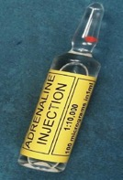
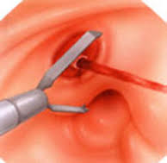
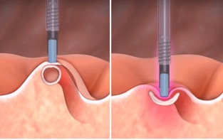
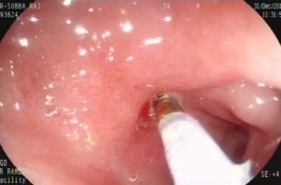
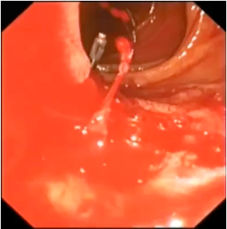
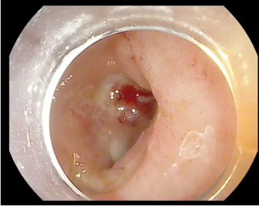
Endoscopic Therapy

Slide 16
Conclusion
Resuscitation before endoscopy is paramount in the management of UGIB
The majority of patients respond to medical therapy
All patients should have an endoscopy within 24 hours
Andexanet can be useful in life-threatening UGIB provided sufficient senior decision-making is involved

Slide 17
Looking for more resources on this topic?
CME/CE in minutes
Congress highlights
Late-breaking data
Quizzes
Webinars
In-person events
Slides & resources
www.MedEdOTG.com

