Slide 1
Providing Optimal Care for the Anticoagulated Patient with Intracranial Hemorrhage in the Acute Care Setting:
Does the Patient Need Reversal, Repletion, or Surgery?
Natalie Kreitzer, MD, MS
Associate Professor of Emergency Medicine, Neurocritical Care, and UC Stroke Team
University of Cincinnati
Cincinnati, OH

Slide 2



Resource Information
About This Resource
These slides are one component of a continuing education program available online at MedEd On The Go titled Optimizing ICH Care By Leveraging AC Reversal, AI & Care Bundling
Program Learning Objectives:
Describe the optimal approach to reverse and replete in the anticoagulated patient
Evaluate best practices related to the management of ICH via guideline-directed interventions
Describe the primary determinants of improving outcomes for patients with ICH, with an emphasis on the role of care bundling for optimizing outcomes
Demonstrate the ability to delineate emerging reversal from repletion strategies for life-threatening bleeding in the anticoagulated patient
Describe how to use AI in rapidly diagnosing and treating ischemic and hemorrhagic strokes
MedEd On The Go®
www.mededonthego.com
This content or portions thereof may not be published, posted online or used in presentations without permission.
This content can be saved for personal use (non-commercial use only) with credit given to the resource authors.
To contact us regarding inaccuracies, omissions or permissions please email us at support@MedEdOTG.com

Slide 3
Disclaimer
The views and opinions expressed in this educational activity are those of the faculty and do not necessarily represent the views of Total CME, LLC, the CME providers, or the companies providing educational grants. This presentation is not intended to define an exclusive course of patient management; the participant should use their clinical judgment, knowledge, experience, and diagnostic skills in applying or adopting for professional use any of the information provided herein. Any procedures, medications, or other courses of diagnosis or treatment discussed or suggested in this activity should not be used by clinicians without evaluation of their patient's conditions and possible contraindications or dangers in use, review of any applicable manufacturer’s product information, and comparison with recommendations of other authorities. Links to other sites may be provided as additional sources of information.

Slide 4
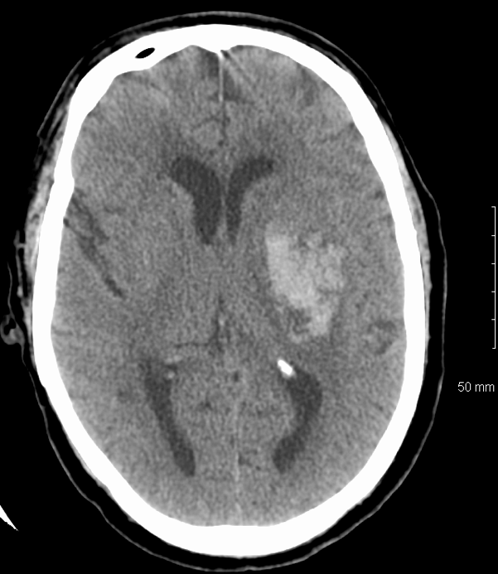
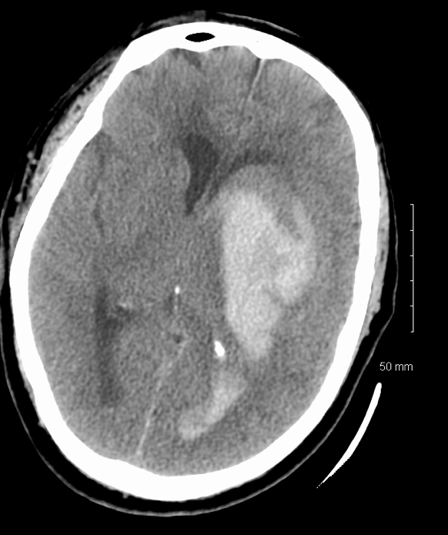
Hemorrhage Expansion

Slide 5
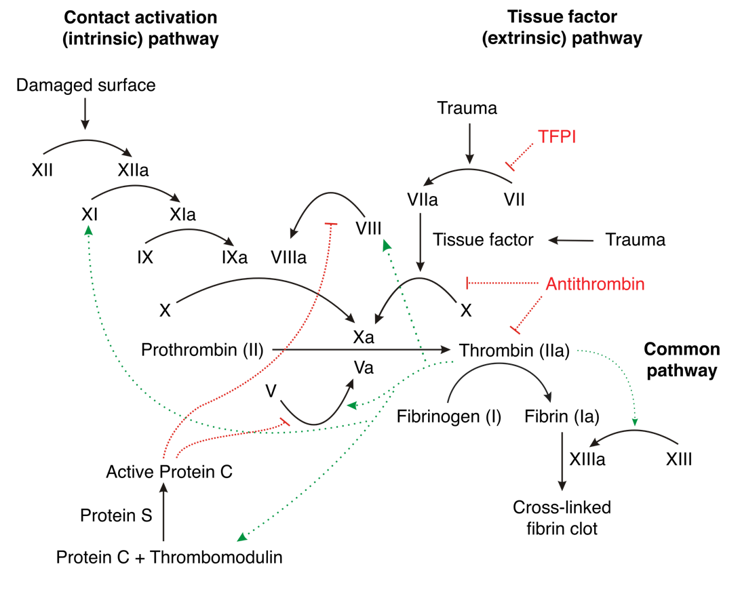
Vitamin K Antagonists (VKA) and Direct Oral Anticoagulants (DOAC)

Slide 6
Repletion and Reversal
Reversal
  Factor Xa inhibitors – andexanet alfa
  Direct thrombin inhibitors – idarucizumab
Repletion
  FFP
  4 Factor PCCs
  Vit K dependent- 2, 7, 9, 10
  Approved for warfarin repletion
  Off-label for DOAC reversal
FFP, fresh frozen plasma; PCCs, prothrombin complex concentrates.

Slide 7
Repletion Strategies:
Recommend treatment for INR greater than 1.4 in VKA bleeding
Vitamin K: 10 mg IV
FFP
PCC
Factors I (fibrinogen),
II, V, VII, IX, X, XI, XIII,
and antithrombin
Large volumes often needed (10-15 ml/kg)
Time to prepare and administer, risk fluid overload
Risk transfusion reaction
4 Factor: 2, 7, 9, 10
3 Factor: 2, 9, 10
Activated vs. inactivated
Dose: Fixed or based on INR and weight
Faster reversal, less volume
Increased cost

Slide 8
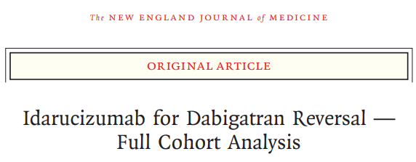
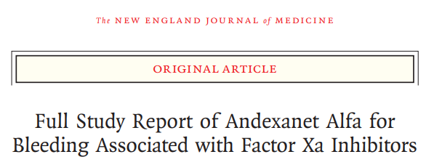
Reversal Strategies in Setting of Major Bleeding
Monoclonal antibody that binds to dabigatran
May be needed if last dose within 12 to 24 hours
Lab to follow: PTT and
thrombin time
Dose: 5 grams (2.5 grams X 2)
Recombinant modified human “decoy” factor Xa protein
May be needed if last dose within 18 hours
Lab to follow: Anti-Xa level
Dose: High dose or low dose
  Xa inhibitor dose
  Time since taken

Slide 9
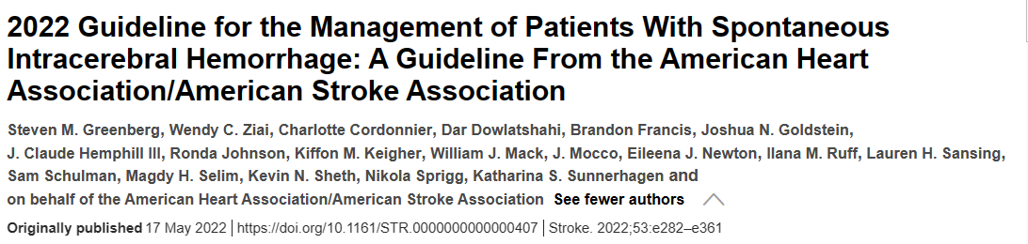
Surgical
Indications
Surgical Option | AHA/ASA Recommendation | Level of Evidence
Minimally invasive | 2a: Mortality 2b: Functional outcomes | B-R
External ventricular drain | See next slide
Craniotomy supratentorial | 2b | A
Craniotomy posterior fossa | 1 | B-NR
Craniectomy | 2b | C-LD

Slide 10
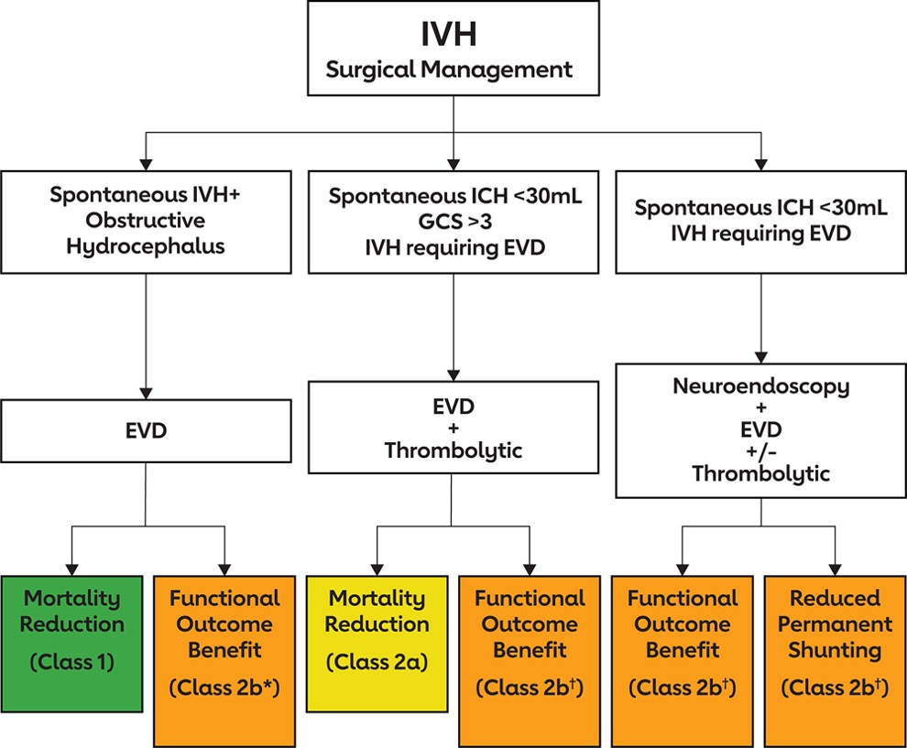
IVH Surgical Management

Slide 11



Looking for more resources
on this topic?
CME/CE in minutes
Congress highlights
Late-breaking data
Quizzes
Webinars
In-person events
Slides & resources
www.MedEdOTG.com

