Slide 1
Implementation of the 2022 AHA/ASA Guideline for the Management of Patients with Spontaneous Intracerebral Hemorrhage – Are You Doing Enough?
Rhonda Cadena, MD, FNCS, FCCM
Clinical Associate Professor Wake Forest School of Medicine
Neurocritical Care/Pulmonary Critical Care Consultants
Atrium Health, Carolinas Medical Center
Charlotte, NC

Slide 2



Resource Information
About This Resource
These slides are one component of a continuing education program available online at MedEd On The Go titled Optimizing ICH Care By Leveraging AC Reversal, AI & Care Bundling
Program Learning Objectives:
Describe the optimal approach to reverse and replete in the anticoagulated patient
Evaluate best practices related to the management of ICH via guideline-directed interventions
Describe the primary determinants of improving outcomes for patients with ICH, with an emphasis on the role of care bundling for optimizing outcomes
Demonstrate the ability to delineate emerging reversal from repletion strategies for life-threatening bleeding in the anticoagulated patient
Describe how to use AI in rapidly diagnosing and treating ischemic and hemorrhagic strokes
MedEd On The Go®
www.mededonthego.com
This content or portions thereof may not be published, posted online or used in presentations without permission.
This content can be saved for personal use (non-commercial use only) with credit given to the resource authors.
To contact us regarding inaccuracies, omissions or permissions please email us at support@MedEdOTG.com

Slide 3
Disclaimer
The views and opinions expressed in this educational activity are those of the faculty and do not necessarily represent the views of Total CME, LLC, the CME providers, or the companies providing educational grants. This presentation is not intended to define an exclusive course of patient management; the participant should use their clinical judgment, knowledge, experience, and diagnostic skills in applying or adopting for professional use any of the information provided herein. Any procedures, medications, or other courses of diagnosis or treatment discussed or suggested in this activity should not be used by clinicians without evaluation of their patient's conditions and possible contraindications or dangers in use, review of any applicable manufacturer’s product information, and comparison with recommendations of other authorities. Links to other sites may be provided as additional sources of information.

Slide 4
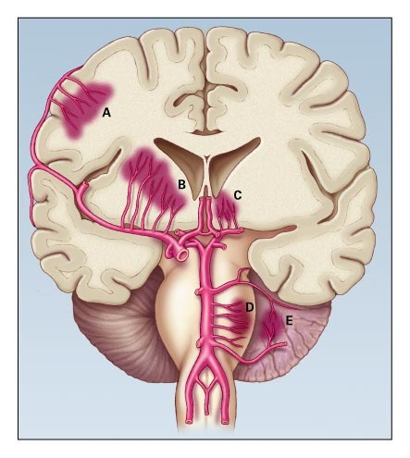
Spontaneous Intracerebral Hemorrhage
About 80,000 hemorrhagic strokes
occur per year in U.S.
Only 12 to 39% of patients are functionally
independent at 6 months; most have
some disability for their entire life
Mortality 30 to 40%; highest among
anticoagulated patients

Slide 5
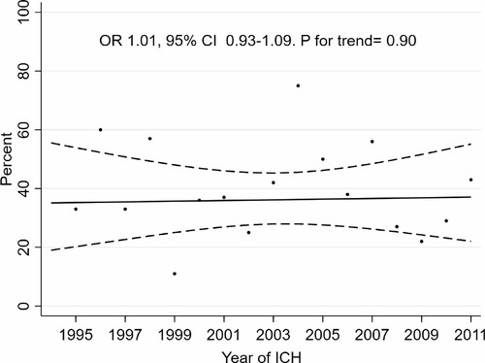
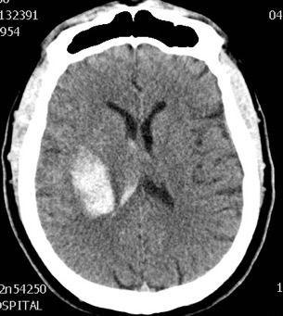
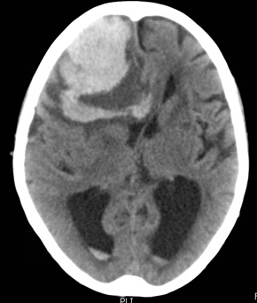
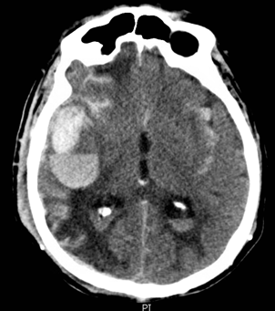
Mortality Hasn’t Changed in Years
Majority of causes of ICH:
  Hypertension
  Cerebral amyloid angiopathy
  Anticoagulation

Slide 6
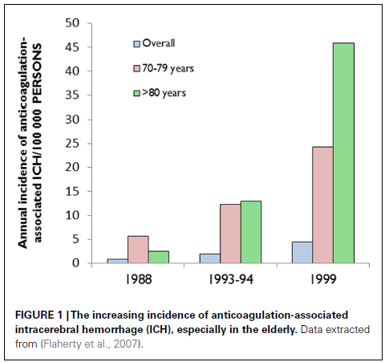
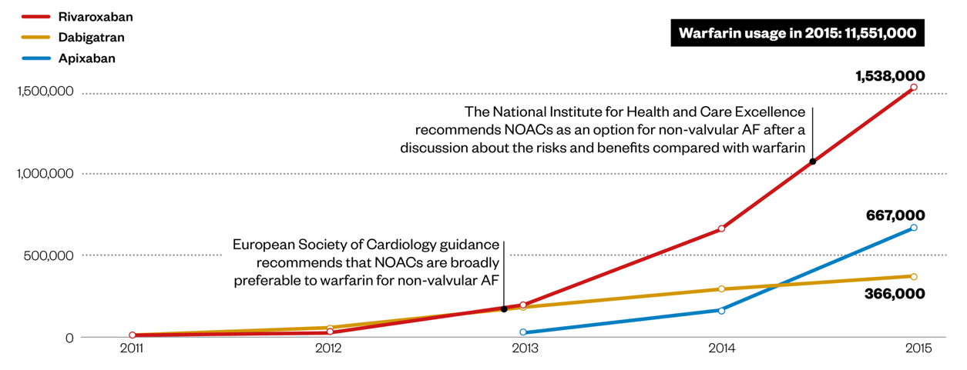
Use of Anticoagulants

Slide 7
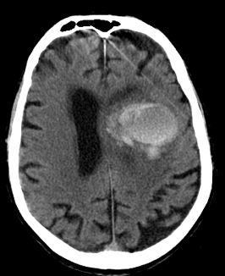
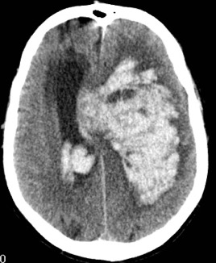
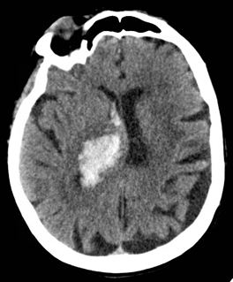
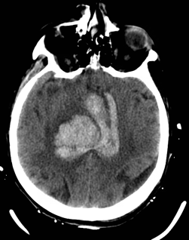
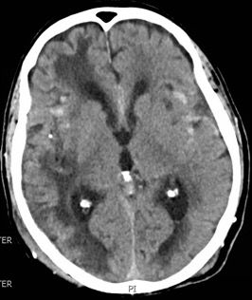

Predictors of Poor Outcome in ICH
Advanced age
Large hematoma size at presentation
Intraventricular extension
Poor neurological status at presentation
Location of hemorrhage
Hematoma expansion
Anticoagulant use
6h
4h
3.5h

Slide 8
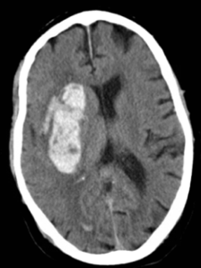
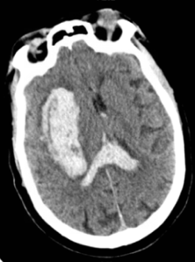
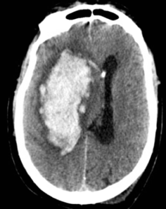
Blood Pressure and Outcome
High blood pressures associated with greater hematoma
expansion, neurological deterioration, and worse outcome
  Reduction in SBP less than 130 mmHg is harmful
  Reduction in SBP less than 140 mmHg appears safe
  Reduction in SBP less than 150 mmHg probably fine
  Unclear goals if presenting SBP greater than 220 mmHg
High SBP variability during early ICH associated with
poor outcomes
Earlier control of SBP associated with better outcomes

Slide 9
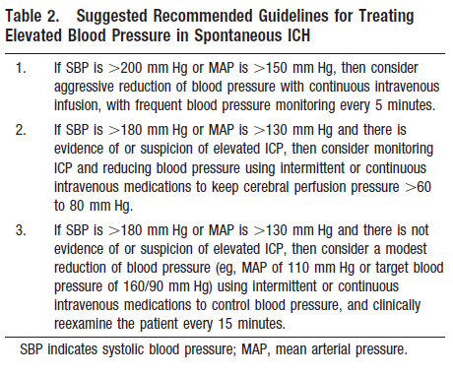
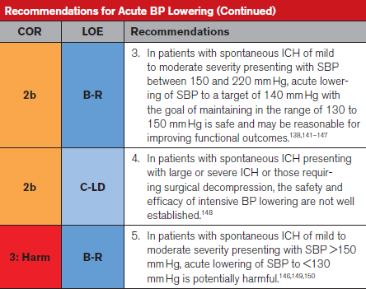
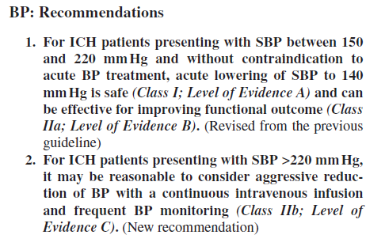
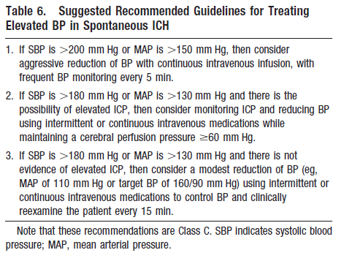
The Pressure Question – Are We Doing Enough?
2015
2007
2010
2022

Slide 10

The Pressure Question – Are We Doing Enough?
Goal blood pressure… it depends:
  Presenting pressure matters;
  how low can we go?
  Can we safely control every patient
  to the same goals?
  Does ICH location matter?
Outcomes better with earlier control
  How do we get control sooner?
  How long do we control it?

Slide 11
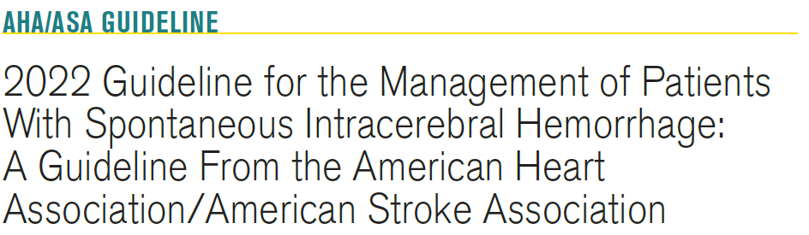
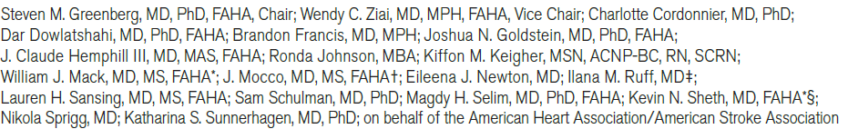
Improve risk stratification
Blood pressure control
Rapid reversal of coagulopathy
Inpatient care with appropriate resources
Management with standardized protocols
Surgical treatments
Outcome prediction caution
Post-ICH recovery including rehab and caregiver support

Slide 12
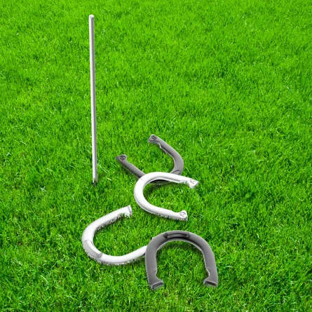
Missed Targets in ICH, Even with Guidelines
Time constraints:
  Delayed presentation
  Delayed BP control
  Delayed reversal of anticoagulation
Blood pressure goal not yet perfected
Standardized protocol implementation barriers
Lack of guidelines for treatment of secondary injuries

Slide 13

Thank you
Rhonda Cadena, MD, FNCS, FCCM
Atrium Health, Carolinas Medical Center
Charlotte, NC
@CadenaRoni
Rhonda.cadena@atriumhealth.org

Slide 14



Looking for more resources
on this topic?
CME/CE in minutes
Congress highlights
Late-breaking data
Quizzes
Webinars
In-person events
Slides & resources
www.MedEdOTG.com

