Slide 1
ABC-ICH: Does Care Bundling Improve Outcomes for Patients with Intracranial Hemorrhage?
Adrian R. Parry-Jones, MD, PhD
Stroke Association Reader and Consultant Neurologist
Geoffrey Jefferson Brain Research Centre
University of Manchester
Manchester, UK

Slide 2



Resource Information
About This Resource
These slides are one component of a continuing education program available online at MedEd On The Go titled Optimizing ICH Care By Leveraging AC Reversal, AI & Care Bundling
Program Learning Objectives:
Describe the optimal approach to reverse and replete in the anticoagulated patient
Evaluate best practices related to the management of ICH via guideline-directed interventions
Describe the primary determinants of improving outcomes for patients with ICH, with an emphasis on the role of care bundling for optimizing outcomes
Demonstrate the ability to delineate emerging reversal from repletion strategies for life-threatening bleeding in the anticoagulated patient
Describe how to use AI in rapidly diagnosing and treating ischemic and hemorrhagic strokes
MedEd On The Go®
www.mededonthego.com
This content or portions thereof may not be published, posted online or used in presentations without permission.
This content can be saved for personal use (non-commercial use only) with credit given to the resource authors.
To contact us regarding inaccuracies, omissions or permissions please email us at support@MedEdOTG.com

Slide 3
Disclaimer
The views and opinions expressed in this educational activity are those of the faculty and do not necessarily represent the views of Total CME, LLC, the CME providers, or the companies providing educational grants. This presentation is not intended to define an exclusive course of patient management; the participant should use their clinical judgment, knowledge, experience, and diagnostic skills in applying or adopting for professional use any of the information provided herein. Any procedures, medications, or other courses of diagnosis or treatment discussed or suggested in this activity should not be used by clinicians without evaluation of their patient's conditions and possible contraindications or dangers in use, review of any applicable manufacturer’s product information, and comparison with recommendations of other authorities. Links to other sites may be provided as additional sources of information.

Slide 4
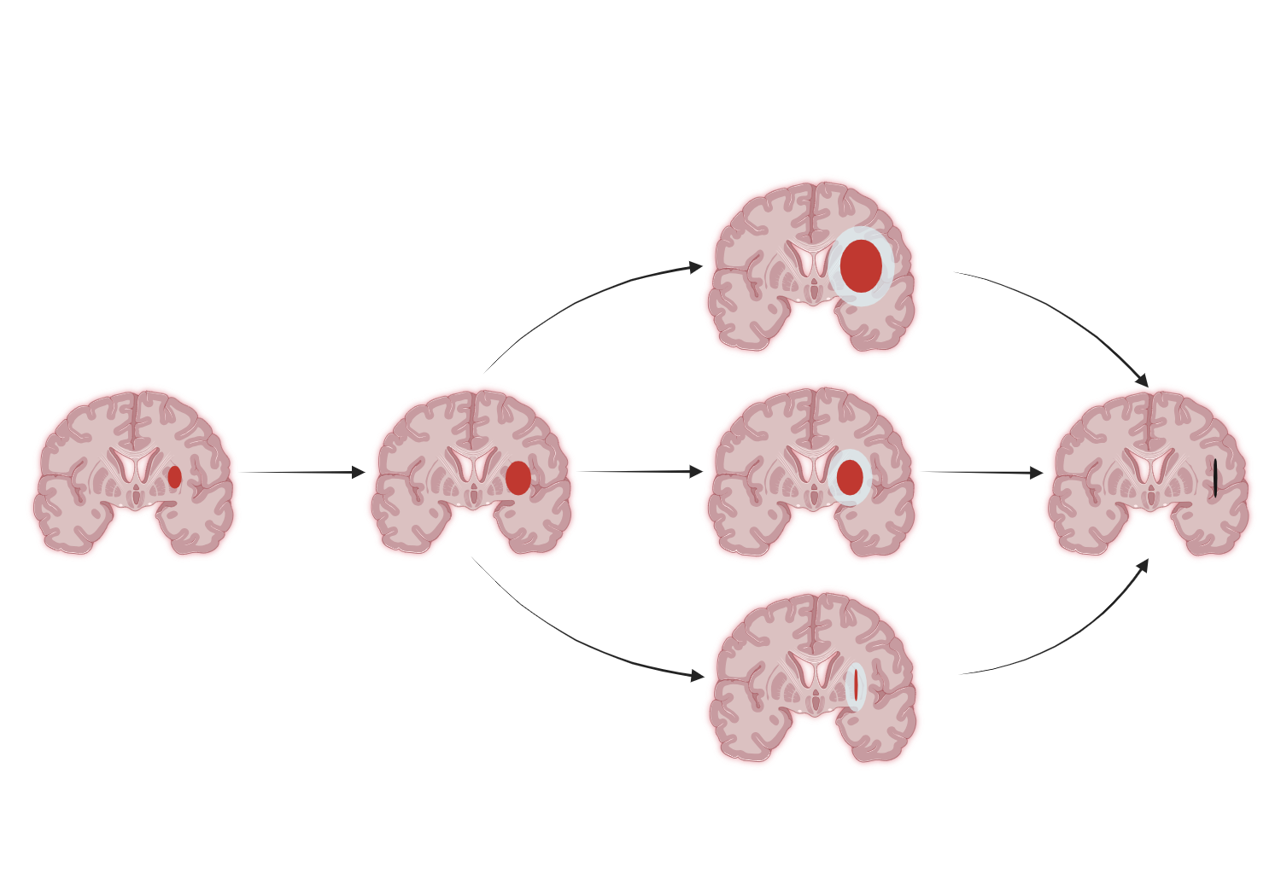
Therapeutic Targets
Anticoagulant reversal
BP lowering
Haemostatic drugs?
Platelet transfusion
in-hospital haematoma expansion
pre-hospital haematoma expansion
secondary injury
endogenous clearance
Haematoma evacuation
surgical clearance

Slide 5
Pessimism in ICH Care

Slide 6



ABC Care Bundle for ICH
Anticoagulant reversal: Reversal agents delivered as quickly as possible
Blood pressure lowering: Using intravenous antihypertensives for rapid, intensive BP lowering
Care pathway: Prompt referral of appropriate patients to neurosurgery

Slide 7
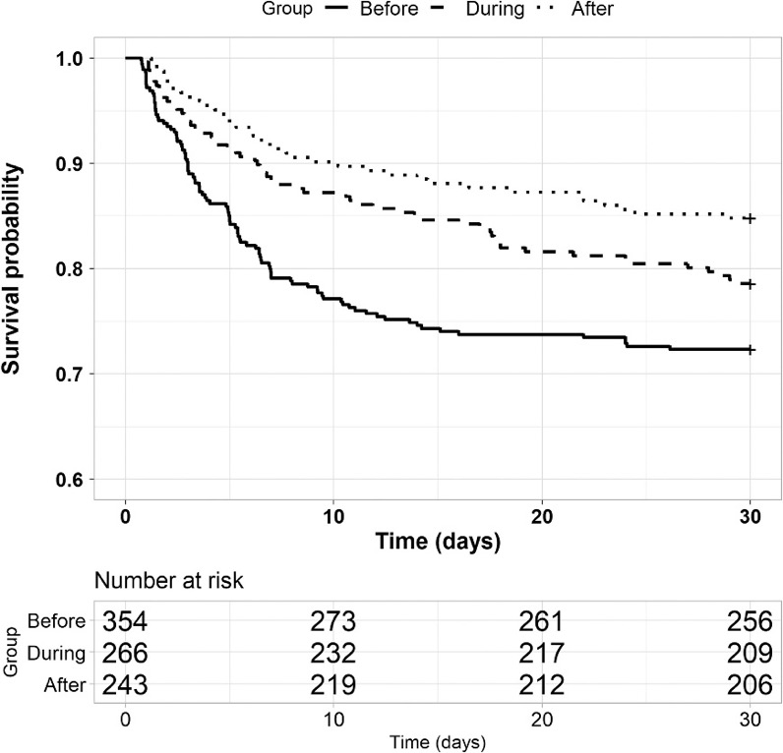
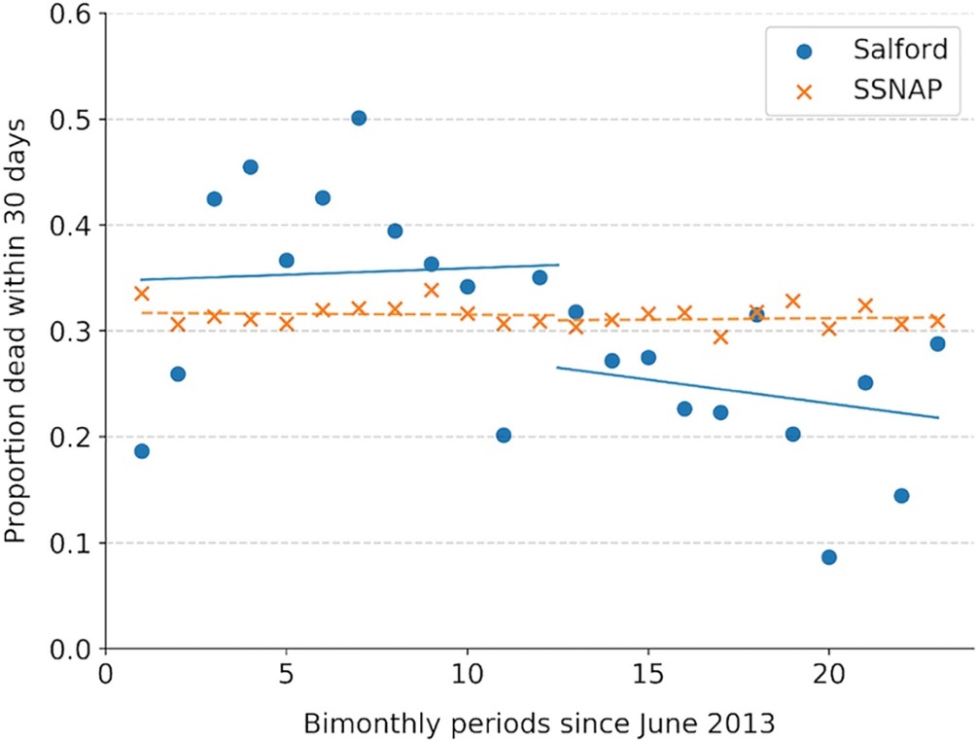
ABC-ICH: Results
Difference in difference (Salford vs. England and Wales): -10.8 pp (95% CI-17.9 to 3.7), p = 0.003

Slide 8
Indirect Changes in Supportive Care
DNR orders < 24 h
Critical care admissions
Pre QI
Post QI
Pre QI
Post QI

Slide 9
Mediation Analysis
 | Total Effect |  | NIE |  | NDE |  | % mediated
 | Estimate (p-value) | 95% CI | Estimate (p-value) | 95% CI | Estimate (p-value) | 95% CI
Access to HDU | -0.0593 (0.02) | (-0.1097, -0.01) | -0.0073 (0.03) | (-0.0167, 0.00) | -0.0519 (0.04) | (-0.1019, 0.00) | 12.3%
DNR within 24 h | -0.0594 (0.03) | (-0.1090, -0.01) | -0.0352 (<0.01) | (-0.0616, -0.01) | -0.0242 (0.36) | (-0.0669, 0.03) | 59.3%
Non-significant effects: Anticoagulant reversal (DNT), intensive blood pressure lowering (y/n, DTT, ΔSBP 0-4 h), ICU (y/n), surgery (y/n, onset-to-surgery)

Slide 10
Why Did Implementation Work?
Bundle was seen as a systematic way to deliver care
Staff described a ‘culture shift’ in ICH care, felt that more could be done to improve outcome
Quarterly regional meetings to share learning and create ‘healthy competition’
Early and proactive involvement of other departments
Launch event to improve awareness of project
Close data monitoring with ‘debriefs’ after each patient

Slide 11
INTERACT3: Aim
Aim: Does goal-directed care bundle protocol in hospital improve outcomes after ICH?
INTERACT3 bundle (for 7 days):
Early intensive blood pressure lowering (SBP < 140 mmHg)
Management algorithms for:
  Hyperglycaemia (non-DM: 6.1-7.8, DM: 7.8-10 mmol/l)
  Pyrexia (< 37.5°C)
  Abnormal anticoagulation (reversal warfarin, INR < 1.5)

Slide 12
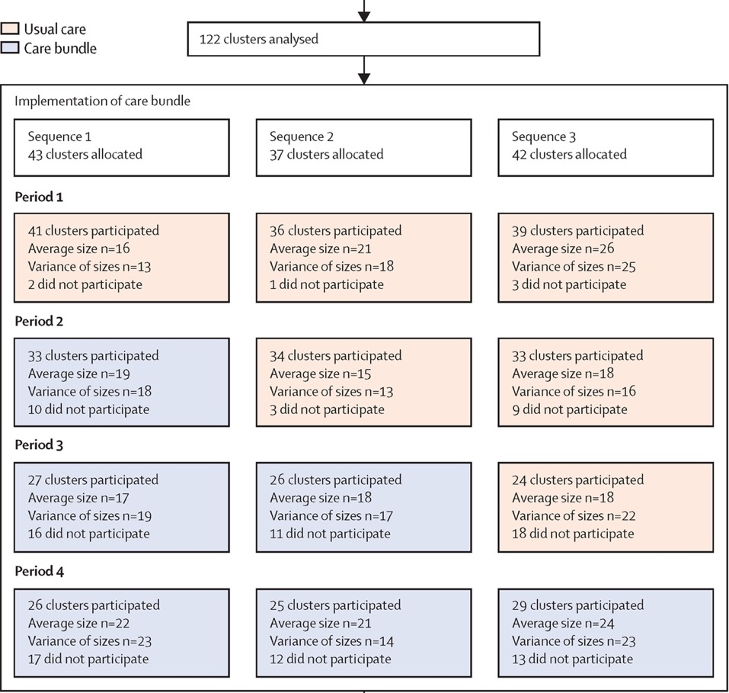
INTERACT3: Design
Stepped-wedge cluster RCT
Data collection to day 7
Central follow-up at 6 months
Initially China, expanded to other countries from 2020
9 LMICs, 1 HIC, 144 hospitals

Slide 13
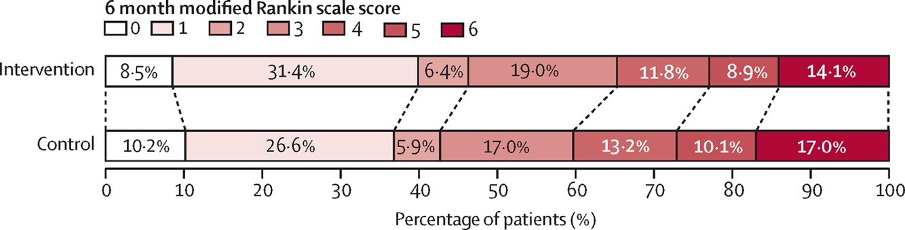
INTERACT3: Results
3221 patients ‘care bundle’ group; 3815 ‘standard care’
Primary outcome mRS at 6 months–88 to 90% complete
common OR 0.86, 95% CI 0.76 to 0.97; p=0.015
Fewer SAEs with care bundle (16.0% vs. 20.1%; p=0.0098)

Slide 14
Conclusions
Bundled care for ICH improves outcomes
Provides a framework and supports buy-in for
quality improvement
Indirect effects on supportive care likely to be at least as important as specific interventions
Implementation is very context specific – sites should work to achieve process targets governed by local barriers

Slide 15



Looking for more resources
on this topic?
CME/CE in minutes
Congress highlights
Late-breaking data
Quizzes
Webinars
In-person events
Slides & resources
www.MedEdOTG.com

