Slide 1
Emerging Data in the Management of Intracranial Hemorrhage in the
Anticoagulated Patient
Stuart J. Connolly, MD, FRCPC
Professor Emeritus, McMaster University
Senior Scientist, Population Health Research Institute
Hamilton, Ontario, Canada
On behalf of the ANNEXa-I Steering Committee and Investigators

Slide 2



Resource Information
About This Resource
These slides are one component of a continuing education program available online at MedEd On The Go titled Optimizing ICH Care By Leveraging AC Reversal, AI & Care Bundling
Program Learning Objectives:
Describe the optimal approach to reverse and replete in the anticoagulated patient
Evaluate best practices related to the management of ICH via guideline-directed interventions
Describe the primary determinants of improving outcomes for patients with ICH, with an emphasis on the role of care bundling for optimizing outcomes
Demonstrate the ability to delineate emerging reversal from repletion strategies for life-threatening bleeding in the anticoagulated patient
Describe how to use AI in rapidly diagnosing and treating ischemic and hemorrhagic strokes
MedEd On The Go®
www.mededonthego.com
This content or portions thereof may not be published, posted online or used in presentations without permission.
This content can be saved for personal use (non-commercial use only) with credit given to the resource authors.
To contact us regarding inaccuracies, omissions or permissions please email us at support@MedEdOTG.com

Slide 3
Disclaimer
The views and opinions expressed in this educational activity are those of the faculty and do not necessarily represent the views of Total CME, LLC, the CME providers, or the companies providing educational grants. This presentation is not intended to define an exclusive course of patient management; the participant should use their clinical judgment, knowledge, experience, and diagnostic skills in applying or adopting for professional use any of the information provided herein. Any procedures, medications, or other courses of diagnosis or treatment discussed or suggested in this activity should not be used by clinicians without evaluation of their patient's conditions and possible contraindications or dangers in use, review of any applicable manufacturer’s product information, and comparison with recommendations of other authorities. Links to other sites may be provided as additional sources of information.

Slide 4
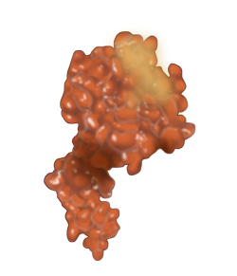
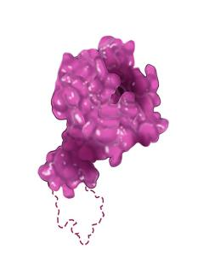
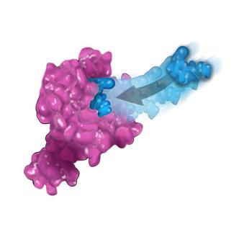
Andexanet Reverses FXa Inhibitors
Rapid reversal of anti-FXa activity in
healthy volunteers
Andexanet
FXa decoy
Native FXa
Rapidly binds with high affinity
Lacks FXa catalytic activity
Active site
Prevents anticoagulant effect by removing
GLA domain
Binds to FXa inhibitors
Rivaroxaban
Apixaban
Edoxaban
Binds and sequesters FXa inhibitors
Rapid onset and offset of action
Allows native FXa to restore
thrombin generation
ANNEXA-4 in patients with acute
major bleeding
  Andexanet rapidly reversed anti-FXa activity
  80% with excellent or good hemostatic efficacy
  TEs in 10% of patients

Slide 5
ANNEXa-I Study Design
Primary efficacy population, N=452
Extended population, N=530
Patients presenting with acute intracranial hemorrhage within
6 hrs of symptom onset and within 15 hrs of taking an oral FXa inhibitor (apixaban, rivaroxaban, edoxaban)
ANDEXANET
IV bolus + infusion
Primary endpoint†: Effective hemostasis
12 hrs post-randomization as determined by the EAC
Safety endpoints:
Thrombotic events
Death
1:1 randomization
USUAL CARE*
30-day follow-up

Slide 6
Patient Eligibility Summary
Acute intracerebral bleeding episode
  Head CT or MRI scan demonstrating intracranial bleeding
  within 2 hours prior to randomization
  Hematoma volume of 0.5 to 60 mL
Oral FXa inhibitor use within 15 hours prior to randomization
Symptom onset less than 6 hours prior to the baseline scan
Glasgow Coma Scale score greater than 7

Slide 7
Primary Endpoint: Excellent or Good Hemostatic Efficacy at 12 Hours
  Hematoma expansion less than or equal to 20% (excellent) or less than or equal to 35% (good)
  and
  Change in NIHSS score less than 7 points
  and
  No rescue therapy 3 to 12 hours post-randomization

Slide 8
ANNEXa-I Stopped Early for Efficacy
900 patients planned
  Pre-defined interim analysis at 450 patients
  Early termination for efficacy if p<0.031
Interim analysis performed May 30, 2023, and efficacy criterion met
Study close out initiated and final data base lock completed September 18, 2023

Slide 9
Baseline Patient Characteristics
Parameter* | Andexanet (N=263) | Usual care (N=267)
Mean age (yrs) | 79.4 (8.5) | 78.7 (8.6)
Female | 117 (44.5%) | 128 (47.9%)
Myocardial infarction | 29 (11.0%) | 36 (13.5%)
Stroke | 59 (22.4%) | 54 (20.2%)
Deep vein thrombosis | 20 (7.6%) | 27 (10.1%)
Pulmonary embolism | 21 (8.0%) | 24 (9.0%)
Atrial fibrillation | 238 (90.5%) | 225 (84.3%)
Median CHA₂DS₂-VASc score | 4 (3, 5) | 4 (3, 5)
Median hematoma volume | 10.5 (4.1, 25.0) | 9.3 (3.3, 23.1)
Median baseline NIHSS score | 9.0 (5.0, 16.0) | 9.0 (4.0, 15.0)
Andexanet - low dose | 199 (75.7%) | –
Received PCC as part of usual care | – | 232 (86.9%)
Median symptoms-to-baseline scan time (hrs) | 2.2 (1.3, 3.8) | 2.4 (1.4, 3.7)
Median scan-to-randomization time (hrs) | 1.1 (0.7, 1.5) | 1.2 (0.7, 1.7)
Median door-to-needle time (hrs) | 2.1 (1.6, 2.8) | 2.3 (1.7, 3.1)

Slide 10
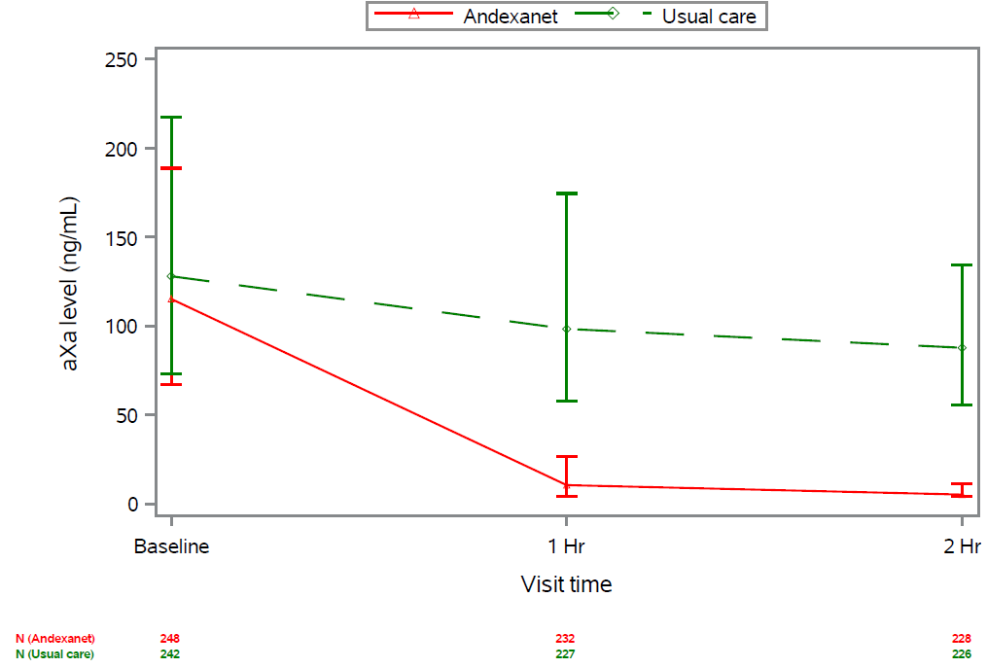
Reduction in Median Anti-FXa Activity from Baseline to Nadir at 2 Hours
250
200
150
100
50
0
Usual Care
P <0.0001
Andexanet
Anti-FXa activity (ng/mL)
23.5% reduction
94.4% reduction
Baseline
1 hr
Visit time
2 hrs
 | Andexanet† | Usual care† | Median reduction with andexanet
Patients on apixaban | 162 (61.6%) | 158 (59.2%) | 94.0% (96.4, 88.8)
Patients on rivaroxaban | 79 (30.0%) | 75 (28.1%) | 96.4% (97.9, 93.2)
Patients on edoxaban | 22 (8.4%) | 31 (11.6%) | 72.3% (78.9, 37.4)

Slide 11
Hemostatic Efficacy
Parameter | Andexanet (N=263)* n (%) | Usual care (N=267)* n (%) | Increase with andexanet per 100 patients (95% CI)† | P value†
Excellent or good††, £ | 168 (63.9%) | 140 (52.4%) | 11.0 (2.8, 19.3) | 0.008
Excellent | 147 (55.9%) | 121 (45.3%) | 10.6 (2.1, 19.0) | –
Good | 21 (8.0%) | 19 (7.1%) | 0.9 (–3.6, 5.4) | –
Hematoma increase ≥12.5 mL§ | 29 (11.6%) | 48 (19.0%) | –7.4 (–13.7, –1.1) | –
Modified Rankin Scale score at 30 days ≤3§ | 69 (28.0%) | 79 (30.9%) | –2.9 (–10.9, 5.2) | –

Slide 12
Thrombotic Events and Death (30 Days)
Parameter, n (%) | Andexanet (N=263)* | Usual care (N=267)* | Increase with andexanet per 100 patients (95% CI)† | P value†
Patients with ≥1 TE | 27 (10.3%) | 15 (5.6%) | 4.6 (0.1, 9.2) | 0.048
Transient ischemic attack | 0 (0%) | 0 (0%) | – | –
Ischemic stroke | 17 (6.5%) | 4 (1.5%) | 5.0 (1.5, 8.8) | –
Myocardial infarction | 11 (4.2%) | 4 (1.5%) | 2.7 (–0.2, 6.1) | –
Deep vein thrombosis | 1 (0.4%) | 2 (0.7%) | –0.4 (–2.4, 1.5) | –
Pulmonary embolism | 1 (0.4%) | 6 (2.2%) | –1.9 (–4.5, 0.2) | –
Arterial systemic embolism | 3 (1.1%) | 2 (0.7%) | 0.4 (–1.7, 2.7) | –
Death | 73 (27.8%) | 68 (25.5%) | 2.3 (–5.2, 9.8) | 0.55

Slide 13
Selected Subgroups

Slide 14
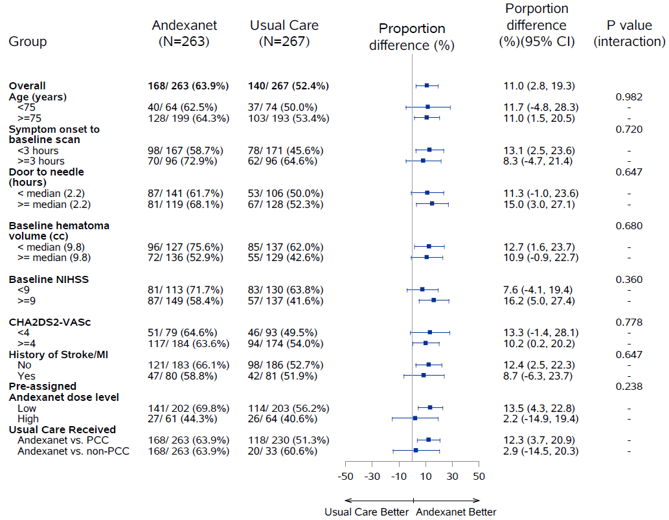
Hemostatic Efficacy
Proportion
difference
(%) (95% CI)

Slide 15
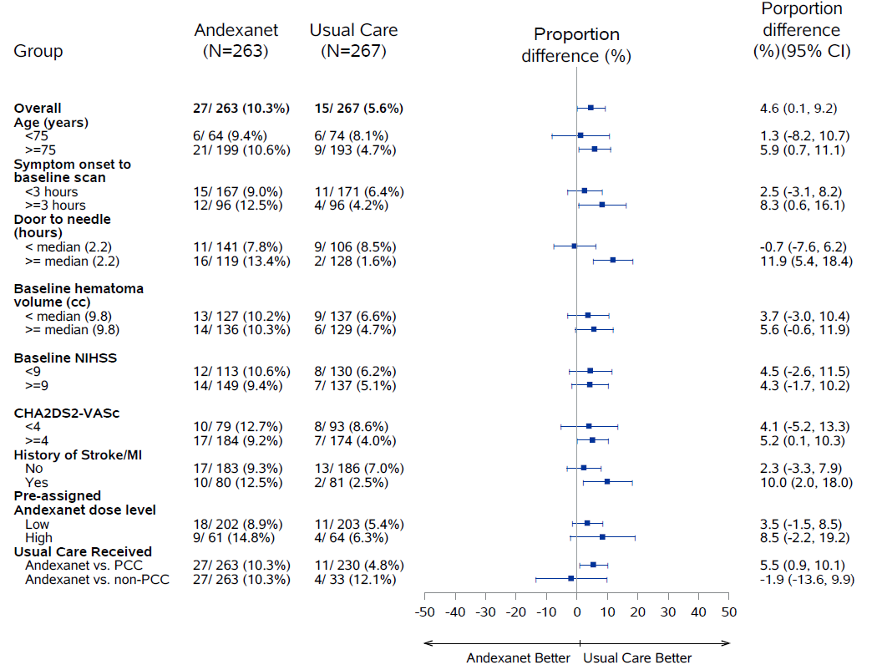
Thrombotic Events
Proportion
difference
(%) (95% CI)

Slide 16
Conclusions
Andexanet rapidly reduced anti-FXa activity and increased the rate of hemostatic efficacy
Andexanet increased the rate of TEs compared to usual care
Andexanet can be considered for patients with acute intracerebral hemorrhage associated with FXa inhibitor therapy

Slide 17



Looking for more resources
on this topic?
CME/CE in minutes
Congress highlights
Late-breaking data
Quizzes
Webinars
In-person events
Slides & resources
www.MedEdOTG.com

