Slide 1
The Frontier of Stroke Diagnosis: How Can Artificial Intelligence Improve Acute Care for Ischemic and Hemorrhagic Stroke?
Greg Albers, MD
Professor of Neurology, Stanford University
Director, Stanford Stroke Center
Stanford, CA

Slide 2



Resource Information
About This Resource
These slides are one component of a continuing education program available online at MedEd On The Go titled Optimizing ICH Care By Leveraging AC Reversal, AI & Care Bundling
Program Learning Objectives:
Describe the optimal approach to reverse and replete in the anticoagulated patient
Evaluate best practices related to the management of ICH via guideline-directed interventions
Describe the primary determinants of improving outcomes for patients with ICH, with an emphasis on the role of care bundling for optimizing outcomes
Demonstrate the ability to delineate emerging reversal from repletion strategies for life-threatening bleeding in the anticoagulated patient
Describe how to use AI in rapidly diagnosing and treating ischemic and hemorrhagic strokes
MedEd On The Go®
www.mededonthego.com
This content or portions thereof may not be published, posted online or used in presentations without permission.
This content can be saved for personal use (non-commercial use only) with credit given to the resource authors.
To contact us regarding inaccuracies, omissions or permissions please email us at support@MedEdOTG.com

Slide 3
Disclaimer
The views and opinions expressed in this educational activity are those of the faculty and do not necessarily represent the views of Total CME, LLC, the CME providers, or the companies providing educational grants. This presentation is not intended to define an exclusive course of patient management; the participant should use their clinical judgment, knowledge, experience, and diagnostic skills in applying or adopting for professional use any of the information provided herein. Any procedures, medications, or other courses of diagnosis or treatment discussed or suggested in this activity should not be used by clinicians without evaluation of their patient's conditions and possible contraindications or dangers in use, review of any applicable manufacturer’s product information, and comparison with recommendations of other authorities. Links to other sites may be provided as additional sources of information.

Slide 4

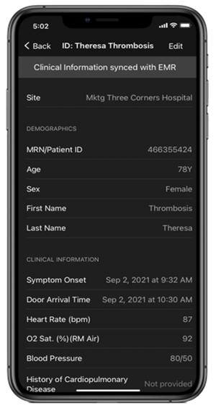
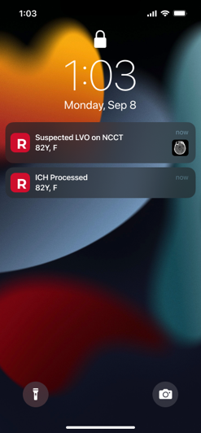
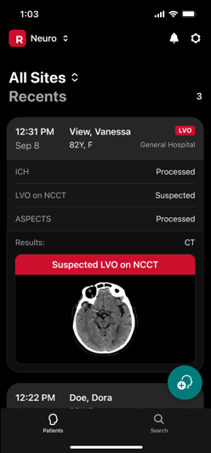
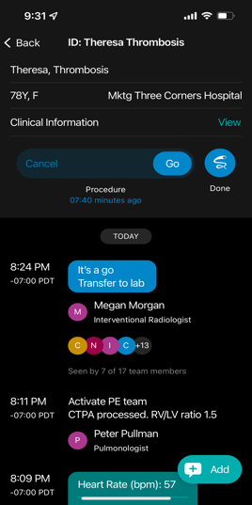

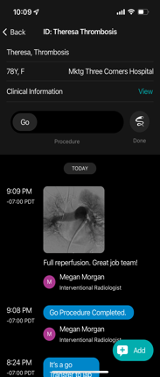
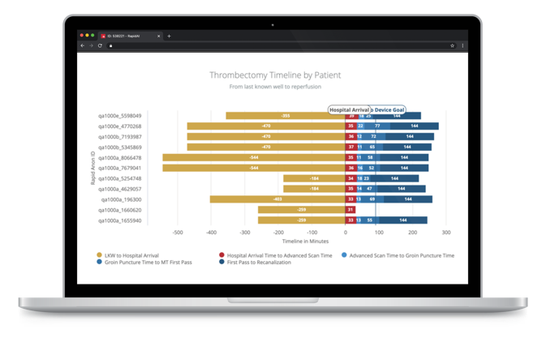
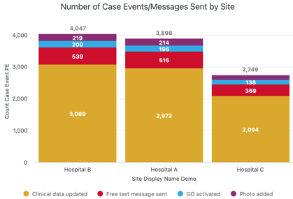
AI Solutions
Clinical decision support
in the palm of your hand
Team workflow
across entire care continuum
(HIPAA compliant)
EMR integration
avoid duplicate data entry
Post-case outcomes and program analytics
to speed up compliance reporting and operational efficiencies

Slide 5
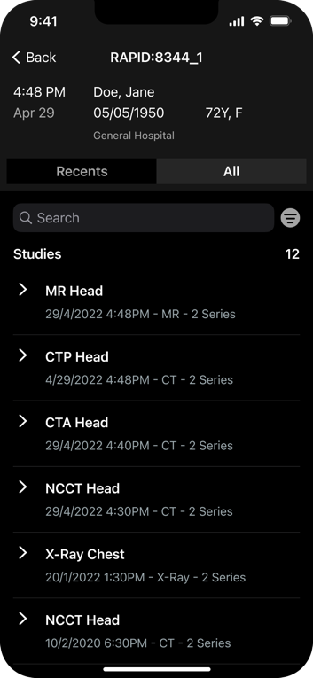
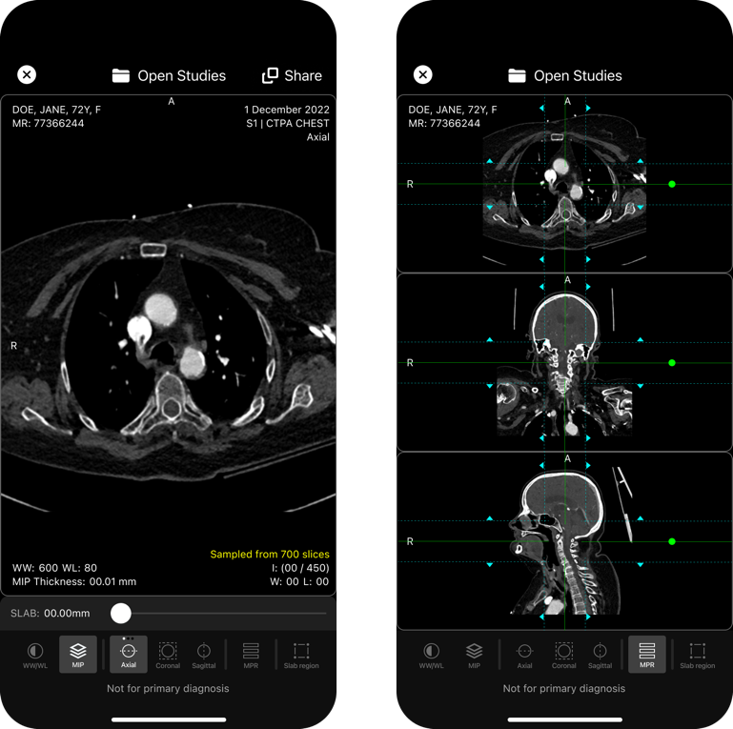
Mobile Multi-Modality Clinician Viewer
Multi-modality support
Advanced PACS features (crosshairs)
Standalone viewer with custom worklist & query (PACS/EMR)

Slide 6
Stroke AI 2024: Know the Benefits and Limitations
False positives and false negatives
Clinician oversight mandatory
Should be trained on all protocols that are encountered in practice
Technical issues: Bolus timing, FOV, slice thickness, etc.
Triage and notification versus CAD products
FOV, field of view; CAD, computer-aided design.

Slide 7
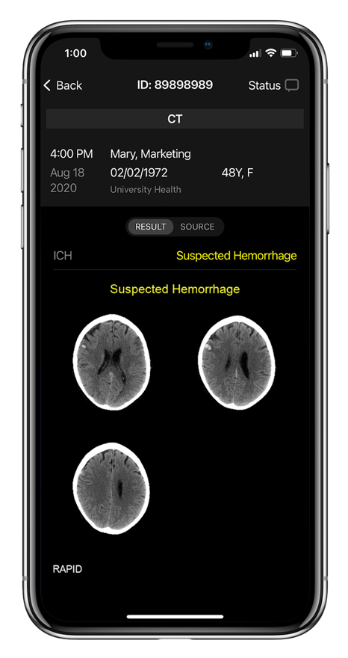
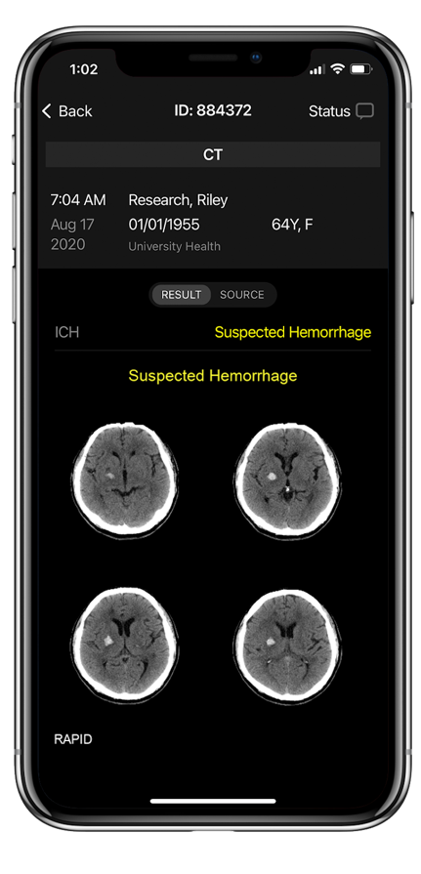
ICH 3.0: Key Features
Faster detection and notification (1 min)
Identifies all types of suspected hemorrhage, including IPH, IVH, SDH and SAH
Broad range including suspected ICH as small as 0.4ml
N=900
Sensitivity
98%
Specificity
>99%

Slide 8

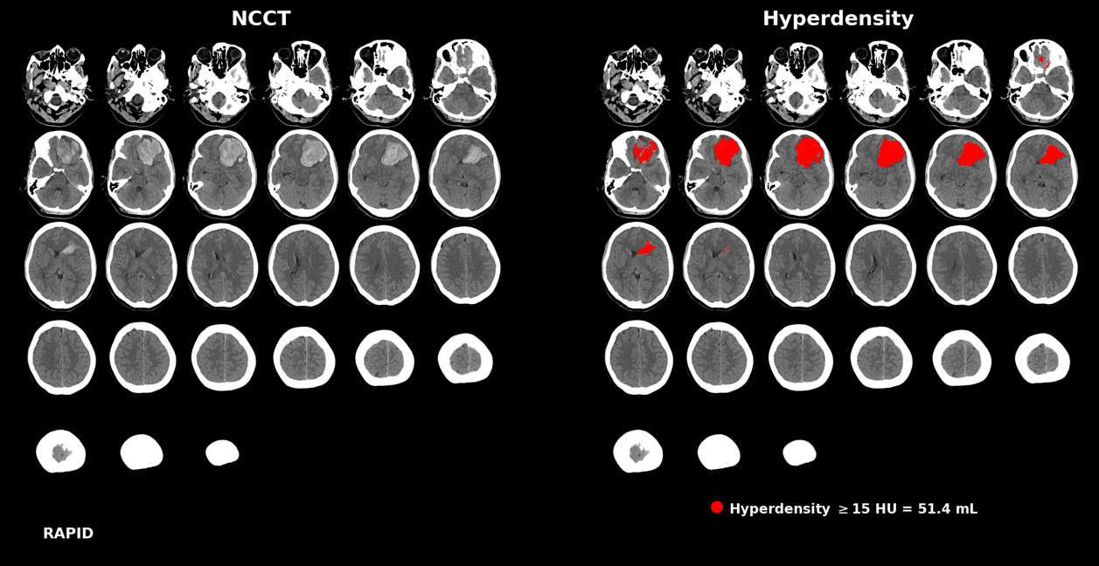
Hyperdensity
Hyperdensity: Automatically detects ICH/hyperdense lesions
Quick identification of volumes to help improve hemorrhage care
Accuracy: Matches hand drawn volumes by experts Pearson correlation = 0.994

Slide 9
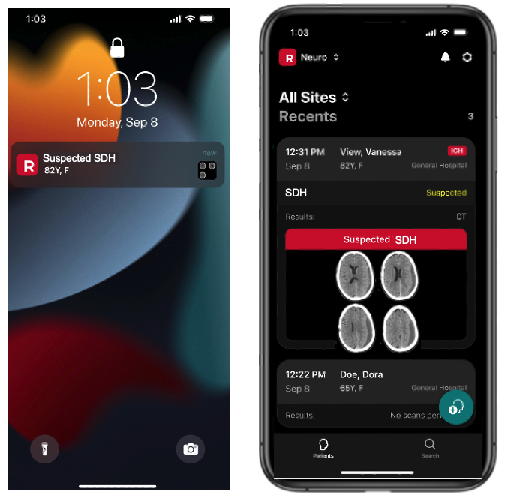
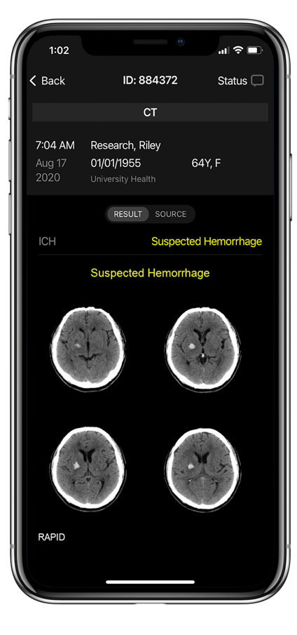
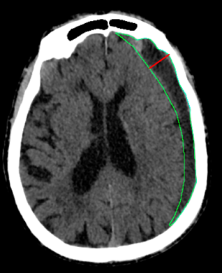
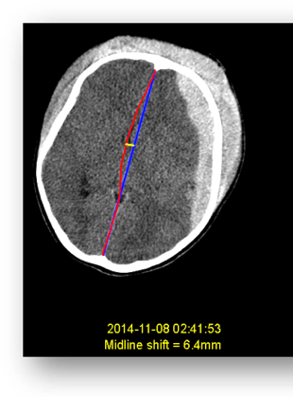
SDH Triage + Midline Shift + Volume + Max Width
Identify patients in the network with SDH (chronic and acute) for new MMA embolization treatments
Follow up with key measurement (MLS, hematoma volume, max width)

Slide 10



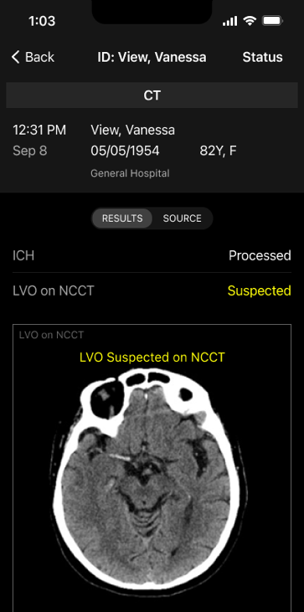
Rapid NCCT Stroke: Focus on Spoke/Critical
Access Hospitals
Breakthrough FDA designation: Multiple modules work simultaneously; identify ICHs for ICH modules
Ischemic pathway: Evaluates hyperdense MCA and early signs of ischemia
Automatically identifies suspected ICA & MCA-M1 LVO on NCCT
Advanced motion correction: Embedded in algorithm

Slide 11

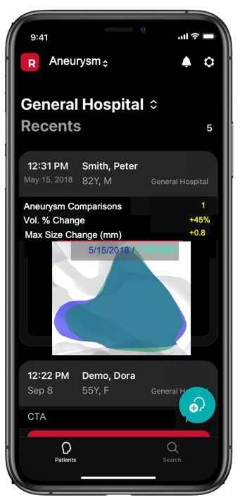

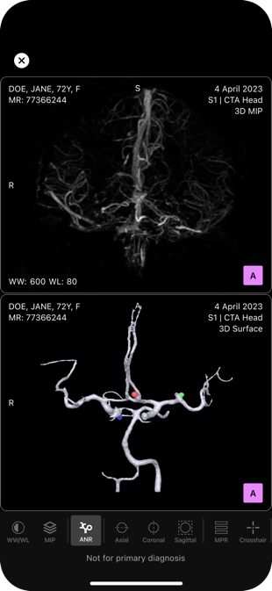
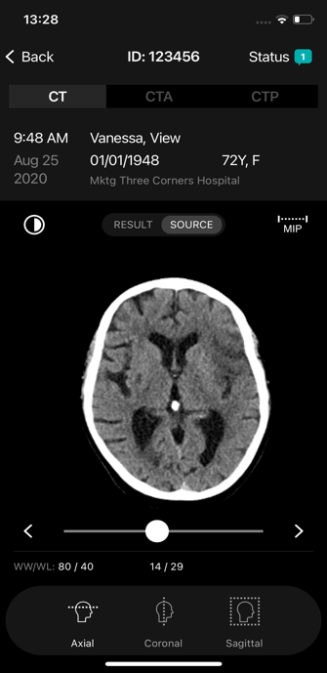
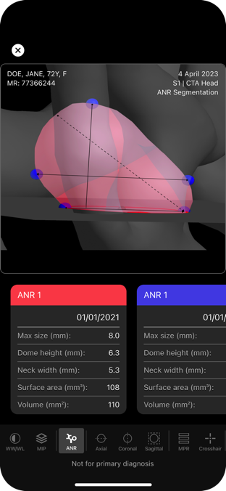
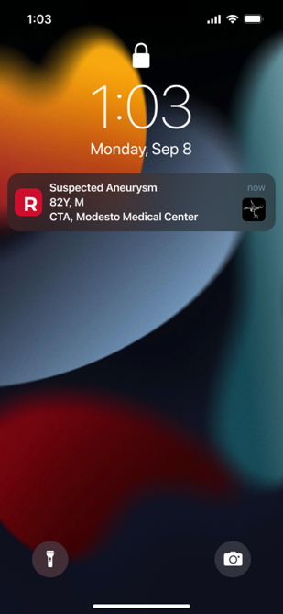



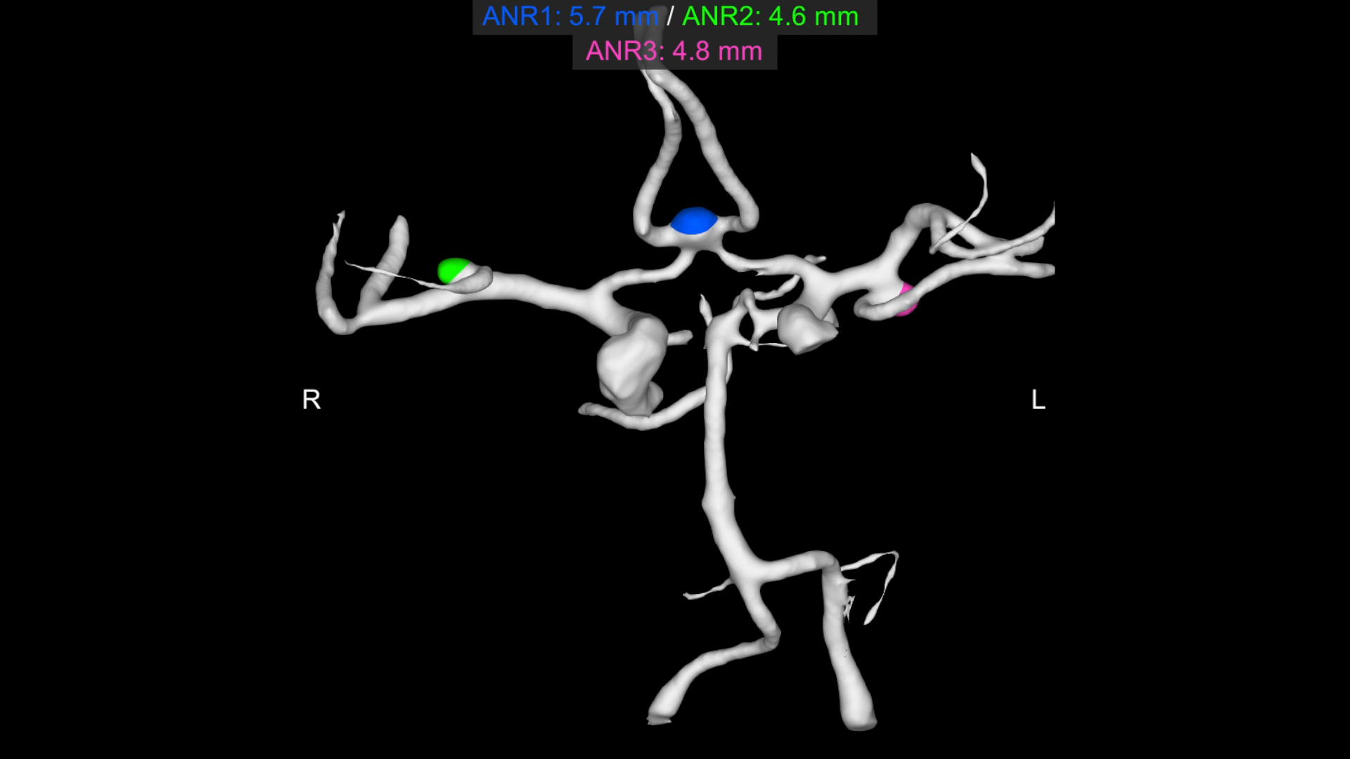
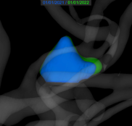




Comprehensive AI Aneurysm Solution
CTA
Is there a patient with an unruptured cerebral aneurysm in my network?
What are the key linear and volume measurements?
(max size, dome height, neck width, surface area, volume)
Are aneurysms growing & changing in size, shape, morphology?

Slide 12
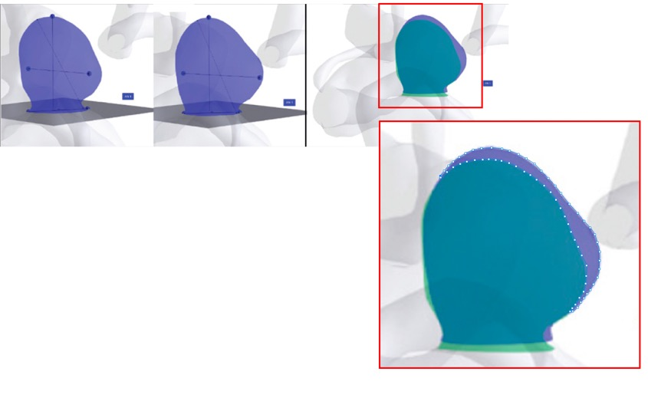
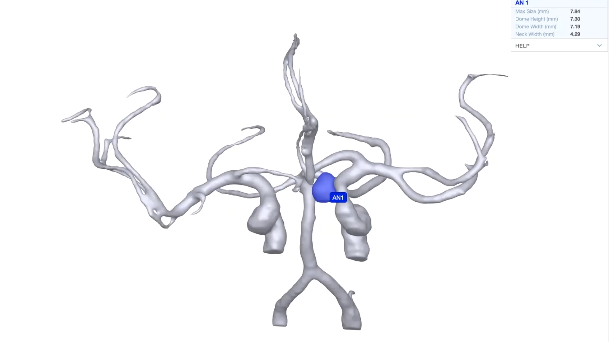
Aneurysm Surveillance
Standard AI
Images in nearly identical plane of section
No discernable change in linear dimension was found by the radiologists
Patient went on to hemorrhage from rupture of
the aneurysm
Co-registration of the aneurysm images demonstrates an increase in aneurysm volume and surface area
Axial
Coronal

Slide 13
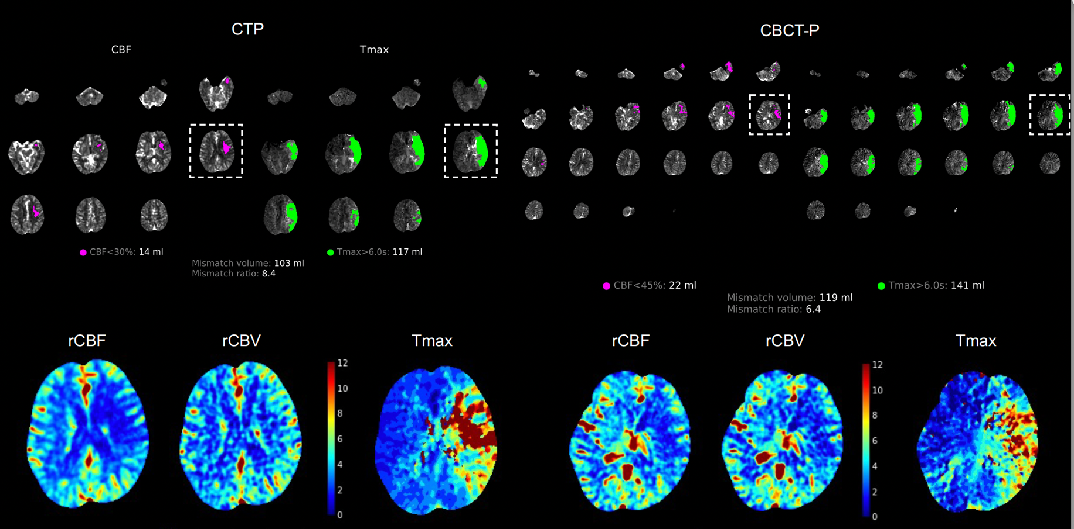
Cone Beam CT Perfusion:
Perfusion Imaging in the Angio Suite

Slide 14
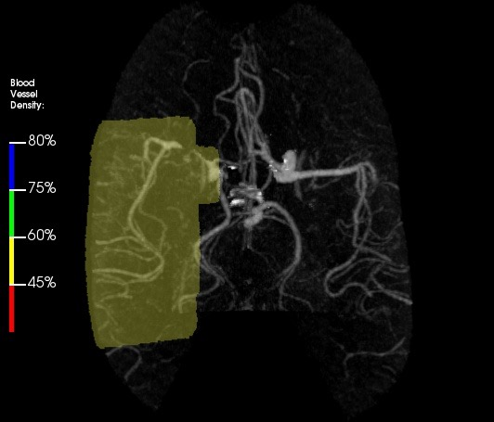
Limitations
  LVO Example
  Vessel segments limited: ICA/MCA
  Incorrect FOV can lead to false positives
  Triage and notification only
FoV 354

Slide 15
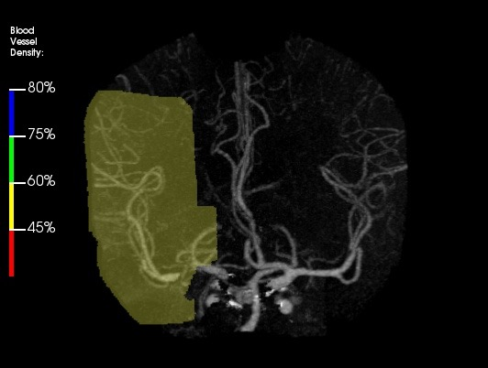
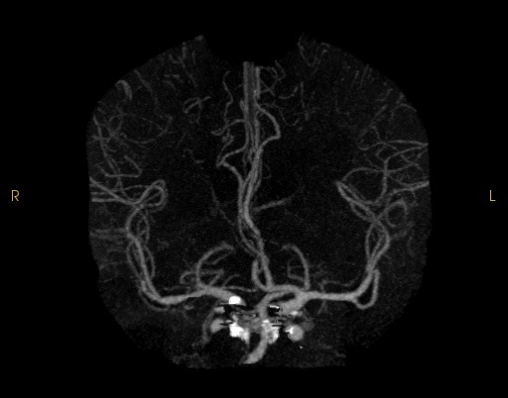
Effect of Field-of-View
FoV 354
FoV 237
False positive True negative

Slide 16
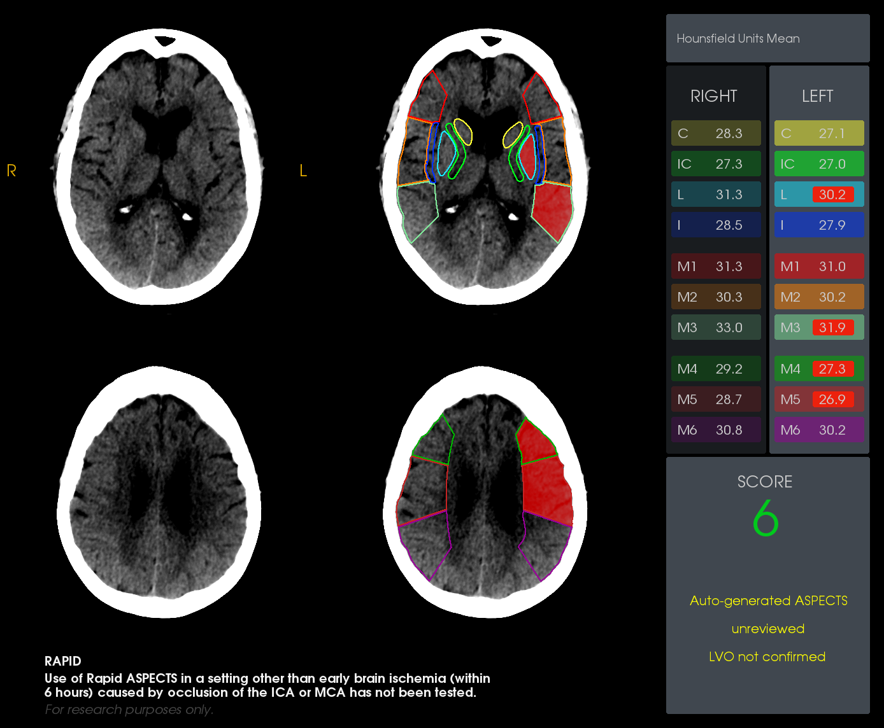
Limitations
ASPECTS Example
Case study: U of Wisconsin reported excessive false positives compared with published data

Slide 17
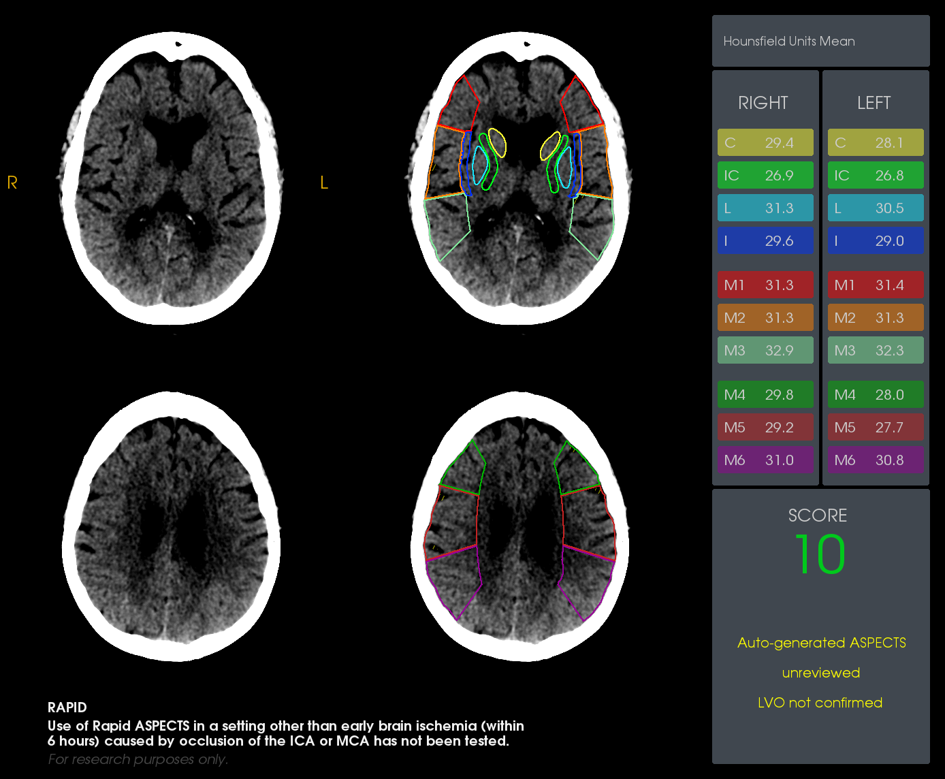
ASPECTS: Thick slice
ASPECTS: Thin slice

Slide 18
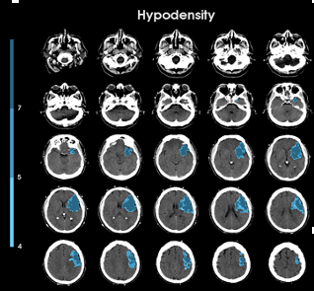
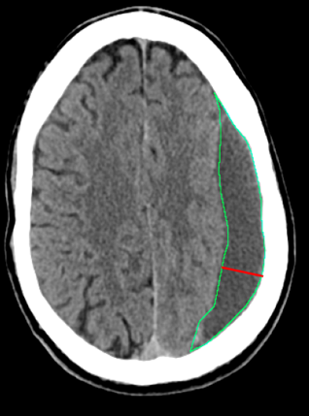
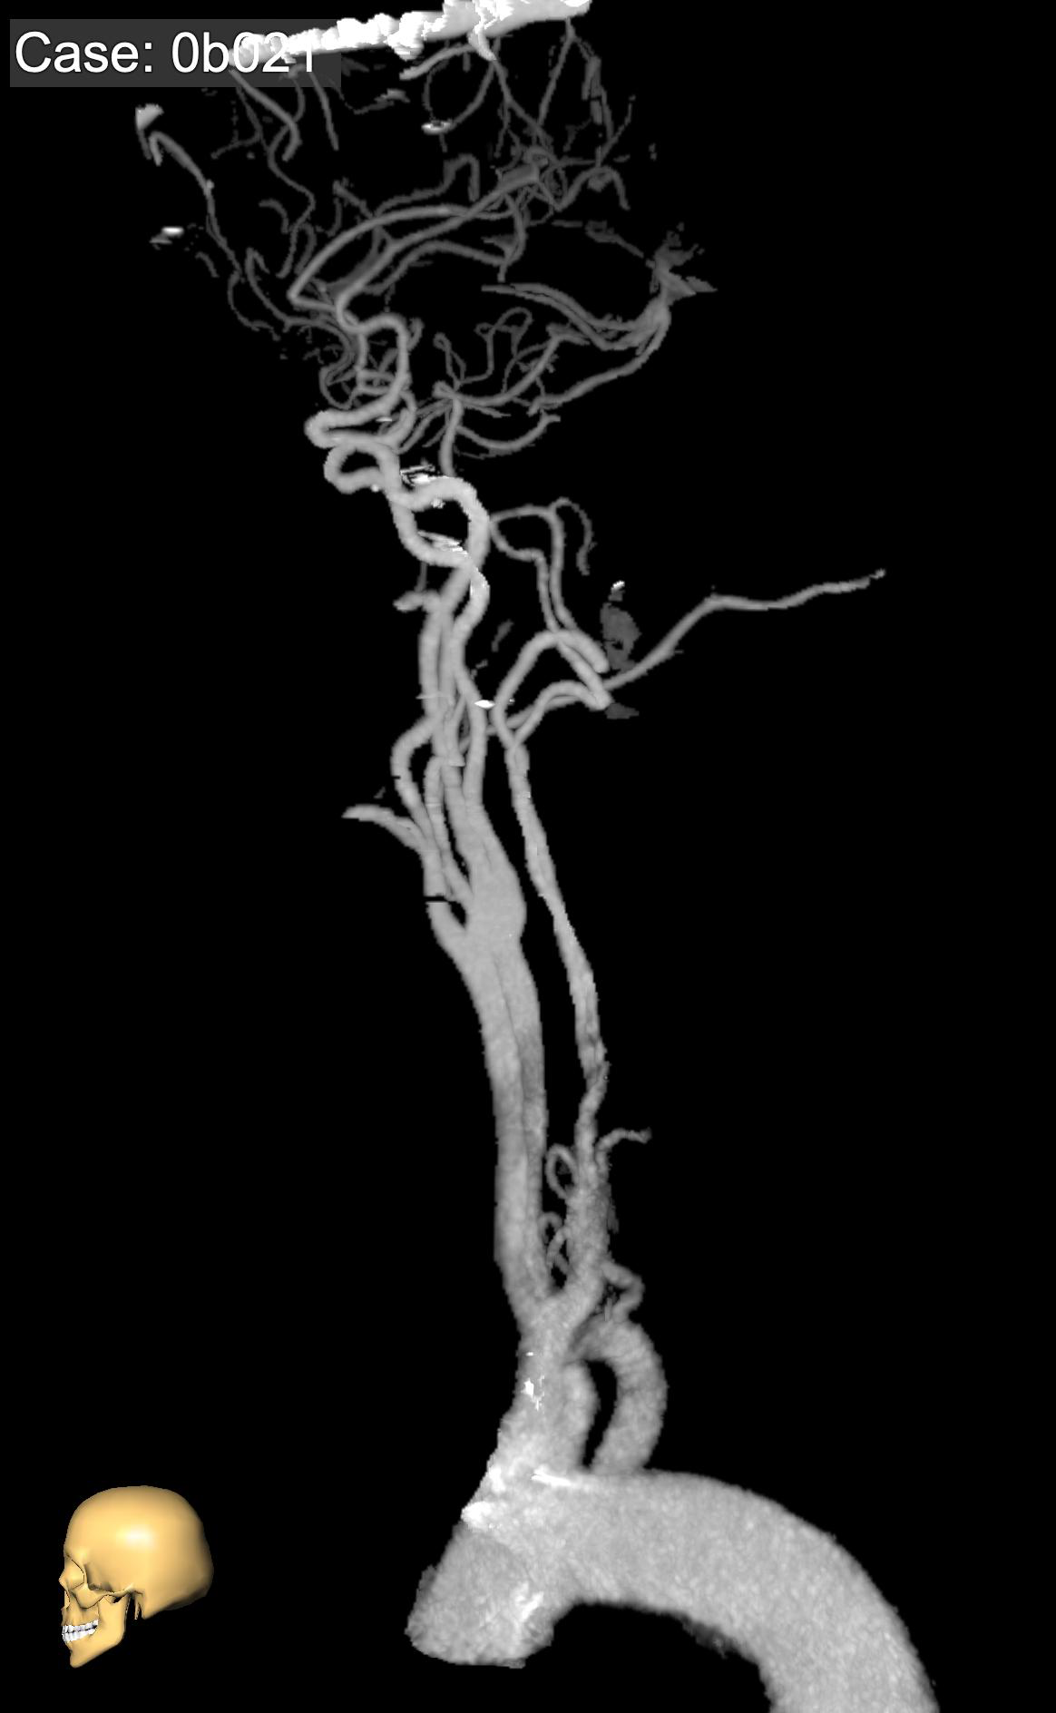

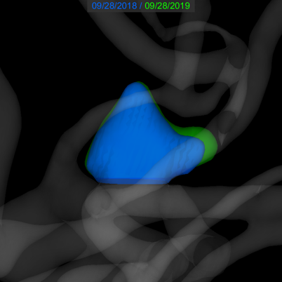
The Promise of AI
Measurement/ Quantification
Detection & Triage
Localization & Visualization
Characterization
2017-11-12, 08:13:52
Max width = 4.7mm

Slide 19



Looking for more resources
on this topic?
CME/CE in minutes
Congress highlights
Late-breaking data
Quizzes
Webinars
In-person events
Slides & resources
www.MedEdOTG.com

