Slide 1

What Is the Acute and Post
Acute Risk of VTE in
Acute Medically Ill Patients?
Alex C. Spyropoulos MD, FACP, FCCP, FRCPC
Professor of Medicine
The Donald and Barbara Zucker School of Medicine at Hofstra/Northwell
Professor – The Institute of Health Systems Science
The Feinstein Institutes for Medical Research
System Director – Anticoagulation and Clinical Thrombosis Service
Northwell Health System at Lenox Hill Hospital
New York, NY

Slide 2



Resource Information
About This Resource
These slides are one component of a continuing education program available online at MedEd On The Go titled Primary Prevention, Initial Treatment & Management of VTE, Secondary VTE Prevention Strategies
Program Learning Objectives:
Discuss patient populations that are particularly susceptible to blood clot development, emphasizing the importance of risk assessment and stratification for the primary prevention of VTE and the secondary prevention of recurrent VTE
Illustrate how to implement evidence-based medicine, clinical guideline statements, and real-world clinical data in clinical practice to improve outcomes for primary prevention of VTE, initial treatment and management of VTE, and the secondary prevention of recurrent VTE
MedEd On The Go®
www.mededonthego.com
This content or portions thereof may not be published, posted online or used in presentations without permission.
This content can be saved for personal use (non-commercial use only) with credit given to the resource authors.
To contact us regarding inaccuracies, omissions or permissions please email us at support@MedEdOTG.com

Slide 3
Disclaimer
The views and opinions expressed in this educational activity are those of the faculty and do not necessarily represent the views of Total CME, LLC, the CME providers, or the companies providing educational grants. This presentation is not intended to define an exclusive course of patient management; the participant should use their clinical judgment, knowledge, experience, and diagnostic skills in applying or adopting for professional use any of the information provided herein. Any procedures, medications, or other courses of diagnosis or treatment discussed or suggested in this activity should not be used by clinicians without evaluation of their patient's conditions and possible contraindications or dangers in use, review of any applicable manufacturer’s product information, and comparison with recommendations of other authorities. Links to other sites may be provided as additional sources of information.

Slide 4
Scope of the Problem in Hospitalized
Medical Patients
An estimated 8 million acutely ill medical patients at risk for VTE are hospitalized annually in the US
  The number is approximately 12 million in the European Union
Significant unmet medical need exists for VTE prevention for the acutely ill medical population, especially post-hospital discharge
  50 to 70% of symptomatic VTEs and 70 to 80% of fatal PEs occur in acute, medically ill, non-surgical patients, especially those with high VTE risk
  Hospitalized medical patients have more severe forms of VTE than surgical patients and more VTE-related deaths
  Rate of symptomatic VTE more than doubles over the first 21 days post-discharge and is associated with a five-fold increase of fatal PE within 45 days
PE, pulmonary embolism; VTE, venous thromboembolism.
Anderson F, et al. Am J Hematol. 2007;82:777-82; Cohen AT, et al. Thromb Haemost. 2007;98:756-64; Goldhaber S, et al. Chest. 2000;118(6):1680-4; Kahn SR, et al. Chest. 2012;141(2)(Suppl):e195S-e226S; Monreal M, et al. J Thromb Haemost. 2004;2:1892-8; Spyropoulos AC, et al. Chest. 2011;10:10-19.
Notes:
Source:
http://www.portola.com/pdfs/Portola_APEX_FPI.pdf
Russell Hull – (Hull, R, et al. Rate of late VTE in high-risk hospital medical patients) data presented at KOL meeting on February 26, 2013

Slide 5
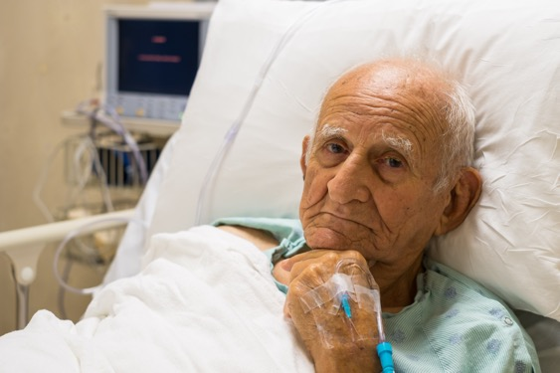
Acutely Ill Medical Patients
Mean age 70 years and immobilized for 3 or more days
Congestive heart failure (NYHA class III or IV)
Acute respiratory failure/COPD exacerbation
Acute infection without septic shock
Stroke
Acute rheumatic disorders, including acute lumbar pain or sciatica or vertebral compression (caused by osteoporosis or a tumor)
Acute arthritis of the legs, or an acute episode of rheumatoid arthritis in the legs
Inflammatory bowel disease exacerbation
Kahn SR, et al. CHEST. 2012;141(2)(Suppl):e195S-e226S.

Slide 6
VTE Risk Factors in Hospitalized
Medical Patients
High Risk
Probable Risk
History of VTE
Family history of VTE
Acute infection
Malignancy
Age over 75 years
CHF
Stroke
Immobility more than 4 days
Pregnancy/postpartum
Acute/chronic lung disease
Acute inflammatory disease
Shock/ICU stay
Elevated Dd (>2X ULN)*
High-dose estrogen
BMI greater than 25
Varicose veins
HIT
Congenital/acquired thrombophilia
Possible Risk
Paraproteinemia
Behcet’s disease
Nephrotic syndrome
Polycythemia
PNH
Myeloproliferative disease
Age over 40

Slide 7
VTE Risk Assessment Models:
Padua and IMPROVE*
Baseline Features | Score
Active cancer | 3
Previous VTE (with the exclusion of superficial vein thrombosis) | 3
Reduced mobility | 3
Already known thrombophilic condition | 3
Recent (≤1 month) trauma and/or surgery | 2
Elderly age (≥70 years) | 1
Heart and/or respiratory failure | 1
Acute MI or ischemic stroke | 1
Acute infection and/or rheumatic disorder | 1
Obesity (BMI ≥30) | 1
Ongoing hormonal treatment | 1
VTE Risk Factor | Points for the Risk Score
Previous VTE | 3
Thrombophilia | 2
Lower limb paralysis | 2
Current cancer | 2
ICU/CCU stay | 1
Immobilization ≥7 days | 1
Age >60 years | 1
Low risk for VTE = score 0-1 points
Intermediate risk for VTE = 2-3 points
High risk for VTE = ≥4 points
* IMPROVEDD Score with elevated Dd (≥ 2x ULN) 2 points)
Low risk for VTE = score <4 points
High risk for VTE = ≥4 points

Slide 8
Inpatient Thromboprophylaxis Trials in Medically Ill Patients
Average duration 7 to 14 days
Study RRR Thromboprophylaxis Patients with VTE (%)
14.9*
MEDENOX 63% Placebo
N=1102 Enoxaparin 40 mg daily
PREVENT 49% Placebo
N=3706 Dalteparin 5000 IU daily
ARTEMIS 47% Placebo
N=849 Fonda 2.5 mg daily
p<0.001
5.5
5.0*
p=0.0015
2.8
10.5†
p=0.029
5.6

Slide 9
Fatal Pulmonary Embolism During Anticoagulant Prophylaxis
Prophylaxis
n/n
Placebo
n/n
RR Fixed
(95% CI)
RR Fixed
(95% CI)
Dahan et al, 1986 (41) 1/132 3/131 0.33 (0.03 to 3.14)
Garlund at al, 1996 (35) 3/5776 12/5917 0.26 (0.07 to 0.91)
Leizorovic et al, 2004 (23) 0/1829 2/1807 0.20 (0.01 to 4.11)
Mahe et al, 2005 (22) 10/1230 17/1244 0.59 (0.27 to 1.29)
Cohen at, 2006 (42) 0/321 5/323 0.09 (0.01 to 1.65)
Total events 14 39 0.38 (0.21 to 0.69)
0.001 0.01 0.1 1.0 10 100 1000
Favors Treatment Favors Placebo
Notes:
9
9

Slide 10

Updated 2024 International Consensus Statement:
Thromboprophylaxis Guideline Recommendations in Medical Inpatients
Inpatient Thromboprophylaxis
For acutely ill medical patient with high individual risk factors for VTE or with minimum score thresholds utilizing validated VTE RAMs (i.e. PADUA VTE score ≥4 or IMPROVE/IMPROVE-DD score ≥2) LMWH (enoxaparin 40mg once daily or dalteparin 5,000 IU once daily) is recommended (level of evidence high; recommendation strong). If LMWH is not available, LDUH 5000 twice or thrice daily is recommended. Single daily doses of fondaparinux 2.5mg or rivaroxaban 10mg are an alternative (level of evidence moderate; recommendation moderate).

Slide 11
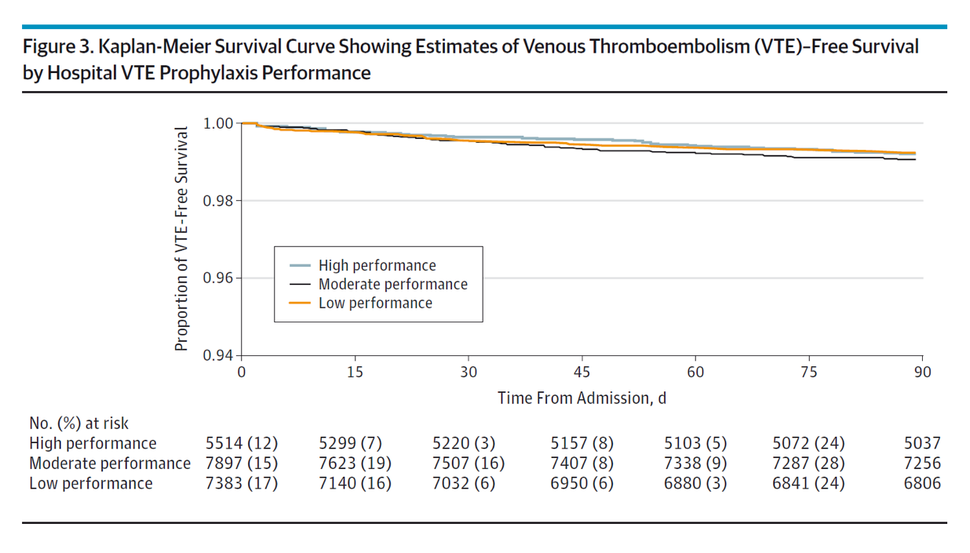
No Difference in VTE-Free Survival by
In-Hospital Only VTE Prophylaxis Performance*
Median LOS 4 days
*Quality improvement project in 35 Michigan hospitals – rates of pharmacologic thromboprophylaxis in high-, moderate-, and low-performing tertiles was 85.8%, 72.6%, and 55.5%

Slide 12

Conclusions – Thromboprophylaxis in
Medical Inpatients
Extended Period
(Post-Hospital Discharge) (up to ~45d)
(High Risk Period)
~25% of patients
Chronic Medical
Illness
(Low Risk Period)
? ~5% of patients
Acute
Hospitalization
(Highest Risk Period)
30%-65% of patients
 | VTE tied to immobility based on disease severity | Period of VTE risk tied to hospital discharge period | Chronic VTE risk tied to medical condition
Admission
Discharge
?
VTE Risk
IMPROVE ≥ 2
Padua ≥ 4
Low Bleed Risk*
IMPROVE < 7
High VTE Risk
IMPROVE or IMPROVE-DD≥ 4
DD ≥ 2X ULN + IMPROVE 2 to 3
Age > 75 years, history of VTE,
or cancer
New paradigm in medically ill thromboprophylaxis: Individualized (patient-level) risk adapted approach with clinical decision support/EHR interoperability
UFH or LMWH
Fondaparinux (EU)
Betrixaban (US)
Rivaroxaban (US)
Betrixaban (US)
Rivaroxaban (US)
LMWH

Slide 13



Looking for more resources
on this topic?
CME/CE in minutes
Congress highlights
Late-breaking data
Quizzes
Webinars
In-person events
Slides & resources
www.MedEdOTG.com

