Slide 1
VTE Prophylaxis in Patients at
Risk for a Secondary VTE Event - Options?
Scott Kaatz, DO, MSc, FACP, SFHM
Clinical Professor of Medicine, Michigan State University College of Human Medicine
Clinical Professor of Medicine, Wayne State University School of Medicine
Medical Director for Professional Development and Research
Co-director, Anticoagulation Clinics
Henry Ford Hospital
Detroit, MI

Slide 2



Resource Information
About This Resource
These slides are one component of a continuing education program available online at MedEd On The Go titled Primary Prevention, Initial Treatment & Management of VTE, Secondary VTE Prevention Strategies
Program Learning Objectives:
Discuss patient populations that are particularly susceptible to blood clot development, emphasizing the importance of risk assessment and stratification for the primary prevention of VTE and the secondary prevention of recurrent VTE
Illustrate how to implement evidence-based medicine, clinical guideline statements, and real-world clinical data in clinical practice to improve outcomes for primary prevention of VTE, initial treatment and management of VTE, and the secondary prevention of recurrent VTE
MedEd On The Go®
www.mededonthego.com
This content or portions thereof may not be published, posted online or used in presentations without permission.
This content can be saved for personal use (non-commercial use only) with credit given to the resource authors.
To contact us regarding inaccuracies, omissions or permissions please email us at support@MedEdOTG.com

Slide 3
Disclaimer
The views and opinions expressed in this educational activity are those of the faculty and do not necessarily represent the views of Total CME, LLC, the CME providers, or the companies providing educational grants. This presentation is not intended to define an exclusive course of patient management; the participant should use their clinical judgment, knowledge, experience, and diagnostic skills in applying or adopting for professional use any of the information provided herein. Any procedures, medications, or other courses of diagnosis or treatment discussed or suggested in this activity should not be used by clinicians without evaluation of their patient's conditions and possible contraindications or dangers in use, review of any applicable manufacturer’s product information, and comparison with recommendations of other authorities. Links to other sites may be provided as additional sources of information.

Slide 4
Case
42-year-old male with pulmonary embolism several days after 2-day hospitalization for pneumonia
  Pneumonia not COVID
  No ICU for pneumonia or PE
Has been on full dose for 6 months
No signs of recurrent VTE, feels well, no shortness of breath, fully recovered
No increased bleeding risk
Shared decision-making decision to extended treatment
What would you do?
  Continue therapeutic dose DOAC
  Step down to lower dose DOAC (apixaban or rivaroxaban)
  Change to aspirin
  Change to warfarin

Slide 5
ACCP Guideline for Extended-Phase Therapy
In patients offered extended-phase anticoagulation, we suggest the use of reduced-dose apixaban or rivaroxaban over full-dose apixaban or rivaroxaban
  Remark: Reduced dose refers to
    apixaban 2.5 mg twice daily and
    rivaroxaban 10 mg once daily
In patients offered extended-phase anticoagulation, we recommend reduced-dose DOAC over aspirin or no therapy and suggest rivaroxaban over aspirin
In patients with VTE diagnosed in the absence of transient risk factor (unprovoked VTE or provoked by a persistent risk factor) who cannot receive a DOAC, we suggest offering extended-phase anticoagulation with a VKA
In patients with an unprovoked proximal DVT or PE who are stopping anticoagulant therapy and do not have a contraindication to aspirin, we suggest aspirin over no aspirin to prevent recurrent VTE

Slide 6
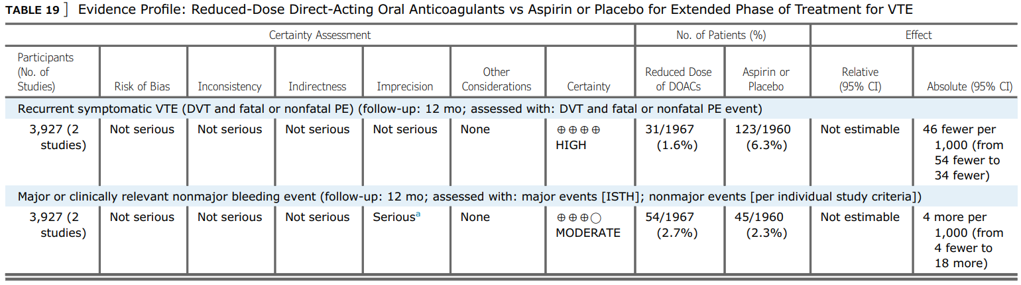
ACCP Evidence Table for Secondary Prevention
Lower Dose Versus Standard Dose DOAC
Versus placebo or ASA
  4.6% (3.4% – 5.4%) fewer recurrent symptomatic VTE
  0.4% more (0.4% fewer to 1.8% more) major or clinically non-major bleeding

Slide 7
ASH Guideline for Extended-Phase Therapy
For patients with DVT and/or PE who have completed primary treatment and will continue with a DOAC for secondary prevention, the ASH guideline panel suggests using standard dose DOAC or lower-dose DOAC
  Remarks: Lower-dose DOAC regimens that may be considered for patients who have completed primary treatment and will continue with a DOAC include
    rivaroxaban, 10 mg daily, or
    apixaban, 2.5 mg twice daily
For patients with DVT and/or PE who have completed primary treatment and will continue to receive secondary prevention, the ASH guideline panel suggests using anticoagulation over ASA
For patients with DVT and/or PE who have completed primary treatment and will continue VKA therapy as secondary prevention, the ASH guideline panel recommends using an INR range of 2.0 to 3.0 over a lower INR range

Slide 8
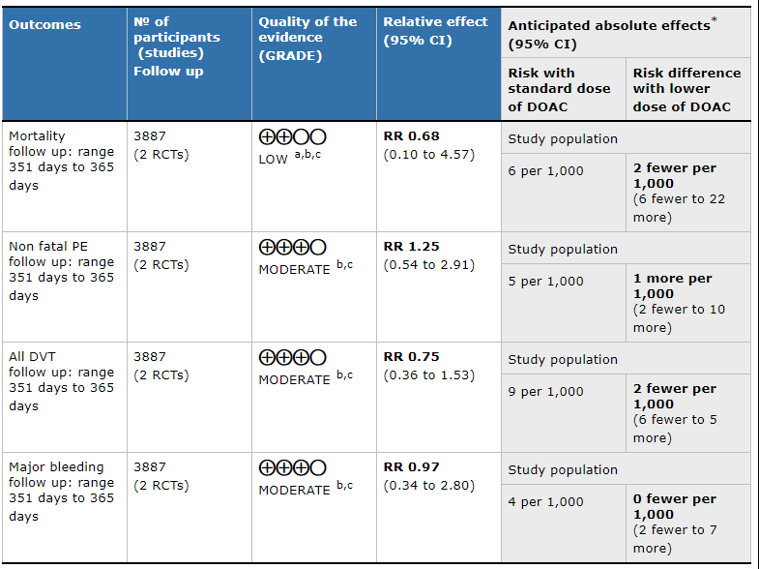
ASH Evidence Table for Secondary Prevention
Lower Dose Versus Standard Dose DOAC
Reduced dose compared to standard dose
Mortality
  0.2% fewer (0.6% fewer to 2.2% more)
Non-fatal PE
  0.1% more (0.2% fewer to 1.0% more)
All DVT
  0.2% fewer (0.6% fewer to 0.5% more)
Major bleeding
  0% fewer (.02% fewer to 0.7% more)

Slide 9



Looking for more resources
on this topic?
CME/CE in minutes
Congress highlights
Late-breaking data
Quizzes
Webinars
In-person events
Slides & resources
www.MedEdOTG.com

