Slide 1
Migraine Treatment Update 2023
Stephen D. Silberstein, MD, FACP
Director, Jefferson Headache Center
Professor of Neurology
Thomas Jefferson University Hospital
Philadelphia, PA

Slide 2
Resource Information
About This Resource
These slides are one component of a continuing education program available online at MedEd On The Go titled Chronic Migraine Prevention: Novel Treatment Strategies
Program Learning Objectives:
Inform clinicians on the overuse of OTC and other prescription medication by their patients experiencing migraines
Provide clinicians with up-to-date, evidence-based guidelines on the use of current prophylactic therapies used to manage chronic migraines
Improve clinician's ability to differentiate between the new and emerging preventative, chronic migraine therapies
MedEd On The Go®
www.mededonthego.com
This content or portions thereof may not be published, posted online or used in presentations without permission.
This content can be saved for personal use (non-commercial use only) with credit given to the resource authors.
To contact us regarding inaccuracies, omissions or permissions please email us at support@MedEdOTG.com

Slide 3
Disclaimer
The views and opinions expressed in this educational activity are those of the faculty and do not necessarily represent the views of Total CME, LLC, the CME providers, or the companies providing educational grants. This presentation is not intended to define an exclusive course of patient management; the participant should use their clinical judgment, knowledge, experience, and diagnostic skills in applying or adopting for professional use any of the information provided herein. Any procedures, medications, or other courses of diagnosis or treatment discussed or suggested in this activity should not be used by clinicians without evaluation of their patient's conditions and possible contraindications or dangers in use, review of any applicable manufacturer’s product information, and comparison with recommendations of other authorities. Links to other sites may be provided as additional sources of information.

Slide 4
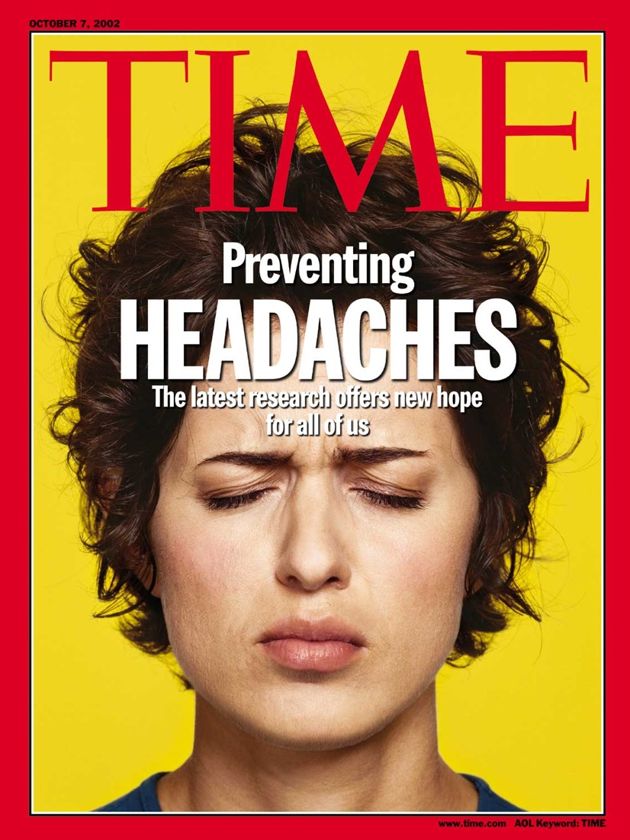

Slide 5
Consider Prevention When
Migraine significantly interferes with patients' daily routine, despite acute treatment
Frequency attacks (>1/week) with risk of Chronic Daily Headache (CDH) or Medication Overuse Headache (MOH)
Acute medications ineffective, contraindicated, troublesome Adverse Events (AEs), or overused
Patient preference
Special circumstances such as
Hemiplegic Migraine
Basilar Migraine
Migraine with Prolonged Aura
Migrainous Infarction

Slide 6
Migraine Prevention Underutilized: The American Migraine Prevalence and Prevention (AMPP) Study
40% of migraine sufferers may be eligible for prevention
Migraine
Sufferers
13% of all migraine sufferers currently receive prevention
Prevention
Candidates

Slide 7
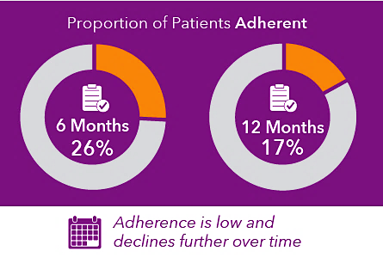
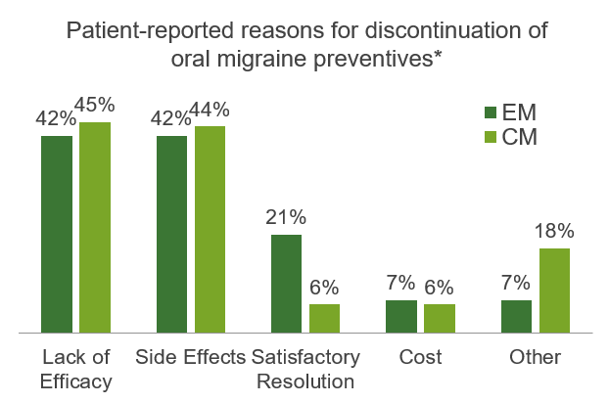
Migraine Treatment Adherence

Slide 8
Preventive Medications
Anticonvulsants
Divalproex*
Topiramate*
Antidepressants
TCAs, SNRIs
B-Blockers
Propranolol*/ Timolol*/ Metoprolol/Atenolol /Nadolol
5-HT antagonists
Methylergonovine
Pizotifen
Neurotoxins
OnabotulinumtoxinA - Chronic Migraine (CM)* *
Angiotensin system
ACE inhibitors or antagonists
mAbs
Erenumab */ Fremanzumab *
Galcanezumab */Eptinezumab*
Neutroceuticals
Riboflavin, Coenzyme Q10
Feverfew, Petasites
Gepants
Atogepant, Rimegepant

Slide 9
Principles of Preventive Drug Treatment
Start with low dose and increase slowly
Not for mABs and Gepants
Need adequate trial (3 to 6 months)
Avoid drug overuse and interfering drugs
Evaluate therapy
Use calendar
Taper (stop?) if well controlled for ≥ 6 months
Avoid pregnancy
Ascertain birth control use

Slide 10
Preventive Rx Depends Upon
Migraine type
Drug’s efficacy
Scientific evidence and clinical experience
Drug’s Adverse Events (AEs) and safety
Comorbid and coexisting diseases
Patient preference
Use safest, most effective medication with fewest AEs

Slide 11
Comorbidities Impact Treatment Choice¹⁻³
Neurologic
Epilepsy
Bell’s palsy?
Essential tremor
Fibromyalgia
Positional vertigo
Restless legs syndrome
Cardiovascular
Stroke
Angina/MI
Raynaud disease
Hypertension
Mitral valve prolapse
Patent foramen ovale (migraine with aura)
Gastrointestinal
Irritable bowel syndrome
Peptic ulcer disease?
Psychiatric
Bipolar disorder
Depression
Generalized anxiety disorder Panic disorder
Other
Allergies
Asthma
Obesity?

Slide 12
Coexisting Conditions: Recommended Approach
Select best drug to treat each disorder
Try to pick one drug if it is a first line option for multiple disorders
Do not treat migraine with drug contraindicated for another condition
Do not use drug for other condition that exacerbates migraine
Beware of drug interactions
Pay attention to women of child-bearing potential

Slide 13
Looking for more resources on this topic?
CME/CE in minutes
Congress highlights
Late-breaking data
Quizzes
Webinars
In-person events
Slides & resources
www.MedEdOTG.com

