Slide 1
Idiopathic Hypersomnia and Cardiovascular Health
Too Much of a Good Thing?
Logan Schneider, MD
Consultant Neurologist
Stanford/VA Alzheimer's Center
Clinical Assistant Professor
Stanford Sleep Center
Redwood City, CA

Slide 2



Resource Information
About This Resource
These slides are one component of a continuing education program available online at MedEd On The Go titled Idiopathic Hypersomnia: Improving QoL Through Patient-Centered Care
Program Learning Objectives:
Improve the accuracy and timing when diagnosing patients suffering from IH
Educate HCPs on the cardiovascular and QoL impact experienced by patients suffering from IH
Develop an evidence-based, comprehensive treatment plan for the management of IH
MedEd On The Go®
www.mededonthego.com
This content or portions thereof may not be published, posted online or used in presentations without permission.
This content can be saved for personal use (non-commercial use only) with credit given to the resource authors.
To contact us regarding inaccuracies, omissions or permissions please email us at support@MedEdOTG.com

Slide 3
Disclaimer
The views and opinions expressed in this educational activity are those of the faculty and do not necessarily represent the views of Total CME, LLC, the CME providers, or the companies providing educational grants. This presentation is not intended to define an exclusive course of patient management; the participant should use their clinical judgment, knowledge, experience, and diagnostic skills in applying or adopting for professional use any of the information provided herein. Any procedures, medications, or other courses of diagnosis or treatment discussed or suggested in this activity should not be used by clinicians without evaluation of their patient's conditions and possible contraindications or dangers in use, review of any applicable manufacturer’s product information, and comparison with recommendations of other authorities. Links to other sites may be provided as additional sources of information.

Slide 4
CoI
1. I do not have any relationships with any entities producing, marketing, re-selling, or distributing health care goods or services consumed by, or used on, patients, OR
X
2. I have the following relationships with entities producing, marketing, re-selling, or distributing health care goods or services consumed by, or used on, patients.
Type of Potential Conflict | Details of Potential Conflict
Grant/Research Support
Consultant
Speakers’ Bureaus | Jazz: solriamfetol (Sunosi), oxybates (Xyrem/Xywav); Harmony Biosciences: pitolisant (Wakix); Avadel: oxybate (Lumryz); Eisai: lemborexant (Dayvigo)
Financial support
Other | Alphabet Inc
X
3. The material presented in this lecture has no relationship with any of these potential conflicts, OR
4. This talk presents material that is related to one or more of these potential conflicts, and the following objective references are provided as support for this lecture (as well as throughout the lecture):

Slide 5
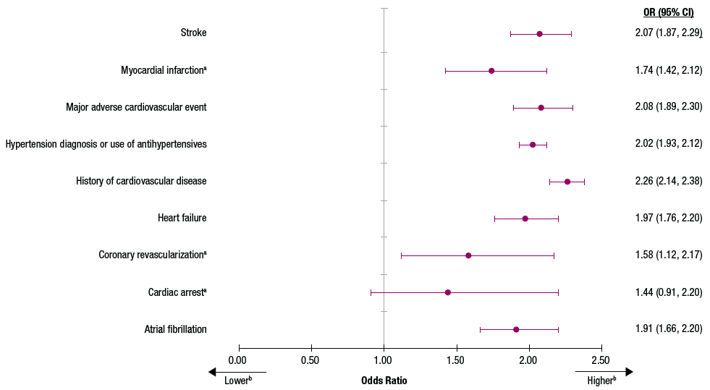
I Wouldn’t Bet on Those Odds
I Wouldn’t Bet on Those Odds
Cardiovascular Burden of Patients With Idiopathic Hypersomnia: Real-World Idiopathic Hypersomnia Total Health Model (CV-RHYTHM)
IH (N = 11,412)
Ctrl (N = 57,058)

Slide 6
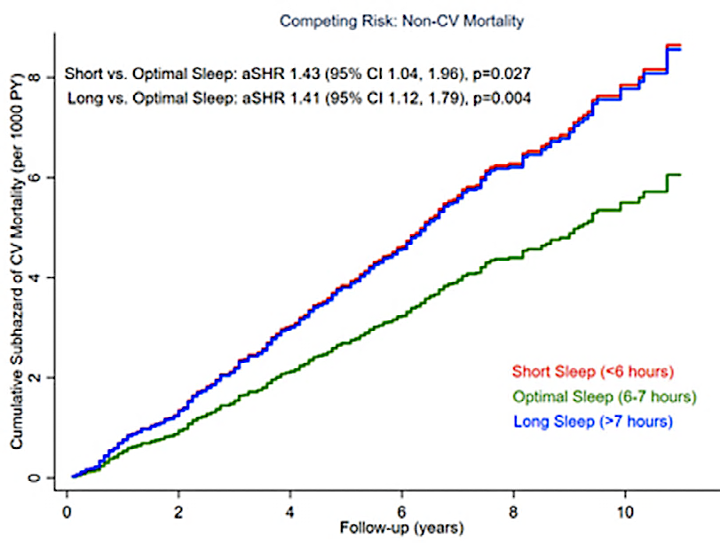
Squint to See the Difference
Notice the definition of “Optimal”

Slide 7
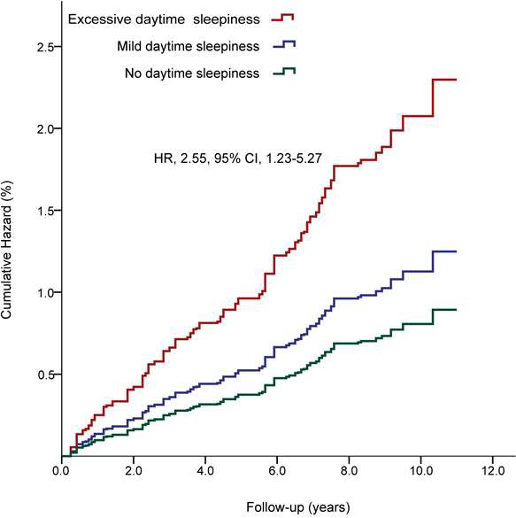
CV Mortality Risk
~2.5x with EDS
Regardless of sleep duration

Slide 8
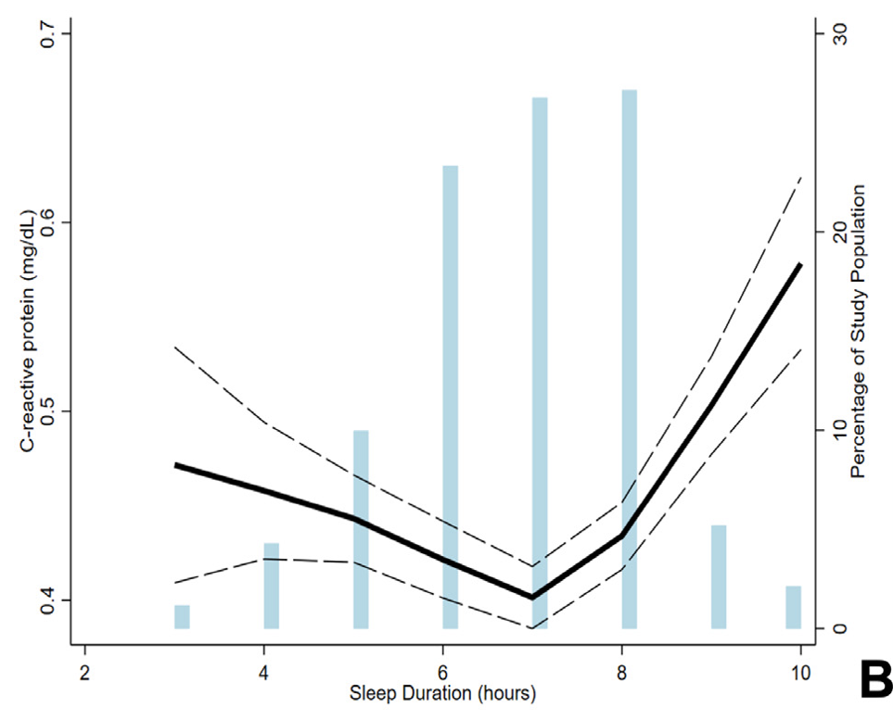
Inflammation May Be Part of the Process

Slide 9
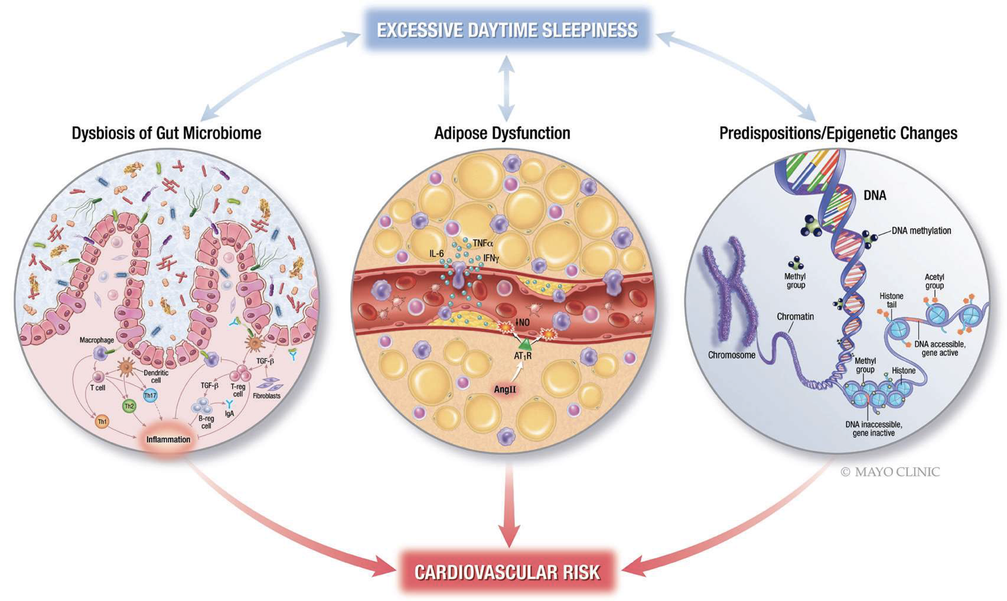
Mechanism of Action?

Slide 10



Looking for more resources
on this topic?
CME/CE in minutes
Congress highlights
Late-breaking data
Quizzes
Webinars
In-person events
Slides & resources
www.MedEdOTG.com

