Slide 1
From Prescription to Personalization
An HCP’s Guide to Tailoring
MS Therapeutic Management
Dr. Mark S. Freedman, MSc MD FANA FAAN CSPQ FRCPC
Professor of Neurology
University of Ottawa
Sr. Scientist
Ottawa Hospital Research Institute
Ottawa, Canada

Slide 2
Timing of Treatment for MS: Pathological Versus Clinical Course of Disease
RIS
CIS
Relapsing – Remitting
Transitional
Secondary Progressive
Brain RESERVE with compensatory measures
Treatment depends on WHERE in the window you think the patient is when you are initiating treatment
First Clinical Attack
Are you dealing with new disease presenting early?
Or advanced (silent) disease presenting late?
Time Window for Early Treatment
Disease parameter
Axonal Loss
Clinical Threshold
Demyelination
Inflammation

Slide 3
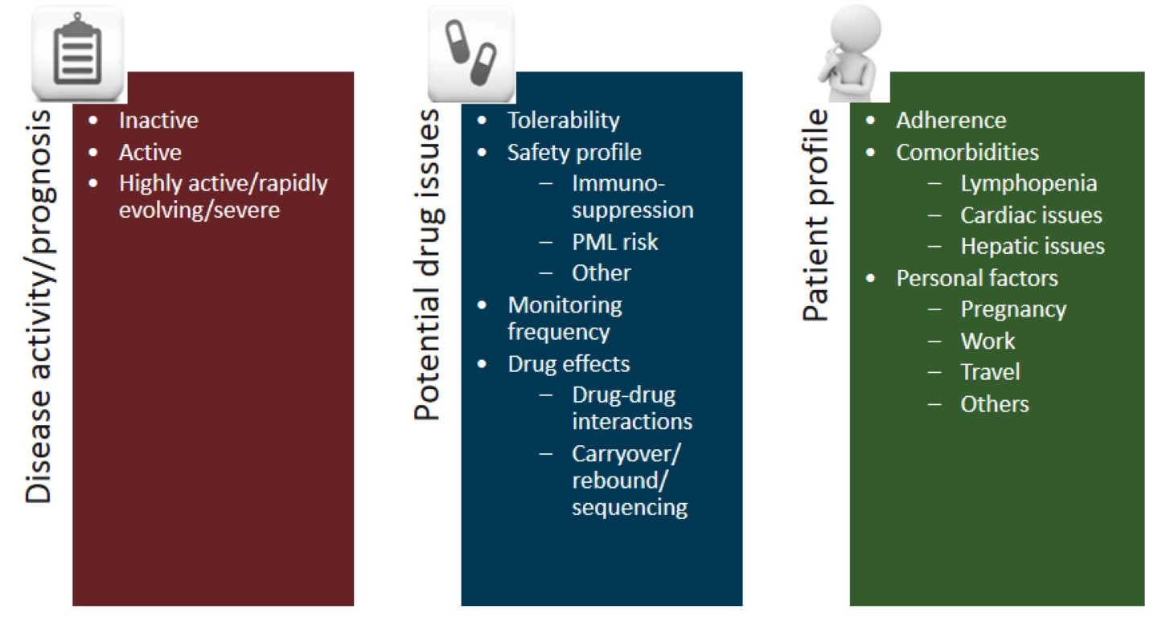
Personalizing Therapy
Personalizing Therapy in Multiple Sclerosis
Profile the disease
  Type of MS (rel/prog)
  Risk of progression
Profile the therapy
  MoA
    Onset of action
    Durability
  Risk of adverse event
Profile the patient
  Sex, race, co-morbidity
  Risk aversity
  Personal plans (travel, pregnancy)
Personalizing Therapy in Multiple Sclerosis

Slide 4
Factors Impacting Treatment Decision
JCV antibody seropositivity and titre
Co-morbidities
Pregnancy
Monitoring requirements
Previous use of immunosuppressants
Treatment decisions
Patient
lifestyle & preference
Health insurance coverage
Geographical parameters
Neurologist experience

Slide 5
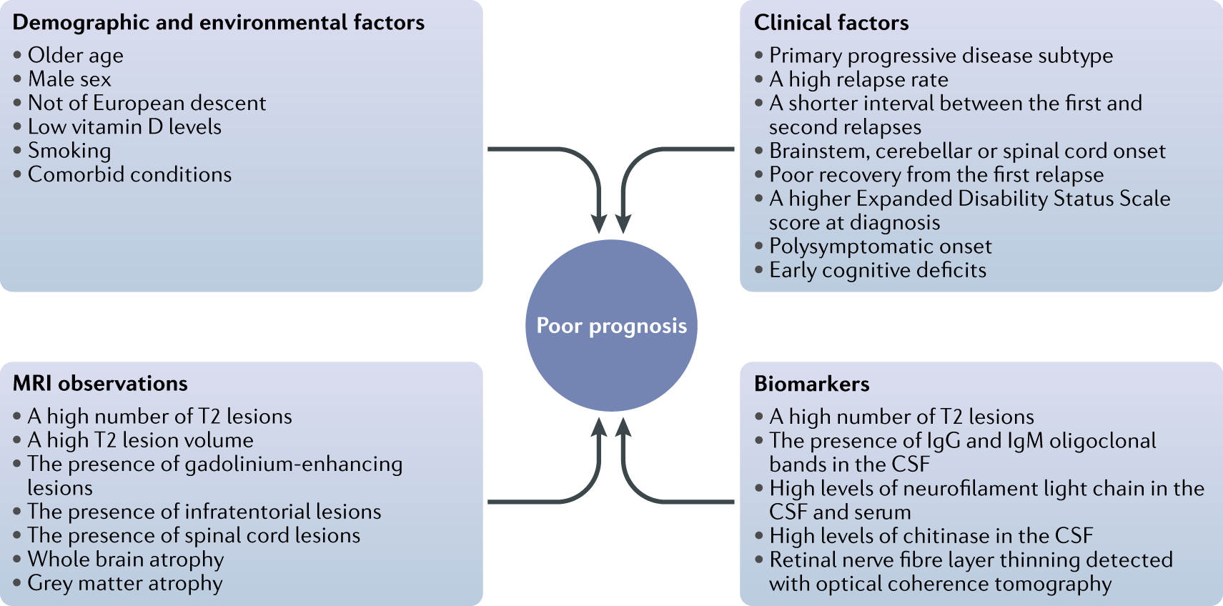
Profiling the Disease:
Predictors of a Poorer Prognosis in Multiple Sclerosis

Slide 6
Disease Modifying Medications: Categories
Anti-Cell
Trafficking Agents
Cell Depleting
Therapies
Immunomodulators
Interferon-β
GA
DMF
Teriflunomide
Fingolimod
Natalizumab
Ozanimod
Ponesimod
Siponimod (SPMS only)
Alemtuzumab
Cladribine Tablets
Ocrelizumab
Ofatumumab
Teriflunomide
Mitoxantrone
Cyclophosphamide
AHSCT (BMT)
Pros
Safety
Long term experience
Cons
Modest efficacy
Many injectable
Pros
Greater efficacy
Onset of action quick
Well tolerated
Cons
Opportunistic infections (PML)
Cells still in body
Rebound disease
Long term safety unclear
Pros
Definitive in depleting disease causing cells
Some are IRT
No rebound disease
Cons
Opportunistic infections
Secondary autoimmunity (alemtuzumab)
Most cumbersome

Slide 7
Disease Modifying Medications: Immunomodulators
No major issues with either Interferon-b; Glatiramer acetate (GA)
DMF
  Early side effects are flushing and diarrhea
  Lymphopenia a risk for PML
  Herpes Zoster not uncommon
Teriflunomide
  Mild hypertension in borderline hypertensive patients may develop over time:
  monitor BP
  Telogen Effluvium: typical of many drugs and similar to post-partum
  Early on, mild loose stools

Slide 8
Disease Modifying Medications:
Anti-Trafficking Agents
S1PR agents (Fingolimod, Ozanimod, Siponimod, Ponesimod)
  Potential for heart arrhythmias (especially on first dose), mostly bradycardia
  or heart block
  Macular oedema
  Immunosuppressive (many opportunistic infections possible including PML)
  Lymphocyte sequestration (very low lymphocyte counts not uncommon; i.e. <0.02)
  Occasional reduction in total WBC and neutrophil counts require drug cessation
  Rebound disease, possibly severe upon cessation
Natalizumab
  Immunosuppressive (many opportunistic infections possible, especially PML)
    Risk of PML higher in those patients with higher serum anti-JCV Ab titres
  Rebound disease, possibly severe upon cessation

Slide 9
Disease Modifying Medications: Cell Depletion
Alemtuzumab (immune reconstitution therapy – IRT)
  Immunosuppressive (opportunistic infections possible, but mainly HZ and Listeria)
  Hypo/hyperthyroidism
  ITP
  Goodpasture’s
Cladribine (immune reconstitution therapy – IRT)
  Immunosuppressive (many opportunistic infections possible, mainly HZ when lymphopenic)
  Malignancy not really a problem based on extensive long term registry data
Anti-CD20 monoclonal antibodies (ofatumumab, ocrelizumab,
ublituximab, rituximab)
  Immunosuppressive (many opportunistic infections, especially respiratory)
  Malignancy (breast) not seen consistently

