Slide 1
The Role of S1P Receptor Agonists in MS: Strategies for Disease Management
Bianca Weinstock-Guttman, MD
Professor of Neurology
Jacobs School of Medicine and Biomedical Sciences
The State University of New York
Director Jacobs MS center for Treatment and Research
Buffalo, NY

Slide 2
Resource Information
About This Resource
These slides are one component of a continuing education program available online at MedEd On The Go titled Multiple Sclerosis: Using S1P Receptor Modulators to Slow Disease Progression
Program Learning Objectives:
Identify metrics and barriers that exclude multiple sclerosis mimics and facilitate early diagnosis and treatment initiation
Provide clinical knowledge regarding the role and impact of the most current S1P modulators for multiple sclerosis symptom management
Examine the evolution of the treatment landscape of the past 30 years and outline best practices to enhance decision-making focusing on long- and short-term disease-modifying therapies
MedEd On The Go®
www.mededonthego.com
This content or portions thereof may not be published, posted online or used in presentations without permission.
This content can be saved for personal use (non-commercial use only) with credit given to the resource authors.
To contact us regarding inaccuracies, omissions or permissions please email us at support@MedEdOTG.com

Slide 3
Disclaimer
The views and opinions expressed in this educational activity are those of the faculty and do not necessarily represent the views of Total CME, LLC, the CME providers, or the companies providing educational grants. This presentation is not intended to define an exclusive course of patient management; the participant should use their clinical judgment, knowledge, experience, and diagnostic skills in applying or adopting for professional use any of the information provided herein. Any procedures, medications, or other courses of diagnosis or treatment discussed or suggested in this activity should not be used by clinicians without evaluation of their patient's conditions and possible contraindications or dangers in use, review of any applicable manufacturer’s product information, and comparison with recommendations of other authorities. Links to other sites may be provided as additional sources of information.

Slide 4
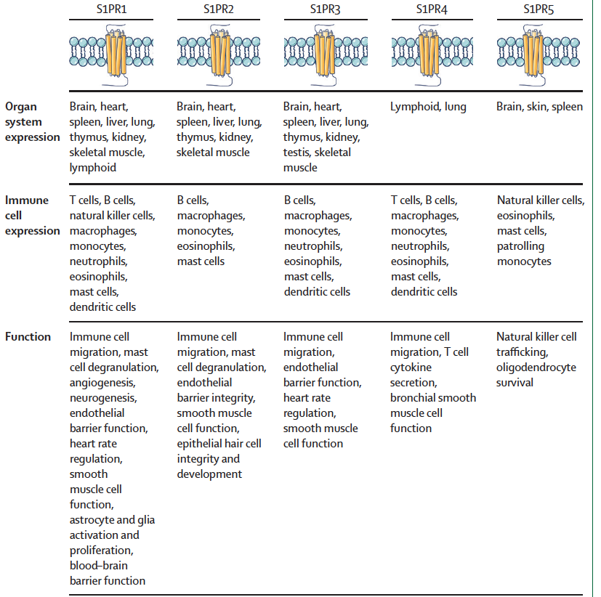
S1P Receptors, Location and Function
S1P receptors (S1PRs) have been proposed as a therapeutic target for various diseases due to their involvement in regulation of lymphocyte trafficking, brain and cardiac function, vascular permeability, and vascular and bronchial tone
S1PR modulators were first developed to prevent rejection by the immune system following renal transplantation, but the only currently approved indications are MS and ulcerative colitis
The primary mechanism of action of S1PR modulators in MS is through binding S1PR subtype 1 on lymphocytes resulting in internalization of the receptor and loss of responsiveness to the S1P gradient that drives lymphocyte egress from lymph nodes
The reduction in circulating lymphocytes presumably limits inflammatory cell migration into the CNS
The SPR5 may benefit oligodendrocyte survival
Four S1PR modulators (fingolimod, siponimod, ozanimod, and ponesimod) have regulatory approval for MS

Slide 5
S1P Modulators FDA Approved for MS
S1P modulators have complex actions on receptors, in some cases acting both as agonists with functional antagonism, and as traditional agonists in other cases
Some of the modulators are prodrugs that require phosphorylation or other metabolic steps, resulting in different pharmacokinetics (fingolimod), whereas others are direct modulators of the receptor (second generation S1P)
Subsequently developed S1PR modulators are more specific, with the goal of preserving effectiveness while mitigating some of the adverse effects (ie, cardiac, vascular)
The improved pharmacodynamics and subtype specificity for S1PR1 and S1PR5 may also contribute to improved bioavailability and potentially greater CNS effects compared with fingolimod
Fingolimod, a prodrug that requires phosphorylation has broad receptor affinity (S1PR1, 3, 4, and 5)
Ozanimod and siponimod are selective modulators of S1PR1 and S1PR5, and ponesimod is specific for S1PR1
All S1PR modulators are thought to have a similar effect on lymphocytes, although their different half lifetime is important when considering adherence and discontinuation therapy

Slide 6
S1P Modulators FDA Approved for MS
Phase 3 clinical trials have been completed for fingolimod, ozanimod, and ponesimod evaluating efficacy in RRMS
All studies found a significant reduction in the primary outcome of ARR over 12–24 months, compared with placebo, interferon beta-1a, or teriflunomide
There was also significant benefit on MRI markers of inflammatory disease activity (GAD enhancing lesions and new or enlarging lesions on T2-weighted images) and MRI measures of cumulative tissue damage (accrual of T2-hyperintense and T1-hypointense lesions, brain volume loss, and cortical matter and thalamic volume loss)
There were variable changes in worsening of disability as measured by the EDSS and the MSFC showing significant benefit in one fingolimod trial and siponimod as compared to placebo, but not reaching significance in the other studies that were evaluated against active comparators (IFN beta or teriflunomide)
All S1P modulators are approved for patients with CIS, RRMS and active SPMS. However, only siponimod has so far demonstrated efficacy in active SPMS contrasting with the absence of clinical effects with fingolimod in primary progressive MS

Slide 7
S1P Modulators FDA Approved for MS
Important consideration in the use of S1PR modulators in MS is the slowing of heart rate and AV conduction with initiation of therapy
On initiation of therapy, fingolimod acts as an agonist activating S1PR1 leading to transient bradycardia, delayed atrioventricular conduction, and prolongation of the QTc interval
With continued administration, there is downregulation of S1PR1 and resolution of the cardiac effects
First dose effects lead to a requirement for first dose observation (FDO) for at least 6 h for all patients starting fingolimod monitored with pulse and blood pressure hourly, ECG before dosing and at the end of the observational period
However, the benefit of dose up-titration of ozanimod and siponimod over the first several days of treatment attenuates the initial cardiac effects, and no second- or third-degree AV block was reported in the phase 3 trials, eliminating the requirement for FDO in the absence of a cardiac history

Slide 8
Side Effects Requiring Monitoring
As related to vascular side effects on S1P:
Increased blood pressure (vasoconstriction), macular edema (history of diabetes and uveitis) and pulmonary dysfunction (due to constriction of bronchial smooth muscles) related to S1PR subtypes 1, 2, 3, 4, which might contribute to airway constriction.
Many of the adverse effects observed with fingolimod were thought to be related to broader engagement of S1PRs, which led to the development of more selective S1P modulators
Infections were reported in all of the phase 3 clinical trials, primarily upper respiratory and urinary tract infections. One death occurred in a phase 3 trial of fingolimod due to disseminated varicella infection, leading to the recommendation to check varicella zoster antibodies before initiation
There are also rare reports of progressive multifocal leukoencephalopathy due to reactivation of the John Cunningham virus and cryptococcus meningitis
Increased risk for skin malignancy: ie, basal cell carcinoma seen more frequently

Slide 9
Recommendations for Use of S1P
Contraindications in the prescribing S1P modulators include primary history of several cardiovascular conditions (eg, MI, TIA, stroke in the last 6 months, unstable angina, decompensated heart failure, history of Mobitz type II second- or third-degree AV block, sick sinus syndrome, QTc interval more than 500 ms, or cardiac arrhythmia on therapy), severe sleep apnea, MAO inhibitors, pregnancy
With siponimod, the majority of patients can initiate treatment without the need for monitoring, whereas FDO is recommended only for patients with sinus bradycardia, first- or second-degree (Mobitz type I)
With ozanimod, no monitoring at treatment initiation is required but cardiologist consultation is suggested for patients with conduction abnormalities
Consultation is also suggested for both siponimod and ozanimod in cases where patients require concomitant use with other drugs that decrease heart rate
Differential pharmacokinetic response to siponimod in patients with CYP2C9 genotypes 1/3 or 2/3, genotyping of patients must be performed and treatment initiated at the relevant maintenance dose (1 mg for CYP2C9 1/3 or 2/3 patients; 2 mg for all other patients), according to the prescribing information
Strong CYP2C8 Inhibitors ( as gemfibrozil) contraindicated and advised to avoid foods containing a large amount of tyramine (aged cheese, pickled herring) while taking recommended doses of ozanimod
General Baseline and Monitoring:
Blood w/u baseline and monitoring (CBC- risk for lymphopenia and LFT)
Varicella Zoster antibodies- if negative vaccination required before initiating therapy
Ophthalmology (including OCT) as related to risk for macular edema, baseline and any there is any change in vision
Dermatology yearly (risk for cutaneous malignancies: ie, basal cell and squamous carcinoma, melanoma)

Slide 10
Looking for more resources on this topic?
CME/CE in minutes
Congress highlights
Late-breaking data
Quizzes
Webinars
In-person events
Slides & resources
www.MedEdOTG.com

