Slide 1
Challenges in Recognizing and Diagnosing Narcolepsy
Kevin Trice, MD, MBA
Medical Director, Sleep Medicine
Norton Healthcare
Louisville, KY

Slide 2
Resource Information
About This Resource
These slides are one component of a continuing education program available online at MedEd On The Go titled Narcolepsy: The Life Essential 8 Connection
Program Learning Objectives:
Improve the accuracy and timing when diagnosing patients suffering from narcolepsy
Educate HCPs on how narcolepsy increases cardiovascular risk
Address how treatment of narcolepsy can improve sleep, which is a pillar of the AHA Life Essential 8, albeit with the caveat of a potentially high salt load
MedEd On The Go®
www.mededonthego.com
This content or portions thereof may not be published, posted online or used in presentations without permission.
This content can be saved for personal use (non-commercial use only) with credit given to the resource authors.
To contact us regarding inaccuracies, omissions or permissions please email us at support@MedEdOTG.com

Slide 3
Disclaimer
The views and opinions expressed in this educational activity are those of the faculty and do not necessarily represent the views of Total CME, LLC, the CME providers, or the companies providing educational grants. This presentation is not intended to define an exclusive course of patient management; the participant should use their clinical judgment, knowledge, experience, and diagnostic skills in applying or adopting for professional use any of the information provided herein. Any procedures, medications, or other courses of diagnosis or treatment discussed or suggested in this activity should not be used by clinicians without evaluation of their patient's conditions and possible contraindications or dangers in use, review of any applicable manufacturer’s product information, and comparison with recommendations of other authorities. Links to other sites may be provided as additional sources of information.

Slide 4
Narcolepsy with Cataplexy
Rare sleep disorder affecting 0.02% of adults worldwide^{[1]}
Estimated prevalence of narcolepsy in the United States was around 1 in 2,000 people
Syndrome is often associated with weight gain^{[2]}
Adolescents and young adults are more likely to experience the onset of this disorder^{[3]}
It lasts a lifetime

Slide 5
Narcolepsy is characterized by
Chronic pathological daytime drowsiness
2. Episodes of sudden loss of muscle tone (cataplexy)
3. Sleep paralysis
4. Hypnagogic and hypnopompic hallucinations
5. Disrupted nighttime sleep^{[1]}

Slide 6
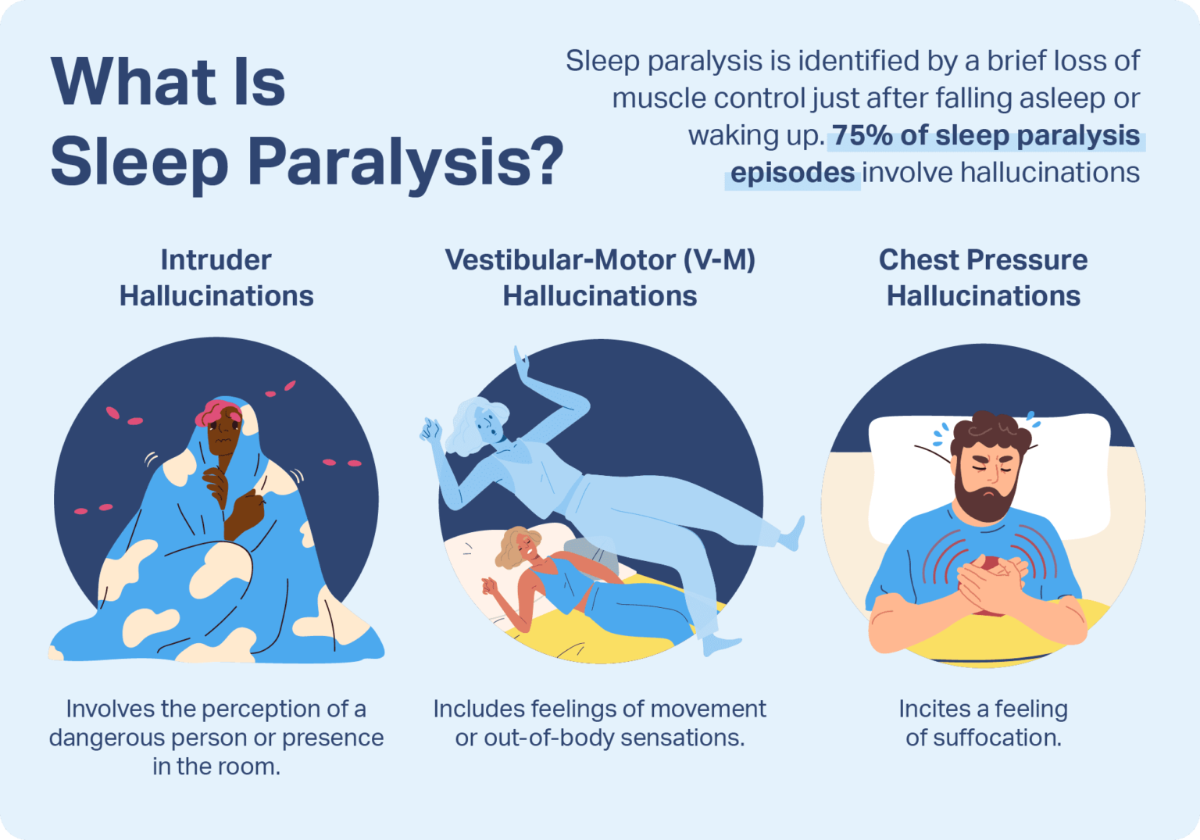

Slide 7
Features in Children
At disease onset, a wide range of motor disturbances, negative (hypotonia) or active (eg, perioral movements, dyskinetic-dystonic, or stereotypic movements)
Motor disturbances may resolve later in the course of the disorder
Cataplectic facies is an unusual facial feature^{[1]}
Restlessness and motor overactivity may predominate
Academic deterioration, inattentiveness, and emotional lability are common

Slide 8
Narcolepsy Testing
Clinical Evaluation
Epworth Sleepiness Scale
Polysomnography (PSG)
Multiple Sleep Latency Test (MSLT) - JCSM 2021 guidelines
Invasive – HLA / CSF - Labcorp

Slide 9
Looking for more resources on this topic?
CME/CE in minutes
Congress highlights
Late-breaking data
Quizzes
Webinars
In-person events
Slides & resources
www.MedEdOTG.com

