Slide 1
Tackling the Unmet Need HEad On—What Does HE Look Like?
Arun B. Jesudian, MD
Associate Professor of Clinical Medicine
Director of Liver Quality and Inpatient Liver Services
Weill Cornell Medicine
New York, NY

Slide 2



Resource Information
About This Resource
These slides are one component of a continuing education program available online at MedEd On The Go titled Addressing the Core Unmet Needs to Our Approach for Hepatic Encephalopathy
Program Learning Objectives:
Identify approaches for clinicians to aid in the symptomatic recognition of HE
Improve the referral process to specialists in the initial onset of HE
Narrow the gap in care for the underserved population
MedEd On The Go®
www.mededonthego.com
This content or portions thereof may not be published, posted online or used in presentations without permission.
This content can be saved for personal use (non-commercial use only) with credit given to the resource authors.
To contact us regarding inaccuracies, omissions or permissions please email us at support@MedEdOTG.com

Slide 3
Disclaimer
The views and opinions expressed in this educational activity are those of the faculty and do not necessarily represent the views of Total CME, LLC, the CME providers, or the companies providing educational grants. This presentation is not intended to define an exclusive course of patient management; the participant should use their clinical judgment, knowledge, experience, and diagnostic skills in applying or adopting for professional use any of the information provided herein. Any procedures, medications, or other courses of diagnosis or treatment discussed or suggested in this activity should not be used by clinicians without evaluation of their patient's conditions and possible contraindications or dangers in use, review of any applicable manufacturer’s product information, and comparison with recommendations of other authorities. Links to other sites may be provided as additional sources of information.

Slide 4
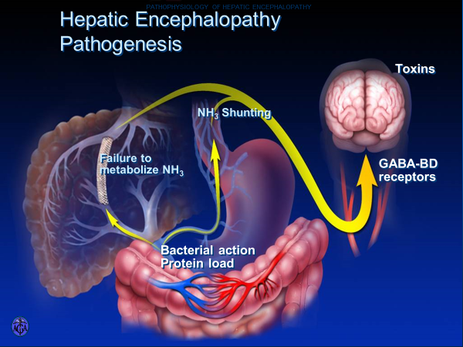

Slide 5
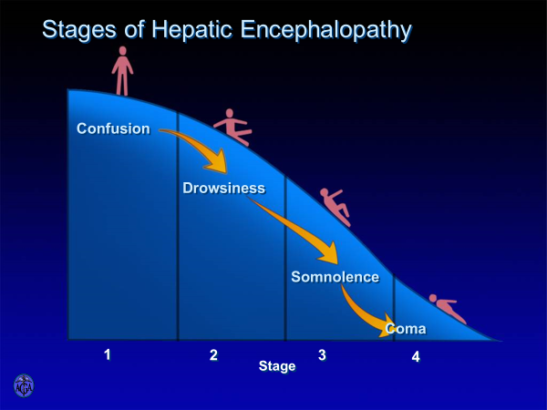
Clinical Manifestations of HE
Reversible neuropsychiatric syndrome
Symptoms range from mild cognitive impairment
to coma
Clinical diagnosis
Serum ammonia unhelpful

Slide 6
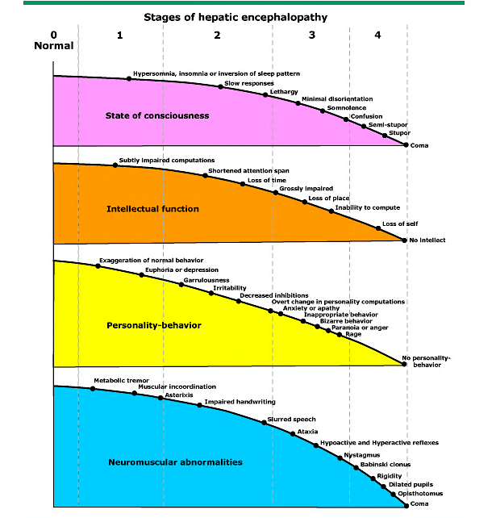

Slide 7
Non-HE Related Cognitive Decline
Parkinson’s disease
Alcohol-related cognitive impairment
  Wernicke encephalopathy
Mild cognitive impairment
  Cognitive decline unrelated to acute medical/neurological condition
  Greater than expected for normal aging
  Does not affect daily function
Dementia
  Alzheimer’s disease
  Vascular
  Parkinson’s dementia and dementia with Lewy bodies

Slide 8
Distinguishing HE from Dementia
Fluctuating versus progressive course
Reversible versus generally irreversible cognitive impairment
Asterixis
Elevated serum ammonia (generally not advised to send)
Evidence of underlying cirrhosis
  i.e., platelets less than 150k, risk factors (alcohol use disorder, metabolic syndrome)
Cognitive testing
  EncephalApp Stroop test (www.encephalapp.com)
  1-minute animal naming test (ANT)

Slide 9



Looking for more resources
on this topic?
CME/CE in minutes
Congress highlights
Late-breaking data
Quizzes
Webinars
In-person events
Slides & resources
www.MedEdOTG.com

