Slide 1
West HavEn Criteria—Meaningfulness Into Clinical Practice
Arun B. Jesudian, MD
Associate Professor of Clinical Medicine
Director of Liver Quality and Inpatient Liver Services
Weill Cornell Medicine
New York, NY

Slide 2



Resource Information
About This Resource
These slides are one component of a continuing education program available online at MedEd On The Go titled Addressing the Core Unmet Needs to Our Approach for Hepatic Encephalopathy
Program Learning Objectives:
Identify approaches for clinicians to aid in the symptomatic recognition of HE
Improve the referral process to specialists in the initial onset of HE
Narrow the gap in care for the underserved population
MedEd On The Go®
www.mededonthego.com
This content or portions thereof may not be published, posted online or used in presentations without permission.
This content can be saved for personal use (non-commercial use only) with credit given to the resource authors.
To contact us regarding inaccuracies, omissions or permissions please email us at support@MedEdOTG.com

Slide 3
Disclaimer
The views and opinions expressed in this educational activity are those of the faculty and do not necessarily represent the views of Total CME, LLC, the CME providers, or the companies providing educational grants. This presentation is not intended to define an exclusive course of patient management; the participant should use their clinical judgment, knowledge, experience, and diagnostic skills in applying or adopting for professional use any of the information provided herein. Any procedures, medications, or other courses of diagnosis or treatment discussed or suggested in this activity should not be used by clinicians without evaluation of their patient's conditions and possible contraindications or dangers in use, review of any applicable manufacturer’s product information, and comparison with recommendations of other authorities. Links to other sites may be provided as additional sources of information.

Slide 4
Grading the Severity of HE
The West Haven Criteria can be used to measure the severity of HE1
West Haven Criteria
Covert HE¹ |  | Overt HE¹
Minimal | I | II | III | IV
No observable symptoms Detectable only by psychometric testing | Euphoria or anxiety Trivial lack of awareness Shortened attention span Impaired ability to add or subtract Altered sleep rhythm | Lethargy or apathy Disorientation with respect to time Obvious personality change Inappropriate behavior | Somnolence to semi-stupor Confusion Responsive to stimuli Gross disorientation Bizarre behavior | Coma
Worsening cognitive function²
Higher stages (ie, overt HE) are associated with¹⁻⁴:
More prominent
symptoms
Worsening
cognitive function
Poor
prognosis
Increased risk of
hospitalization
30% to 40% of patients with cirrhosis
will develop overt HE at some point

Slide 5
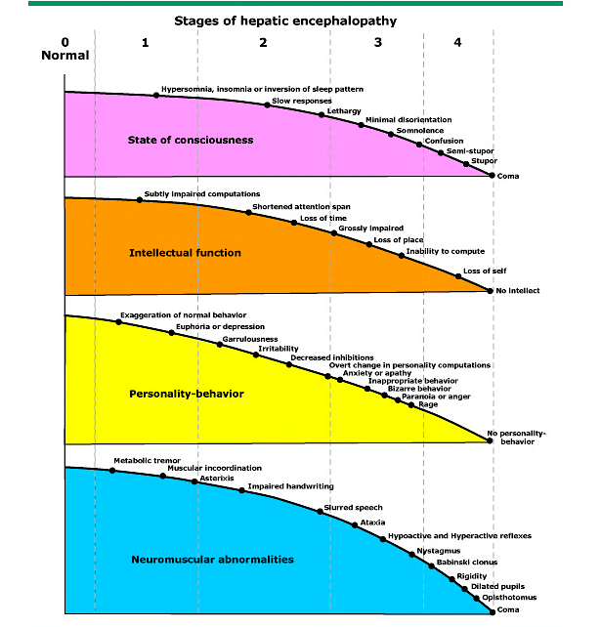

Slide 6
Diagnosis & Grading
Diagnosis and grading of HE is based on a clinical examination and a clinical decision
Clinical Description of HE per West-Haven Criteria
Grade I | Covert/ Minimal HE | Trivial lack of awareness, euphoria or anxiety, shortened attention span, impairment of addition or subtraction, altered sleep rhythm
Grade II | Overt | Lethargy or apathy, disorientation of time, obvious personality change, inappropriate behavior, dyspraxia, asterixis
Grade III |  | Somnolence to semistupor, responsive to stimuli, confused, gross disorientation, bizarre behavior
Grade IV |  | Coma

Slide 7
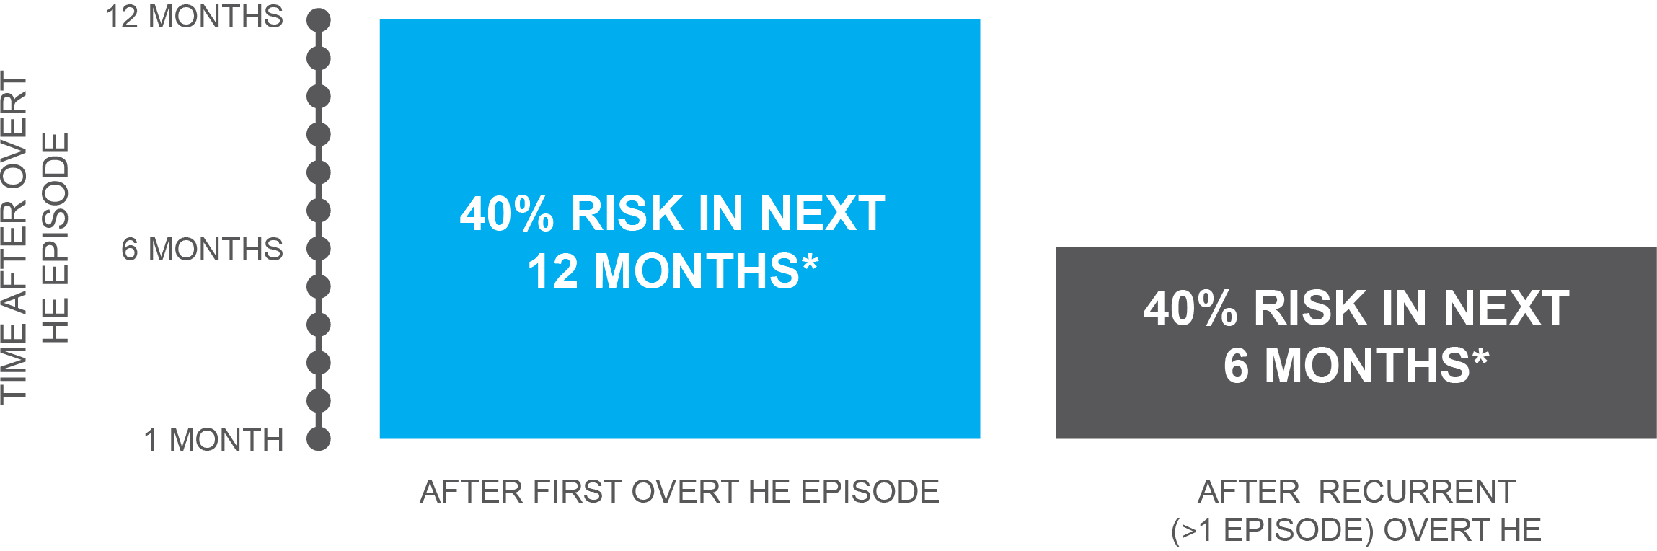
Once Overt Hepatic Encephalopathy Occurs, Patients Are at High Risk for Recurrence
Patients who have experienced an episode of OHE have a 40% cumulative risk for a recurrence of OHE within 1 year
Patients who have experienced a recurrence of OHE have a 40% cumulative risk for another recurrence of OHE within 6 months,
despite standard treatment with lactulose

Slide 8



Looking for more resources
on this topic?
CME/CE in minutes
Congress highlights
Late-breaking data
Quizzes
Webinars
In-person events
Slides & resources
www.MedEdOTG.com

