Slide 1

Examining Treatment Options for Insomnia: from Orexin to GABA
Kevin Trice, MD, MBA
Medical Director, Sleep Medicine
Norton Healthcare
Louisville, KY

Slide 2



Resource Information
About This Resource
These slides are one component of a continuing education program available online at MedEd On The Go titled Insomnia Treatment Goals: Restful Nights and Productive Days
Program Learning Objectives:
Explain the importance of improving nighttime sleep difficulties and the positive impact this has on improving daytime function
Describe the role of neurotransmitter systems involved in the sleep-wake cycle
Integrate assessment tools to clinically differentiate insomnia from episodes of poor sleep
Compare current treatment options relative to their clinical impact in the management of both the nighttime and daytime symptoms of insomnia
MedEd On The Go®
www.mededonthego.com
This content or portions thereof may not be published, posted online or used in presentations without permission.
This content can be saved for personal use (non-commercial use only) with credit given to the resource authors.
To contact us regarding inaccuracies, omissions or permissions please email us at support@MedEdOTG.com

Slide 3
Disclaimer
The views and opinions expressed in this educational activity are those of the faculty and do not necessarily represent the views of Total CME, LLC, the CME providers, or the companies providing educational grants. This presentation is not intended to define an exclusive course of patient management; the participant should use their clinical judgment, knowledge, experience, and diagnostic skills in applying or adopting for professional use any of the information provided herein. Any procedures, medications, or other courses of diagnosis or treatment discussed or suggested in this activity should not be used by clinicians without evaluation of their patient's conditions and possible contraindications or dangers in use, review of any applicable manufacturer’s product information, and comparison with recommendations of other authorities. Links to other sites may be provided as additional sources of information.

Slide 4


About Insomnia
Insomnia, also known as sleep disturbance, is a condition in which a person has difficulty falling asleep, maintaining sleep, or feels an insufficient sense of recovery after sleep.
This can manifest itself in the form of frequent awakenings at night, long periods of wakefulness during the night or early awakening in the morning. Insomnia can have a negative impact on overall health, mood and quality of life.

Slide 5
Facts About The Prevalence of Insomnia:
30%
According to the World Health Organization (WHO), insomnia affects about 30% of the world's population.
Insomnia is more common in women than in men.
Age can influence the frequency of insomnia. Older people may have more difficulty falling asleep and maintaining sleep.
Stress, anxiety, depression, changes in work schedules and other factors can worsen insomnia.
Modern lifestyle, including the use of electronic devices before going to bed, can also affect the quality of sleep.
♀>♂

Slide 6
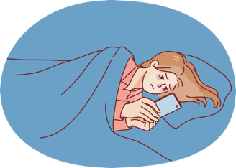



Cognitive-Behavioral Therapy for Insomnia (CBTI)
Components of CBT-I:
Sleep Hygiene
Sleep restriction:
Combination of CBT-I with drug treatment improves results
It is important to note that each patient is unique, and the approach to the treatment of insomnia should be individualized. The decision on the choice of treatment, including CBTI, medication, or a combination thereof, should be made jointly with a medical specialist.
Stimulus control:
Cognitive therapy:

Slide 7
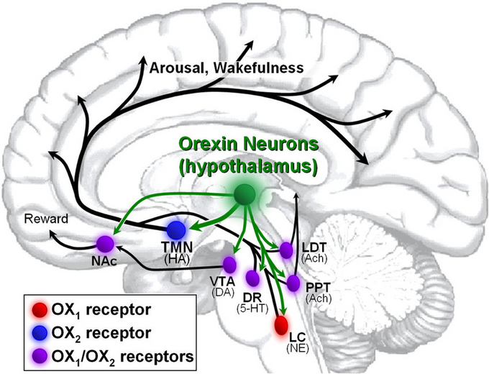
Orexin as a Target
Orexin, also known as hypocretin, is a neuropeptide that plays an important role in the regulation of sleep & wakefulness.
Orexin receptor antagonists:
This class of drugs blocks the action of orexin on its receptors. This can lead to a decrease in wakefulness and deeper and longer sleep.

Slide 8
Dual Orexin Receptor Antagonists (DORAs)
Orexin receptor antagonists are a class of drugs that block the action of orexin on its receptors
This affects the regulation of wakefulness and sleep
Common drugs
include:
Lemborexant
Suvorexant
Daridorexant

Slide 9
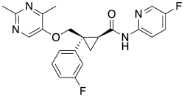

Dual Orexin Receptor Antagonists (DORAs)
Generic Name: Lemborexant
Mechanism: Dual orexin receptor antagonist
Onset of Action: ~30 minutes
Duration of Effect: Up to 7 hours
Less fall risk than suvorexant or benzodiazepines
Generic Name: Suvorexant
Mechanism: Orexin receptor antagonist
Onset of Action: ~30 minutes
Duration of Effect: 7-10 hours
Common Side Effects: Headache, somnolence, sleep paralysis
It is important to understand that each person is unique, and the reaction to orexin receptor antagonists may vary. Before starting treatment using orexin receptor antagonists, it is necessary to consult with a doctor and discuss potential side effects, contraindications and benefits of treatment in each case.

Slide 10
GABAergic System and Insomnia
GABA is a neurotransmitter that has an inhibitory (inhibitory) effect on neural activity. It binds to receptors in neurons, to decrease arousal and relaxation. Benzodiazepine receptor agonists (BZRAs) bind the receptor and can help with insomnia.
These drugs include the five FDA hypnotic benzodiazepines (temazepam, triazolam, etc.) and the so-called “Z drugs” such as eszopiclone,
zaleplon, and zolpidem. These drugs are all rapidly absorbed
but have different ½ lives (zolpidem 2.5 hours vs zaleplon 6 hours).
The benzodiazepines carry a higher risk of dependence
or habit forming and are generally not 1st line.

Slide 11




New Methods of Treatment and Lifestyle Changes
Melatonin agonists: their role in the regulation of the sleep-wake cycle
Light therapy: Restoration of circadian rhythms
Herbal supplements (valerian, chamomile)
Lifestyle Changes: Exercise, Diet, stress management

Slide 12

Future directions of research in the field of insomnia treatment
Medical science continues to investigate insomnia and develop new treatments. In the future, there may be more innovative approaches based on a deep understanding of the biological and neurochemical mechanisms of sleep. Technological solutions, individual genetic aspects and a more accurate study of circadian rhythms can open up new prospects for the effective treatment of insomnia.
It is always important to stay in contact with medical specialists and follow their recommendations for the best approach to the treatment of insomnia.

Slide 13



Looking for more resources
on this topic?
CME/CE in minutes
Congress highlights
Late-breaking data
Quizzes
Webinars
In-person events
Slides & resources
www.MedEdOTG.com

