Slide 1
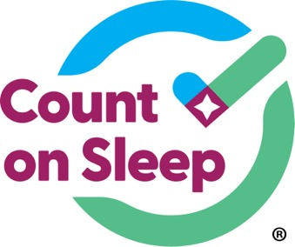


Jointly provided by the American Academy of Sleep Medicine, Global Learning Collaborative, Inc., and Total CME, LLC.
The Count On Sleep program is led by the AASM and its key partner, the Sleep Research Society. Collaborating organizations include the Alliance of Sleep Apnea Partners, American Academy of Dental Sleep Medicine, American Academy of Otolaryngology – Head and Neck Surgery, American College of Chest Physicians, American Society for Metabolic and Bariatric Surgery, American Thoracic Society, and the National Sleep Foundation.
This program was supported by the Centers for Disease Control and Prevention of the U.S. Department of Health and Human Services (HHS) as part of a financial assistance award. The contents are those of the author(s) and do not necessarily represent the official views of, nor an endorsement by, CDC/HHS or the U.S. government.

Slide 2
Obstructive Sleep Apnea (OSA): Exploring the Impact on Morbidity and Mortality
Alcibiades J. Rodriguez, MD, FAASM
Associate Professor of Neurology
NYU Grossman School of Medicine
New York, NY

Slide 3



Resource Information
About This Resource
These slides are one component of a continuing education program available online at MedEd On The Go titled Obstructive Sleep Apnea (OSA) Screening Made Simple: Effective Strategies for Healthcare Professionals
Program Learning Objectives:
Understand the link between OSA and chronic disease
Develop strategies to integrate routine OSA screening into primary care practice, considering the current barriers and challenges
MedEd On The Go®
www.mededonthego.com
This content or portions thereof may not be published, posted online or used in presentations without permission.
This content can be saved for personal use (non-commercial use only) with credit given to the resource authors.
To contact us regarding inaccuracies, omissions or permissions please email us at support@MedEdOTG.com

Slide 4
Disclaimer
The views and opinions expressed in this educational activity are those of the faculty and do not necessarily represent the views of Total CME, LLC, the CME providers, or the companies providing educational grants. This presentation is not intended to define an exclusive course of patient management; the participant should use their clinical judgment, knowledge, experience, and diagnostic skills in applying or adopting for professional use any of the information provided herein. Any procedures, medications, or other courses of diagnosis or treatment discussed or suggested in this activity should not be used by clinicians without evaluation of their patient's conditions and possible contraindications or dangers in use, review of any applicable manufacturer’s product information, and comparison with recommendations of other authorities. Links to other sites may be provided as additional sources of information.

Slide 5
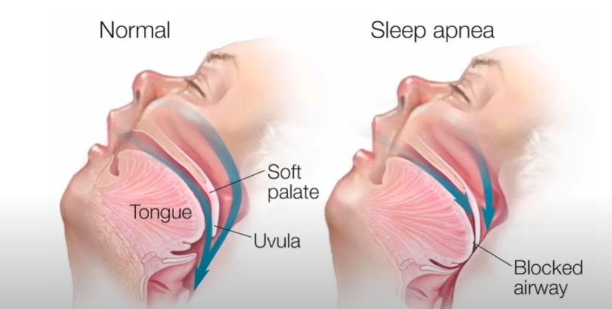
OSA: Definition
Medical condition where airway repeatedly, completely or partially, closes during sleep
Pauses are associated with a drop in blood oxygen levels, leading to a surge in adrenaline
An arousal from sleep and subsequent reopening of the airway
Events recur multiple times throughout sleep

Slide 6
OSA: Symptoms
Wake Symptoms | Sleep Symptoms
Daytime sleepiness – falling asleep inappropriately (at driving, work, school, meetings, conversations, other sedentary activities). Epworth Sleepiness Scale (ESS) | Loud, habitual snoring (can be disruptive to others)
Morning headaches | Choking/gasping
Mood changes | Others say you stop breathing during sleep
Forgetfulness | Fragmented sleep, insomnia
Difficulty with focus or concentration | Unrefreshing sleep
Car crashes (especially single-vehicle, rear-ending another vehicle, off-road deviation) | Frequent urination at night
Declining work performance | Nightmares
Absenteeism (school, work)
Presenteeism (school, work) – in attendance, but not performing your best

Slide 7
OSA: Risk Factors
Patients at High Risk for Sleep Disordered Breathing (including OSA)
Obesity (BMI > 35)
Congestive heart failure
Atrial fibrillation
Treatment refractory hypertension
Type 2 diabetes
Nocturnal dysrhythmias
Stroke
Pulmonary hypertension
High-risk driving populations
Decreased concentration

Slide 8
Why the need?
A significant challenge in OSA management is the risk of disjointed treatment during the referral from general practitioners to sleep experts
The clinical presentation of OSA does not always include alarming symptoms, and 80% of patients remain undiagnosed
If left untreated, it can significantly increase the risk of CVD, including hypertension, atrial fibrillation, heart failure, stroke, pulmonary hypertension, and myocardial infarction
OSA remains a prominent disease state and is estimated to plague 936 million adults globally
Notes:
Sleep apnea can affect any age, gender, weight, or ethnicity.
Common conditions such as COPD and depression face similar disparities between prevalence of disease and specialist availability and primary care manages these conditions in most patients. Research illustrates the possible role of primary care providers and other non-specialists in expanding access.

Slide 9
OSA: Morbidity
Cardio and cerebrovascular disease
  HTN (40%), CAD, stroke (2 to 4-fold), PH, cardiac arrhythmias
Metabolic dysfunction
  Increased glucose and triglyceride levels
Excessive daytime sleepiness
  Decreased social interactions, MVA
Impaired brain function
  Memory, attention, concentration

Slide 10
OSA: Morbidity
Social/sexual functioning
Eye conditions
  Glaucoma, non-arthritic ischemic optic neuropathy, floppy eye syndrome, retinal vein occlusion
Pulmonary conditions
  Asthma exacerbation
Depression
Quality of life

Slide 11
OSA: Mortality
Moderate to severe OSA
Patients with severe OSA: Death from all causes 3.8 times higher than controls
Patients with severe OSA: Death due to cardiovascular disease 5.2 times higher than controls
PAP reduces mortality in patients with OSA after stroke and reduces fatal and non-fatal cardiac events

Slide 12
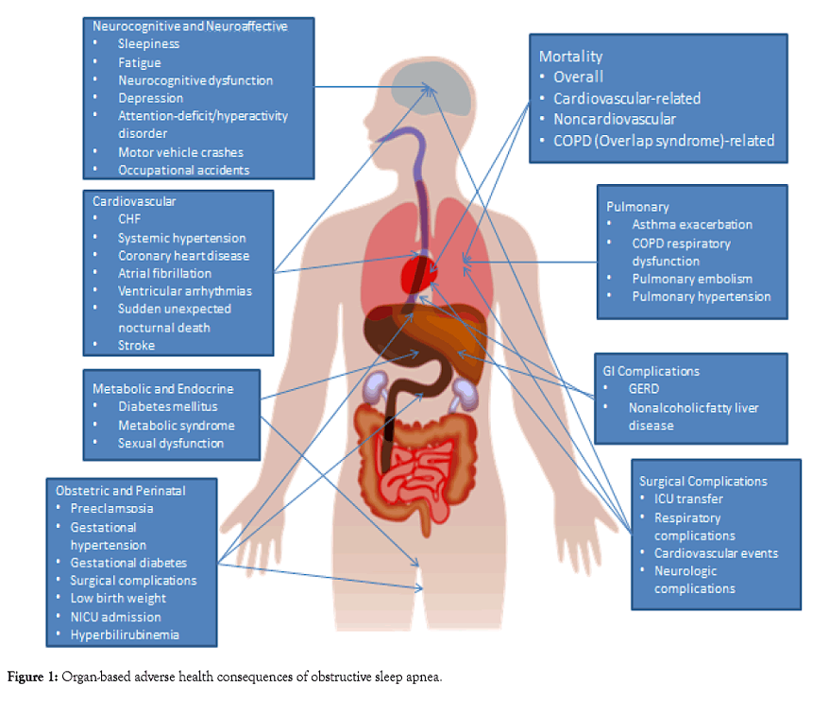
OSA:
Consequences

Slide 13



Looking for more resources
on this topic?
CME/CE in minutes
Congress highlights
Late-breaking data
Quizzes
Webinars
In-person events
Slides & resources
www.MedEdOTG.com

