Slide 1
Jointly provided by the American Academy of Sleep Medicine, Global Learning Collaborative, Inc., and Total CME, LLC.
The Count On Sleep program is led by the AASM and its key partner, the Sleep Research Society. Collaborating organizations include the Alliance of Sleep Apnea Partners, American Academy of Dental Sleep Medicine, American Academy of Otolaryngology – Head and Neck Surgery, American College of Chest Physicians, American Society for Metabolic and Bariatric Surgery, American Thoracic Society, and the National Sleep Foundation.
This program was supported by the Centers for Disease Control and Prevention of the U.S. Department of Health and Human Services (HHS) as part of a financial assistance award. The contents are those of the author(s) and do not necessarily represent the official views of, nor an endorsement by, CDC/HHS or the U.S. government.

Slide 2
Overcoming Hurdles: Effective OSA Screening in Primary Care
Michael E. Yurcheshen, MD, FAASM
Professor, Neurology and Medicine
University of Rochester School of Medicine and Dentistry
Rochester, NY

Slide 3
Resource Information
About This Resource
These slides are one component of a continuing education program available online at MedEd On The Go titled Obstructive Sleep Apnea (OSA) Screening Made Simple: Effective Strategies for Healthcare Professionals
Program Learning Objectives:
Understand the link between OSA and chronic disease
Develop strategies to integrate routine OSA screening into primary care practice, considering the current barriers and challenges
MedEd On The Go®
www.mededonthego.com
This content or portions thereof may not be published, posted online or used in presentations without permission.
This content can be saved for personal use (non-commercial use only) with credit given to the resource authors.
To contact us regarding inaccuracies, omissions or permissions please email us at support@MedEdOTG.com

Slide 4
Disclaimer
The views and opinions expressed in this educational activity are those of the faculty and do not necessarily represent the views of Total CME, LLC, the CME providers, or the companies providing educational grants. This presentation is not intended to define an exclusive course of patient management; the participant should use their clinical judgment, knowledge, experience, and diagnostic skills in applying or adopting for professional use any of the information provided herein. Any procedures, medications, or other courses of diagnosis or treatment discussed or suggested in this activity should not be used by clinicians without evaluation of their patient's conditions and possible contraindications or dangers in use, review of any applicable manufacturer’s product information, and comparison with recommendations of other authorities. Links to other sites may be provided as additional sources of information.

Slide 5
US Preventive Services Task Force Recommends Against Asymptomatic Screen
“For adults 18 years of older who do not have signs or symptoms of OSA: The USPSTF found that the current evidence is insufficient to assess the balance of benefits and harms of screening for OSA”
The task force considered multiple findings (BMI, neck circumference) and screening questionnaires/clinical prediction tools (Epworth Sleepiness Scale, STOP-BANG, Berlin, Wisconsin Sleep, Multivariable Apnea Prediction Tool)
This recommendation is not for patients with symptoms

Slide 6
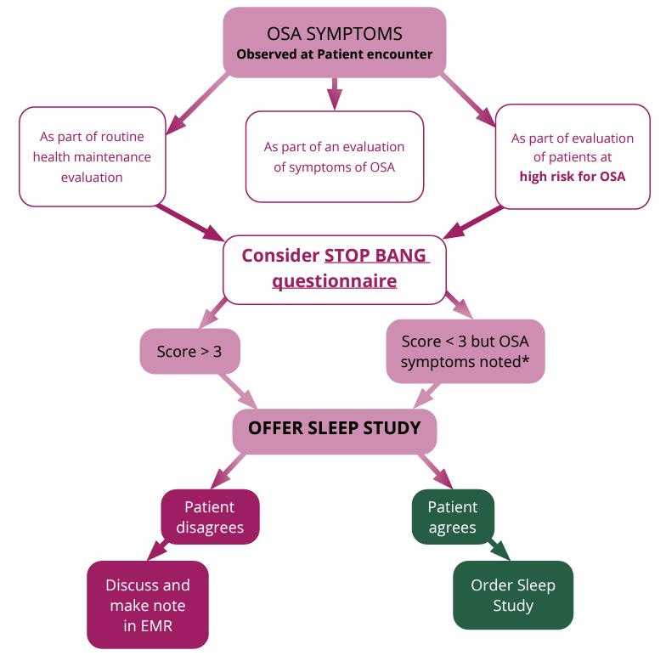
Primary Care Provider Screening Algorithm

Slide 7
Overcoming OSA Barriers

Slide 8
“I’m Pickin’ Up Good Coordination”

Slide 9
Looking for more resources on this topic?
CME/CE in minutes
Congress highlights
Late-breaking data
Quizzes
Webinars
In-person events
Slides & resources
www.MedEdOTG.com

