Slide 1
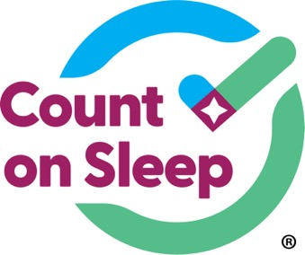


Jointly provided by the American Academy of Sleep Medicine, Global Learning Collaborative, Inc., and Total CME, LLC.
The Count On Sleep program is led by the AASM and its key partner, the Sleep Research Society. Collaborating organizations include the Alliance of Sleep Apnea Partners, American Academy of Dental Sleep Medicine, American Academy of Otolaryngology – Head and Neck Surgery, American College of Chest Physicians, American Society for Metabolic and Bariatric Surgery, American Thoracic Society, and the National Sleep Foundation.
This program was supported by the Centers for Disease Control and Prevention of the U.S. Department of Health and Human Services (HHS) as part of a financial assistance award. The contents are those of the author(s) and do not necessarily represent the official views of, nor an endorsement by, CDC/HHS or the U.S. government.

Slide 2
How to Screen for OSA
Seema Khosla, MD, FCCP, FAASM
Medical Director
ND Center for Sleep
Fargo, ND

Slide 3



Resource Information
About This Resource
These slides are one component of a continuing education program available online at MedEd On The Go titled Obstructive Sleep Apnea (OSA) Screening Made Simple: Effective Strategies for Healthcare Professionals
Program Learning Objectives:
Understand the link between OSA and chronic disease
Develop strategies to integrate routine OSA screening into primary care practice, considering the current barriers and challenges
MedEd On The Go®
www.mededonthego.com
This content or portions thereof may not be published, posted online or used in presentations without permission.
This content can be saved for personal use (non-commercial use only) with credit given to the resource authors.
To contact us regarding inaccuracies, omissions or permissions please email us at support@MedEdOTG.com

Slide 4
Disclaimer
The views and opinions expressed in this educational activity are those of the faculty and do not necessarily represent the views of Total CME, LLC, the CME providers, or the companies providing educational grants. This presentation is not intended to define an exclusive course of patient management; the participant should use their clinical judgment, knowledge, experience, and diagnostic skills in applying or adopting for professional use any of the information provided herein. Any procedures, medications, or other courses of diagnosis or treatment discussed or suggested in this activity should not be used by clinicians without evaluation of their patient's conditions and possible contraindications or dangers in use, review of any applicable manufacturer’s product information, and comparison with recommendations of other authorities. Links to other sites may be provided as additional sources of information.

Slide 5
Validated Questionnaires
STOP-Bang (if >3, consider further evaluation)
Epworth Sleepiness Scale (>10 indicates pathological hypersomnolence)
Berlin Questionnaire (high risk if >1 category is positive)
STOP Bang had the highest sensitivity among sleep clinic patients

Slide 6
Caveats
Screening questionnaires are not meant to exclude OSA
They have not been validated in all patient populations
Those of Asian descent and many women (perimenopausal, pregnant) are overlooked
Clinical symptomatology is important
Identifying, diagnosing, and treating these patients can positively impact their lives

Slide 7
Clinical Vignette
35-year-old G5P1 at 33 weeks
Snoring present since second trimester beginning week 13
BMI 31.2, neck circumference 37 cm
SB 3, ESS 6, negative home sleep apnea test at week 13
Now BMI 36.4, neck circumference 38 cm BP 136/86
SB 4, ESS 11
HSAT: AHI 69.1, ODI 48.4, nadir saturation 63%
OSA does not always resolve with delivery

Slide 8
Untreated OSA in Pregnancy
Higher rate of eclampsia/pre-eclampsia
Higher rate of C-section
Multiple adverse pregnancy outcomes and maternal morbidities EVEN AFTER DELIVERY
Pregnancy is a window into future health

Slide 9
Screening for OSA
Low threshold to treat those with a high clinical index of suspicion and a low ESS or SB
These questionnaires are good but limited, especially in populations where the screening test was not validated

Slide 10
References
STOP-Bang:
http://www.stopbang.ca/osa/screening.php
Epworth Sleepiness Scale:
https://epworthsleepinessscale.com/about-the-ess/
Berlin Questionnaire: https://www.frontiersin.org/articles/10.3389/fmed.2022.866822/full

Slide 11
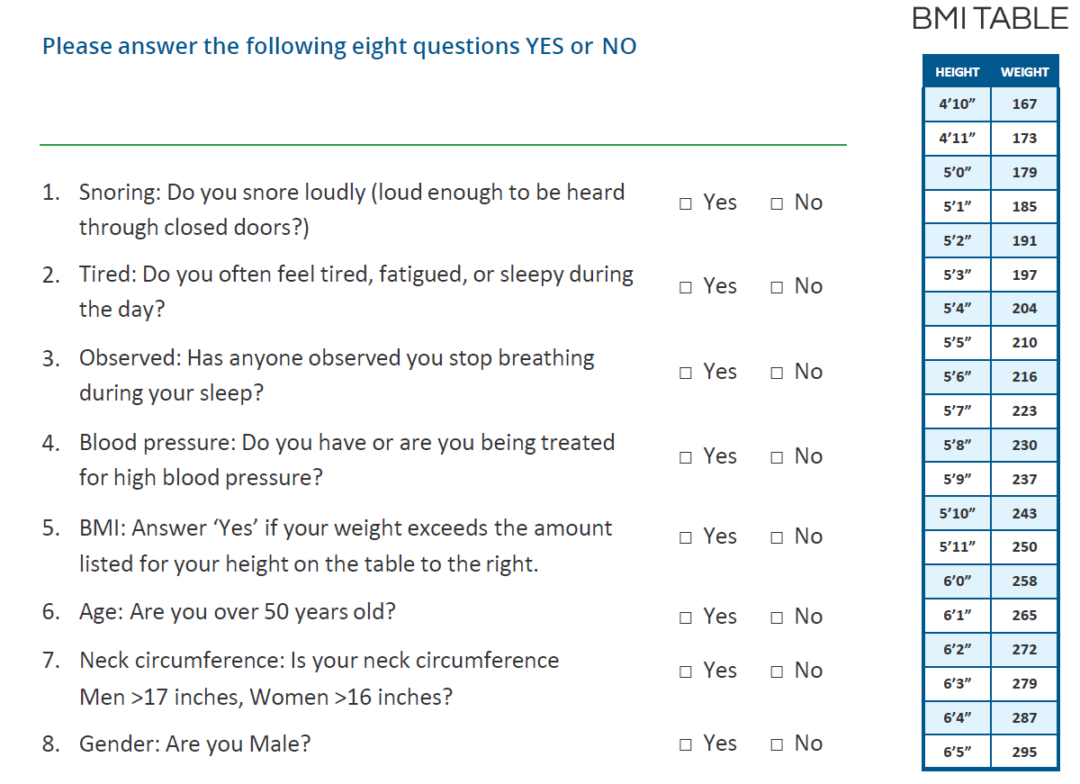
STOP-BANG

Slide 12
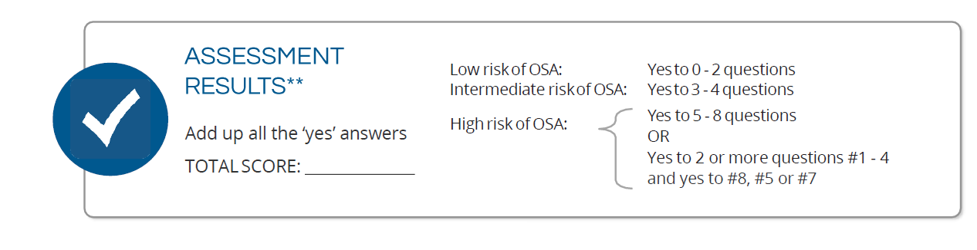
How to Interpret

Slide 13



Looking for more resources
on this topic?
CME/CE in minutes
Congress highlights
Late-breaking data
Quizzes
Webinars
In-person events
Slides & resources
www.MedEdOTG.com

