Slide 1




Saturday, September 9, 2023
9:00am – 3:00pm PT
UCLA Covel Commons | Los Angeles, CA
This activity is supported by independent educational grants from Actelion Pharmaceuticals US, Division of Janssen Pharmaceuticals and United Therapeutics Corporation.
Jointly provided by the Global Learning Collaborative (GLC) and Total CME, LLC.

Slide 2



Resource Information
About This Resource
These slides are one component of a continuing education program available online at MedEd On The Go titled West Regional Pulmonary Hypertension Summit – A Case-Based Look At Diagnosis and Treatment
Program Learning Objectives:
Review essentials of the updated ERS/ESC diagnostic and treatment guidelines and emerging medical entities for treatment
Discuss current concepts on diagnosis and treatment of CTEPH and CTED with a real-world focus
Debate the importance and practice of screening for, diagnosing, and treating PAH associated with connective tissue disease
Learn the essentials of cardiopulmonary exercise testing for the detection and diagnosis of pulmonary hypertension
Consider lessons from the symposium in light of real-world case examples
MedEd On The Go®
www.mededonthego.com
This content or portions thereof may not be published, posted online or used in presentations without permission.
This content can be saved for personal use (non-commercial use only) with credit given to the resource authors.
To contact us regarding inaccuracies, omissions or permissions please email us at support@MedEdOTG.com

Slide 3
Disclaimer
The views and opinions expressed in this educational activity are those of the faculty and do not necessarily represent the views of Total CME, LLC, the CME providers, or the companies providing educational grants. This presentation is not intended to define an exclusive course of patient management; the participant should use their clinical judgment, knowledge, experience, and diagnostic skills in applying or adopting for professional use any of the information provided herein. Any procedures, medications, or other courses of diagnosis or treatment discussed or suggested in this activity should not be used by clinicians without evaluation of their patient's conditions and possible contraindications or dangers in use, review of any applicable manufacturer’s product information, and comparison with recommendations of other authorities. Links to other sites may be provided as additional sources of information.

Slide 4

Overview of New ERS/ESC Guideline Recommendations
Richard Channick, MD
David Geffen School of Medicine at UCLA
Los Angeles, CA

Slide 5
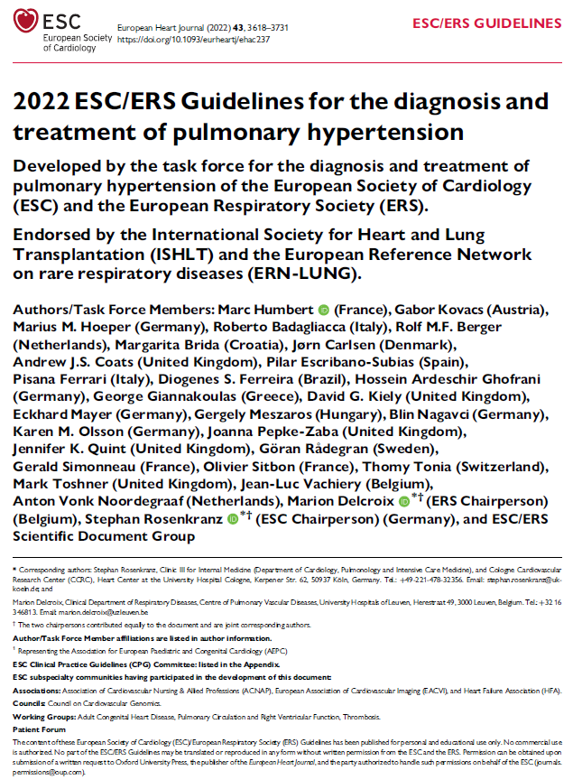
Comprehensive, evidence-based evaluation and recommendations
113 pages
854 references
ERN-LUNG, European Reference Network on rare respiratory diseases; ERS, European Respiratory Society; ESC, European Society of Cardiology; ISHLT, International Society for Heart and Lung Transplantation.
Humbert M, et al. Eur Heart J. 2022;43:3618-731.

Slide 6
ESC/ERS Guidelines 2022: What We Will Discuss
Definition
Classification
Diagnosis
Risk Stratification
Treatment

Slide 7
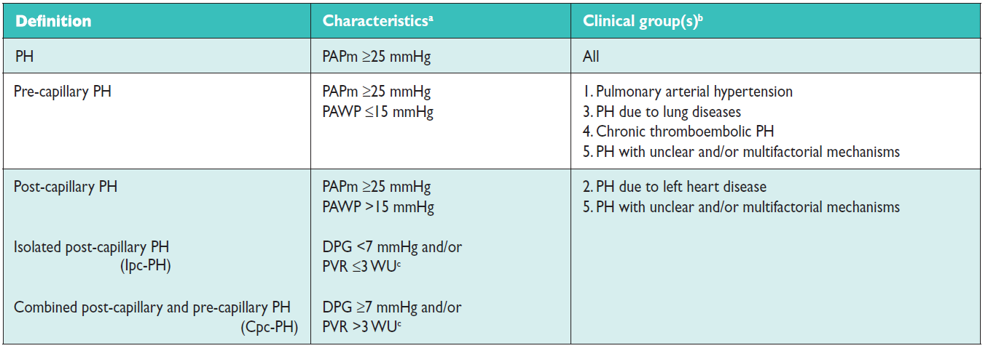
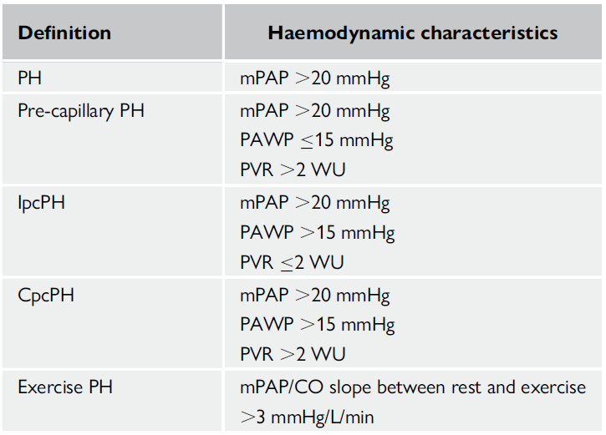
PH Definitions: New Evidence Driving Change in Hemodynamic Thresholds
2015 Guidelines
2022 Guidelines
CO, cardiac output; CpcPH, combined postcapillary and pre-capillary pulmonary hypertension; DPG, diastolic pulmonary gradient; Ipc-PH, isolated post-capillary pulmonary hypertension; mPAP, mean pulmonary artery pressure; PAPm, mean pulmonary artery pressure; PAWP, pulmonary arterial wedge pressure; PH, pulmonary hypertension; PVR, pulmonary vascular resistance; WU, Wood Unit.

Slide 8
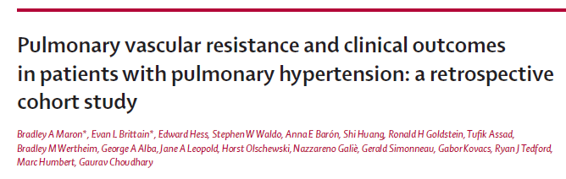

What Led to the Revision of PVR Cutoff for PAH?
PAH, pulmonary arterial hypertension.
Maron BA, et al. Lancet Respir Med. 2020;8:873-84.

Slide 9
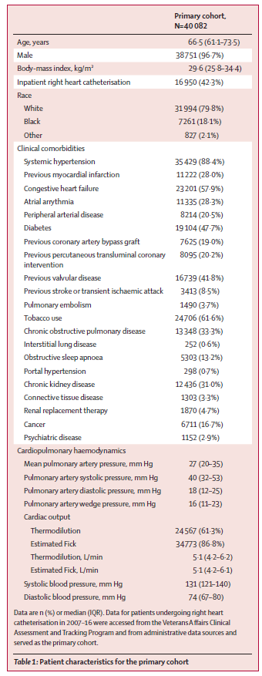
Very large data set
Mainly men (VA study)
Many cardiac comorbidities
No doubt many of these patients had left heart disease, lung disease, OSA, or all of the above
IQR, interquartile range; OSA, obstructive sleep apnea; VA, Veterans Affairs.

Slide 10
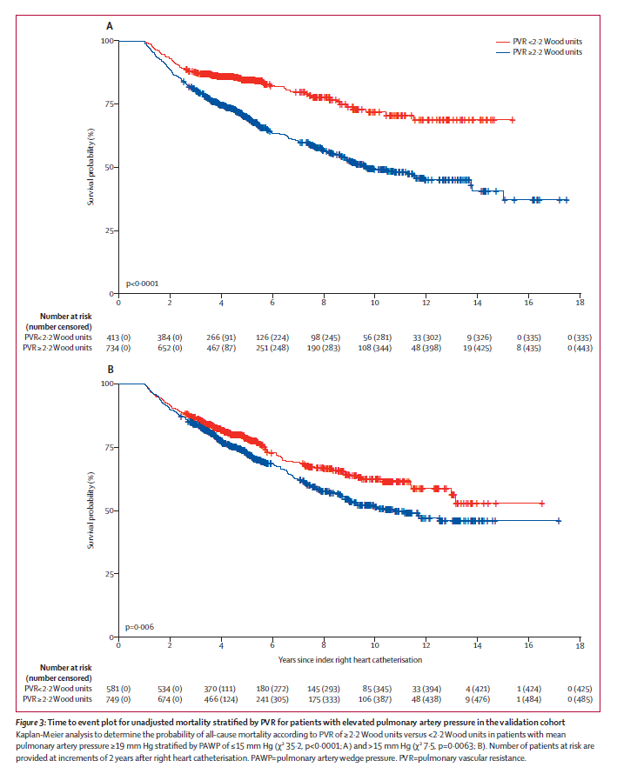
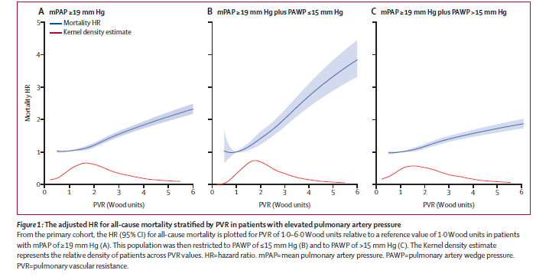
In Patients With Even Mildly Elevated mPAP, PVR Above 2.2 Was Associated With Worsened Mortality. That Doesn’t, of Course, Necessarily Imply Causation
CI, confidence interval; HR, hazard ratio.

Slide 11
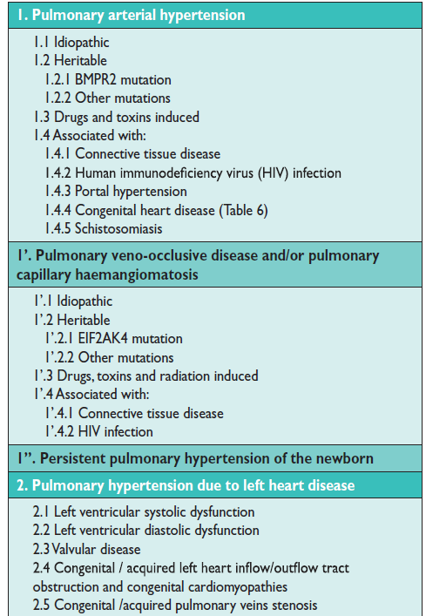
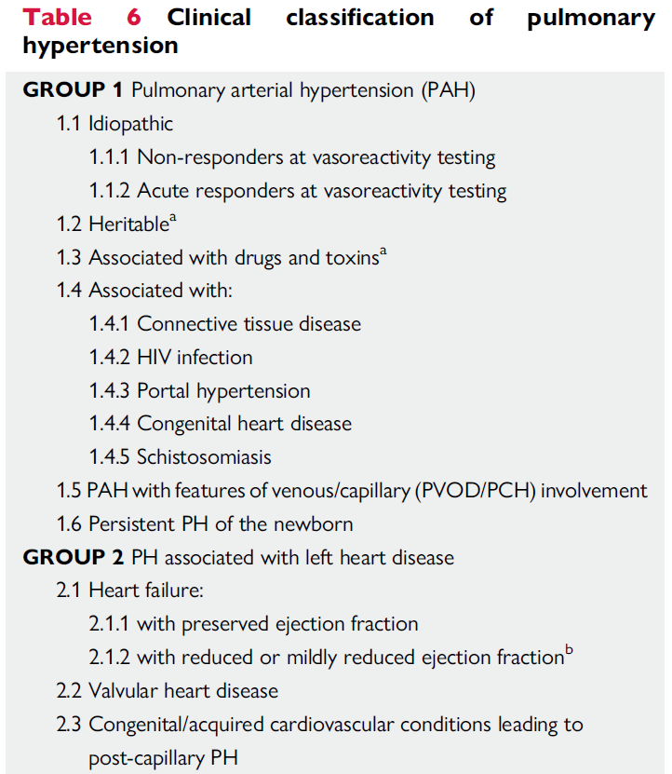
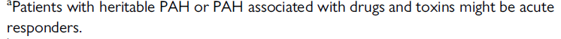
PH Classifications – Group 1
2015 Guidelines
2022 Guidelines
ªPatients with heritable PAH or PAH associated with drugs and toxins might be acute responders.
BMPR2, bone morphogenetic protein receptor 2; EIF2AK4, eukaryotic translation initiation factor 2 alpha kinase 4; HIV, human immunodeficiency virus; PCH, pulmonary capillary hemangiomatosis; PVOD, pulmonary veno-occlusive disease.

Slide 12
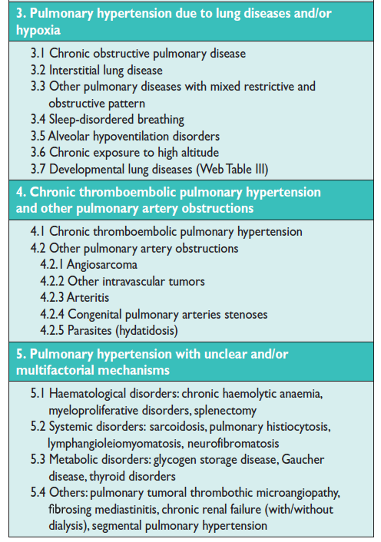
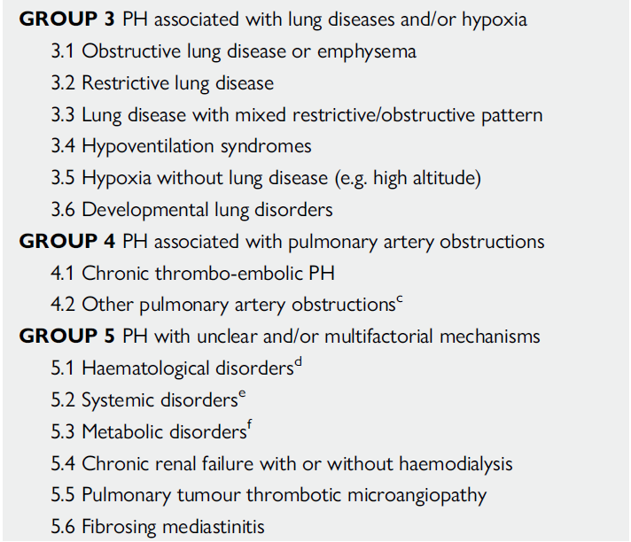
PH Classifications – Group 2, Group 3
2015 Guidelines
2022 Guidelines
^{b}Left ventricular ejection fraction for HF with reduced ejection fraction: $≤$40%; for HF with mildly reduced ejection fraction: 41-49%.
HF, heart failure.

Slide 13
PH Classifications – Group 4, Group 5
2015 Guidelines
2022 Guidelines
^{c}Other causes of pulmonary artery obstructions include: sarcomas (high or intermediate grade or angiosarcoma), other malignant tumours (e.g. renal carcinoma, uterine carcinoma, germ-cell tumours of the testis), non-malignant tumours (e.g. uterine leiomyoma), arteritis without connective tissue disease, congenital pulmonary arterial stenoses, and hydatidosis; ^{d}Including inherited and acquired chronic haemolytic anaemia and chronic myeloproliferative disorders; ^{e}Including sarcoidosis, pulmonary Langerhans’s cell histiocytosis, and neurofibromatosis type 1; ^{f}Including glycogen storage diseases and Gaucher disease.

Slide 14
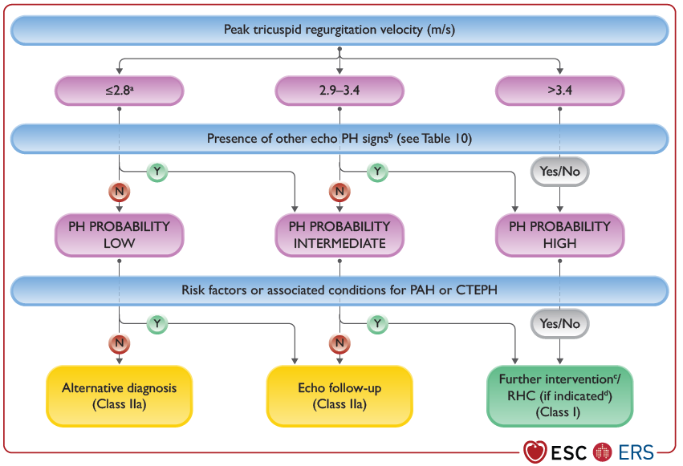
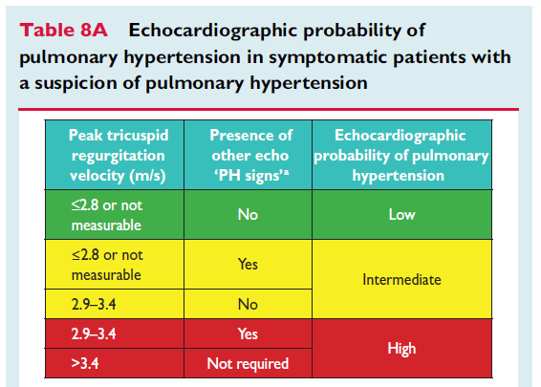
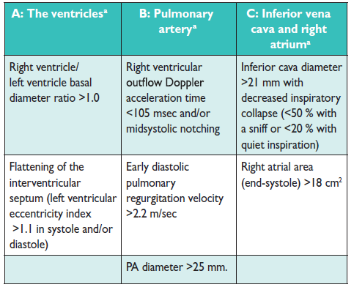
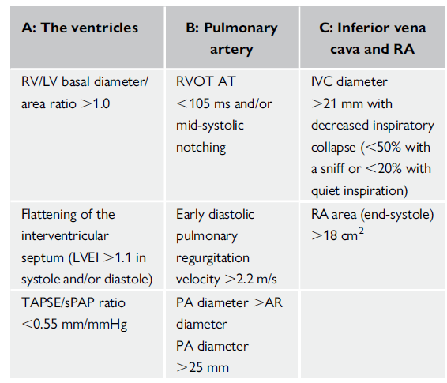
Echo Screening
2022 Guidelines
2015 Guidelines
AT, acceleration time; AR, aortic root; CTEPH, chronic thromboembolic pulmonary hypertension; IVC, inferior vena cava; LV, left ventricle; LVEI, left ventricular ejection fraction; PA, pulmonary artery; RA, right atrium; RHC, right heart catheterization; RV, right ventricle; RVOT, right ventricular outflow tract; sPAP, systolic pulmonary artery pressure; TAPSE, tricuspid annular plane systolic excursion.

Slide 15
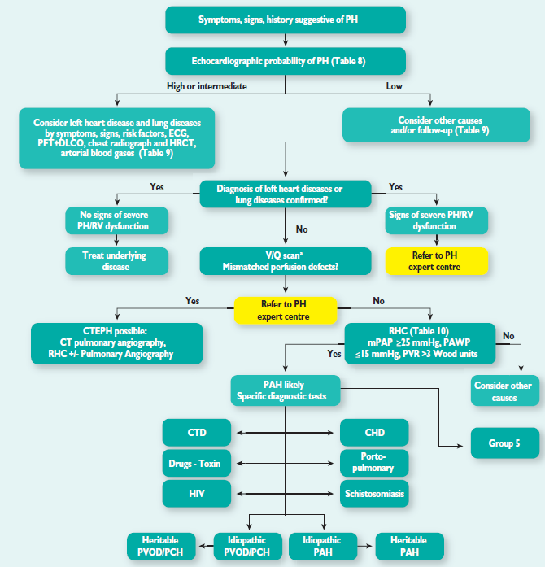
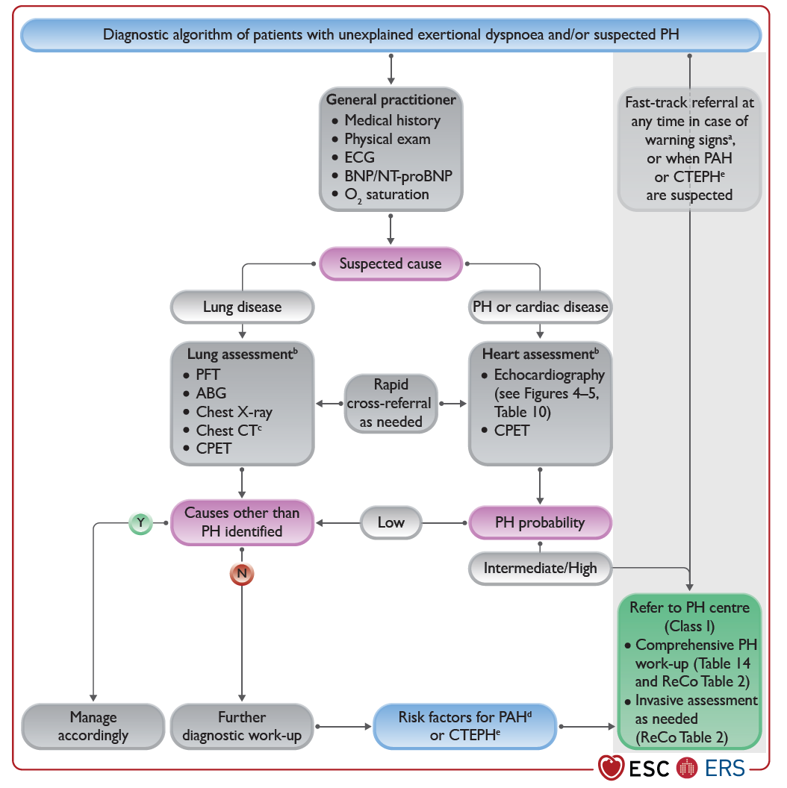
PH Diagnostic Algorithm: Emphasis on Early Referral
2015
2022
ABG, arterial blood gas; BNP, brain natriuretic peptide; CHD, congenital heart disease; CPET, cardiopulmonary exercise testing; CT, computed tomography; CTD, connective tissue disease; DLCO, diffusing capacity of the lungs for carbon monoxide; ECG, electrocardiogram; HRCT, high-resolution computed tomography; NT-proBNP, N-terminal pro-B-type natriuretic peptide; PFT, pulmonary function test; V/Q, ventilation/perfusion.

Slide 16
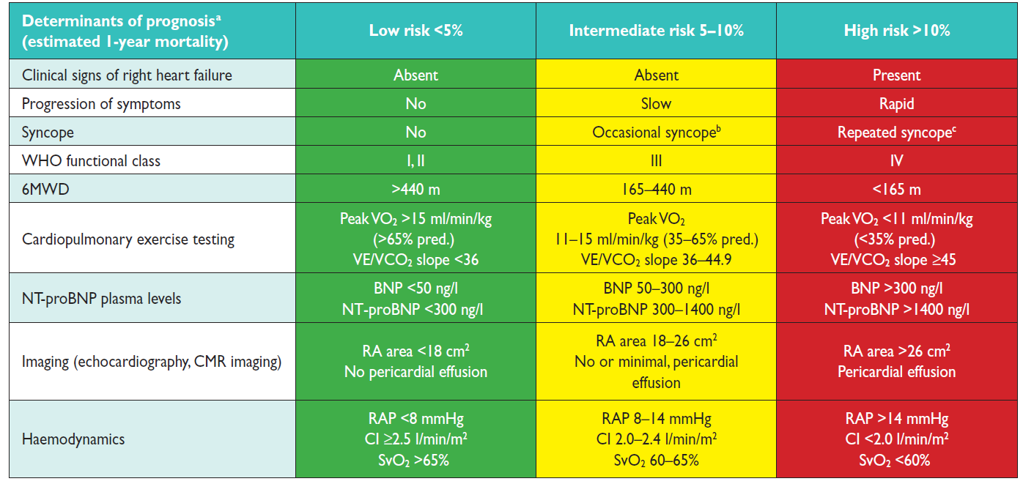
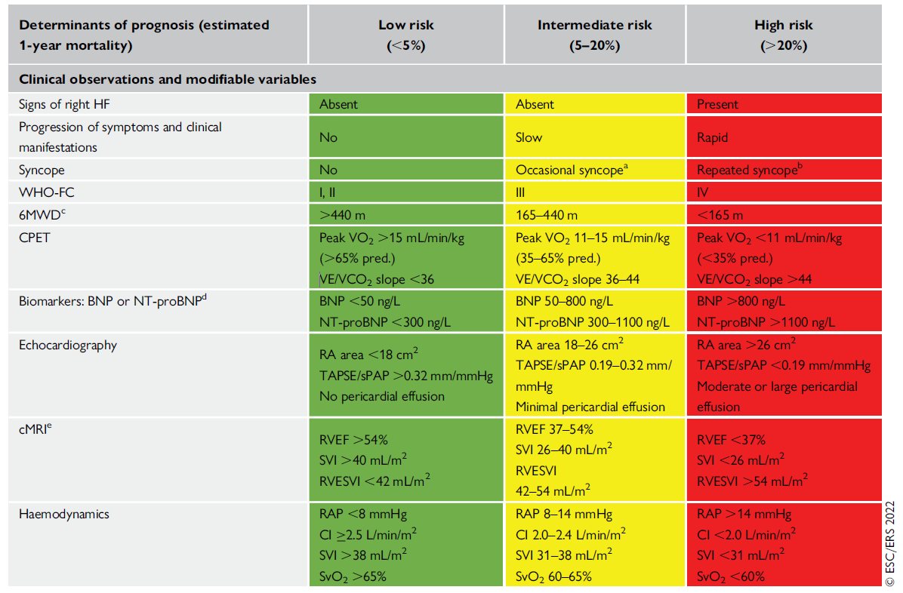
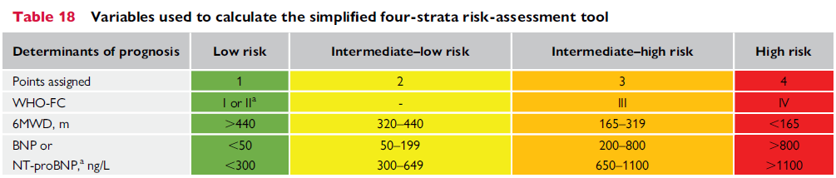
Risk Stratification: 4 Strata model for follow-up
2015 Guidelines
2022 Guidelines
6MWD, 6-minute walk distance; CI, cardiac index; cMRI, cardiac magnetic resonance imaging; Peak VO₂, peak oxygen consumption; RAP, right atrial pressure; RVEF, right ventricular ejection fraction; RVESVI, right ventricular end systolic volume index; SVI, stroke volume index; SvO₂, venous oxygen saturation; VE/VCO₂, minute ventilation/carbon dioxide production; WHO, World Health Organization; WHO-FC, World Health Organization Function Class.

Slide 17
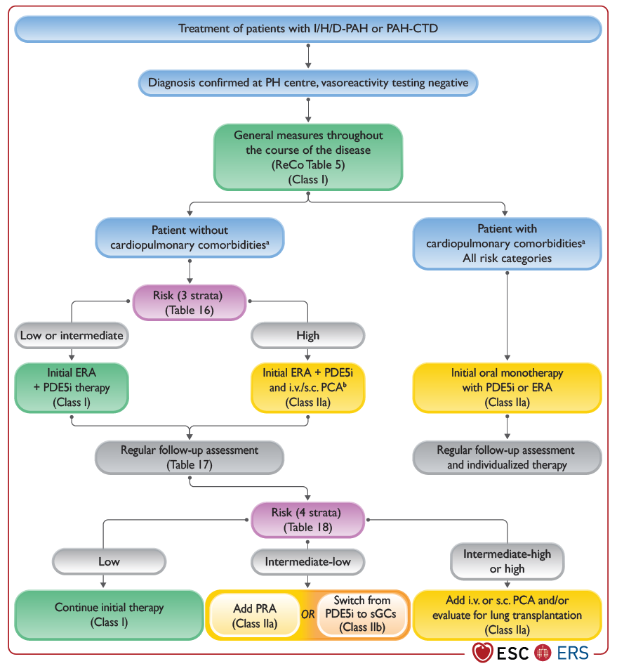
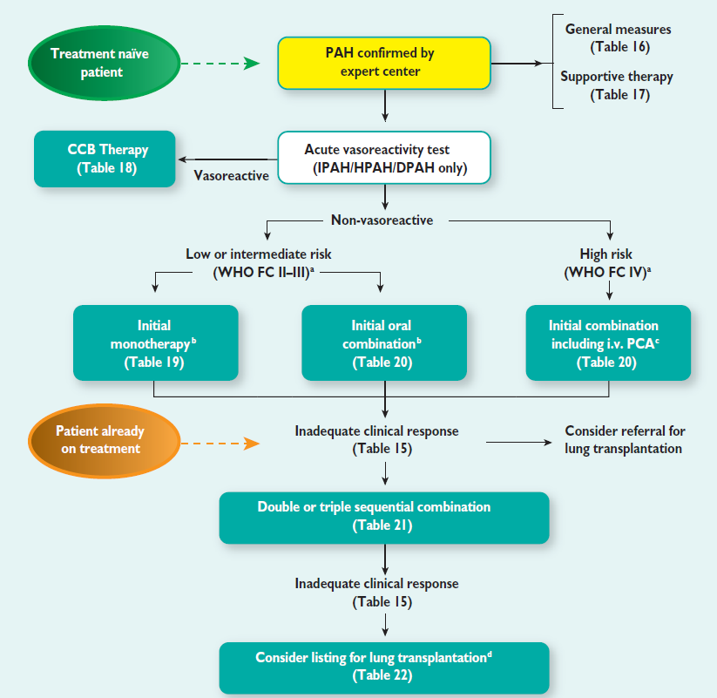
PAH Treatment Algorithm
2022
2015
CCB, calcium channel blocker; ERA, endothelin receptor antagonist; DPAH, drug-associated pulmonary arterial hypertension; HPAH, heritable pulmonary arterial hypertension; IPAH, idiopathic pulmonary arterial hypertension; I/H/D-PAH, idiopathic/heritable/drug-associated pulmonary arterial hypertension; i.v., intravenous; PAH-CTD, pulmonary arterial hypertension-associated connective tissue disease; PCA, prostacyclin analogue; PDE5i, phosphodiesterase-5 inhibitor; PRA, prostacyclin receptor antagonist; s.c., subcutaneous.

Slide 18
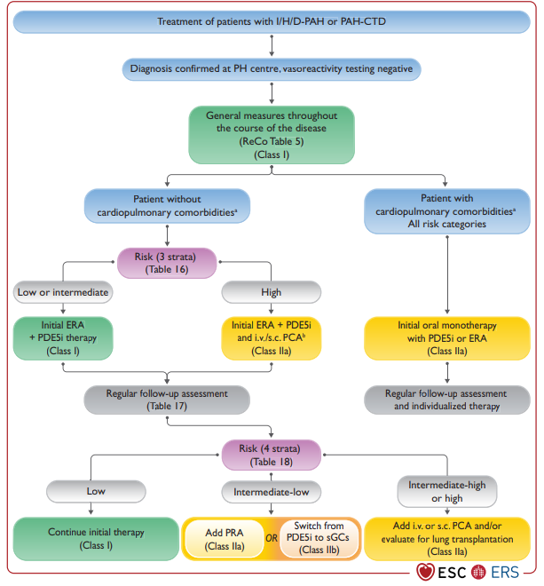
Why the Emphasis on Cardiopulmonary Comorbidities?

Slide 19
Comorbidities in PAH
Patients diagnosed with PAH are older (average age 60) in modern day registries
Two described phenotypes:
  Left heart phenotype: elderly, mostly female patients with risk factors for HFpEF (e.g. hypertension, obesity, diabetes, or coronary heart disease) but pre-capillary rather than post-capillary PH. 30% have atrial fibrillation
  Cardiopulmonary phenotype: elderly, predominantly male patients who have a low DLCO (less than 45% of the predicted value), are often hypoxemic, have a significant smoking history, and have risk factors for LHD
  COMPERA registry: Of 841 IPAH patients, 12.6% had a classic phenotype of young, mostly female patients without cardiopulmonary comorbidities, while 35.8% presented with a left heart phenotype and 51.6% had a cardiopulmonary phenotype
HFpEF, heart failure with preserved ejection fraction; LHD, left heart disease.

Slide 20
Response to Therapy in Patients With Left Heart or Cardiopulmonary Phenotype is Different
Patients with left heart phenotype more likely to have edema, higher discontinuation rates and less efficacy in response to combination therapy
Patients with cardiopulmonary phenotype also respond less well, have more side effects and higher discontinuation rates

Slide 21
Comorbidities in PAH
Although older patients with left heart and pulmonary disease features should be treated cautiously, possibly with initial monotherapy as per guidelines, one should not extrapolate to all PAH patients with comorbidities
Example:
45-year-old woman with scleroderma and PAH who also has well controlled hypertension and DM. This patient should be treated the same as a PAH patient without comorbidities!
DM, diabetes mellitus.

Slide 22
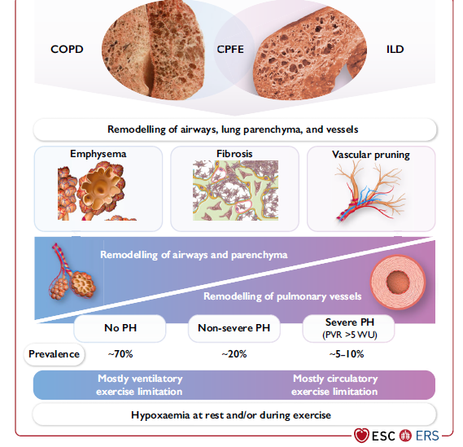
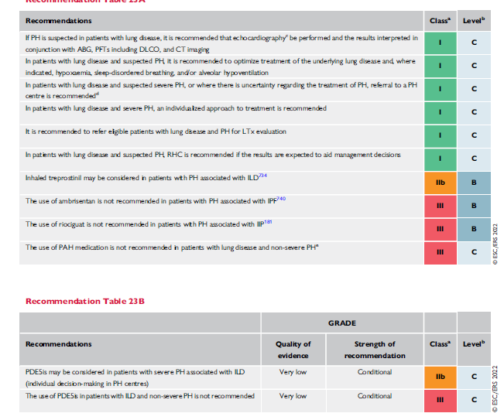
Lung Disease and PH (Group 3)
COPD, chronic obstructive pulmonary disease; CPFE, combined pulmonary fibrosis and emphysema; IIP, idiopathic interstitial pneumonia; ILD, interstitial lung disease; IPF, idiopathic pulmonary fibrosis; LTx, lung transplant.

Slide 23
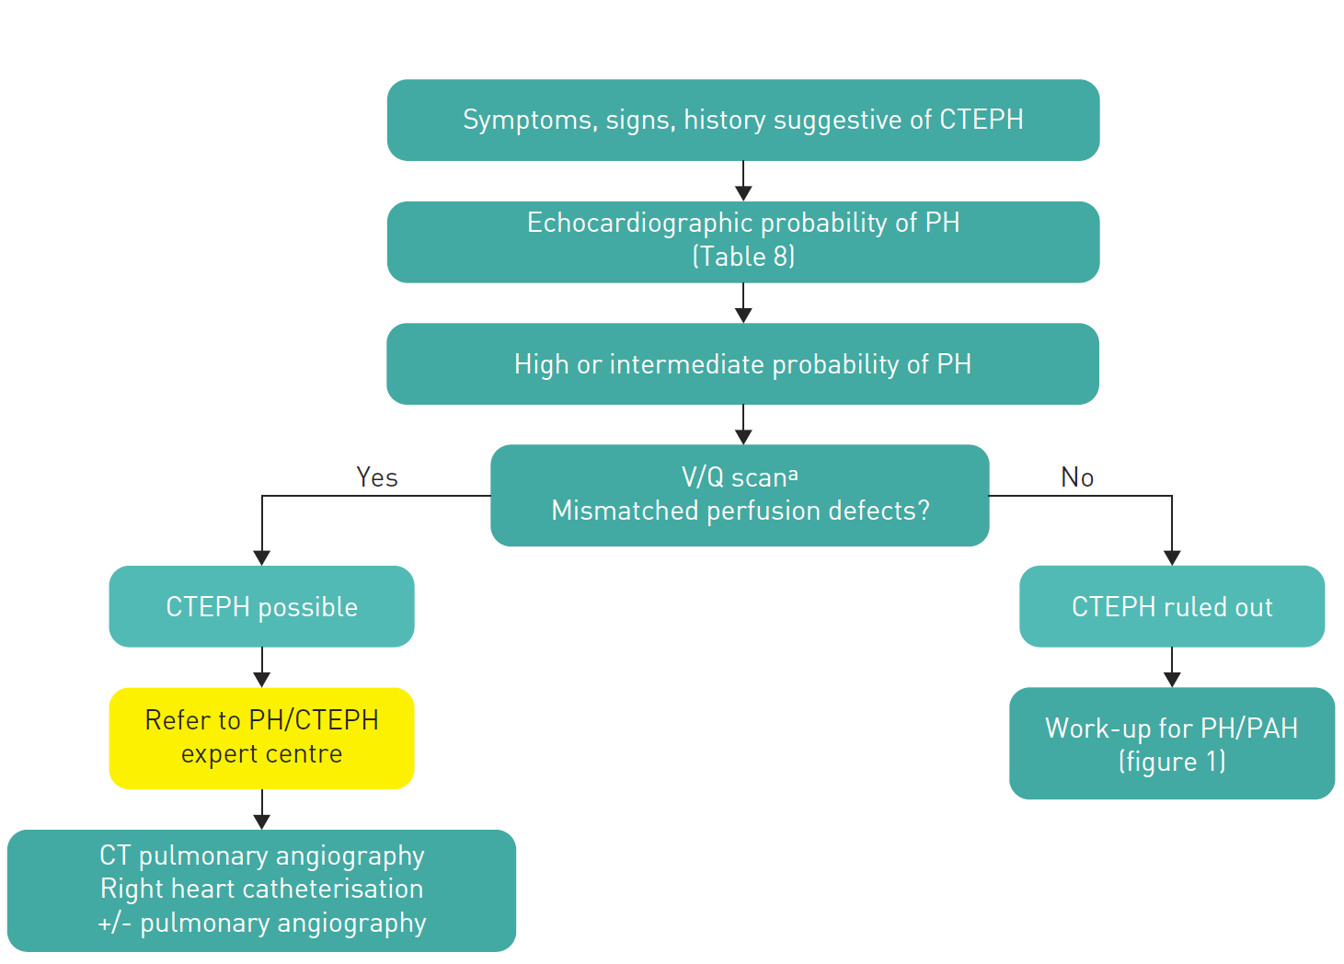
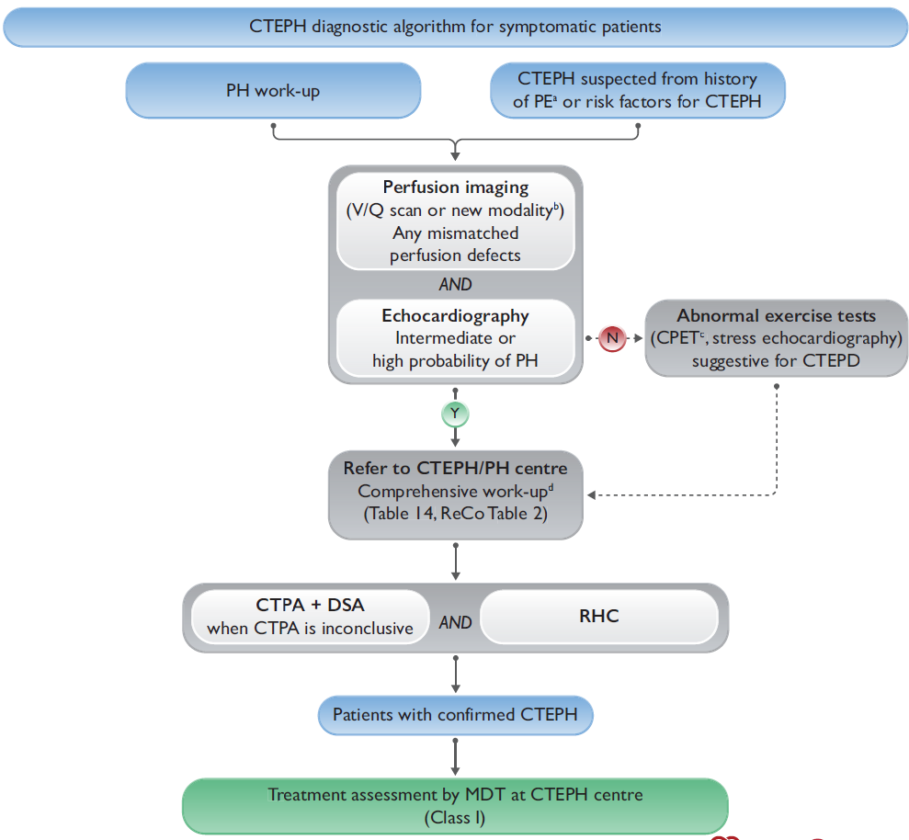
CTEPH Diagnostic Strategy
2022 Guidelines
2015 Guidelines
CTEPD, chronic thromboembolic pulmonary disease; CTPA, computed tomography pulmonary angiography; DSA, digital subtraction angiography; MDT, multidisciplinary team; PE, pulmonary embolism.

Slide 24
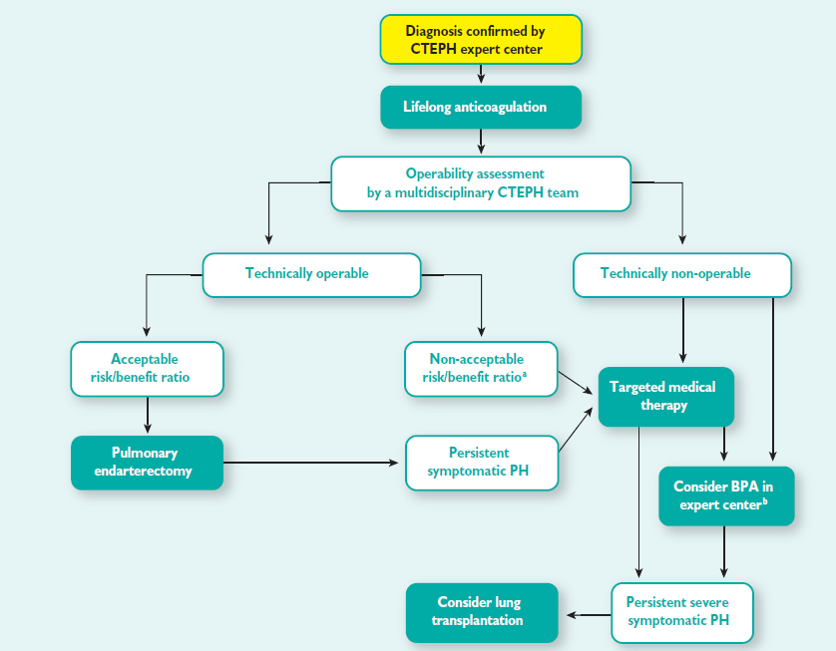
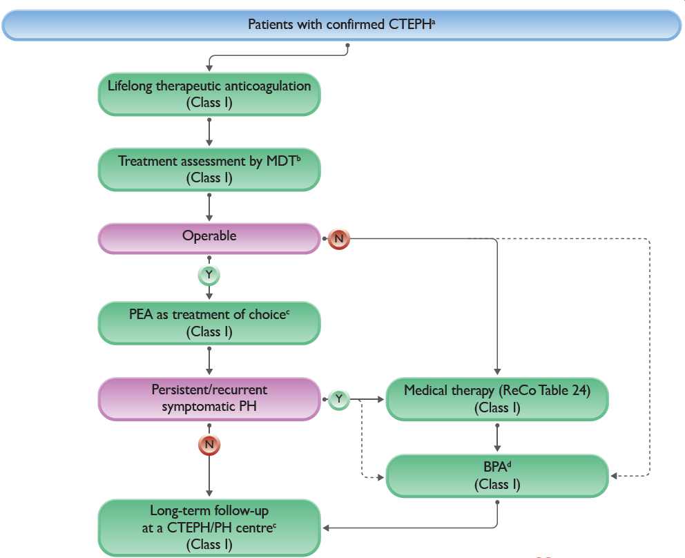
CTEPH Patient Management Algorithm
2015 Guidelines
2022 Guidelines
BPA, balloon pulmonary angioplasty; PEA, pulmonary endarterectomy.

Slide 25
Conclusions
New definition of pre-capillary PH is controversial
Clinical classification system continues with minimal changes (and therefore with similar limitations)
The diagnostic algorithm continues to emphasize initial search for common conditions, but early referral for PAH workup
New emphasis on measures of RV function to help with risk stratification
The treatment algorithm continues to evolve as new drugs become available, but continues to emphasize “treat to low risk”

Slide 26



Looking for more resources
on this topic?
CME/CE in minutes
Congress highlights
Late-breaking data
Quizzes
Webinars
In-person events
Slides & resources
www.MedEdOTG.com

