Slide 1






Saturday, September 9, 2023
9:00am – 3:00pm PT
UCLA Covel Commons | Los Angeles, CA
This activity is supported by independent educational grants from Actelion Pharmaceuticals US, Division of Janssen Pharmaceuticals and United Therapeutics Corporation.
Jointly provided by the Global Learning Collaborative (GLC) and Total CME, LLC.

Slide 2



Resource Information
About This Resource
These slides are one component of a continuing education program available online at MedEd On The Go titled West Regional Pulmonary Hypertension Summit – A Case-Based Look At Diagnosis and Treatment
Program Learning Objectives:
Review essentials of the updated ERS/ESC diagnostic and treatment guidelines and emerging medical entities for treatment
Discuss current concepts on diagnosis and treatment of CTEPH and CTED with a real-world focus
Debate the importance and practice of screening for, diagnosing, and treating PAH associated with connective tissue disease
Learn the essentials of cardiopulmonary exercise testing for the detection and diagnosis of pulmonary hypertension
Consider lessons from the symposium in light of real-world case examples
MedEd On The Go®
www.mededonthego.com
This content or portions thereof may not be published, posted online or used in presentations without permission.
This content can be saved for personal use (non-commercial use only) with credit given to the resource authors.
To contact us regarding inaccuracies, omissions or permissions please email us at support@MedEdOTG.com

Slide 3
Disclaimer
The views and opinions expressed in this educational activity are those of the faculty and do not necessarily represent the views of Total CME, LLC, the CME providers, or the companies providing educational grants. This presentation is not intended to define an exclusive course of patient management; the participant should use their clinical judgment, knowledge, experience, and diagnostic skills in applying or adopting for professional use any of the information provided herein. Any procedures, medications, or other courses of diagnosis or treatment discussed or suggested in this activity should not be used by clinicians without evaluation of their patient's conditions and possible contraindications or dangers in use, review of any applicable manufacturer’s product information, and comparison with recommendations of other authorities. Links to other sites may be provided as additional sources of information.

Slide 4
Management of PAH: Update on the Therapeutic Landscape
Rajan Saggar, MD
David Geffen School of Medicine at UCLA
Los Angeles, CA

Slide 5
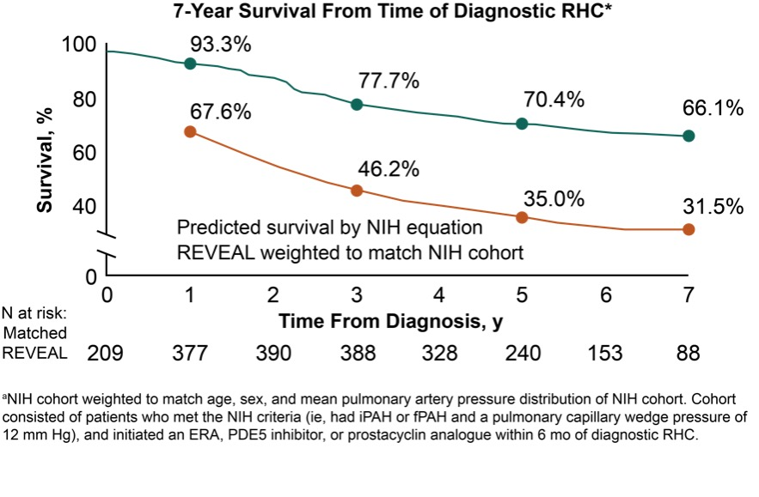
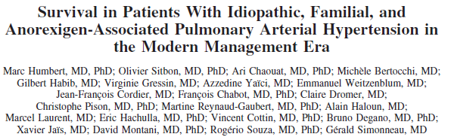
Unmet Need in the Modern Management Era
Despite Drug Discovery and Development, PAH Remains a Devastating Condition
Median Survival (NIH): 2.8 years
Median Survival (REVEAL): ~9 years
Humbert M, et al. Circulation. 2010;122:156-63.

Slide 6
Treatment Targets in PAH
Vessels¹
Therapeutic Pathways²
Endothelin pathway
Endothelium
Pro-
endothelin-1
Nitric oxide
pathway
Prostacyclin
pathway
Endothelin-1
L-arginine
Arachidonic acid
Prostacyclin
Selective ERA
Dual ERA
Nitric oxide
ET_{B}
Prostacyclin analogs
ET_{A}
Y
Non-prostanoid
IP receptor agonist
Y
PDE-5 inhibitors
sGC stimulator
IP receptor
sGC
PDE-5
Y
GTP
cGMP
GMP
cAMP
Smooth muscle cell
Vasoconstriction and proliferation
Vasodilation and anti-proliferation
Vasodilation and anti-proliferation
1. Pugliese S, et al. Am J Physiol Lung Cell Mol Physiol. 2015; 308:L229-252; 2. Lau EMT, et al. Nat Rev Cardiol. 2017;14:603-14; 3. Actelion. ClinicalTrials.gov Identifier: NCT04273945. Updated August 16,2023; 4. Actelion. ClinicalTrials.gov Identifier: NCT03904693. Updated August 16, 2023; 5. Liquidia Technologies, Inc. ClinicalTrials.gov Identifier: NCT03399604. Updated November 6, 2020; 6. Torres F, et al. Eur Resp J. 2019;54:1901030.

Slide 7
New Developments Target Well-Established Pathological Pathways in PAH
Vessels¹
Therapeutic Pathways²
Endothelin pathway
Endothelium
Pro-
endothelin-1
Nitric oxide
pathway
Prostacyclin
pathway
Endothelin-1
Macitentan 75 mg³
L-arginine
Arachidonic acid
Prostacyclin
Selective ERA
Dual ERA
Ralinepag⁷
Nitric oxide
ET_{B}
Macitentan + tadalafil fixed dose combo⁴
Prostacyclin analogs
ET_{A}
Y
Non-prostanoid
IP receptor agonist
Y
PDE-5 inhibitors
sGC stimulator
Treprostinil dry powder, inhaled⁵
sGC stimulator, inhaled⁸
Liposomal treprostinil, inhaled⁶
IP receptor
Vardenafil dry powder, inhaled⁹
Y
sGC
PDE-5
GTP
cGMP
GMP
cAMP
Smooth muscle cell
Vasoconstriction and proliferation
Vasodilation and anti-proliferation
Vasodilation and anti-proliferation
1. Pugliese S, et al. Am J Physiol Lung Cell Mol Physiol. 2015; 308:L229-252; 2. Lau EMT, et al. Nat Rev Cardiol. 2017;14:603-14; 3. Actelion. ClinicalTrials.gov Identifier: NCT04273945. Updated August 16,2023; 4. Actelion. ClinicalTrials.gov Identifier: NCT03904693. Updated August 16, 2023; 5. Liquidia Technologies, Inc. ClinicalTrials.gov Identifier: NCT03399604. Updated November 6, 2020; 6. Liquidia Technologies, Inc. ClinicalTrials.gov Identifier: NCT04691154. Updated August 14, 2023; 7. Torres F, et al. Eur Resp J. 2019;54:1901030; Merck Sharp & Dohme LLC. ClinicalTrials.gov Identifier: NCT04732221. Updated August 9, 2023; Respira Therapeutics, Inc. ClinicalTrials.gov Identifier: NCT04266197. Updated February 10, 2023.

Slide 8
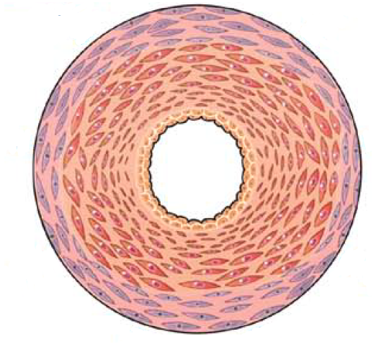
Conclusion: Targeting Novel Pathways in PAH
Pulmonary artery endothelial cell dysfunction is a major abnormality identified in PAH
Strong translational research has
identified a large number of novel
targets in recent years
A major challenge is to prioritize
drug discovery and development
  Inflammation
  Mitochondrial
  metabolism
  Growth
  factors
  Dysregulated
  angiogenesis
  BMPR-II/TGF-β
  superfamily signaling
  Extra-cellular
  matrix
  Calcium
  signaling
  Neurohormonal
  activation
  Vasoactive
  peptides
Humbert M, et al. Circulation. 2014;130:2189-208.

Slide 9
Novel Treatment Targets in Alternative Pathogenic Pathways in PAH
Mechanism | Target | Drug
Genetic^{1,2} | BMPR-II | Tacrolimus
 | ActRIIA (ligand trap) | Sotatercept
Growth factors^{3,4} | PDGFR | Imatinib, Seralutinib
Inflammation^{1,5,12} | CD20 | Rituximab
 | IL-6 receptor | Tocilizumab
 | TNF-α | Etanercept
 | Unconfirmed | Sulfasalazine
Metabolic¹ | AMPK | Metformin
 | Nf2 and NFκB | Bardoxolone
Oestrogen signalling^{1, 13} | Aromatase | Anastrozole
 | Oestrogen receptor | Tamoxifen
Humoural¹ | ACE2 | Recombinant ACE2
 | Mineralocorticoid receptor | Spironolactone
DNA repair¹ | PARP1 | Olaparib
Epigenetic^{6,7} | BRD4 | Apabetalone
Serotonin inhibition⁸ | Tryptophan hydroxylase 1 | Rodatristat ethyl
Dopamine inhibition⁹ | DBH | Zamicastat
VIP analogue^{10,11} | VPAC1 and VPAC2 | Pemziviptadil
Two promising therapeutic pathways—BMPR-II/ActRIIA and PDGF—have been shown to play pivotal roles in PAH pathogenesis
The serotonin pathway is another interesting target
ActRIIA, activin receptor type IIA; ACE2, angiotensin converting enzyme 2; AMPK, adenosine monophosphate-activated protein kinase; BMPR, bone morphogenetic protein receptor; BRD4, bromodomain-containing protein 4; CD20, cluster of differentiate 20; DBH, dopamine beta-hydroxylase; IL-6, interleukin-6; NF2, neurofibromatosis type 2 protein; NFκB, nuclear factor-kappa B; PARP1, poly(ADP-ribose) polymerase 1; PDGFR, platelet derived growth factor receptor; TNF, tumor necrosis factor; VIP, vasoactive intestinal peptide; VPAC, vasoactive intestinal peptide receptor.
1. Sitbon O, et al. Eur Respir J. 2019;53:1801908; 2. Guignabert C, et al. Eur Respir J. 2021;57:2002341; 3. Kanaan R, et al. Eur Respir Rev. 2017;26:170061; 4. Li J, et al. Am J Respir Crit Care Med. 2020;201:A2907; 5. Dunmore J, et al. Cardiovasc Res 2021;117(11):2309-25; 6. Laval University. ClinicalTrials.gov Identifier: NCT04915300; 7. Resverlogix Corp. GlobeNewswire. https://www.globenewswire.com/news-release/2021/09/08/2293386/0/en/Resverlogix-Announces-Apabetalone-Meets-Primary-Endpoint-in-a-Pulmonary-Arterial-Hypertension-Pilot-Study.html. 2021; 8. Altavant Sciences GmbH. ClinicalTrials.gov Identifier: NCT0471266. Updated August 4, 2023; 9. Bial – Portela C S.A. ClinicalTrials.gov Identifier: NCT04316143. Updated November 1, 2021; 10. PhaseBio Pharmaceuticals Inc. ClinicalTrials.gov Identifier: NCT03795428. Updated February 22, 2022; 11. Sumita P, et al. Pulmonary Vascular Research Institute Annual World Congress. 2021; 12. RenJi Hospital. ClinicalTrials.gov Identifier: NCT04528056. Updated August 27, 2020; 13. Vanderbilt University Medical Center. ClinicalTrials.gov Identifier: NCT03528902. Updated August 1, 2023.

Slide 10
Sotatercept

Slide 11
BMPR-II and TGF-β Receptor Superfamily Signalling:
Critical in Maintaining Normal Pulmonary Vascular Homeostasis
Role of TGF-β Receptor Superfamily in Pulmonary Vascular Homeostasis¹
Balance of anti-proliferative and pro-proliferative signalling via BMPR-II/ActRII is important for pulmonary vascular homeostasis^{1,2}
Anti-proliferative
Pro-proliferative
BMPs
Activins
and GDFs
ALK
1/2/3/6
ALK
4/5/7
Smad 1/5/8
Smad 2/3
BMPR-II
ActRIIA/B
pSMAD1/5/8
SMAD4
pSMAD2/3
Gremlin-1 and Noggin
Vascular homeostasis
ALK, anaplastic lymphoma kinase; BMP, bone morphogenic protein; BMPR-II, bone morphogenic protein receptor type II; GDF,growth differentiation factor; TGF-β: transforming growth factor beta.
1. Humbert M, et al. N Engl J Med. 2021;384:1204-15; 2. Guignabert C, et al. Eur Respir J. 2021;57:2002341.

Slide 12

Mutations in BMPR-II Represent the Primary Genetic Risk Factor for Developing PAH
TGF-β Receptor Superfamily Imbalance in PAH¹
Up to 86% of familial PAH and 35% of idiopathic PAH patients show a genetic defect in BMPR-II²
PAH is associated with dysregulation of the
BMPR-II–SMAD 1/5/8 pathway¹
Elevated levels of circulating activins and
GDFs contribute to an imbalance between
anti- and pro-proliferative signalling pathways^{1,2}
Increased pro-inflammatory cytokines downregulate BMPR-II and further contribute to PAH pathogenesis^{3,4}
Anti-proliferative
Pro-proliferative
BMPs
Activins
and GDFs
ALK
1/2/3/6
ALK
4/5/7
BMPR-II
ActRIIA/B
pSMAD1/5/8
SMAD4
pSMAD2/3
Gremlin-1 and Noggin
1. Humbert M, et al. N Engl J Med. 2021;384:1204-15; Guignabert C, et al. Eur Respir J. 2021;57:2002341; 3. Tamura Y. J Clin Invest 2018;128:1956-70; 4. Dunmore J, et al. Cardiovasc Res. 2021;117(11):2309-25.

Slide 13
Therapeutic Developments in Rebalancing BMPR-II/ActRII in PAH
Sotatercept is a novel, first-in-class fusion protein that acts by rebalancing signalling between pro- and anti-proliferative pathways, thereby reversing the characteristic vascular remodelling seen in PAH¹
In the Phase II PULSAR study, sotatercept (0.3 mg/kg or 0.7 mg/kg) decreased PVR* from baseline to Week 24 in patients treated with one, two or three approved PAH drugs¹
In PHASE III STELLAR study, difference between the sotatercept and placebo groups in the change from baseline at week 24 in the 6MWD was 40.8 m (95% CI, 27.5 to 54.1; P<0.001). The first eight secondary end points were significantky improved with sotatercept as compared with placebo.
  40% patients on prostacyclin infusion and 60% patients on triple therapy
Rebalancing BMPR-II/ActRII in PAH¹
Anti-proliferative
Pro-proliferative
BMPs
Activins
and GDFs
Sotatercept
ALK
1/2/3/6
ALK
4/5/7
BMPR-II
ActRIIA/B
pSMAD1/5/8
SMAD4
pSMAD2/3
Gremlin-1 and noggin
*As measured by right heart catheterisation.
6MWD: 6-minute walk distance.
1. Humbert M, et al. N Engl J Med. 2021;384:1204-15; 2. Yung LM, et al. Sci Transl Med. 2020;12:eaaz5660.

Slide 14





Key Phase II/III Studies of Sotatercept*
 | SPECTRA¹ | STELLAR² | ZENITH³ | HYPERION⁴
Objective | Assess efficacy of sotatercept for the treatment of PAH (estimated enrolment: 19) | Assess efficacy and safety of sotatercept for the treatment of PAH (estimated enrolment: 284) | Assess effect of sotatercept on time to first confirmed morbidity/mortality event (estimated enrolment: 166) | Evaluate the effect of sotatercept on time to clinical worsening (estimated enrolment: 662)
Eligibility | Adults with PAH receiving PAH-specific background therapy in WHO FC III**
Design | Open-label. Dosing plus SOC every 3 weeks, starting with 0.3 mg/kg s.c. before increasing to 0.7 mg/kg until EOT | Dosing plus SOC every 3 weeks; randomised 1:1 to placebo or sotatercept (0.3 mg/kg titrated to 0.7 mg/kg s.c.)
Primary endpoint | Change from baseline in peak VO₂ max | Change from baseline in 6MWD at Week 24 | Time to first confirmed morbidity/mortality event from randomisation up to Month 46 | Time to clinical worsening from screening up to Month 56
Estimated completion | COMPLETED | COMPLETED | 2026 | 2028
*This slide does not include the full list of ongoing clinical trials for sotatercept. **See ClinicalTrials.gov for a comprehensive list of eligibility criteria.
EOT, end of treatment; FC: functional capacity; s.c : subcutaneous; VO₂, oxygen uptake.
1. Acceleron Pharma, Inc. ClinicalTrials.gov Identifier: NCT03738150. Updated February 10, 2023; 2. Acceleron Pharma, Inc. NationalTrials.gov Identifier: NCT04576988. Updated August 23, 2023; 3. Acceleron Pharma, Inc. ClinicalTrials.gov Identifier: NCT04896008. Updated August 28, 2023; Acceleron Pharma, Inc. ClinicalTrials.gov Identifier: NCT04811092. Updated August 28, 2023.

Slide 15
Imatinib and Seralutinib

Slide 16
Overexpression of PDGF/PDGFR Implicated in the Development of PAH
Aberrant PDGF signalling occurs in PAH¹
Increased expression of PDGF and PDGFR observed in patients with PAH^{2,3}
PDGF/PDGFR overexpression drives pulmonary vascular remodelling, leading to further upregulation of PDGF and PDGFR²
Potential for reverse remodelling therapy by inhibiting PDGFR in PAH patients²
PDGF
PDGF/PDGFR Signalling in PAH¹
A
B
A
B
A
B
PDGFR
Cell membrane
Cytoplasm
PIP2
PIP3
PI3K/
AKT/mTOR
P
P
P
SHC
Grb2
PI3K
AKT/PKB
SOS
P
PTEN
mTOR
RAS-GDP
RAS-GTP
RAF
MEK
ERK
Nucleus gene transcription
MAPK
cascade
PDGF
PDGFR
1. Kanaan R, et al. Eur Respir Rev. 2017;26:170061; 2. Perros F, et al. Am J Respir Crit Care Med. 2008;178:81-8; 3. Hemnes A, et al. Eur Respir Rev. 2017;26:170093.

Slide 17
The Role of PDGF Signaling Inhibitors as a Therapeutic Option in PAH
PDGF
Therapeutic Targeting of PDGF/PDGFR
Signalling in PAH¹
A
B
Imatinib
Imatinib
GB002
Selective tyrosine kinase inhibitor^{1,2}
IMPRES: Phase III study, improved exercise capacity and haemodynamics in patients with advanced PAH^{1,2}
Serious adverse events were common, however^{1,2}
Planned Phase I-III studies evaluating inhaled imatinib^{3,4}
PDGFR
Cell membrane
Cytoplasm
PIP2
PIP3
PI3K/
AKT/mTOR
P
P
P
SHC
Grb2
PI3K
AKT/PKB
SOS
P
GB002
PTEN
mTOR
RAS-GDP
RAS-GTP
Small molecule PDGFR inhibitor⁵
Ongoing Phase II study evaluating inhaled GB002 effect on improving haemodynamics in patients with PAH⁶
RAF
MEK
ERK
Nucleus gene transcription
MAPK
cascade
PDGF
PDGFR
1. Kanaan R, et al. Eur Respir Rev. 2017;26:170061; 2. Hoeper MM, et al. Circulation. 2013;127:1128-38; 3. Aerami Therapeutics. ClinicalTrials.gov Identifier: NCT04903730. Updated December 7, 2022; 4. Aerovate Therapeutics. ClinicalTrials.gov Identifier: NCT05036135. Updated July 27, 2023; 5. Li J, et al. Am J Respir Crit Care Med. 2020; 201:A2907; 6. Gossamer Bio Inc. ClinicalTrials.gov Identifier: NCT04456998. Updated February 9, 2023.

Slide 18
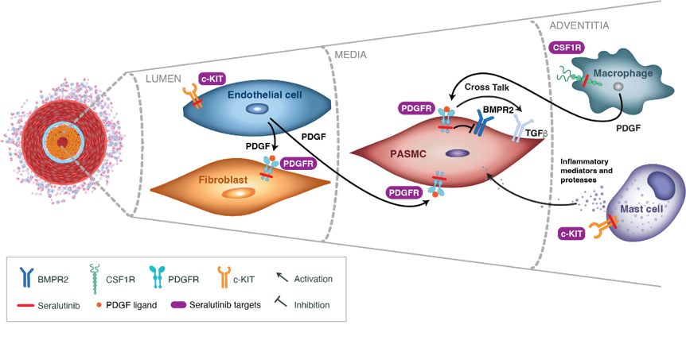
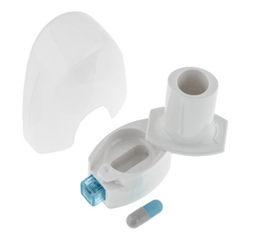
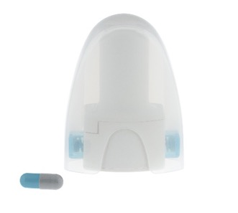
Seralutinib Is A Potent Tyrosine Kinase Inhibitor Which Targets Key Factors of Vascular Remodeling
A. Seralutinib Mechanism of Action
Potent small molecule PDGFRα/β, CSF1R, and c-KIT kinase inhibitor (A)
New mechanism of action that targets inflammatory, proliferative, and fibrotic processes implicated in pulmonary vascular remodeling
Designed as an inhaled treatment for PAH
  Administered by dry powder inhaler for deep lung deposition (B)
  Low oral bioavailability and rapid clearance characteristics to minimize systemic exposure to mitigate adverse events
Adapted from Frantz RP et al. Pulm Circ. 2021;11(4):20458940211057071. Distributed under the terms of the Creative Commons Attribution-Non-Commercial 4.0 License (https://creativecommons.org/licenses/by-nc/4.0/).
B. Dry Powder Inhaler
Galkin A et al. Eur Respir J. 2022;60(6):2102356.
BMPR2, bone morphogenetic protein receptor type 2; CSF1R, colony stimulating factor 1 receptor; PAH, pulmonary arterial hypertension; PASMC, pulmonary arterial smooth muscle cell; PDGFR, platelet-derived growth factor receptor.

Slide 19
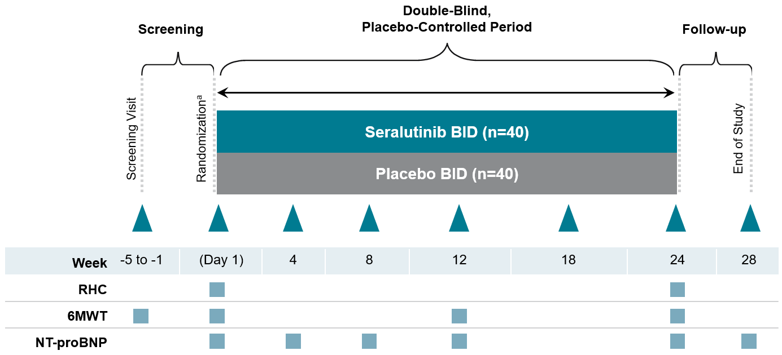
TORREY Phase 2, Randomized, Double-blind, Placebo-controlled Multicenter Study
Objective: To evaluate the efficacy and safety of inhaled seralutinib in PAH over 24 weeks
Key Inclusion Criteria
WHO Group 1 PH
6MWD ≥ 150 meters and ≤ 550 meters
WHO FC II or III
Standard of care PAH background therapies
PVR ≥ 400 dyne*s/cm⁵
Key Exclusion Criteria
WHO Pulmonary Hypertension Group 2–5
HIV-associated PAH
Inhaled prostanoids
Use of anticoagulants
Endpoints
Primary: Change in PVR from BL to Week 24
Secondary: Change in 6MWD from BL to Week 24
Exploratory: NT-proBNP, RH structure and function by echocardiography
Safety assessed during scheduled visits
Dosing: Subjects started on 60 mg BID and after 2 weeks escalated to 90 mg BID as tolerated
After completing the Week 24 visit, subjects have the option to roll into an open-label extension study
RHC Analyses
PAC & other cardiopulmonary hemodynamic parameters
ª Randomization stratified by PVR (< 800 dyne*s/cm⁵ vs. ≥ 800 dyne*s/cm⁵)
6MWD, 6-minute walk distance; 6MWT, 6-minute walk test; BID, twice daily; BL, baseline; FC, functional class; HIV, human immunodeficiency virus; NT-proBNP, N-terminal pro-brain natriuretic peptide; PAC, pulmonary artery compliance (stroke volume/[pulmonary artery pulse pressure]); PAH, pulmonary arterial hypertension; PH, pulmonary hypertension; PVR, pulmonary vascular resistance; RH, right heart; RHC, right heart catheterization; WHO, World Health Organization. NCT04456998.

Slide 20
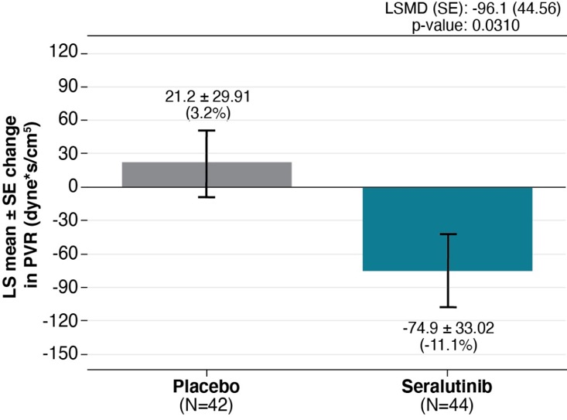
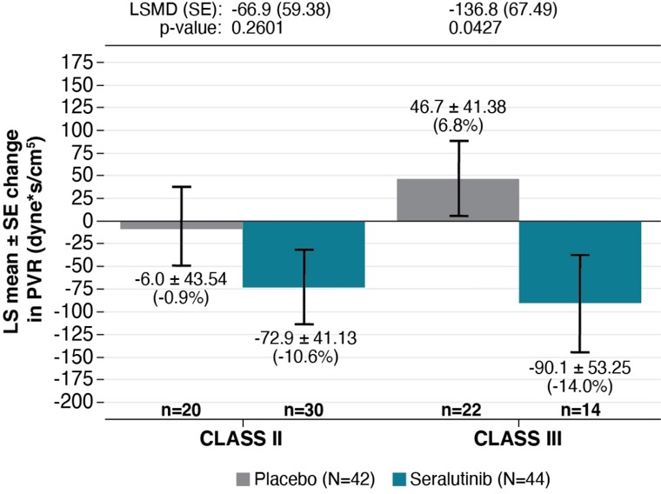
Primary Endpoint: Change in PVR From Baseline to Week 24
(~60% of patients were on triple background PAH therapy; ~45% were on parenteral prostacyclin)
A.
Overall population
B.
Prespecified subgroup analysis:
WHO Functional Class
In the overall population, seralutinib significantly reduced PVR at Week 24 vs placebo (14.3%, p=0.0310) (A)
Seralutinib had a more pronounced effect on PVR in FC III patients: 20.8% reduction (p=0.0427) (B)
Frantz RP et al. Am J Respir Crit Care Med 2023;207:A6726.
Based on an ANCOVA model with multiple imputation. ANCOVA, analysis of covariance; FC, functional class; LS, least squares; LSMD, least squares mean difference; ITT, intention-to-treat; PVR, pulmonary vascular resistance; SE, standard error; WHO, World Health Organization.

Slide 21
Current Status of Seralutinib
Seralutinib, a PDGFR, CSF1R, and c-KIT tyrosine kinase inhibitor administered by dry powder inhaler, demonstrated clinical activity and a favorable safety profile in the Phase 2 TORREY trial
TORREY met the primary endpoint of reduction in PVR in a heavily treated, prevalent study population on standard of care background medications
Prespecified subgroup analyses showed greater benefit in FC III and subjects with REVEAL 2.0 risk score ≥ 6
The reduction in PVR and increase in PAC in conjunction with a reduction of NT-proBNP indicates that seralutinib is reducing RV afterload and having a beneficial effect on the right heart
Proof of concept has been demonstrated and a global registration Phase 3 program in PAH is in process
CSF1R, colony stimulating factor 1 receptor; FC, functional class; NT-proBNP, N-terminal pro-brain natriuretic peptide; PAC, pulmonary artery compliance; PAH, pulmonary arterial hypertension; PDGFR, platelet-derived growth factor receptor; PVR, pulmonary vascular resistance; REVEAL, Registry to Evaluate Early and Long-Term PAH Disease Management; RV, right ventricular.

Slide 22
Serotonin Antagonism

Slide 23
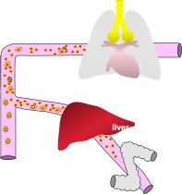
Serotonin: 5-Hydroxytryptamine (5-HT)
  5-HT is synthetized from tryptophan (from the diet) in two steps
  5-HT is degraded almost entirely by monoamine oxidase, which converts it to 5-hydroxyindole acetaldehyde, most of which is dehydrogenated to form 5-hydroxyindole acetic acid, which is excreted in the urine
  Present in gastrointestinal (GI) enterochromaffin cells (90%), platelets, and the brain
  Human pulmonary endothelial cells (ECs) express TPH1 and produce 5-HT, and both TPH1 expression and 5-HT production are increased in P-ECs from patients with idiopathic PAH compared with that of controls
  Eddahibi S, et al. Circulation. 2006;113:1857-64.

Slide 24
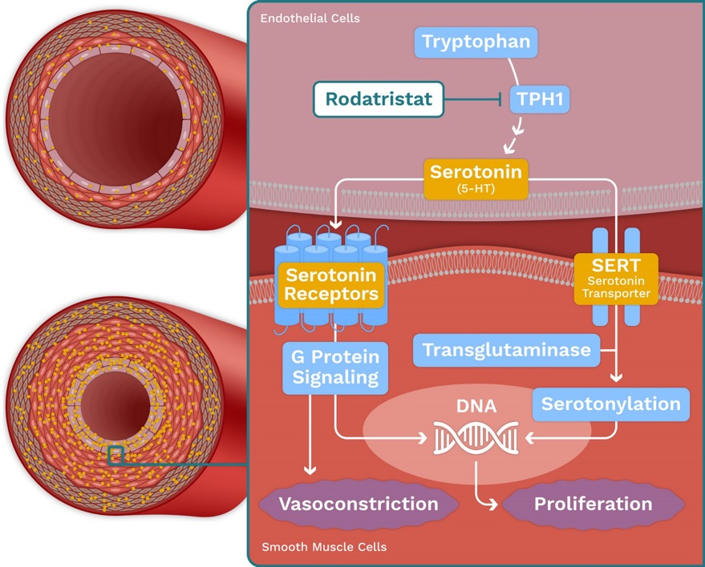


Serotonin Induces Proliferation and Vasoconstriction Leading to Development and Progression of PAH
TPH1 upregulated in PAH
Increased locally-produced and platelet-derived serotonin contributes to the development of PAH
Excess serotonin stimulates thickening and constriction of the pulmonary blood vessels by acting through serotonin receptors and transporters
Pulmonary arterial pressure increases and leads to stress on the right ventricle and ultimately to heart failure

Slide 25
Failure of Targeting the Serotonin Pathway in PAH
Following database lock of the 24-week double-blind placebo-controlled part of the study on Thursday, 29 June 2023 and a review of the preliminary data from this portion of the study with the Chair of the Data Monitoring Committee (DMC) on Friday, 30 June 2023, the DMC Chair recommended, and the Sponsor agreed, that patients should stop their treatment with rodatristat ethyl and terminate the continuation of the study as a result of:
-an increase in the change in PVR from baseline to Week 24 (primary endpoint of the study),
-an increase in the change in NT-proBNP from baseline to week 24 (secondary endpoint), and
-an imbalance in safety data with rodatristat compared with placebo.
DMC, data monitoring committee.

Slide 26
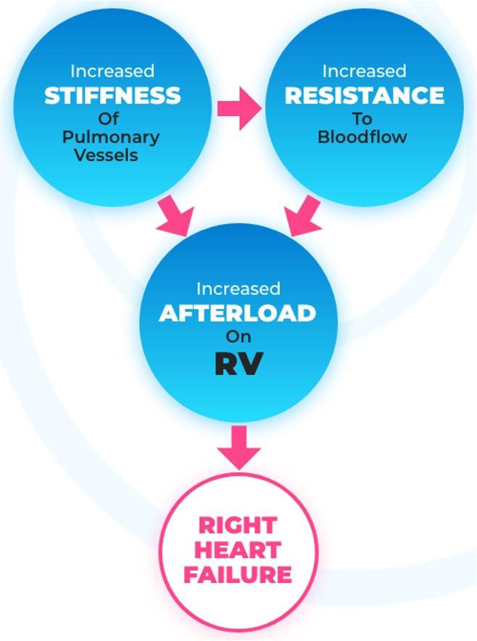
Aria’s Device:
Abnormal compliance contributes to
RV dysfunction
Increased pulse pressure and pulsatile load
Target of Aria’s device
Increase mean pressure and steady state load
Target of drugs
Compliance= (Stroke Volume)
(Pulse Pressure)

Slide 27

Implanted Device

Slide 28
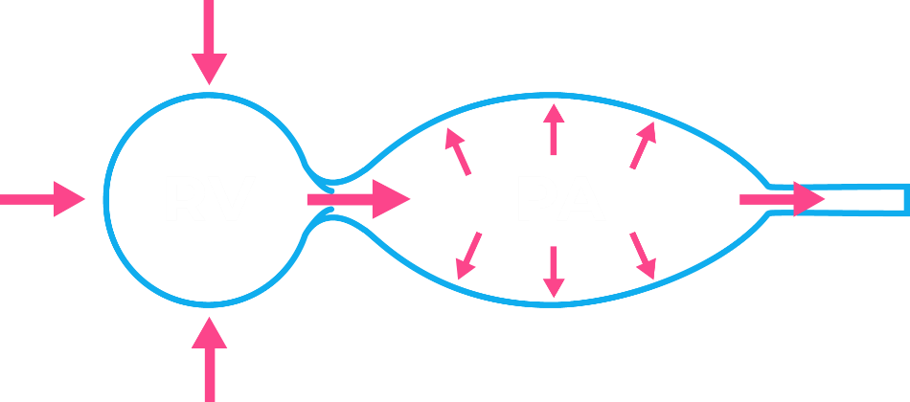
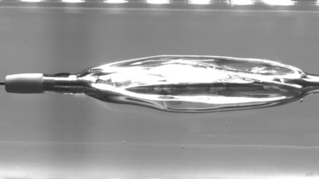

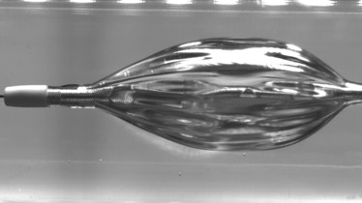
Mechanism of Action: Device mimics the function of a healthy elastic pulmonary artery (functions similar to aortic balloon pump)
Balloon deflation prevents PA pressure from rising - reduces afterload
Systole
RV
PA
Elastic walls of pulmonary artery stretch to make room for incoming stroke volume
Gas in balloon compresses to make room for incoming stroke volume
Balloon inflation “pushes” blood forward – increases cardiac output
Diastole
RV
PA
Elastic walls of pulmonary artery recoil, enabling blood to flow throughout cardiac cycle
Gas in balloon expands, enabling blood to flow throughout cardiac cycle

Slide 29
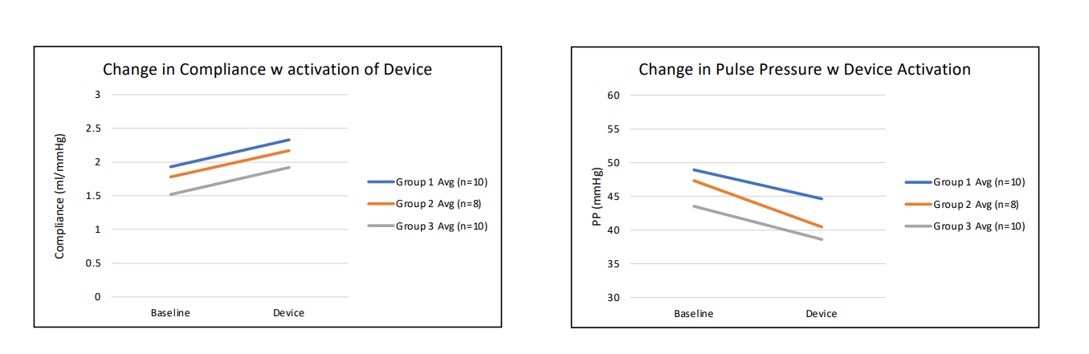
Similar acute results in all WHO Groups (1, 2, 3)
ASPIRE-PH is an early feasibility study assessing treatment of PH (Groups 1, 2, and 3) using the ARIA CV Pulmonary Hypertension System in the ambulatory setting (just starting)

Slide 30
Other Interventional/Surgical Devices
Potts Shunt (percutaneous and surgical)
Pulmonary Artery Denervation
RVAD (Impella RP)
RV pacing
ECMO (Venoarterial; V-PA)

Slide 31




Conclusions
Phase III trials for new approaches to target the well-established pathological pathways in PAH are ongoing
Research in recent years has identified a large number of novel PAH treatment targets, such as BMPR-II/ActRII and PDGFR
Several Phase II and Phase III trials are currently investigating the efficacy and safety of novel treatment options in PAH such as sotatercept, imatinib, and GB002
Prioritising drug discovery and development in PAH remains an important goal for the future

Slide 32
Special Thanks
UCLA Pulmonary & Critical Care
Richard Channick MD
John Belperio MD
David Ross MD
Joseph Lynch III MD
Ariss Derhovanessian MD
Michael Shino MD
Sam Weigt MD
David Sayah MD
Shelley Shapiro MD, PhD
Allison Ramsey, MD
Grant Turner, MD
Olawale Amubieya, MD, PhD
Alex Sherman MD
Sonia Jasuja MD
Brandon Jacubowski
University of Michigan Rheumatology
Dinesh Khanna MD
Temple University Cardiology
Paul Forfia MD
Anjali Vaidya MD
University of Pittsburgh
Stephen Y. Chan MD PhD
UCLA Cardiothoracic Surgery
Abbas Ardehali MD
Curtis Hunter MD
Murray Kwon MD
Reshma Binwale MD
UCLA Pathology
Michael Fishbein MD
Greg Fishbein MD
Dean Wallace MD
Atsuko Seki MD
PH Nursing
Lynne Yoder RN
Kathy McCloy NP
Shannon Salveson NP
Aijin Lee CSN
Charlotte Lipsky NP
Valentina Alvadzhyan PharmD
Lloyd Liang
UCLA Rheumatology
Dan Furst MD
Philip Clements MD
Elizabeth Volkmann MD
Suzanne Kafaja MD

Slide 33
Thank you!
Rajan Saggar MD
Professor of Medicine
Director Pulmonary Hypertension Program
Co-Director Pulmonary Vascular Disease Program
Lung & Heart-Lung Transplant and Pulmonary Hypertension Programs
David Geffen School of Medicine, UCLA

Slide 34



Looking for more resources
on this topic?
CME/CE in minutes
Congress highlights
Late-breaking data
Quizzes
Webinars
In-person events
Slides & resources
www.MedEdOTG.com

