Slide 1






Saturday, September 9, 2023
9:00am – 3:00pm PT
UCLA Covel Commons | Los Angeles, CA
This activity is supported by independent educational grants from Actelion Pharmaceuticals US, Division of Janssen Pharmaceuticals and United Therapeutics Corporation.
Jointly provided by the Global Learning Collaborative (GLC) and Total CME, LLC.

Slide 2



Resource Information
About This Resource
These slides are one component of a continuing education program available online at MedEd On The Go titled West Regional Pulmonary Hypertension Summit – A Case-Based Look At Diagnosis and Treatment
Program Learning Objectives:
Review essentials of the updated ERS/ESC diagnostic and treatment guidelines and emerging medical entities for treatment
Discuss current concepts on diagnosis and treatment of CTEPH and CTED with a real-world focus
Debate the importance and practice of screening for, diagnosing, and treating PAH associated with connective tissue disease
Learn the essentials of cardiopulmonary exercise testing for the detection and diagnosis of pulmonary hypertension
Consider lessons from the symposium in light of real-world case examples
MedEd On The Go®
www.mededonthego.com
This content or portions thereof may not be published, posted online or used in presentations without permission.
This content can be saved for personal use (non-commercial use only) with credit given to the resource authors.
To contact us regarding inaccuracies, omissions or permissions please email us at support@MedEdOTG.com

Slide 3
Disclaimer
The views and opinions expressed in this educational activity are those of the faculty and do not necessarily represent the views of Total CME, LLC, the CME providers, or the companies providing educational grants. This presentation is not intended to define an exclusive course of patient management; the participant should use their clinical judgment, knowledge, experience, and diagnostic skills in applying or adopting for professional use any of the information provided herein. Any procedures, medications, or other courses of diagnosis or treatment discussed or suggested in this activity should not be used by clinicians without evaluation of their patient's conditions and possible contraindications or dangers in use, review of any applicable manufacturer’s product information, and comparison with recommendations of other authorities. Links to other sites may be provided as additional sources of information.

Slide 4
Case Study: CTEPH
Michael Troy, MD
University of California Los Angeles
Los Angeles, CA

Slide 5
Case Study
56 YOF with Crohn's disease and history of arterial and venous thromboses who presents with progressively worsening DOE for 1 to 2 months
Index VTE event 7 years ago:
  Occurred in setting of prolonged air travel and OCP use
  Left leg swelling/pain with discoloration, found to have arterial and venous thrombi and PE in bilateral main pulmonary arteries
  Treated with temporary IVC filter and apixaban x ~ 6 months with resolution of symptoms and normalization of d-dimer off AC
  Apixaban as needed for long air trips
Admitted 2 months ago to OSH with recurrent left arterial femoral clot and central PE:
  In setting of prolonged air travel despite taking apixaban
  TTE with severe RV failure and PFO
  Discharged on rivaroxaban and 2L NC with plan for PFO closure in the future
  Now re-admitted with decreased exercise capacity (able to walk 0.5 blocks, previously 1-2 blocks)

Slide 6
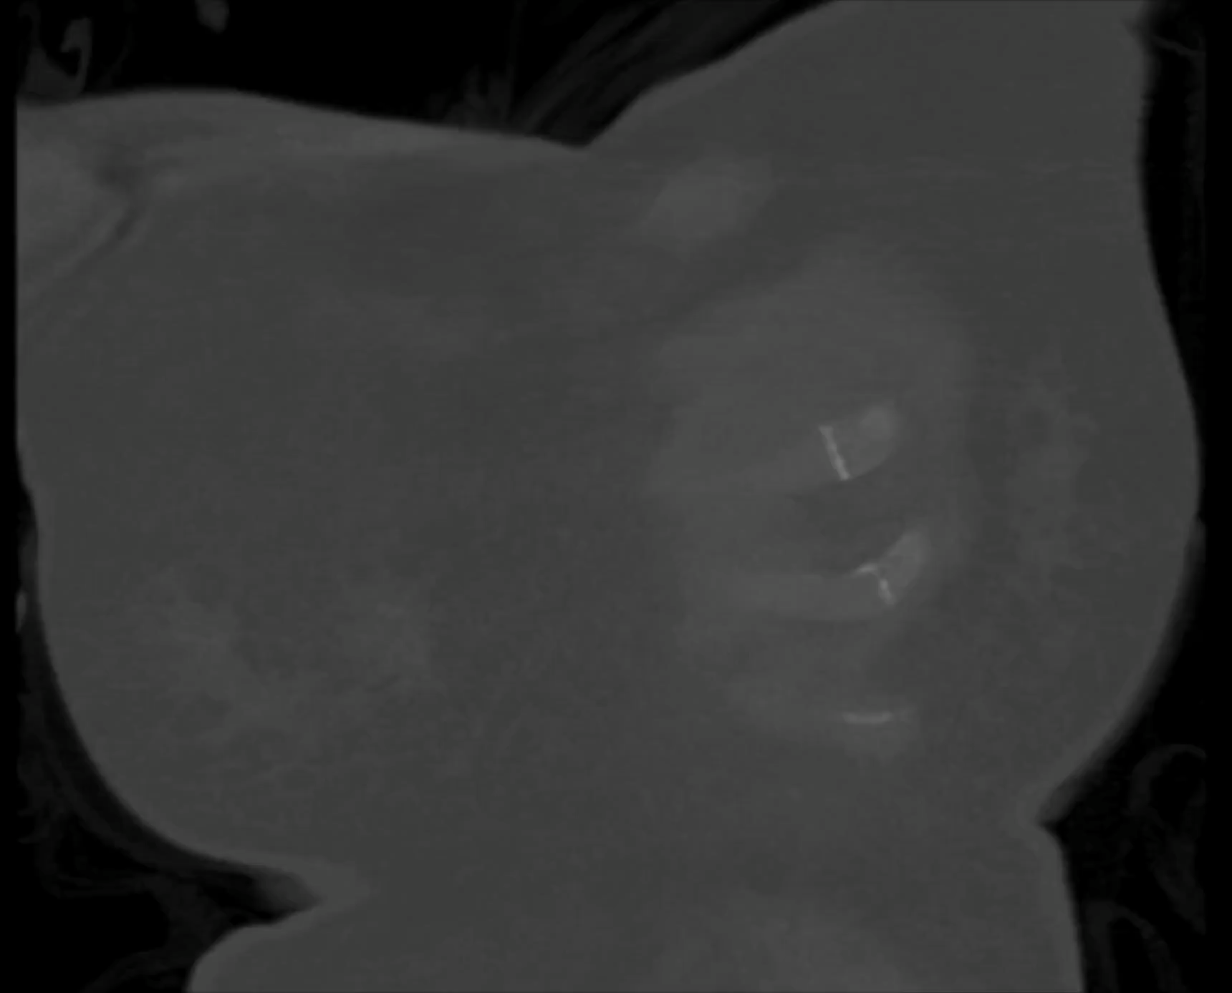
56 YOF with recurrent VTE/PE presenting with worsening DOE despite anticoagulation
HR 120
BP 100/70
RR 22
SpO2 98% on 2L
BNP 2900
Troponin-I 0.042

Slide 7
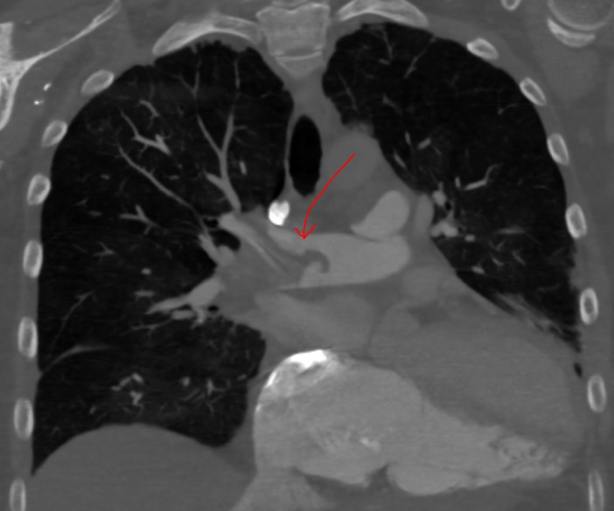
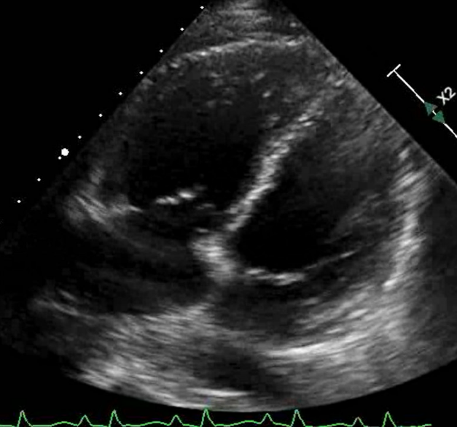
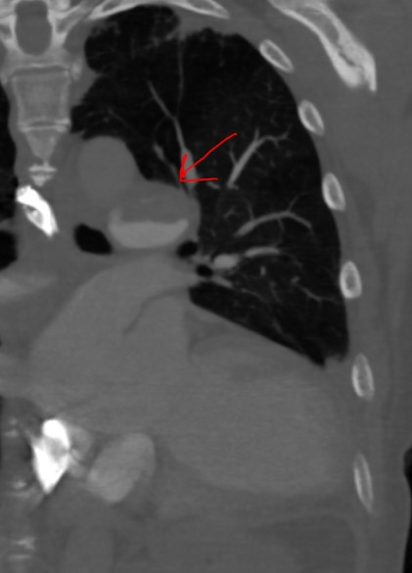
56YOF with recurrent VTE/PE presenting with worsening DOE found to have elevated pressures on RHC
HR 120 BP 100/70 RR 22 SpO2 98% on 2L BNP 2900 troponin-I 0.042
Right heart cath:
  RA 20 PA 74/37|50 PCWP 20 CO 2.93 PVR 10.2 Wood units

Slide 8

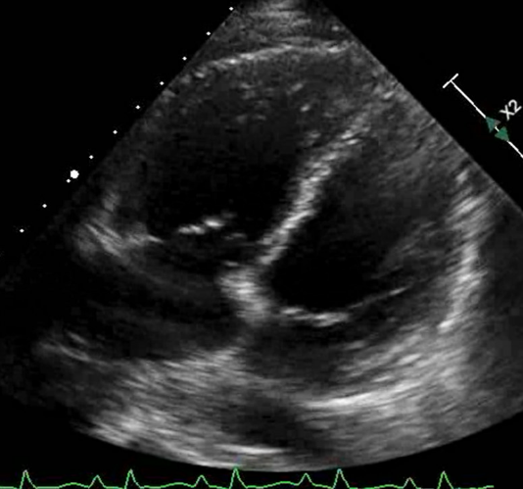

56YOF with recurrent VTE/PE presenting with worsening DOE found to have pre-and post-capillary pulmonary HTN on RHC
RHC: mPAP 50 PCWP 20 CO 2.93 PVR 10.2 Wood units
Diuresed aggressively over the course of several weeks and started on tadalafil and GDMT. Weaned to room air. BNP 2900 → 500
Discharged on anticoagulation, room air at rest and with ambulation, plan to optimize and consider PTE as outpatient

Slide 9
56YOF Crohn’s disease, recurrent VTE, and CTEPH
After months of anticoagulation, tadalafil, and GDMT for left heart disease, functional status steadily improves
Started on macitentan, able to walk on flat surface, but still has DOE with inclined surfaces and hills
Repeat TTE shows PASP improved to 28, improved RV function (TAPSE 22mm)
Discussed at multidisciplinary CTEPH conference, decision to obtain repeat imaging

Slide 10
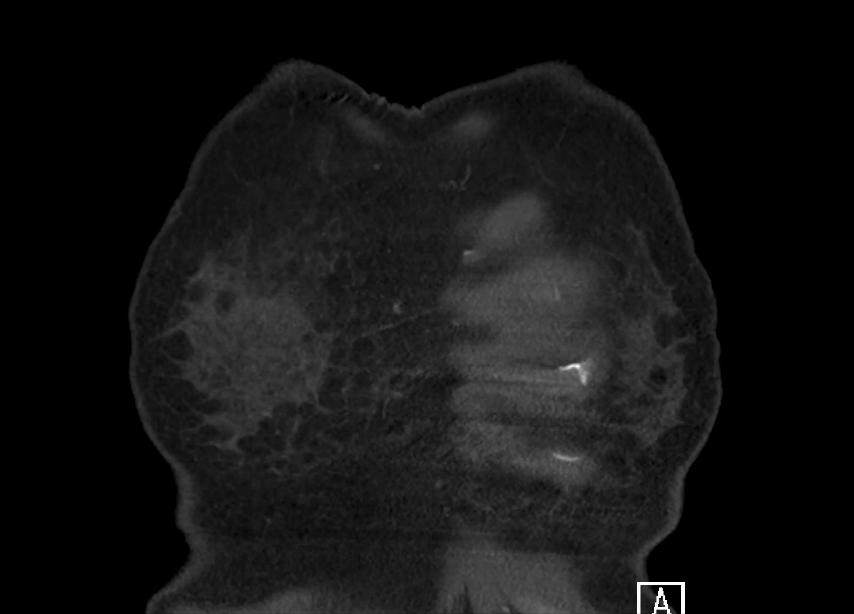
56YOF Crohn’s disease, recurrent VTE, and CTEPH

Slide 11
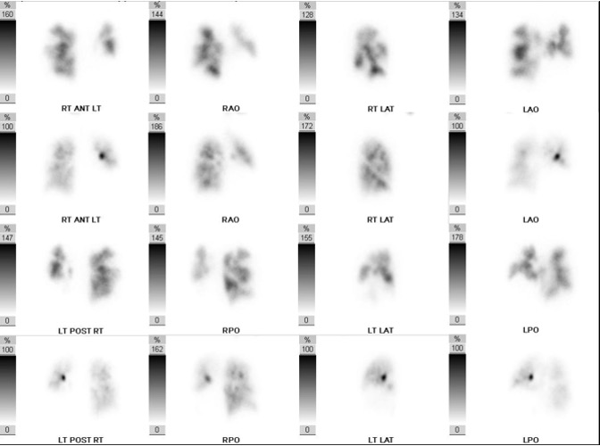
56YOF Crohn’s disease, recurrent VTE and CTEPH

Slide 12
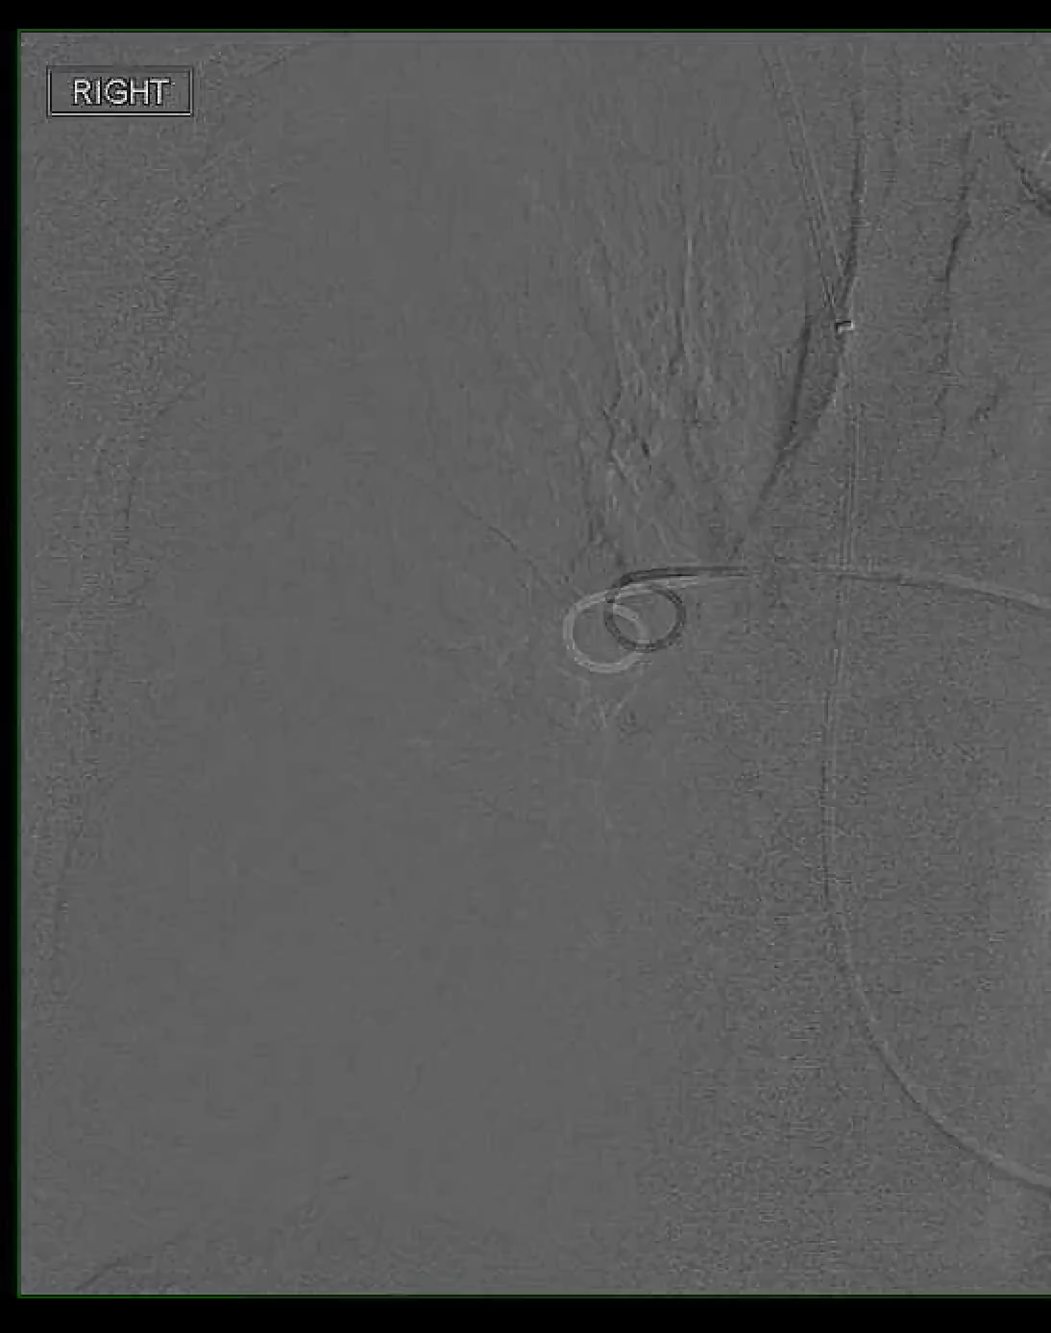
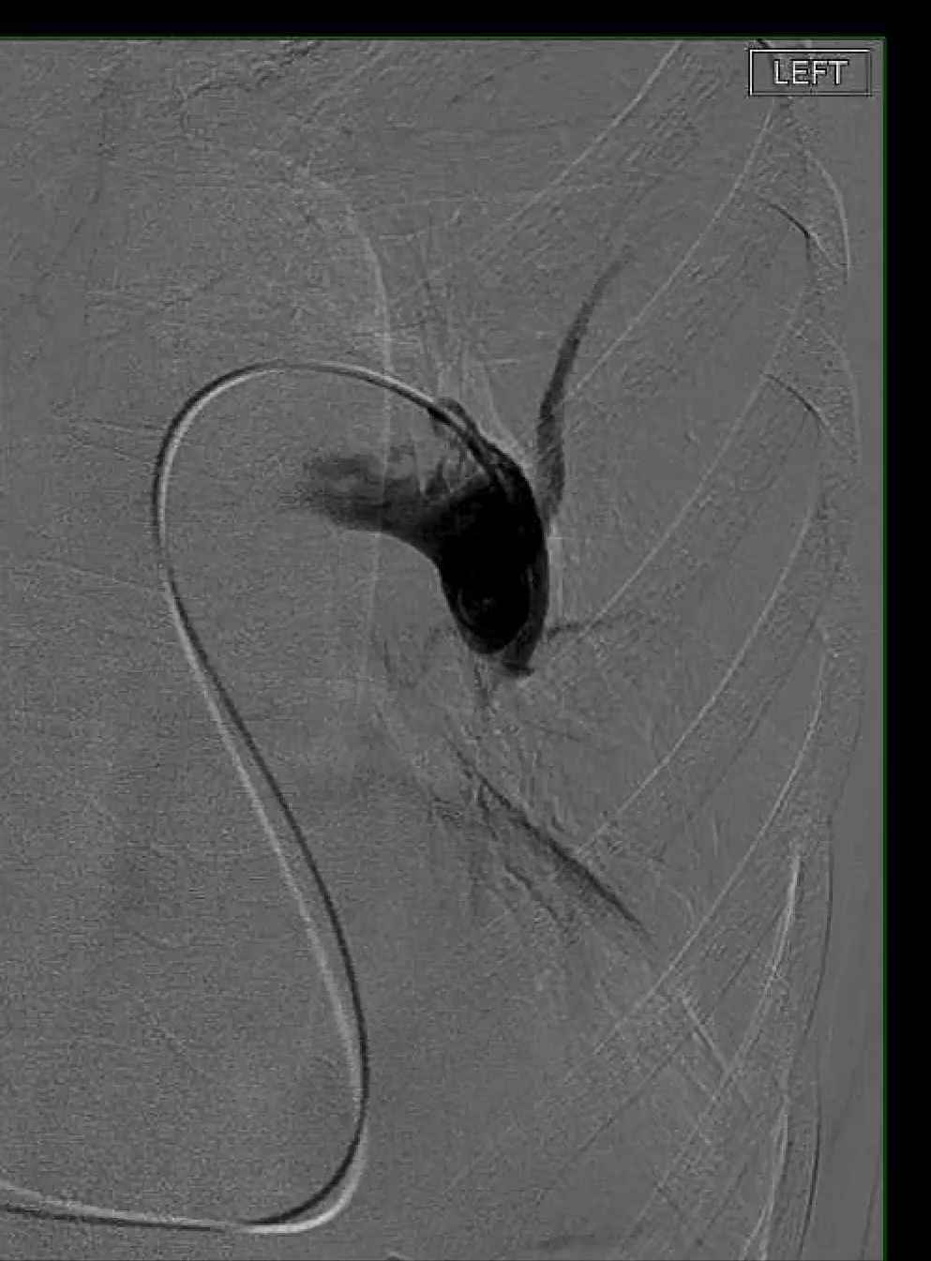

Slide 13
56YOF Crohn’s disease, recurrent VTE, and CTEPH improved but stagnating on 2 drug PAH therapy + AC
Pulmonary arterial angiogram and VQ scan with bilateral filling defects consistent with chronic pulmonary vascular disease
Level 3 CPET:
  mPAP at rest: 26 mmHg
  Exercise-induced hypoxia to SpO2 83%
  mPAP at peak exercise: 53 mmHg
Decision is made to proceed with PTE

Slide 14
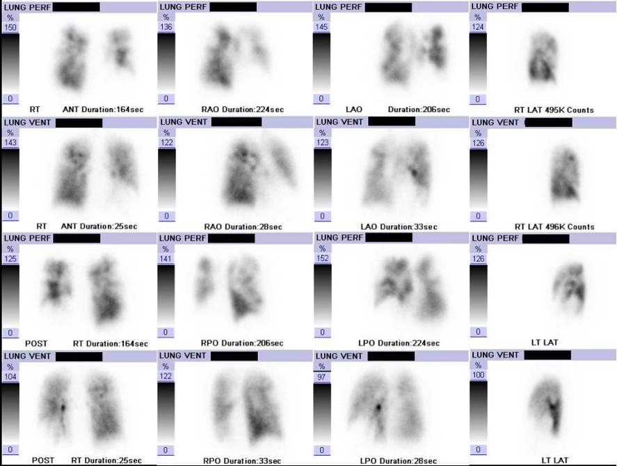
56YOF Crohn’s disease, recurrent VTE, and CTEPH improved but stagnating on 2 drug PAH therapy + AC
Pulmonary arterial angiogram and VQ scan with bilateral filling defects consistent with chronic pulmonary vascular disease
Level 3 CPET:
  mPAP at rest: 26 mmHg
  Exercise-induced hypoxia to SpO2 83%
  mPAP at peak exercise: 53 mmHg
Decision is made to proceed with PTE

Slide 15
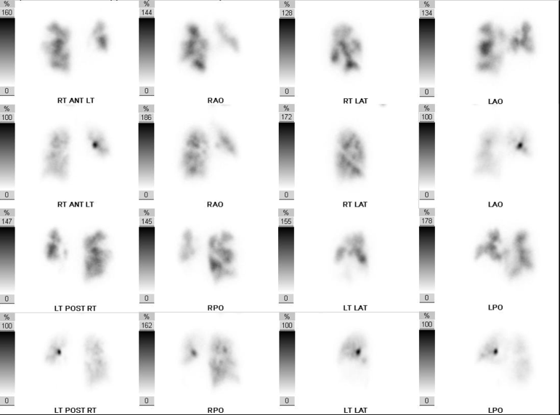
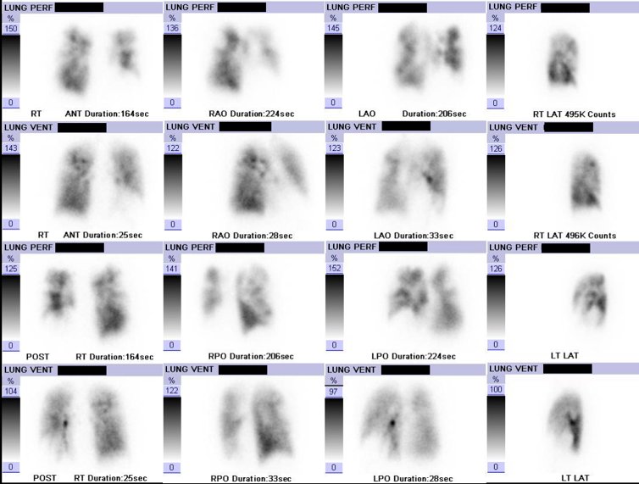
56YOF Crohn’s disease, CTEPH now s/p PTE due to exercise-limiting DOE
After PTE, PAH medications are stopped
Warfarin is eventually transitioned to rivaroxaban + furosemide PRN
Walks greater than 5 mi/day on flat surfaces and inclines, SOB on very steep hills

Slide 16



Looking for more resources
on this topic?
CME/CE in minutes
Congress highlights
Late-breaking data
Quizzes
Webinars
In-person events
Slides & resources
www.MedEdOTG.com

