Slide 1




Saturday, September 9, 2023
9:00am – 3:00pm PT
UCLA Covel Commons | Los Angeles, CA
This activity is supported by independent educational grants from Actelion Pharmaceuticals US, Division of Janssen Pharmaceuticals and United Therapeutics Corporation.
Jointly provided by the Global Learning Collaborative (GLC) and Total CME, LLC.

Slide 2



Resource Information
About This Resource
These slides are one component of a continuing education program available online at MedEd On The Go titled West Regional Pulmonary Hypertension Summit – A Case-Based Look At Diagnosis and Treatment
Program Learning Objectives:
Review essentials of the updated ERS/ESC diagnostic and treatment guidelines and emerging medical entities for treatment
Discuss current concepts on diagnosis and treatment of CTEPH and CTED with a real-world focus
Debate the importance and practice of screening for, diagnosing, and treating PAH associated with connective tissue disease
Learn the essentials of cardiopulmonary exercise testing for the detection and diagnosis of pulmonary hypertension
Consider lessons from the symposium in light of real-world case examples
MedEd On The Go®
www.mededonthego.com
This content or portions thereof may not be published, posted online or used in presentations without permission.
This content can be saved for personal use (non-commercial use only) with credit given to the resource authors.
To contact us regarding inaccuracies, omissions or permissions please email us at support@MedEdOTG.com

Slide 3
Disclaimer
The views and opinions expressed in this educational activity are those of the faculty and do not necessarily represent the views of Total CME, LLC, the CME providers, or the companies providing educational grants. This presentation is not intended to define an exclusive course of patient management; the participant should use their clinical judgment, knowledge, experience, and diagnostic skills in applying or adopting for professional use any of the information provided herein. Any procedures, medications, or other courses of diagnosis or treatment discussed or suggested in this activity should not be used by clinicians without evaluation of their patient's conditions and possible contraindications or dangers in use, review of any applicable manufacturer’s product information, and comparison with recommendations of other authorities. Links to other sites may be provided as additional sources of information.

Slide 4

Diagnosis & Treatment of Chronic Thromboembolic Pulmonary Hypertension
Sonia Jasuja, MD
David Geffen School of Medicine at UCLA
Los Angeles, CA

Slide 5
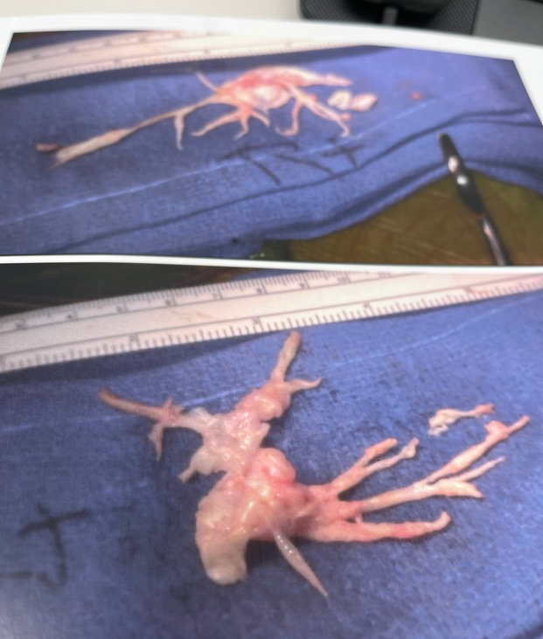
Overview
Terminology
Follow-up of acute PE
CTEPH pathophysiology and diagnosis
CTEPH/CTED treatment: Surgery vs BPA
Images courtesy of Richard Shemin, MD

Slide 6
Let’s Start with Terminology
Post-PE Syndrome: Persistent dyspnea, exercise limitation, and impaired quality of life that persist for longer than 3 months after effective anticoagulation for acute PE
CTEPH: Resting precapillary pulmonary hypertension (PAP mean greater than 20 mmHg, PCW less than 16 mmHg, PVR greater than 3 WU) caused by chronic thromboemboli
CTED or CTEPD: Normal resting hemodynamics, but symptoms and imaging consistent with chronic thromboemboli
CTEPH, chronic thromboembolic pulmonary hypertension; CTED, chronic thromboembolic disease.

Slide 7
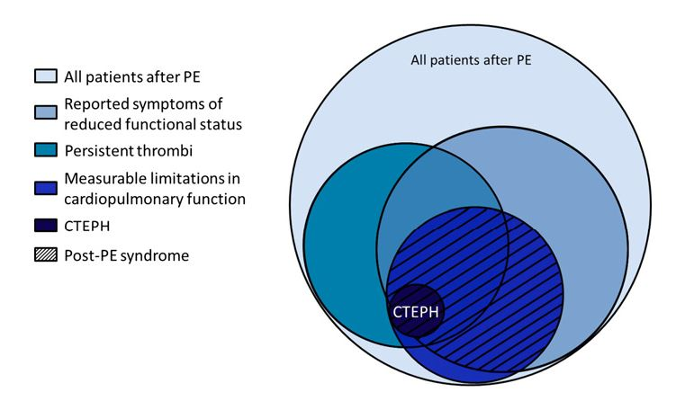
Post PE Syndrome:
Spectrum of Disease from Acute to Chronic
Klok FA, et al. Blood Rev. 2014;28(6):221-6.

Slide 8
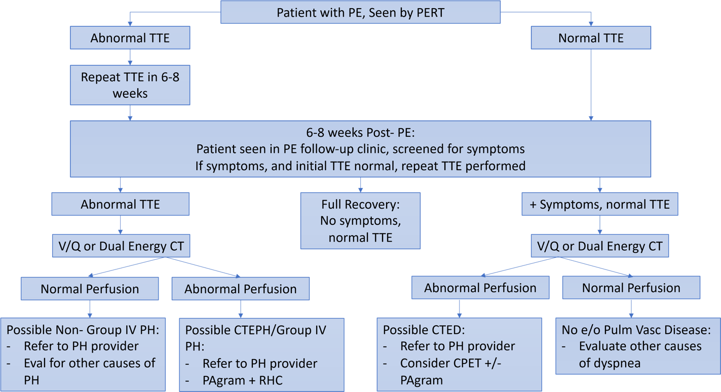
Clear Message: Need to Follow Up After Acute PE
Jasuja S, et al. Adv Pulm Hypertens. 2022; 21(3): 60-5).

Slide 9
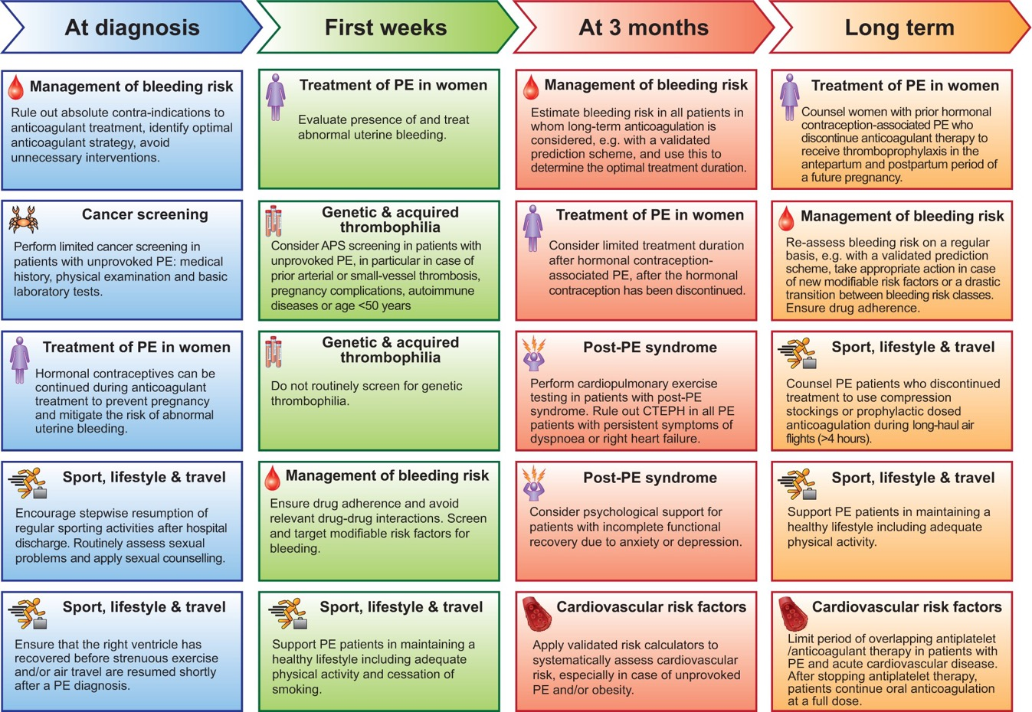

Comprehensive Approach

Slide 10
What is CTEPH?
Acute PE
Incomplete dissolution
Hemodynamically significant
Not hemodynamically
significant
Complete resolution

Slide 11
Risk Factors for CTEPH
PE-related
Medical Conditions
  Previous PE
  Larger perfusion defect
  Unprovoked PE at presentation
  Indwelling catheters
  Presence of a ventriculoatrial shunt or infected pacemaker
  Splenectomy
  Chronic inflammation (osteomyelitis, inflammatory bowel disease)
  Lupus anticoagulant
  Non O blood type

Slide 12
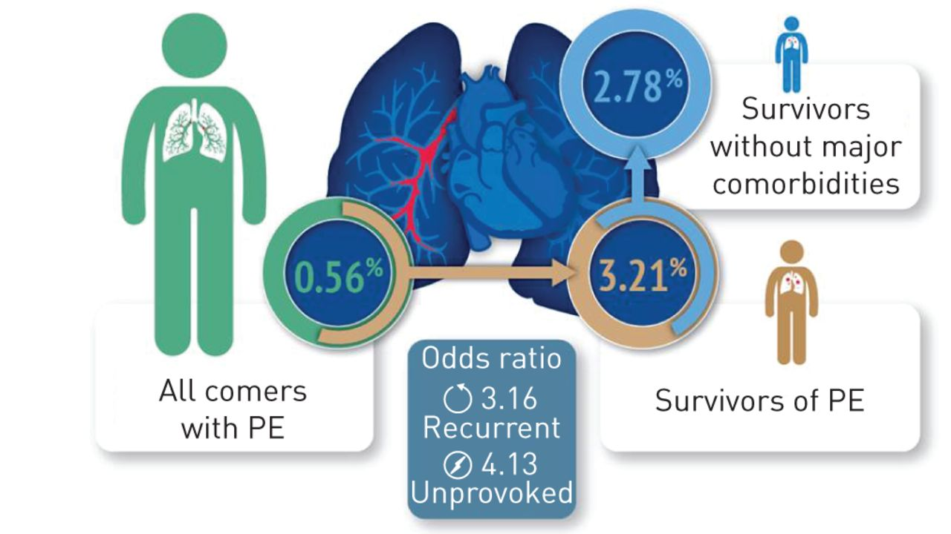
Incidence of CTEPH After Acute PE
Ende-Verhaar YM, et al. Eur Respir J. 2017;49:1601792.

Slide 13
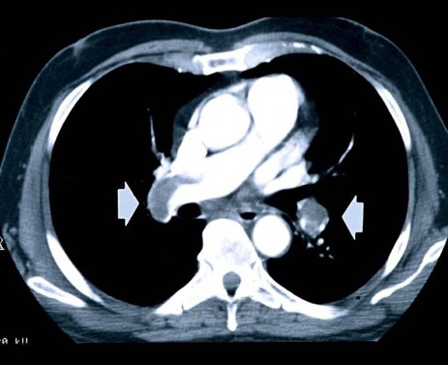
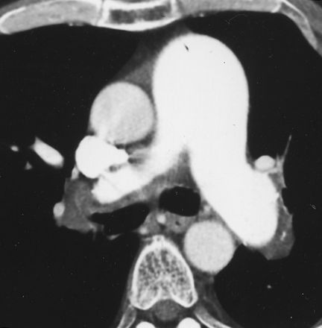
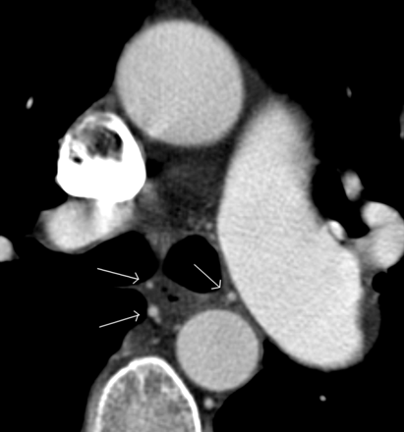
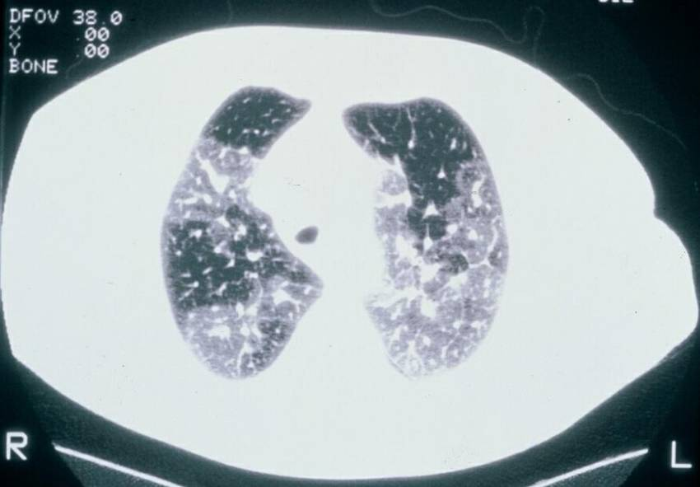
CTEPH: CTA Findings
Eccentric thrombus
Lining thrombus, enlarged main PA
(PH)
Bronchial arterial collateral vessels
Mosaic perfusion

Slide 14
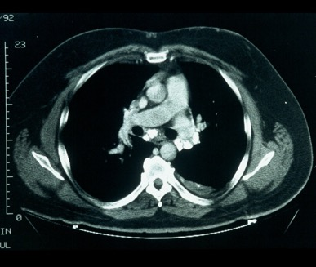
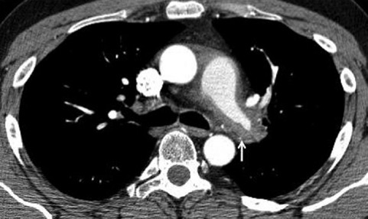
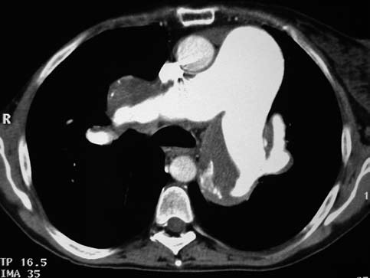
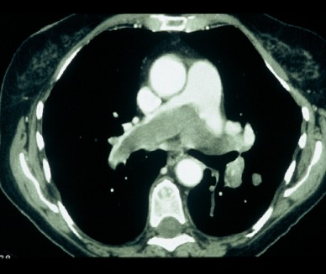
Don’t Forget Mimics of CTEPH
Fibrosing mediastinitis
Pulmonary vasculitis
Pulmonary artery sarcoma
Lining thrombus in PAH patient

Slide 15
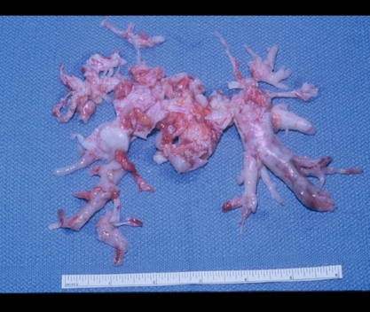
Don’t Forget Mimics of CTEPH
Fibrosing mediastinitis
Pulmonary vasculitis
Pulmonary artery sarcoma
Lining thrombus in PAH patient

Slide 16
Diagnosis of CTEPH
Suspect
Echocardiogram
VQ Scan
Confirm
Right Heart Catheterization
Pulmonary Angiogram
(or CTPA, MRA)
Assess Risk
Hemodynamics
Comorbidities
Surgeon/CTEPH Team Experience

Slide 17
Pulmonary Angiography
Gold standard, confirms diagnosis of CTEPH
Provides anatomic “map” for surgery
Single injection of contrast into each PA
Biplane acquisition provides best anatomic detail
Provides information about location and surgical accessibility
Appearance is different than well-defined intraluminal filling defects of acute PE

Slide 18
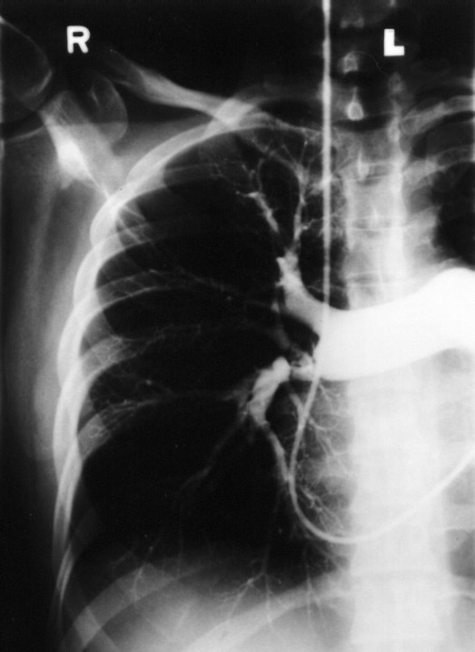
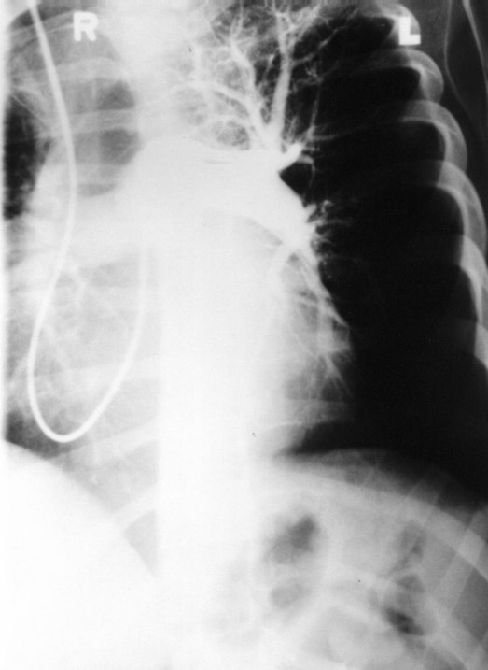
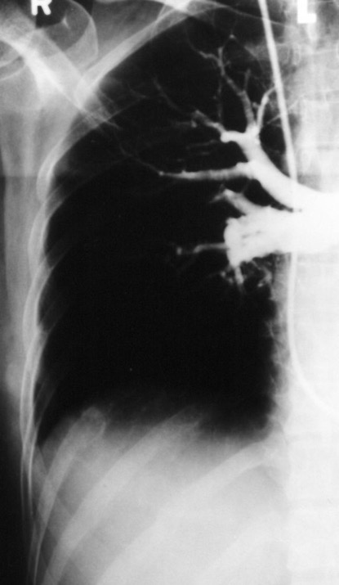
Pulmonary Angiogram Findings
Abrupt vessel narrowing
Pouches, bands
Cutoffs

Slide 19
Assessment Factors to Consider for PTE
Advanced
secondary
arteriopathy?
Proximal,
accessible
lesions
mPAP
≥40 mm Hg
Patient
consent
PTE*
PVR >300
dyn•s/cm⁵
Absence of
severe
comorbidity
NYHA
functional
Class III/IV
Surgical
expertise
*PTE = pulmonary thromboendarterectomy
Rubin LJ, et al. Proc Am Thorac Soc. 2006; 3(7):601-7.

Slide 20
Contraindications to PTE/PEA
Absolute contraindications
  Inoperable CTEPH
  Severe chronic lung disease
  Lack of informed consent
Not considered absolute contraindications
  Advanced age
  Concomitant cardiac disease
  Severe right ventricular failure
  Renal and hepatic insufficiency
  Malignancy with reasonable survival expectations

Slide 21
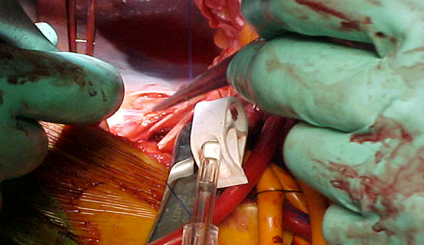
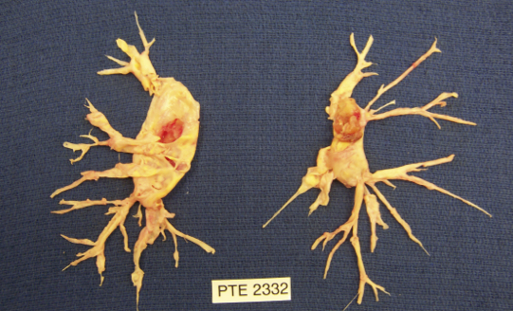
PEA: The Surgical Technique
Median sternotomy with CPB enabling gradual cooling to 20°C and safe arrest of the circulation
DHCA initiated when blood obscures the surgical field and provides a clear operating field
DHCA is limited to approximately 20 min intervals
Usually one DHCA period is enough for the dissection to be completed on each side
Identification of correct plane crucial to prevent perforation of pulmonary artery while permitting adequate removal of thromboembolic material
CPB, cardiopulmonary bypass; DHCA, deep hypothermic circulatory arrest.
Madani MM, Jamieson SW. Oper Tech Thorac Cardiovasc Surg. 2006; 11(4):264–74; Vuylsteke A, et al. Lancet. 2011; 378(9800):1379–87.

Slide 22
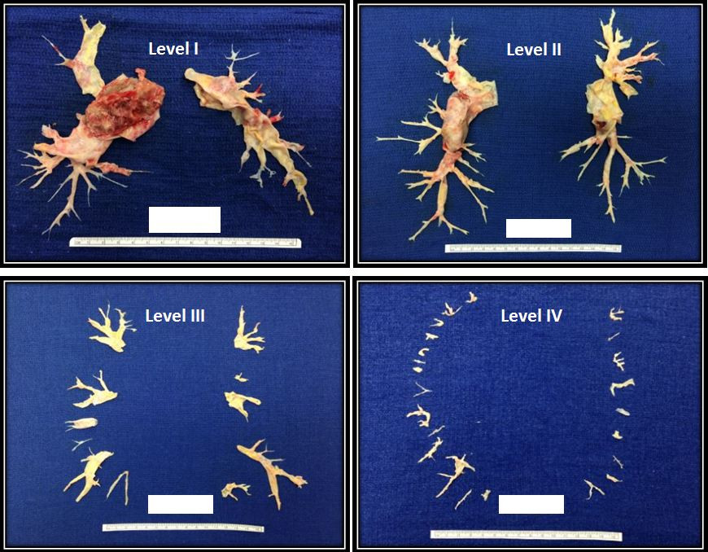
UCSD Surgical Classification System
Kim NH. Proc Am Thorac Soc. 2006;3(7):584–88.

Slide 23
The UCSD Experience: Outcomes of 2700 PTE Surgeries
Variable | Period | Value
PVR (dynes/ sec/cm⁵) | Pre-Op | 719
 | Post-Op | 253
Cardiac output (L/min) | Pre-Op | 4.3
 | Post-Op | 5.6
Mean PAP (mm Hg) | Pre-Op | 46
 | Post-Op | 26
1.0
0.8
0.6
Cumulative Survival
0.4
0.2
0.0
0
2
4
6
8
10
12
14
Years survived since surgery
n = 500, enrolled between October 2006 and December 2010
In-hospital mortality = 2.2%
n = 1410, enrolled between March 1999 and December 2010
Madani MM, et al. Ann Thorac Surg. 2012;94(1):97-103.

Slide 24
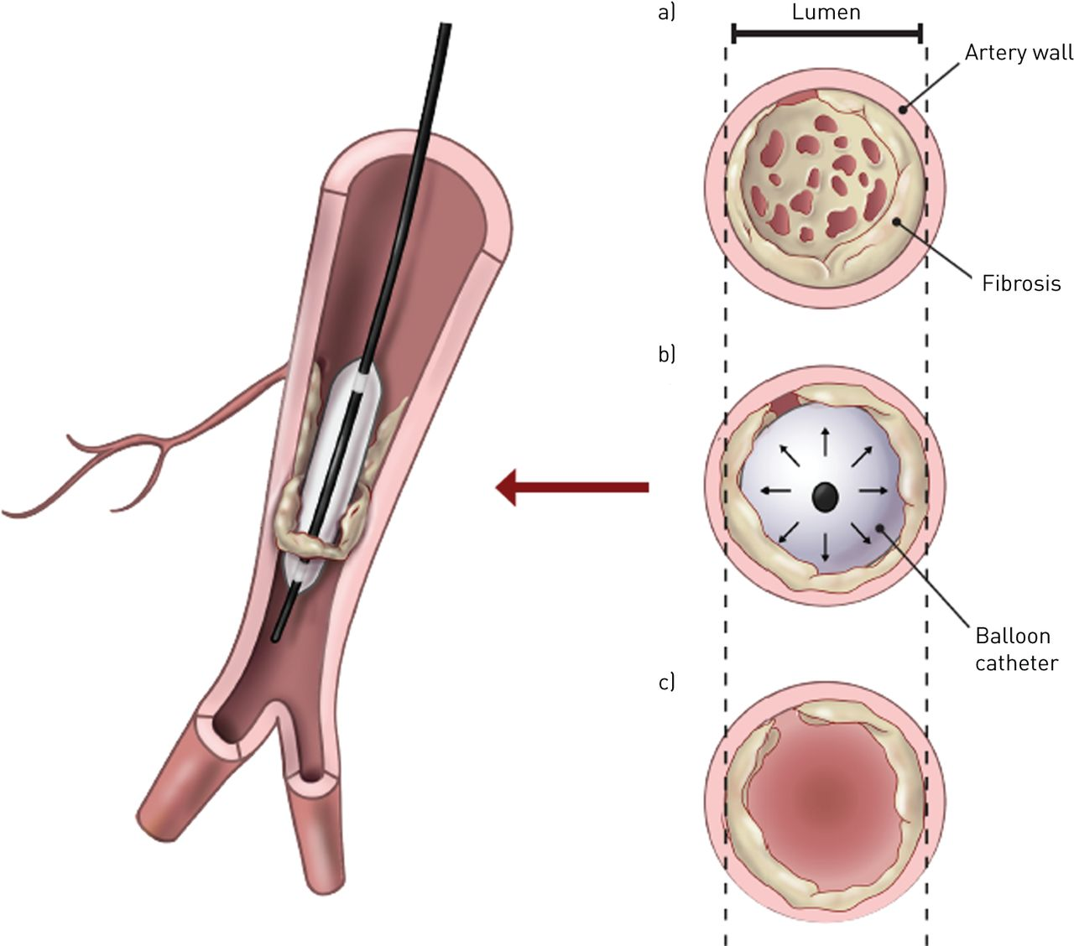
Balloon Pulmonary Angioplasty
Indicated for non-operable CTEPH patients
Delcroix M et al. Eur Respir J. 2021;57(6):2002828.

Slide 25
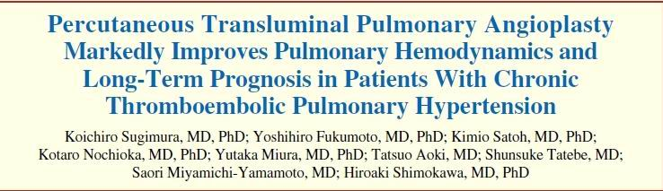
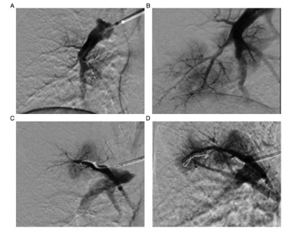
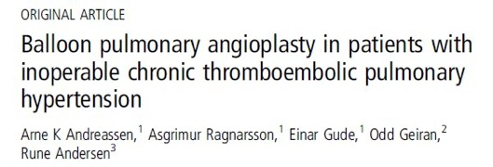
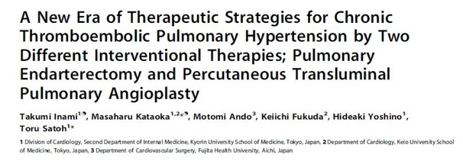
Balloon Pulmonary Angioplasty
Circ J. 2012; 76(2):485-8.
Heart . 2013; 99(19):1415-20.
PloS One. 2014; 9(4):e94587.

Slide 26
BPA Considerations
One lung at a time
3 to 5 vessels treated per session
3 sets of procedures often needed
Hemodynamics improve over time
Perfusion scan prior to each procedure helpful
Lung injury associated with BPA is primarily from mechanical vascular injury (wire manipulation vs balloon dilation) rather than reperfusion pulmonary edema

Slide 27
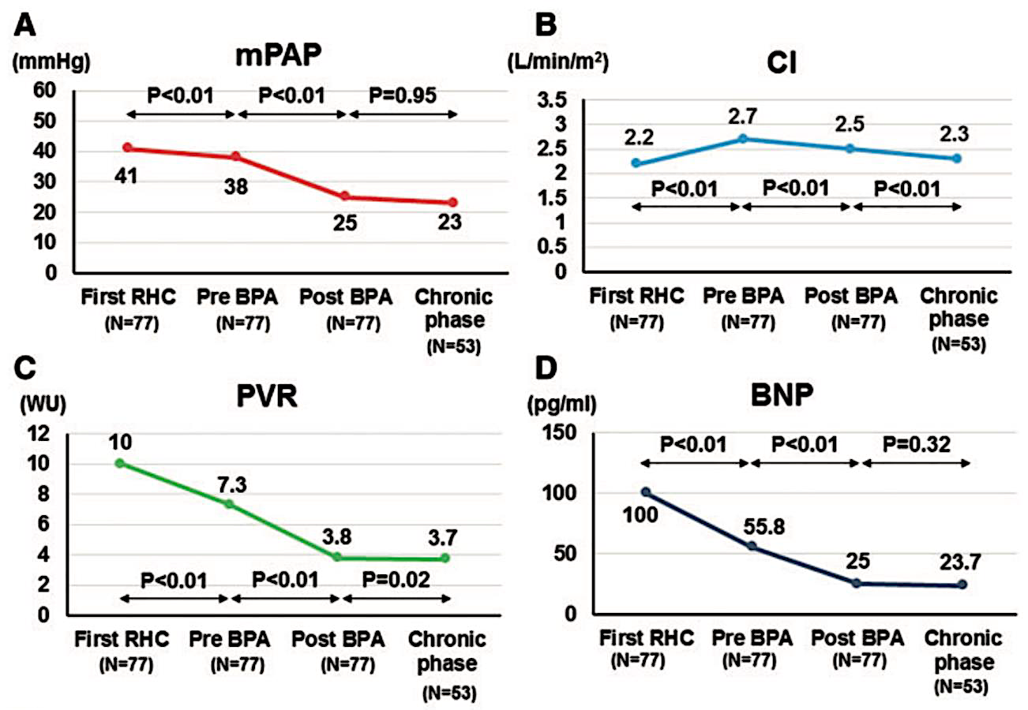

Changes in Hemodynamics, Exercise Capacity, and BNP Before and After BPA
Aoki T, et al. Eur Heart J. 2017;38(42):3152-59.

Slide 28
RCTs of Medical Therapies for CTEPH
 | CHEST-1¹ | Suntharalingam² | MERIT-1³ | BENEFiT⁴
Patients, n | 261 | 19 | 80 | 157
Active Treatment | Riociguat | Sildenafil | Macitentan | Bosentan
Control | Placebo | Placebo | Placebo | Placebo
Treatment Duration (w) | 16 | 12 | 24 | 16
Population, n (%)
Inoperable | 189 (72.4) | 10 (52.6) | 80 (100) | 96 (70.1)
Persistent/Recurrent PH post-PEA | 72 (27.6) | 9 (47.4) | 0 | 41 (29.9)
Baseline PH Therapy n (%)
No | 261 (100) | 19 (100) | 31 (38.8) | 157 (100)
Yes | 0 | 0 | 49 (61.3) | 0
Primary Endpoint | Δ6MWD | Δ6MWD | PVR at week 16 % of BL | Δ6MWD and PVR, co-1º EP
Treatment Effect, 6MWD | +46 (25–67) m, p<0.001 | +18 (-24–59) m, p=NS | +34 (3–65) m, p<0.05 | +2 (-23–27) m, p=NS
Treatment Effect, PVR | -246 (-303–190) dyn·s·cm⁻⁵, p<0.001 | -197 (-389–6) dyn·s·cm⁻⁵, p<0.05 | 0.84 (0.70–0.99), p<0.05 | -24%§(-32–16%), p<0.0001
Treatment Effect, mPAP | -5 (-7–3) mmHg, p<0.001 | -6 (-12–0) mmHg, p=NS | -2 (-6–2) mmHg, p=NS | -3 (-5–0) mmHg, p=NS
Madani M, et al. Eur Respir Rev. 2017;26(146):170105.

Slide 29
Treatment Algorithm for CTEPH
Diagnosis of CTEPH Confirmed By Expert PH Center
Lifelong Anticoagulation
Operability Assessment by a
Multidisciplinary CTEPH Team
Technically Operable
Technically Non-Operable
Acceptable
Risk/Benefit Ratio
Non-Acceptable
Risk/Benefit Ratio
Targeted Medical
Therapy
Pulmonary
Endarterectomy
Persistent
Symptomatic PH
Consider BPA
In Expert Center
Consider Lung
Transplantation
Persistent Severe
Symptomatic PH
Madani M, et al. Eur Respir Rev. 2017;26(146):170105.

Slide 30
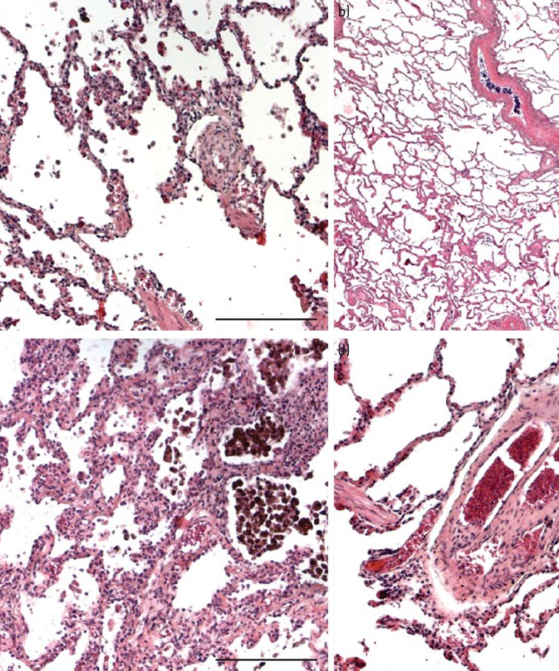
Conclusions
CTEPH is difficult to diagnose, important to have follow-up after PE events
Diagnosis of CTEPH requires high index of suspicion, and patients should be referred to CTEPH centers early in the diagnostic workup
PTE remains the gold standard treatment for operable CTEPH cases.
Treatment plan is formulated amongst a multidisciplinary team of physicians
Delcroix M, et al. Eur Respir J. 2021;57(6):2002828.

Slide 31



Looking for more resources
on this topic?
CME/CE in minutes
Congress highlights
Late-breaking data
Quizzes
Webinars
In-person events
Slides & resources
www.MedEdOTG.com

