Slide 1




Saturday, September 9, 2023
9:00am – 3:00pm PT
UCLA Covel Commons | Los Angeles, CA
This activity is supported by independent educational grants from Actelion Pharmaceuticals US, Division of Janssen Pharmaceuticals and United Therapeutics Corporation.
Jointly provided by the Global Learning Collaborative (GLC) and Total CME, LLC.

Slide 2



Resource Information
About This Resource
These slides are one component of a continuing education program available online at MedEd On The Go titled West Regional Pulmonary Hypertension Summit – A Case-Based Look At Diagnosis and Treatment
Program Learning Objectives:
Review essentials of the updated ERS/ESC diagnostic and treatment guidelines and emerging medical entities for treatment
Discuss current concepts on diagnosis and treatment of CTEPH and CTED with a real-world focus
Debate the importance and practice of screening for, diagnosing, and treating PAH associated with connective tissue disease
Learn the essentials of cardiopulmonary exercise testing for the detection and diagnosis of pulmonary hypertension
Consider lessons from the symposium in light of real-world case examples
MedEd On The Go®
www.mededonthego.com
This content or portions thereof may not be published, posted online or used in presentations without permission.
This content can be saved for personal use (non-commercial use only) with credit given to the resource authors.
To contact us regarding inaccuracies, omissions or permissions please email us at support@MedEdOTG.com

Slide 3
Disclaimer
The views and opinions expressed in this educational activity are those of the faculty and do not necessarily represent the views of Total CME, LLC, the CME providers, or the companies providing educational grants. This presentation is not intended to define an exclusive course of patient management; the participant should use their clinical judgment, knowledge, experience, and diagnostic skills in applying or adopting for professional use any of the information provided herein. Any procedures, medications, or other courses of diagnosis or treatment discussed or suggested in this activity should not be used by clinicians without evaluation of their patient's conditions and possible contraindications or dangers in use, review of any applicable manufacturer’s product information, and comparison with recommendations of other authorities. Links to other sites may be provided as additional sources of information.

Slide 4

Case Study: CTD-PAH
Siyuan Cao, MD
University of California, Los Angeles
Los Angeles, CA

Slide 5
Case Presentation
61-year-old female with likely Sjogren's, CTD-ILD, presents for evaluation of pulmonary hypertension after TTE with ePASP 86.4 mmHg
Breathing problems since age ~47 yo, s/p lung biopsy with interstitial pneumonitis requiring several days of mechanical ventilation and was on prednisone for 2 years
~6 months prior to presentation, ECG during annual physical with a "glitch" and referred to cardiology.
TTE with RV pressure overload and ePASP 86.4 mmHg
2 months prior to presentation, fainted in setting of feeling dizzy when getting up to go to the bathroom.
Functional capacity can walk "unlimited" on flat ground at slow pace. Rare chest pressure or heaviness with exertion. Occasional exertional lightheadedness
Rheumatologic history: Raynauds since age ~49 yo, history of joint pains and rash, difficulty swallowing x5 years s/p esophageal dilation. Ultimately diagnosed with likely Sjogren's given sicca syndrome, +ANA, +SSA)
Social history: Smoked x20 years, 3 cigarettes/day, quit age ~40 yo
ANA, antinuclear antibody; CTD-ILD, connective tissue disease-associated interstitial lung disease; ECG, electrocardiogram; ePASP, estimated pulmonary artery systolic pressure; s/p, status post; SSA, Sjogren’s-syndrome related antigen A autoantibodies; RV, right ventricle; TTE, transthoracic electrocardiogram; yo, years old.

Slide 6
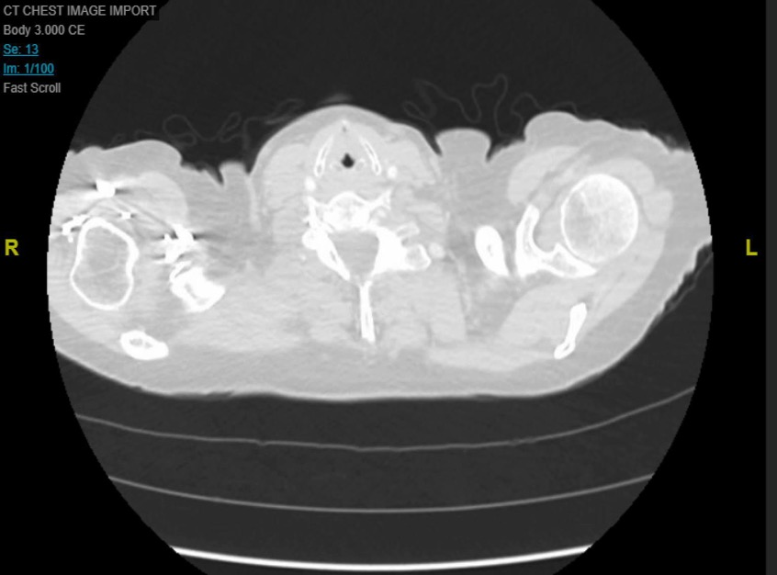
CT Chest Without Contrast
61-year-old female with likely Sjogren's, CTD-ILD, presents for evaluation of pulmonary hypertension after TTE with ePASP 86.4 mmHg

Slide 7
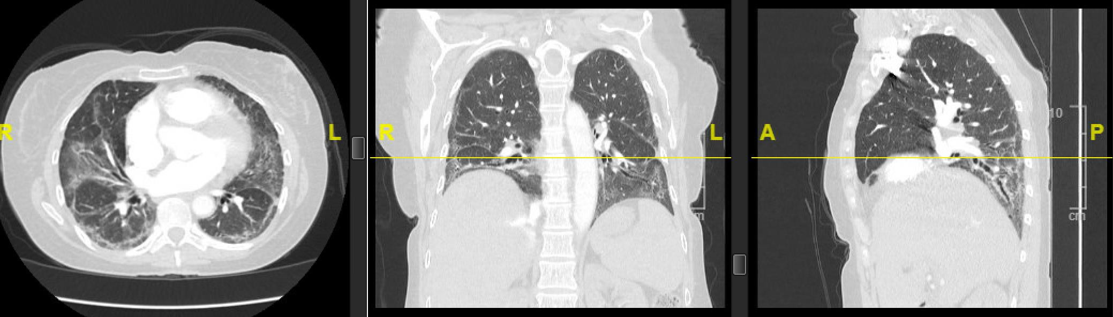
CT Chest Without Contrast
61-year-old female with likely Sjogren's, CTD-ILD, presents for evaluation of pulmonary hypertension after TTE with ePASP 86.4 mmHg

Slide 8
Pulmonary Function Test
61-year-old female with likely Sjogren's, CTD-ILD, presents for evaluation of pulmonary hypertension after TTE with ePASP 86.4 mmHg
PFT
  FVC 1.58 (55% predicted)
  FEV1 1.35 (58% predicted)
  FEV1/FVC 88%
  TLC 2.83 (60% predicted)
  DLCO 6.0 (33% predicted)
6-minute walk 351 meters. SpO2 94% -> 96%
DLCO, diffusing capacity of lung for carbon monoxide; FEV1, forced expiratory volume in 1 second; FVC, forced vital capacity; TLC, total lung capacity; PFT, pulmonary function test; SpO2, oxygen saturation.

Slide 9
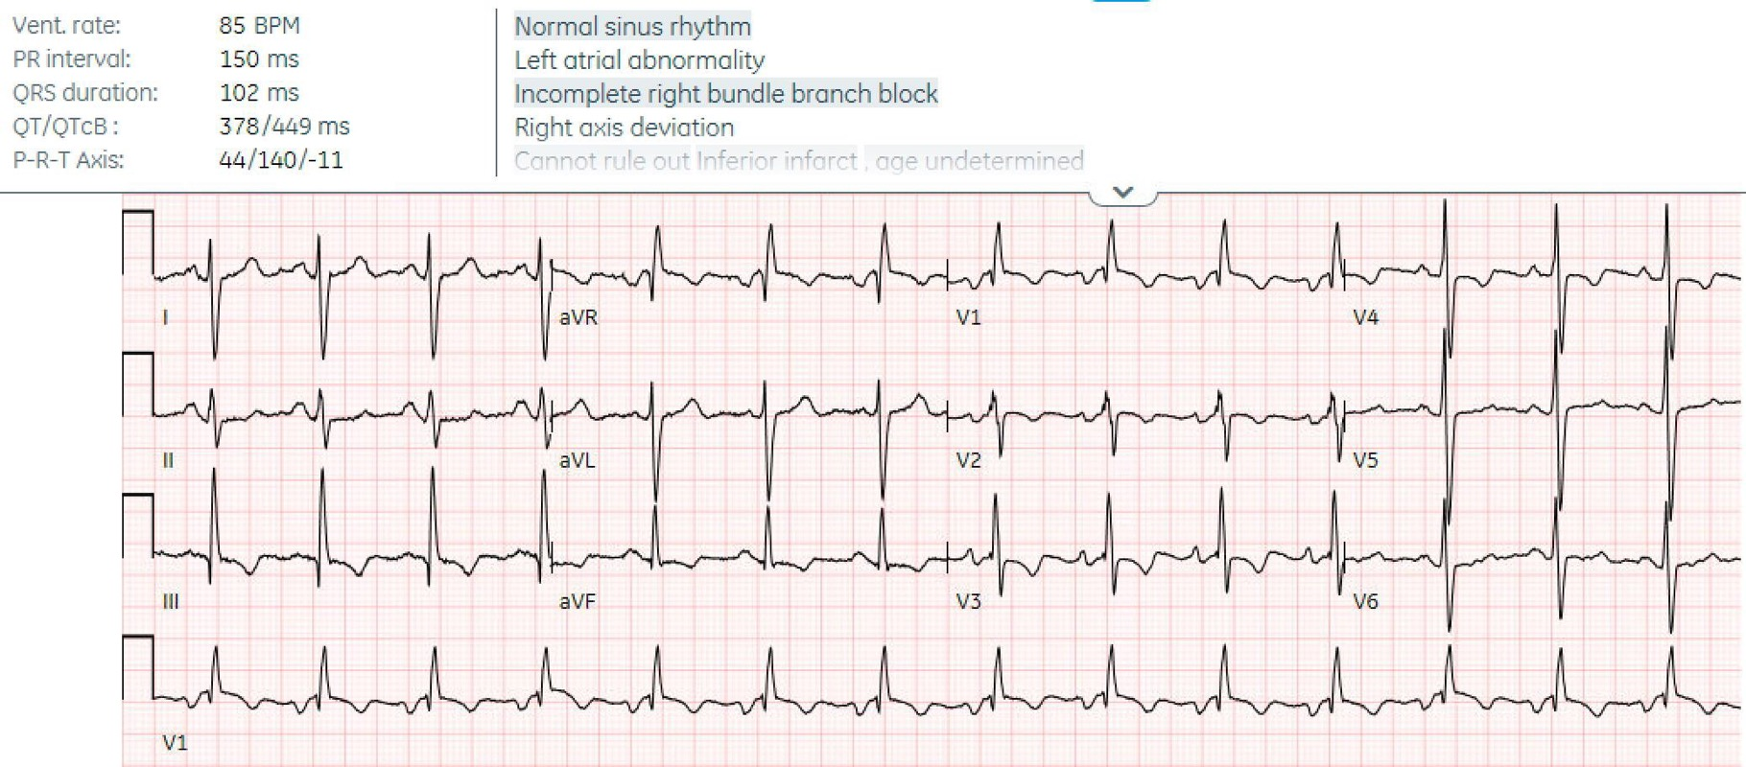
Electrocardiogram
BPM, beats per minute.

Slide 10
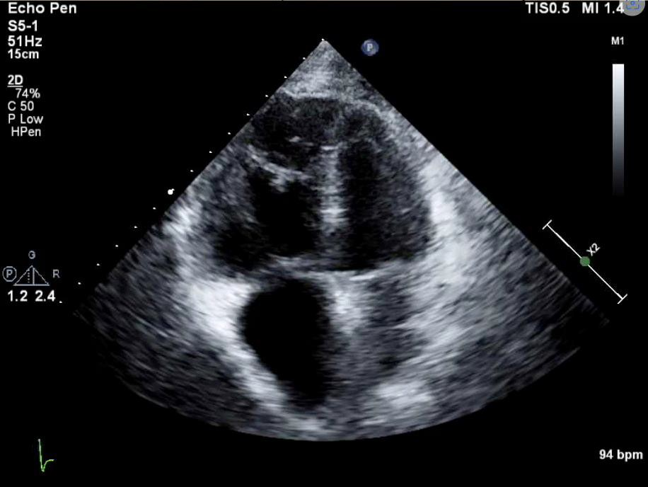
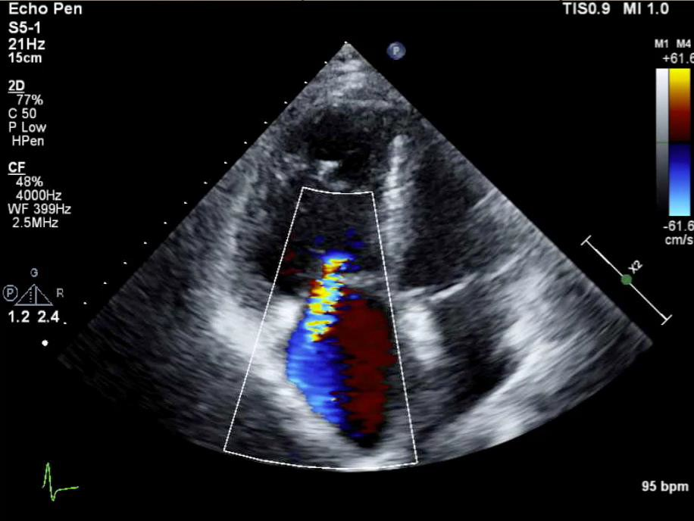
Transthoracic Echocardiogram
61-year-old female with likely Sjogren's, CTD-ILD, presents for evaluation of pulmonary hypertension after TTE with ePASP 86.4 mmHg.

Slide 11
Right heart catheterization
61-year-old female with likely Sjogren's, CTD-ILD, presents for evaluation of pulmonary hypertension after TTE with ePASP 86.4 mmHg
RHC: Severe precapillary pulmonary hypertension related to CTD. No evidence for acute vasoreactivity to iNO.
Baseline: rest
  RA 7 (mean)/13 (v-wave) mmHg
  RV 95/2/15 mmHg
  PA 96/39/58 mmHg
  PCWP 15 (mean) mmHg /no significant v wave
  CO (Thermodilution) 1.63 L/min -> CI 1.01 L/min
  PVR 26.4 Wood units
  Mixed venous O2 on room air 60.8%
Condition 2: iNO 40 ppm and 3L O2 by nasal cannula
  PA 88/40/56 mmHg
  CO 2.09
CI, cardiac index; CO, cardiac output; CTD, connective tissue disease; iNO, inhaled nitric oxide; PA, pulmonary arterial pressure; PCWP, pulmonary capillary wedge pressure; PVR, pulmonary venous resistance; RV, right ventricle;

Slide 12
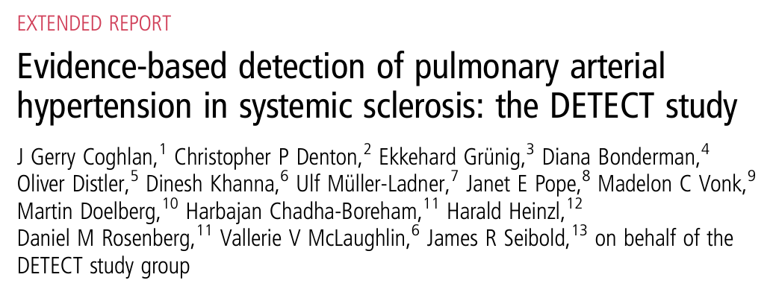
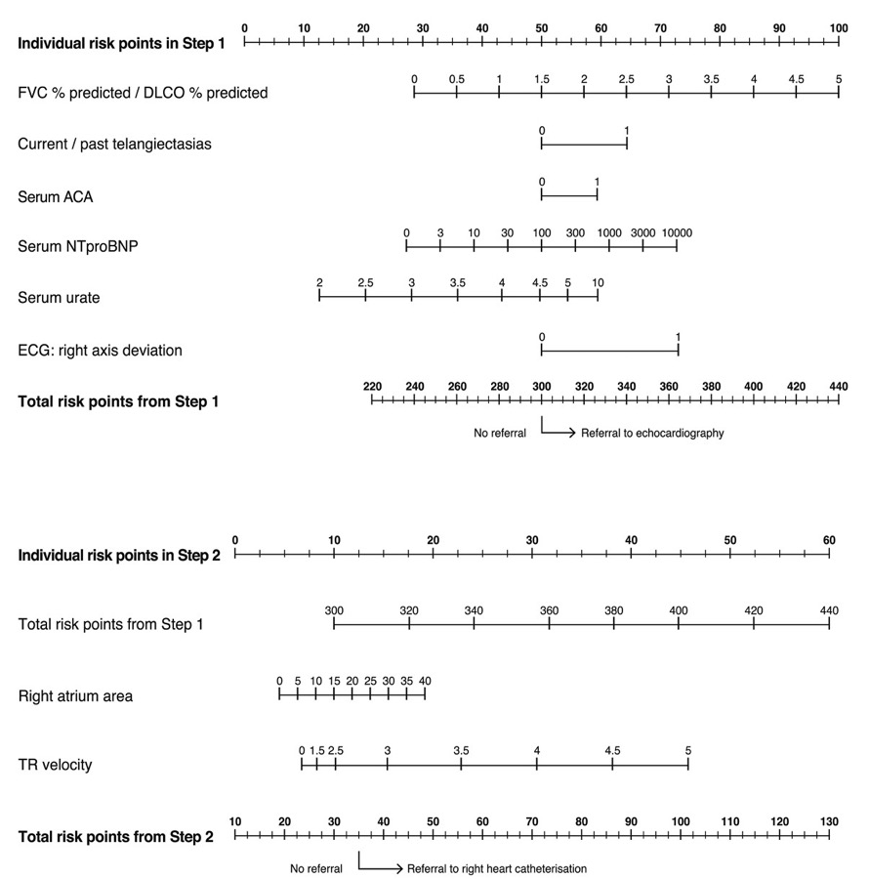
To RHC or Not to RHC?
FVC % predicted/DLCO % predicted: 1.67
BNP 851 (assuming ratio of NT-proBNP to BNP 6.25:1 from Rørth R, et al., 2020)
Original urate not available; uric acid after starting treatment: 8.0 mg/dL
Original TTE unavailable; TTE after starting treatment:
  RA area not available
  TR Max Velocity: 4.7 m/s
ACA, anti-cardiolipin antibodies; BNP, brain natriuretic peptide; NT-proBNP, N-terminal pro-B-type natriuretic peptide; RA, right atrium; RHC, right heart catheterization; TR, tricuspid regurgitation.
Coghlan GJ, et al. Ann Rheum Dis. 2014;73(7):1340-9; Rørth R, et al. Circ Heart Fail. 2020; 13(2):e006541.

Slide 13



Looking for more resources
on this topic?
CME/CE in minutes
Congress highlights
Late-breaking data
Quizzes
Webinars
In-person events
Slides & resources
www.MedEdOTG.com

