Slide 1
Saturday, September 9, 2023 9:00am – 3:00pm PT
UCLA Covel Commons | Los Angeles, CA
This activity is supported by independent educational grants from Actelion Pharmaceuticals US, Division of Janssen Pharmaceuticals and United Therapeutics Corporation. Jointly provided by the Global Learning Collaborative (GLC) and Total CME, LLC.

Slide 2
Resource Information
About This Resource
These slides are one component of a continuing education program available online at MedEd On The Go titled West Regional Pulmonary Hypertension Summit – A Case-Based Look At Diagnosis and Treatment
Program Learning Objectives:
Review essentials of the updated ERS/ESC diagnostic and treatment guidelines and emerging medical entities for treatment
Discuss current concepts on diagnosis and treatment of CTEPH and CTED with a real-world focus
Debate the importance and practice of screening for, diagnosing, and treating PAH associated with connective tissue disease
Learn the essentials of cardiopulmonary exercise testing for the detection and diagnosis of pulmonary hypertension
Consider lessons from the symposium in light of real-world case examples
MedEd On The Go®
www.mededonthego.com
This content or portions thereof may not be published, posted online or used in presentations without permission.
This content can be saved for personal use (non-commercial use only) with credit given to the resource authors.
To contact us regarding inaccuracies, omissions or permissions please email us at support@MedEdOTG.com

Slide 3
Disclaimer
The views and opinions expressed in this educational activity are those of the faculty and do not necessarily represent the views of Total CME, LLC, the CME providers, or the companies providing educational grants. This presentation is not intended to define an exclusive course of patient management; the participant should use their clinical judgment, knowledge, experience, and diagnostic skills in applying or adopting for professional use any of the information provided herein. Any procedures, medications, or other courses of diagnosis or treatment discussed or suggested in this activity should not be used by clinicians without evaluation of their patient's conditions and possible contraindications or dangers in use, review of any applicable manufacturer’s product information, and comparison with recommendations of other authorities. Links to other sites may be provided as additional sources of information.

Slide 4
Pulmonary Hypertension in Rheumatic Diseases – Part I
Suzanne Kafaja, MD
University of California, Los Angeles
Los Angeles, CA

Slide 5
Outline
Introduction to PH in Rheumatic Diseases
Prevalence of PH in Connective Tissue Diseases
Systemic Sclerosis and Useful Clinical Features
Autoantibodies and their Role in CTD PH Assessment
ILD PAH Interplay
Useful Screening Steps

Slide 6
Spectrum of CTD in CTD PH
Severe and frequent complication of various types of CTD, not just SSc
Prevalence of PH in CTD is around 3–25% ( SSc higher prevalence)
Dong X, etal. BMC Pulm Med. 2022;22(1):295.

Slide 7
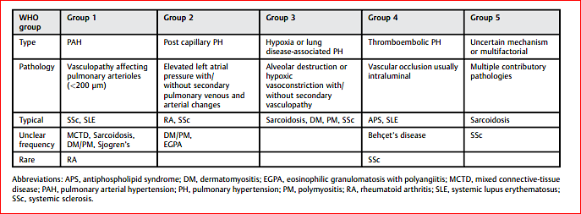
Seminars in Respiratory and Critical Care Medicine. 2019 Vol. 40 No. 2.

Slide 8
‘Any PH group may be detected in patients with CTDs, highlighting the importance of a thorough differential diagnosis once PH is suspected in these patients’
Seminars in Respiratory and Critical Care Medicine. 2019 Vol. 40 No. 2.

Slide 9
PH in CTD
SSc associated PAH accounts for 75% of all CTD-PAH cases
PAH affects 8–15% of SSc patients over the course of the disease
PAH can develop in men or women at any age
F: M ( 1.9-4)
Age of diagnosis, 50 years
Lai YC, et al. Circ Res. 2014;115(1):115-30.

Slide 10
Systemic Sclerosis is a multi-organ disease
Skin thickening
Diffuse or limited
Lung
Fibrosis
Pulmonary hypertension
Gastro-intestinal
Esophagus and stomach
Large and small intestine
Kidney
Renal crisis
Cardiac
Arrythmias, cardiomyopathy, conduction delays, diastolic dysfunction
Sicca
Eyes, mouth, Sjogren’s
Musculoskeletal
Arthritis, bursitis, tendonitis, fibromyalgia
Raynaud’s
Digital ulcerations

Slide 11
Suspicion Symptoms
ILD
Restrictive lung disease
chest wall myopathy
skin tightening
Left heart failure from LV diastolic dysfunction
Aspiration pneumonia
due to oesophageal reflux with Infection
Drug-related respiratory pathology
● (e.g. methotrexate pneumonitis)
Anemia
due to blood loss from gastrointestinal lesions such as GAVE
Thromboembolic disease
Deconditioning
Depression
Dyspnea
Fatigue
Chest pain
Palpitations
Syncope
in early stages
may only be evident on exertion
Steen VD. Semin Cutan Med Surg. 1998;17(1):48-54.

Slide 12
SSc 2013 Classification Criteria
Criteria | Sub-criteria | Weight
Skin thickening of fingers (count highest of the two) | Puffy fingers Whole finger, distal to MCP
Fingertip lesions (count highest of the two) | Digital tip ulcers Pitting scars
Telangiectasias
Abnormal nailfold capillaries
PAH &/or ILD
Raynaud’s
SSc-specific antibodies (x-SCL-70, x-centromere, x-RNAP III)
A total score of 9 or more is classified as systemic sclerosis
These criteria are 91% sensitive and 92% specific
van den Hoogen F, et al. Arthritis Rheum. 2013;65(11):2737-47.

Slide 13
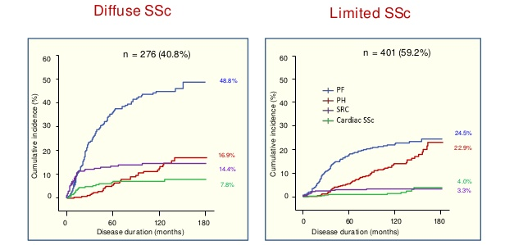
Cumulative frequency of major organ-based complications in systemic sclerosis
1995-2003 incident SSc cohort at RFH(n=677)
Data derived from: Nihtyanova SI, et al. Arthritis Rheumatol. 2014;66(6):1625-35.
& including an additional validation cohort (unpublished)

Slide 14
Clinical Features of SSc patients with PH
Age ( Older age) / postmenopausal
New onset Digital ulcers
Limited SSc
Dilated nailfold Capillaries
Telangiectasias

Slide 16
Raynaud's
Definition
Episodic, symmetrical, vasospastic disorder resulting in classic triphasic color change
trophic changes limited to the skin
uncomfortable sensory symptoms of the extremities in the absence of arterial occlusion
Johnson, A. (2017). Raynaud's syndrome. In G. R. Elkins (Ed.), Handbook of medical and psychological hypnosis: Foundations, applications, and professional issues (pp. 391–397). Springer Publishing Company.

Slide 17
Capilloroscopy

Slide 18
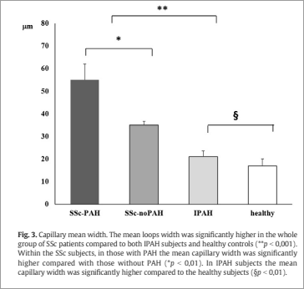
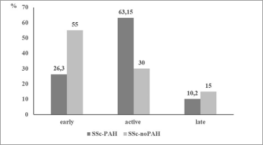
Nailfold capillaroscopy
A higher number of patients with SSc-PAH patients had more “severe” patterns on nail fold capillaroscopy
Lower capillary density
Higher main loop capillary width,
Higher mean number of megacapillaries, and capillaries with neoangiogenesis (P < 0.05 for all)

Slide 19
Capillaroscopy: Abnormal Patterns

Slide 20
SSc
Giant Capillaries

Slide 21
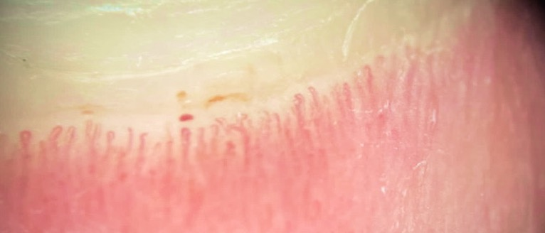
UCTD
Hemorrhages

Slide 22
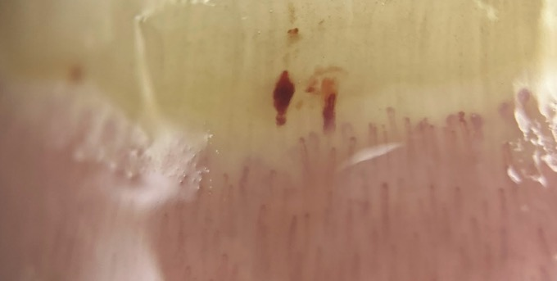
SLE
Hemorrhages

Slide 23
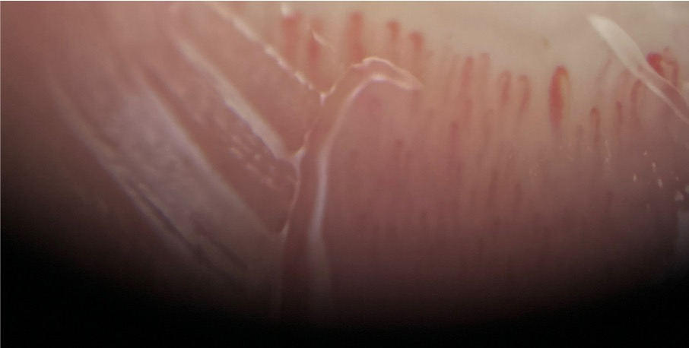
MDA-5
Dilated capillaries

Slide 24
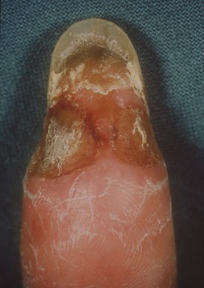
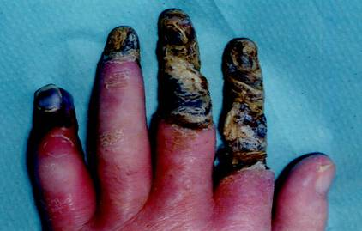
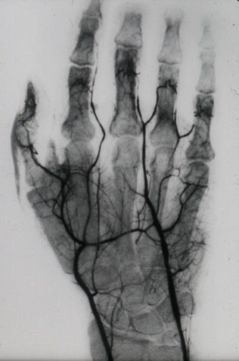
ULCERS
Critical ischemia
Digital ulceration

Slide 25
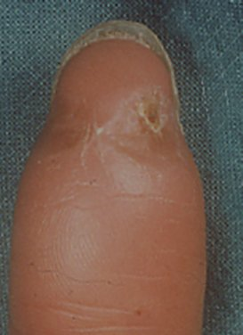
ULCERS
Critical ischemia
Digital ulceration

Slide 26
Looking for more resources on this topic?
CME/CE in minutes
Congress highlights
Late-breaking data
Quizzes
Webinars
In-person events
Slides & resources
www.MedEdOTG.com

