Slide 1




Saturday, September 9, 2023
9:00am – 3:00pm PT
UCLA Covel Commons | Los Angeles, CA
This activity is supported by independent educational grants from Actelion Pharmaceuticals US, Division of Janssen Pharmaceuticals and United Therapeutics Corporation.
Jointly provided by the Global Learning Collaborative (GLC) and Total CME, LLC.

Slide 2



Resource Information
About This Resource
These slides are one component of a continuing education program available online at MedEd On The Go titled West Regional Pulmonary Hypertension Summit – A Case-Based Look At Diagnosis and Treatment
Program Learning Objectives:
Review essentials of the updated ERS/ESC diagnostic and treatment guidelines and emerging medical entities for treatment
Discuss current concepts on diagnosis and treatment of CTEPH and CTED with a real-world focus
Debate the importance and practice of screening for, diagnosing, and treating PAH associated with connective tissue disease
Learn the essentials of cardiopulmonary exercise testing for the detection and diagnosis of pulmonary hypertension
Consider lessons from the symposium in light of real-world case examples
MedEd On The Go®
www.mededonthego.com
This content or portions thereof may not be published, posted online or used in presentations without permission.
This content can be saved for personal use (non-commercial use only) with credit given to the resource authors.
To contact us regarding inaccuracies, omissions or permissions please email us at support@MedEdOTG.com

Slide 3
Disclaimer
The views and opinions expressed in this educational activity are those of the faculty and do not necessarily represent the views of Total CME, LLC, the CME providers, or the companies providing educational grants. This presentation is not intended to define an exclusive course of patient management; the participant should use their clinical judgment, knowledge, experience, and diagnostic skills in applying or adopting for professional use any of the information provided herein. Any procedures, medications, or other courses of diagnosis or treatment discussed or suggested in this activity should not be used by clinicians without evaluation of their patient's conditions and possible contraindications or dangers in use, review of any applicable manufacturer’s product information, and comparison with recommendations of other authorities. Links to other sites may be provided as additional sources of information.

Slide 4

Pulmonary Hypertension in Rheumatic Diseases – Part II
Suzanne Kafaja, MD
University of California, Los Angeles
Los Angeles, CA

Slide 5

Autoantibodies
Limited and Diffuse as predictors
Organ involvement by skin phenotype
Limited | Organ | Diffuse
44% | ILD | 45-64%
1-3% | Renal crisis | 15-20%
1% | Myocardopathy | 10%
Equal | GI | Equal
ACA PM/SCL Th/To U1-RNP | Autoantibodies | SCL-70 RNAP-III U3-RNP
Limited
Diffuse
Steen, M., et al. International Journal of Design, 5(2).
Zhang J, et al. Ann Rheum Dis. 2014;73(7):1301-8.

Slide 6
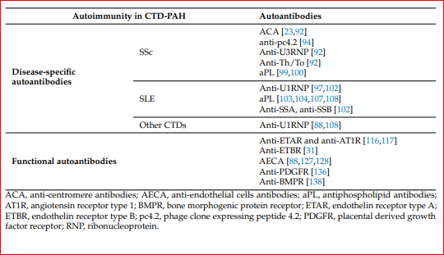
Disease Specific Autoantibodies in CTD-PAH
Morcadeli et al. Int. J. Mol. Sci. 2023, 24, 4178.

Slide 7
Disease Specific Autoantibodies in CTD-PAH
Anti-p4.2 antibodies were found to be associated with a diffusing capacity of the lungs for carbon monoxide (DLCO) < 70%, even in the absence of pulmonary fibrosis, suggesting a role for these autoantibodies in predicting the development of PAH vasculopathy in ACA-positive patients
Morcadeli et al. Int. J. Mol. Sci. 2023, 24, 4178.

Slide 8
Mortality and SSc
50
40
SRC
PAH
GI
ILD
Heart
Multi-organ
30
Frequency (%)
20
10
SRC = scleroderma renal crisis; ILD = interstitial lung disease
0
1972-
1976
1977-
1981
1982-
1986
1987-
1991
1992-
1996
1997-
2001
Year of death
Steen VD, et al. Ann Rheum Dis. 2007;66(7):940-4.

Slide 9
PAH Is A Major Cause of Mortality in SSc
100
80
No heart, lung, or kidney involvement
(n = 138)
60
Survival (%)
Lung involvement (without PAH, n = 73)
40
20
PAH / SSc (n = 17)
0
0
2
4
6
8
10
12
Time from diagnosis of PAH (years)
Koh ET, et al. Br J Rheumatol. 1996;35(10):989-93.

Slide 10
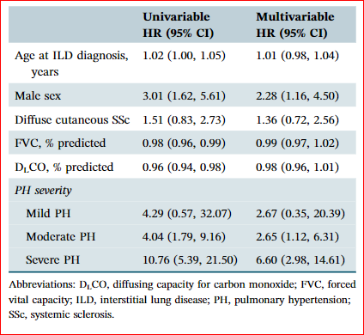
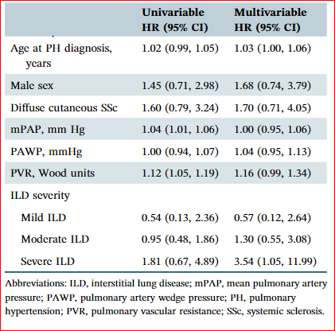
ILD/ PH Interplay
In patients with SSc‐ILD:
Severe PH was associated with a >6‐fold increased hazard for mortality, and moderate PH was associated with a >2‐fold increased hazard formortality
In patients with SSc‐PH:
severe ILD was associated with a > 3‐fold increased hazard for mortality compared to those without concomitant ILD
Sangani RA, et al. Pulm Circ. 2022;12(4):e12117.

Slide 11
Predictors of / Risk for PAH that Indicate Necessity of Right Heart Cath*
Slow decline of DLCO to < 55-60% predicted.
DLCO < 55-60% predicted
%FVC/ %DLCO > 1.6
Echo: RVSP > 40-45 mm Hg, especially if coupled with enlargement or dilatation of right atrium/ventricle
Anti-centromere Ab
Limited SSc of long duration
Extensive telangiectasias
*Fischer A, et al. Arthritis Care Res (Hoboken). 2012;64(3):303-10.

Slide 12
Decline in DLCO over time may predict the onset of pulmonary hypertension in SSc
100
80
60
40
20
Controls (n = 14)
SSc-PAH (n = 19)
10-15
5-10
0-5
PHT
Years Prior to PHT
Steen V. Arthritis Rheum. 2005;52(12):3698-700.

Slide 13
Pulmonary Function Testing
Reductions in FVC, FEV1, TLC and in DLCO correlate with thoracic HRCT scan findings of ILD.
An isolated reduction in DLCO (cHgb) to <55% of predicted, with normal lung volumes, suggests PAH.
A ratio of the percentage of predicted FVC and the percentage of predicted DLCO >1.6 is a predictor of PAH and a value 2.0 predicts worse survival in all forms of SSc lung disease.
Steen V. Arthritis Rheum. 2005;52(12):3698-700.

Slide 14
Is screening useful?

Slide 15
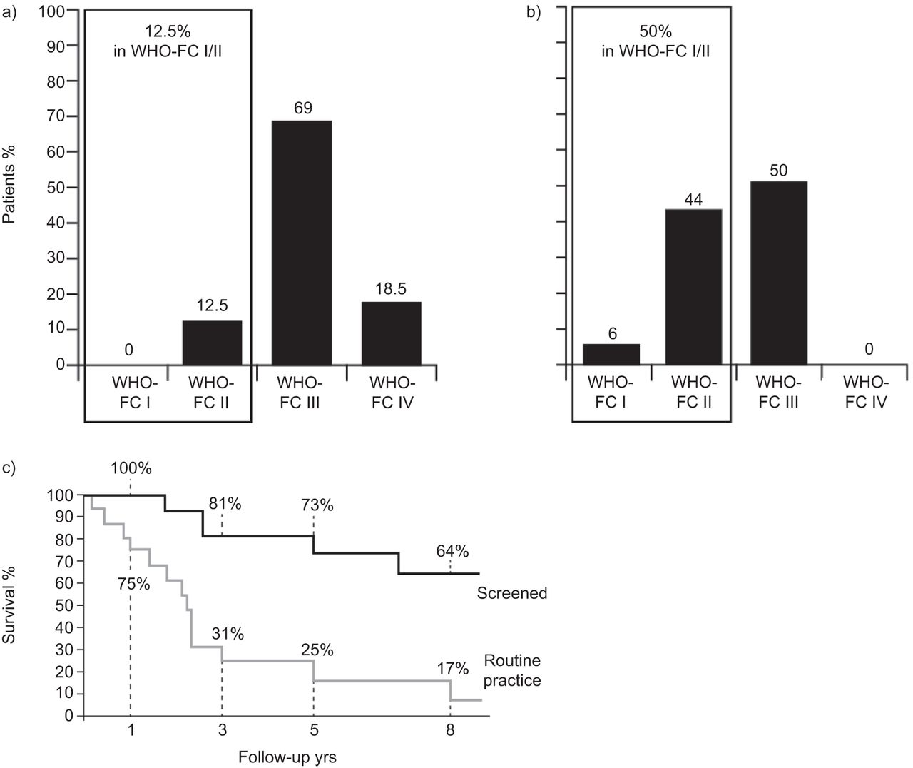
Proportion of patients in WHO class I and II in routine practice vs routine screening at time of diagnosis of PAH
Routine practice
Routinely
screened
Marked difference in survival
in pts followed in routine
practice vs pts routinely screened
Huertas A, et al. Eur Respir J. 2012 Oct;40(4):895-904.

Slide 16
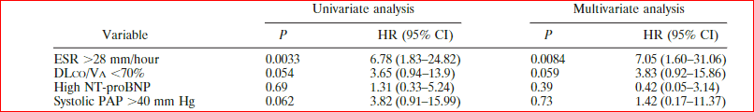
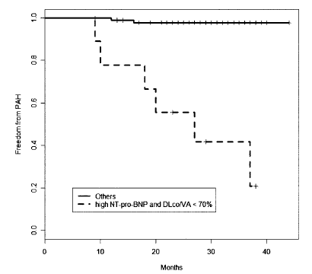
NT-pro-Brain Natriuretic Peptide
An increase in NT-proBNP (representing cardiac wall stress) at baseline is predictive of future PAH development independently from low DLCO (for capillary gas exchange). Together these two parameters are even more predictive for PAH and could represent indices of “pre-PAH” or “early PAH”
Allanore Y, et al. Arthritis Rheum. 2008;58(1):284-91.

Slide 17
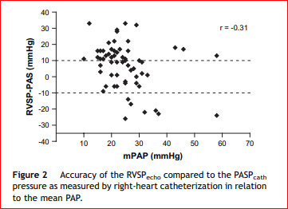
Echocardiography Does Not Accurately Predict PH in Patients With Pulmonary Fibrosis
Celli BR, et al. Respir Med. 2008;102 Suppl 1:S27-35.

Slide 18
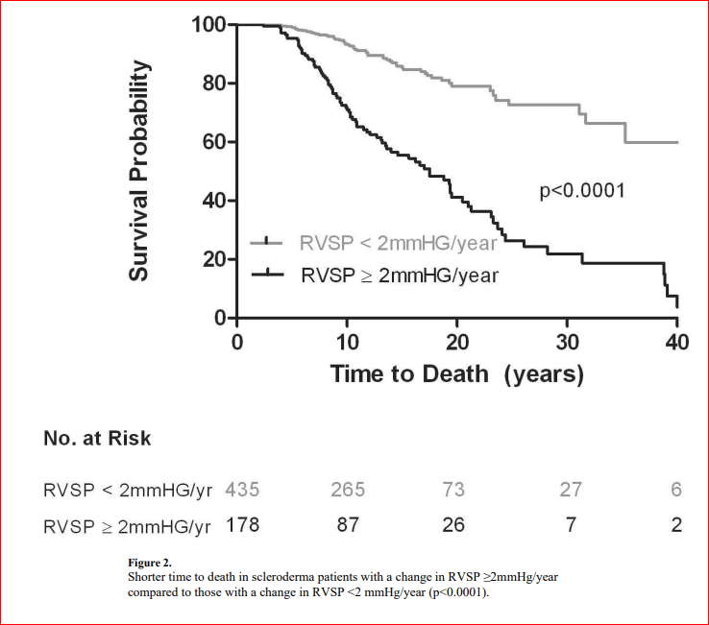
Shah et al. Ann Rheum Dis. 2014.

Slide 19
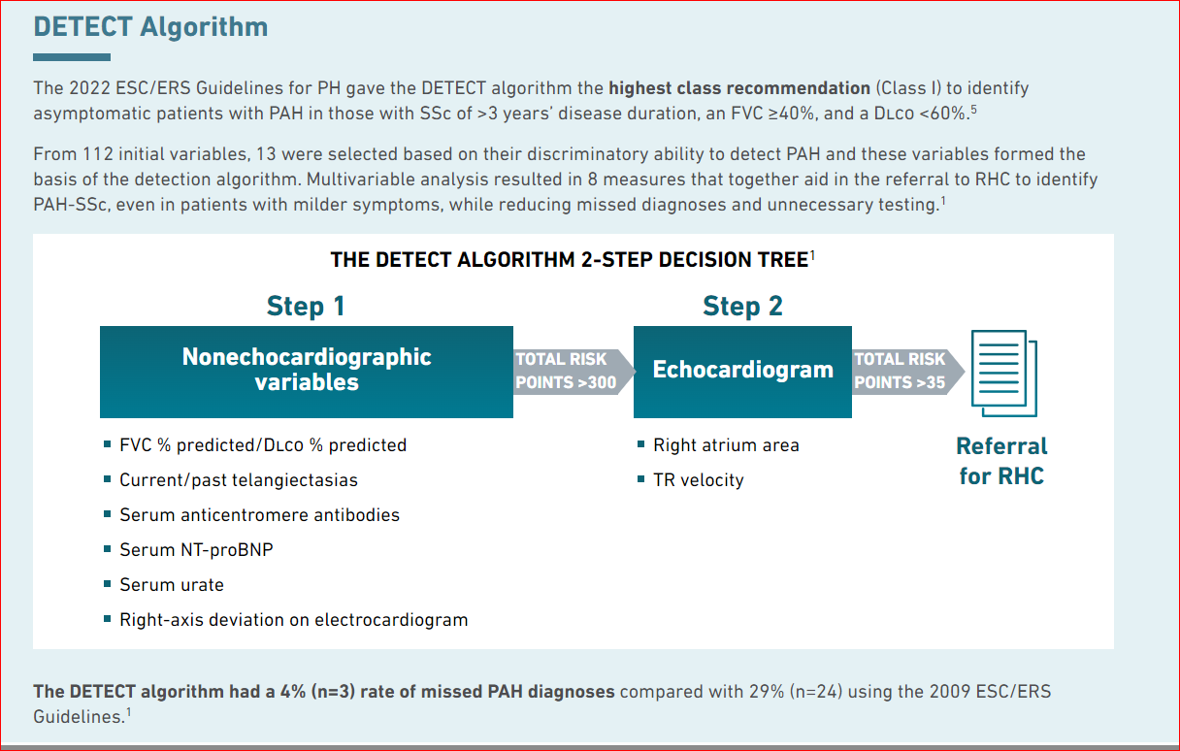
Coghlan JG, et al. Ann Rheum Dis. 2014;73(7):1340-9.

Slide 20
Take Home Points
PH can be present in several Rheumatologic disease , not limited to scleroderma
History, disease duration and presentation of disease are relevant to identing high risk patients for developing PH
Capillaroscopy as a helpful additional tool among other physical exam findings
Evaluation of CTD patients and those presenting with PH ( all classes) in general should include initial serological markers
Importance of early detection techniques including PFT, ECHO, RVSP trend , and DETECT algorithm

Slide 21



Looking for more resources
on this topic?
CME/CE in minutes
Congress highlights
Late-breaking data
Quizzes
Webinars
In-person events
Slides & resources
www.MedEdOTG.com

