Slide 1




Saturday, September 9, 2023
9:00am – 3:00pm PT
UCLA Covel Commons | Los Angeles, CA
This activity is supported by independent educational grants from Actelion Pharmaceuticals US, Division of Janssen Pharmaceuticals and United Therapeutics Corporation.
Jointly provided by the Global Learning Collaborative (GLC) and Total CME, LLC.

Slide 2



Resource Information
About This Resource
These slides are one component of a continuing education program available online at MedEd On The Go titled West Regional Pulmonary Hypertension Summit – A Case-Based Look At Diagnosis and Treatment
Program Learning Objectives:
Review essentials of the updated ERS/ESC diagnostic and treatment guidelines and emerging medical entities for treatment
Discuss current concepts on diagnosis and treatment of CTEPH and CTED with a real-world focus
Debate the importance and practice of screening for, diagnosing, and treating PAH associated with connective tissue disease
Learn the essentials of cardiopulmonary exercise testing for the detection and diagnosis of pulmonary hypertension
Consider lessons from the symposium in light of real-world case examples
MedEd On The Go®
www.mededonthego.com
This content or portions thereof may not be published, posted online or used in presentations without permission.
This content can be saved for personal use (non-commercial use only) with credit given to the resource authors.
To contact us regarding inaccuracies, omissions or permissions please email us at support@MedEdOTG.com

Slide 3
Disclaimer
The views and opinions expressed in this educational activity are those of the faculty and do not necessarily represent the views of Total CME, LLC, the CME providers, or the companies providing educational grants. This presentation is not intended to define an exclusive course of patient management; the participant should use their clinical judgment, knowledge, experience, and diagnostic skills in applying or adopting for professional use any of the information provided herein. Any procedures, medications, or other courses of diagnosis or treatment discussed or suggested in this activity should not be used by clinicians without evaluation of their patient's conditions and possible contraindications or dangers in use, review of any applicable manufacturer’s product information, and comparison with recommendations of other authorities. Links to other sites may be provided as additional sources of information.

Slide 4


Cardiopulmonary Exercise Testing in Pulmonary Arterial Hypertension – Part I
VIDEO DEMO:
Christopher Cooper, MD, PhD
David Geffen School of Medicine, UCLA
Los Angeles, CA
Alex Sherman, MD
David Geffen School of Medicine, UCLA
Los Angeles, CA

Slide 5
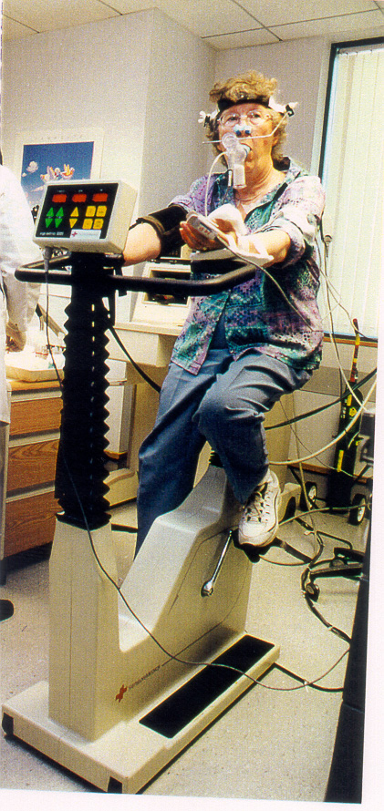
Purpose of Cardiopulmonary Exercise Testing
Generally and specifically in pulmonary hypertension
Level 1 CPET is a non-invasive method of assessing aerobic performance, functional capacity and identifying pathophysiological reasons for exercise limitation
PAH causes a multitude of downstream effects which compromise cardiac function and pulmonary gas exchange, leading to shortness of breath and impaired exercise tolerance
Level 2 and 3 CPET aids in diagnosis, assessment of treatment response, and prognosis in PAH

Slide 6
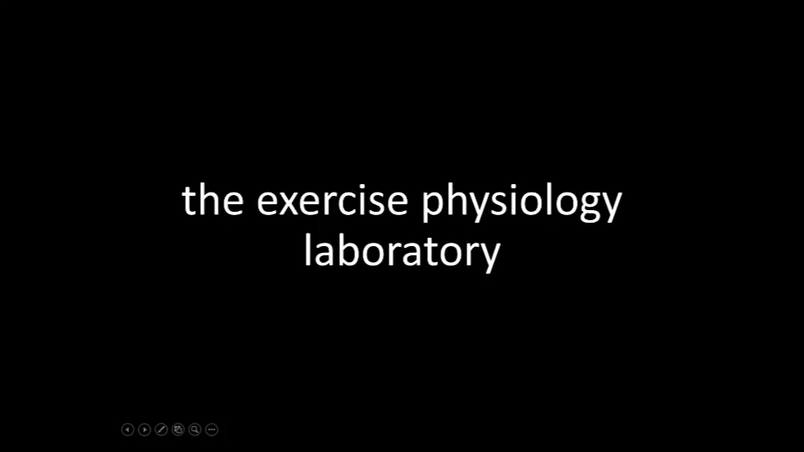

Slide 7
Preparation For The Test
Careful attention must be paid to the following steps:
Subject Consent
  Explanation of test
  Monitoring for safety
  Serious adverse events
  (< 1 in 10,000)
Electrocardiogram
  Degrease the skin with alcohol
  Lightly abrade to improve conductance
  Secure leads
Patient Interface
  Mouthpiece
  Facemask
Saddle Height
  Greater trochanter
  Leg extension 15°

Slide 8
Establish Reference Values
Reliable predictors are based on age, sex, height and MVV

Slide 9



Looking for more resources
on this topic?
CME/CE in minutes
Congress highlights
Late-breaking data
Quizzes
Webinars
In-person events
Slides & resources
www.MedEdOTG.com

