Slide 1





Saturday, September 9, 2023
9:00am – 3:00pm PT
UCLA Covel Commons | Los Angeles, CA
This activity is supported by independent educational grants from Actelion Pharmaceuticals US, Division of Janssen Pharmaceuticals and United Therapeutics Corporation.
Jointly provided by the Global Learning Collaborative (GLC) and Total CME, LLC.

Slide 2



Resource Information
About This Resource
These slides are one component of a continuing education program available online at MedEd On The Go titled West Regional Pulmonary Hypertension Summit – A Case-Based Look At Diagnosis and Treatment
Program Learning Objectives:
Review essentials of the updated ERS/ESC diagnostic and treatment guidelines and emerging medical entities for treatment
Discuss current concepts on diagnosis and treatment of CTEPH and CTED with a real-world focus
Debate the importance and practice of screening for, diagnosing, and treating PAH associated with connective tissue disease
Learn the essentials of cardiopulmonary exercise testing for the detection and diagnosis of pulmonary hypertension
Consider lessons from the symposium in light of real-world case examples
MedEd On The Go®
www.mededonthego.com
This content or portions thereof may not be published, posted online or used in presentations without permission.
This content can be saved for personal use (non-commercial use only) with credit given to the resource authors.
To contact us regarding inaccuracies, omissions or permissions please email us at support@MedEdOTG.com

Slide 3
Disclaimer
The views and opinions expressed in this educational activity are those of the faculty and do not necessarily represent the views of Total CME, LLC, the CME providers, or the companies providing educational grants. This presentation is not intended to define an exclusive course of patient management; the participant should use their clinical judgment, knowledge, experience, and diagnostic skills in applying or adopting for professional use any of the information provided herein. Any procedures, medications, or other courses of diagnosis or treatment discussed or suggested in this activity should not be used by clinicians without evaluation of their patient's conditions and possible contraindications or dangers in use, review of any applicable manufacturer’s product information, and comparison with recommendations of other authorities. Links to other sites may be provided as additional sources of information.

Slide 4
Case Study: CPET
Adam Brownstein, MD
David Geffen School of Medicine, UCLA
Los Angeles, CA

Slide 5
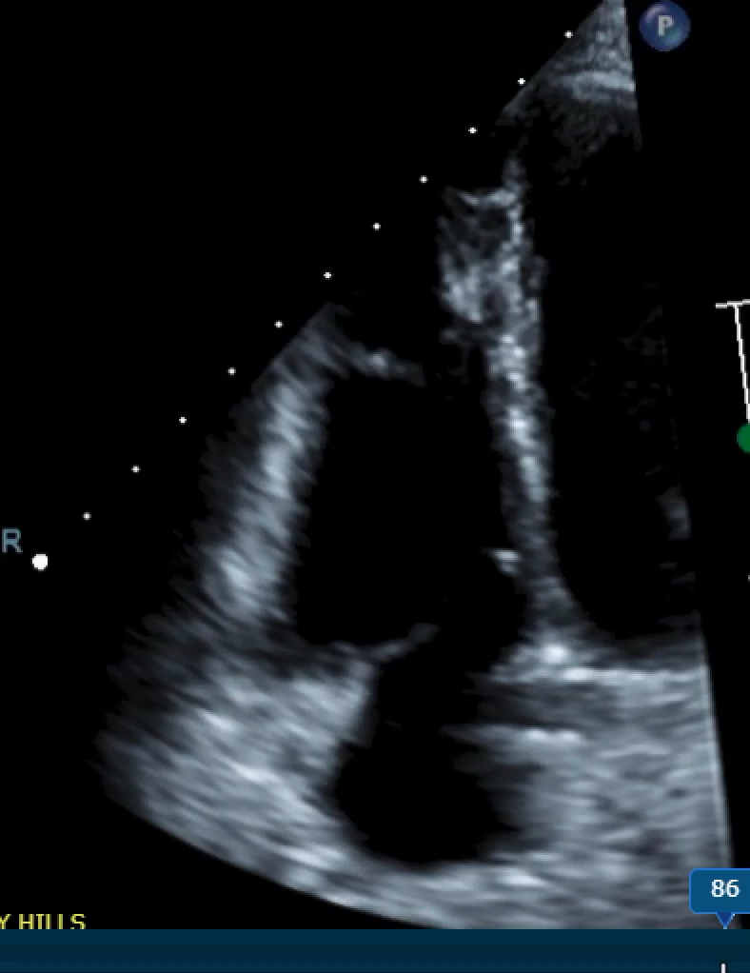
HPI
35 y.o. F with PMH of SLE and PAH who is referred for a Level 3 CPET
  Baseline RHC 6 months prior:
    HR 67, BP 103/64, SpO2 97%
    RA 6
    PA 84/35/51
    PCWP 12
    TD-CO 4.1 L/min
    TD-CI 2.9 L/min/m²
    SVI 43 mL/m²
    PVR 9.5 WU
    PA sat 70%
  Baseline PFTs:
  FVC 2.51L (80%)
  FEV1 2.03L (76%) FEV1/FVC 81%
  TLC 4.12L (91%) DLCO 14.34 (54%)

Slide 6
Level 3 CPET: Resting RHC
Repeat resting RHC on tadalafil 40 mg daily and macitentan 10 mg daily:
HR 61, BP 102/61, SpO₂ 97%
RA 3
PA 52/17/31
PCWP 7
TD-CO 3.9 L/min
TD-CI 2.7 L/min/m²
TD-SVI 45.3 mL/m²
TD-PVR 6.2 WU
VO2 290 mL/min
DF-CO 4.38 L/min
DF-CI 3.01 L/min/m²
DF-SVI 50.9 mL/m²
DF-PVR 5.48 WU
PA sat 69.8%

Slide 7
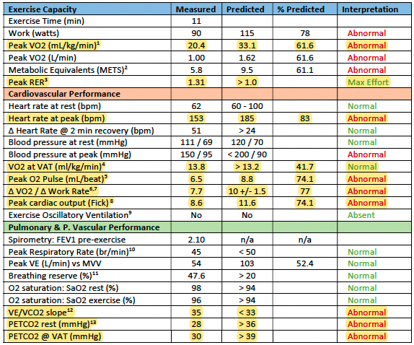
Level 3 CPET Synopsis

Slide 8
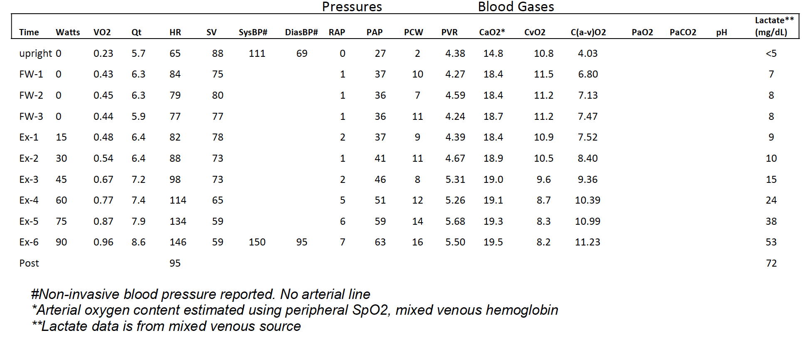
Level 3 CPET Hemodynamics
ΔPAP/ΔCO = 12.1 ±0.8
ΔTPG/ΔCO = 8.6±0.5

Slide 9
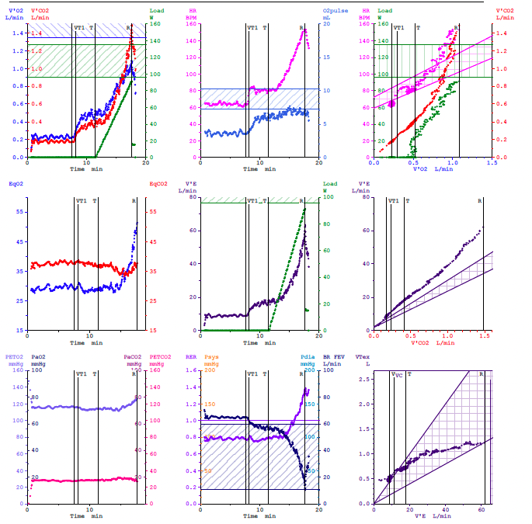
Level 3 CPET 9-Plot
1
2
3
Low peak VO₂ and low VO₂/WR slope
Early plateau and low peak O₂ pulse
Low/normal VAT of 13.8 ml/kg/min
(41.6% predicted)
4
5
High VE/VCO₂ nadir
High VE/VCO₂ slope
Low PETCO₂ that does not increase
with exertion
No pulmonary mechanical limitation
6
7

Slide 10
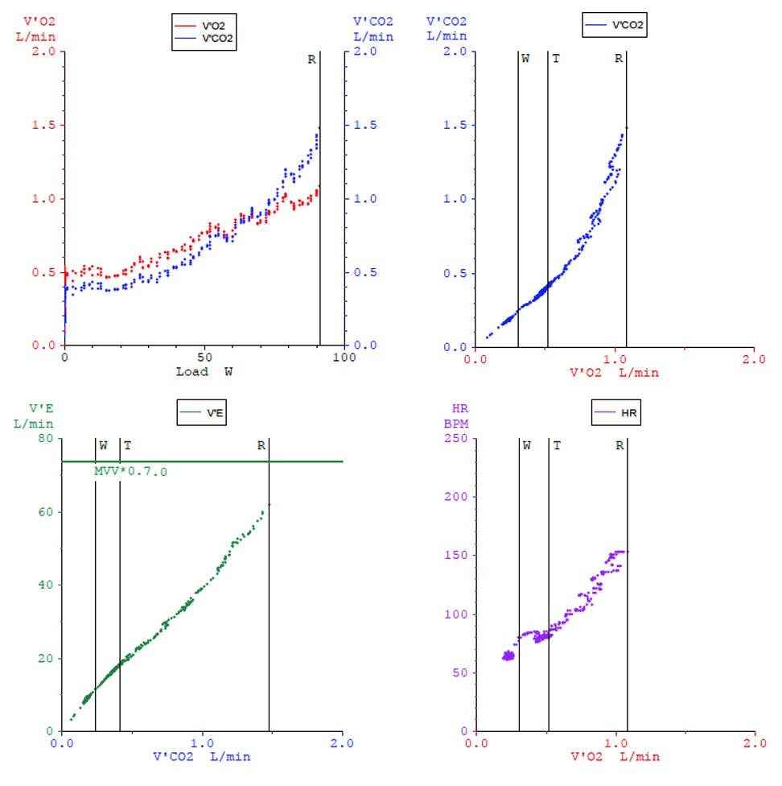
Level 3 CPET 4-Plot
Low/normal VAT of 13.8
ml/kg/min (41.6% predicted)
Low peak VO2
Low VO2/WR slope
High VE/VCO2 slope

Slide 11
Summary
Level 3 CPET demonstrates moderately reduced exercise capacity
The overall pattern is consistent with pre-capillary pulmonary hypertension given:
  High PA pressure
  High PAP/CO slope
  TPG greater than PCWP
  High PVR
  High VE/VCO₂ slope
  Low PETCO₂ with abnormal exercise augmentation.
The patient was started on selexipag with improvement in her functional status

Slide 12



Looking for more resources
on this topic?
CME/CE in minutes
Congress highlights
Late-breaking data
Quizzes
Webinars
In-person events
Slides & resources
www.MedEdOTG.com

