Slide 1
PAD Stage, Risk Assessment,
and Comorbidities
Connie N. Hess, MD, MHS
Associate Professor of Medicine
Division of Cardiology
University of Colorado School of Medicine
Aurora, CO

Slide 2



Resource Information
About This Resource
These slides are one component of a continuing education program available online at MedEd On The Go titled Guidelines on the Management of Patients with PAD
Program Learning Objectives:
Demonstrate an understanding of the recent developments in PAD management
Apply the latest guideline-directed approaches for PAD management
MedEd On The Go®
www.mededonthego.com
This content or portions thereof may not be published, posted online or used in presentations without permission.
This content can be saved for personal use (non-commercial use only) with credit given to the resource authors.
To contact us regarding inaccuracies, omissions or permissions please email us at support@MedEdOTG.com

Slide 3
Disclaimer
The views and opinions expressed in this educational activity are those of the faculty and do not necessarily represent the views of Total CME, LLC, the CME providers, or the companies providing educational grants. This presentation is not intended to define an exclusive course of patient management; the participant should use their clinical judgment, knowledge, experience, and diagnostic skills in applying or adopting for professional use any of the information provided herein. Any procedures, medications, or other courses of diagnosis or treatment discussed or suggested in this activity should not be used by clinicians without evaluation of their patient's conditions and possible contraindications or dangers in use, review of any applicable manufacturer’s product information, and comparison with recommendations of other authorities. Links to other sites may be provided as additional sources of information.

Slide 4
Clinical Subsets of PAD
Asymptomatic
Chronic Symptomatic
Chronic Limb-Threatening Ischemia
Acute Limb Ischemia
20-59% patients report no leg symptoms
May self-limit activity to avoid leg pain
Functional impairment present and comparable to patients with claudication
Exertional leg symptoms reported in up to 80% of patients with PAD
Claudication or other non-joint-related exertional leg symptoms
Associated with significant functional impairment, reduced quality of life
11-20% incidence among known PAD
Ischemic rest pain, non-healing wounds/ulcers, or gangrene with symptoms present >2 weeks
Responsible for most PAD-related amputations
Sudden decrease in leg perfusion that threatens limb viability
Acute (<2 weeks) symptoms
“6 P’s” of pain, pallor, pulselessness, poikilothermia (coolness), paresthesias, and paralysis

Slide 5
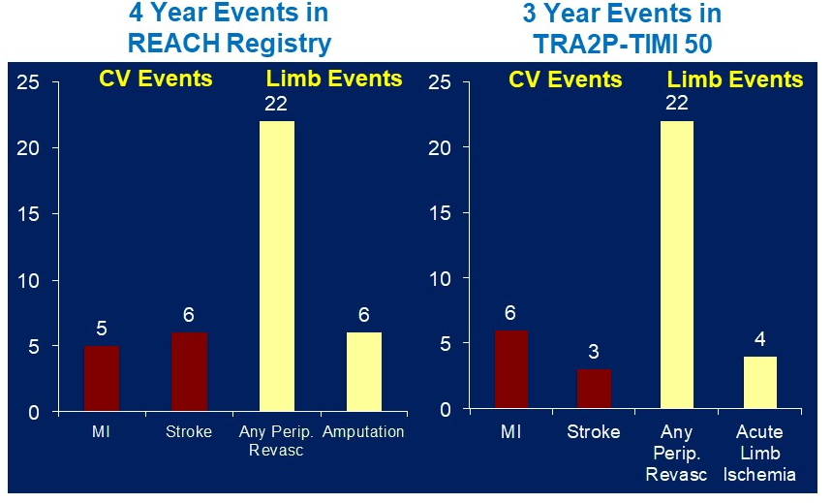
PAD and Risk for MACE and MALE
Placebo patients*
PAD N=1784
MI or Stroke and no PAD N=11996
Adjusted HR
1.81
(1.53 – 2.14)
P<0.001
13.0%
CVD / MI / Stroke
7.6%
Days from Randomization

Slide 6
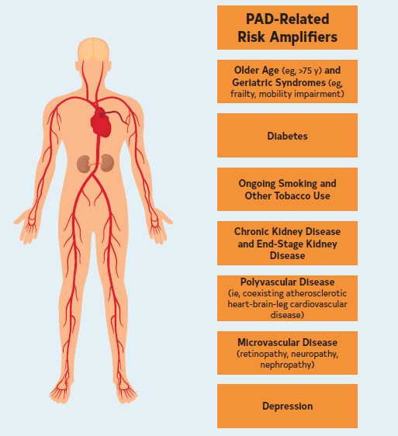
PAD-Related Amplifiers of Risk

Slide 7
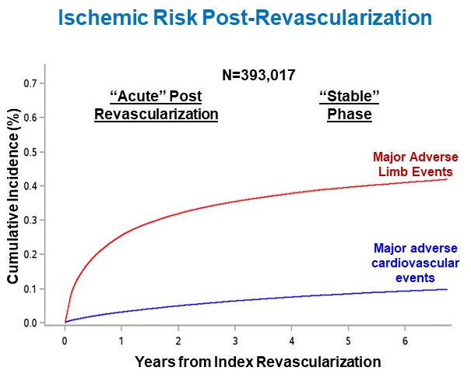
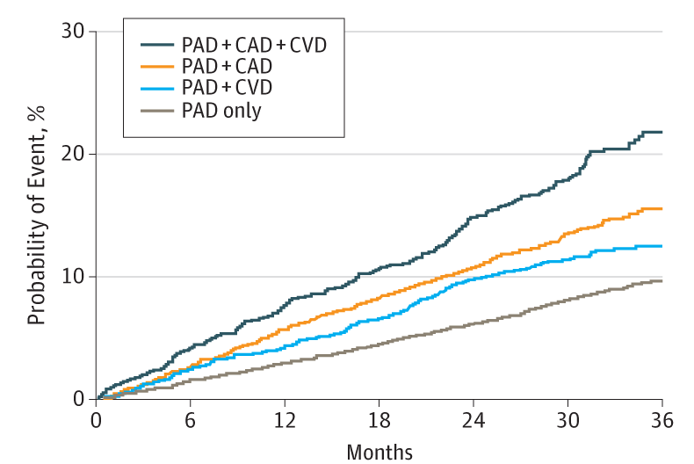
PAD Risk Amplifiers: Polyvascular Disease and Revascularization
Prior peripheral revascularization in chronic PAD associated with 4.7-fold increased risk for ALI
Highest risk for MACE with three involved vascular territories

Slide 8
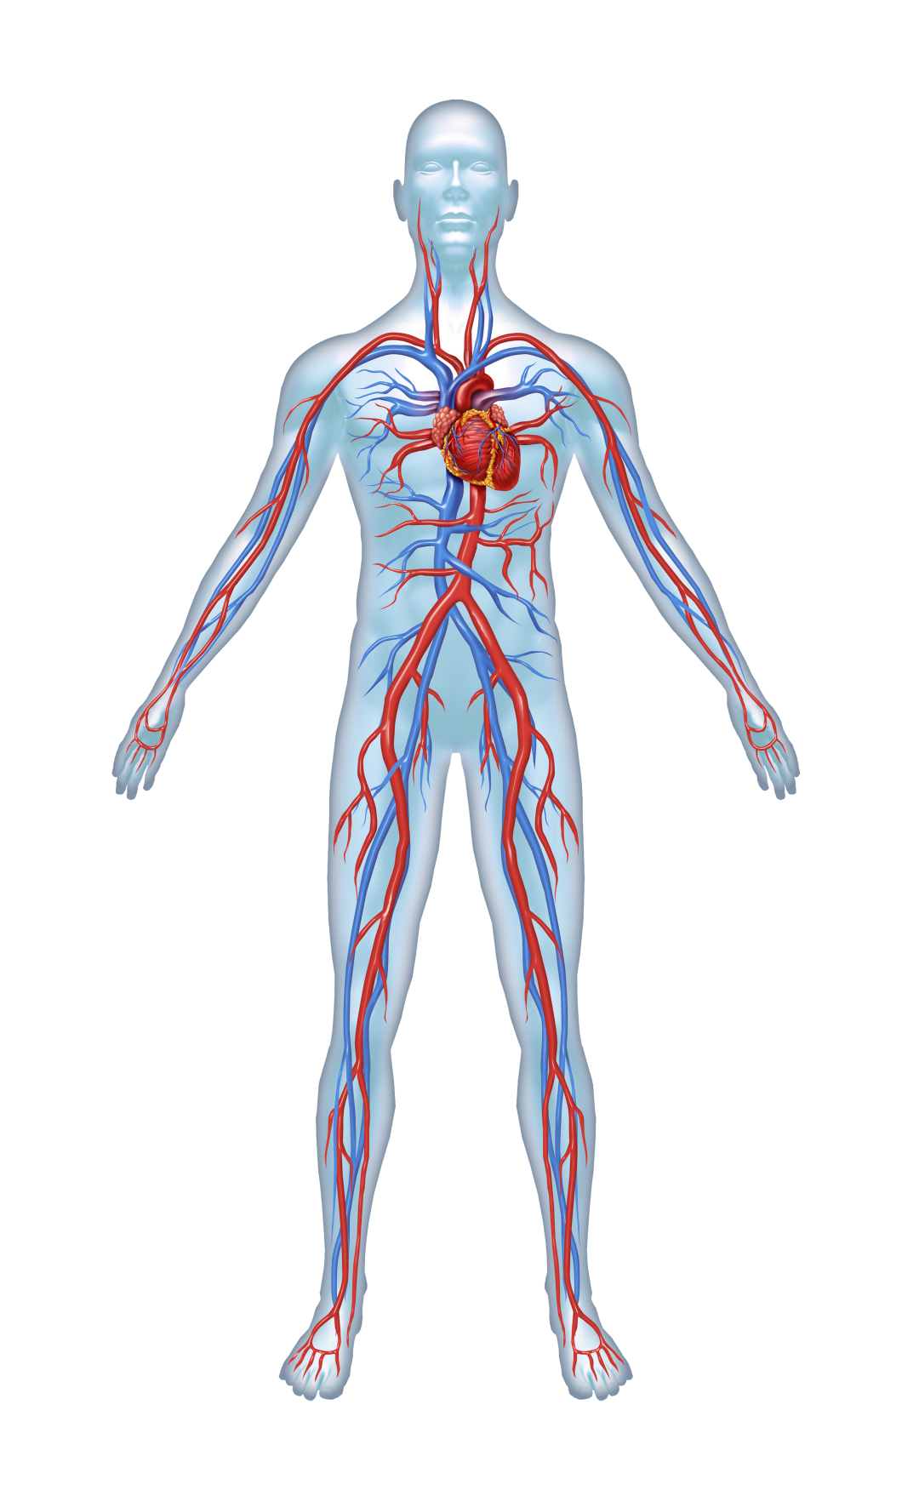
Drivers of Risk for MACE Versus MALE in PAD
MACE Risk
PAD Alone
PAD with CAD
PAD with CAD and recent/history of ACS
MALE Risk
Asymptomatic
Chronic Symptomatic
Chronic Limb-Threatening Ischemia
Acute Limb Ischemia
Lower Extremity Revascularization

Slide 9
Summary
Four clinical subsets of PAD have been defined
PAD is associated with increased risk for cardiovascular and limb events, as well as impaired functional status and reduced quality
of life
Important amplifiers of risk have been identified
Providers should assess for these risk amplifiers and account for their presence when developing individual treatment plans for patients with PAD

Slide 10



Looking for more resources
on this topic?
CME/CE in minutes
Congress highlights
Late-breaking data
Quizzes
Webinars
In-person events
Slides & resources
www.MedEdOTG.com

